Slide 1
Bird Strikes Analysis
An in depth study on bird strike impact on aviation
By- Sri Ratna Chintapalli

Slide 2
Introduction
The transport and communication are crucial in the field of analytics. Environmental impacts and safety are major concerns in transport scenarios . Increasing vehicles and urbanization amplify these issues . Bird strikes are collisions between birds and aircraft.
Significance: Bird strikes pose a significant threat to aircraft safety, causing damage and potential fatalities.

Slide 3
PROJECT DETAILS
Project Title | Bird Strike analysis
Technologies | Data science
Domaine | Transportation and communication
Project difficulties level | Advance

Slide 4
Problem Statement
A bird strike is strictly defined as a collision between a bird and an aircraft which is in flight or on a take-off or landing roll. The term is often expanded to cover other wildlife strikes - with bats or ground animals. Bird Strike is common and can be a significant threat to aircraft safety. For smaller aircraft, significant damage may be caused to the aircraft structure and all aircraft, especially jet-engine ones, are vulnerable to the loss of thrust which can follow the ingestion of birds into engine air intakes. This has resulted in several fatal accidents.
Bird strikes may occur during any phase of flight, but are most likely during the take-off, initial climb, approach and landing phases due to the greater numbers of birds in flight at lower levels. To have a closer look the following document visually depicts the data collected on Bird Strikes by FAA between 2000-2011.

Slide 5
Objectives
Number of bird strikes Cost incurred Altitude and phase of flight at the time of strikes Impact on flight and pilot warning.

Slide 6
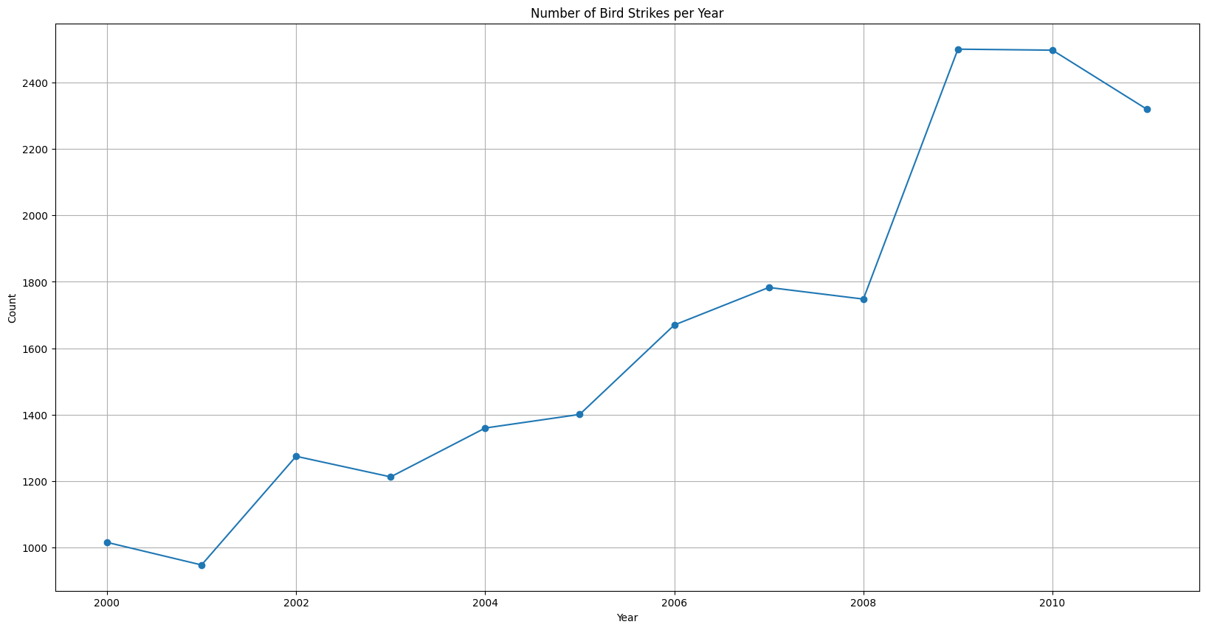
Bird Strikes per year

Slide 7
Bird Strikes per year
Visualization: Line chart showing the number of bird strikes per year.
Insight: Increasing trend in bird strikes over the years from 2000 to 2010.
Conclusion:
Bird strike incidences are increasing year after year.

Slide 8
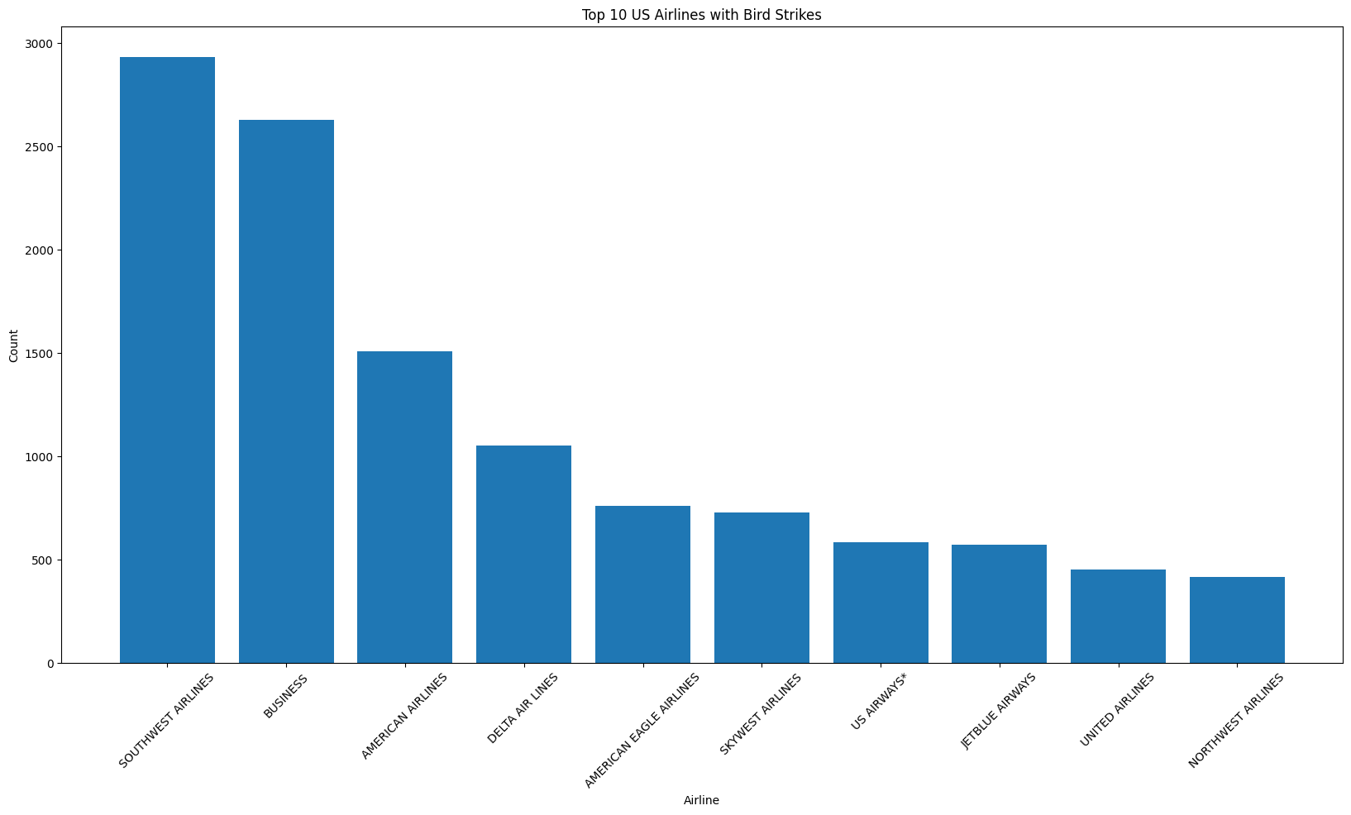
Top 10 US Airlines in terms of Bird Strikes

Slide 9
Top 10 US Airlines in terms of Bird Strikes
Visualization: Bar chart of airlines with the most bird strikes.
Insight: Some airlines encounter more bird strikes among those South West Airlines stood at first position.
Conclusion: Need for targeted bird strike prevention, the airline services should consider about this.

Slide 10
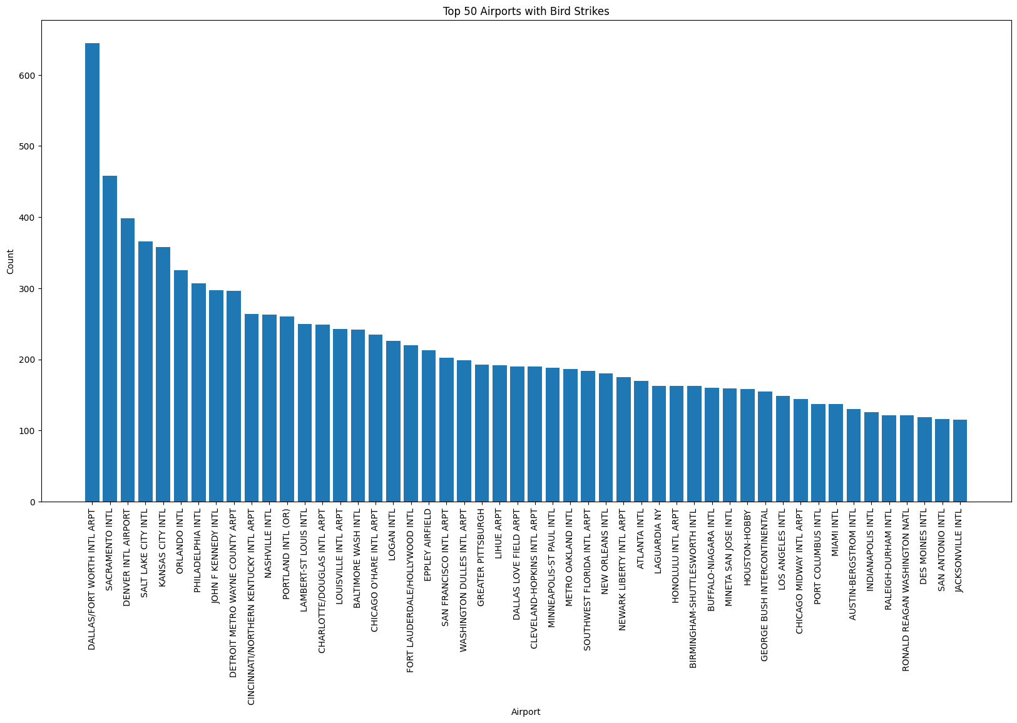
Top 50 Airports with most Bird Strikes

Slide 11
Top 50 Airports with most Bird Strikes
Visualization: Bar chart of top 50 airports with the highest bird strikes.
Insight: Certain airports are hotspots for bird strikes.
Conclusion: Enhanced wildlife management practices needed at these airports.

Slide 12
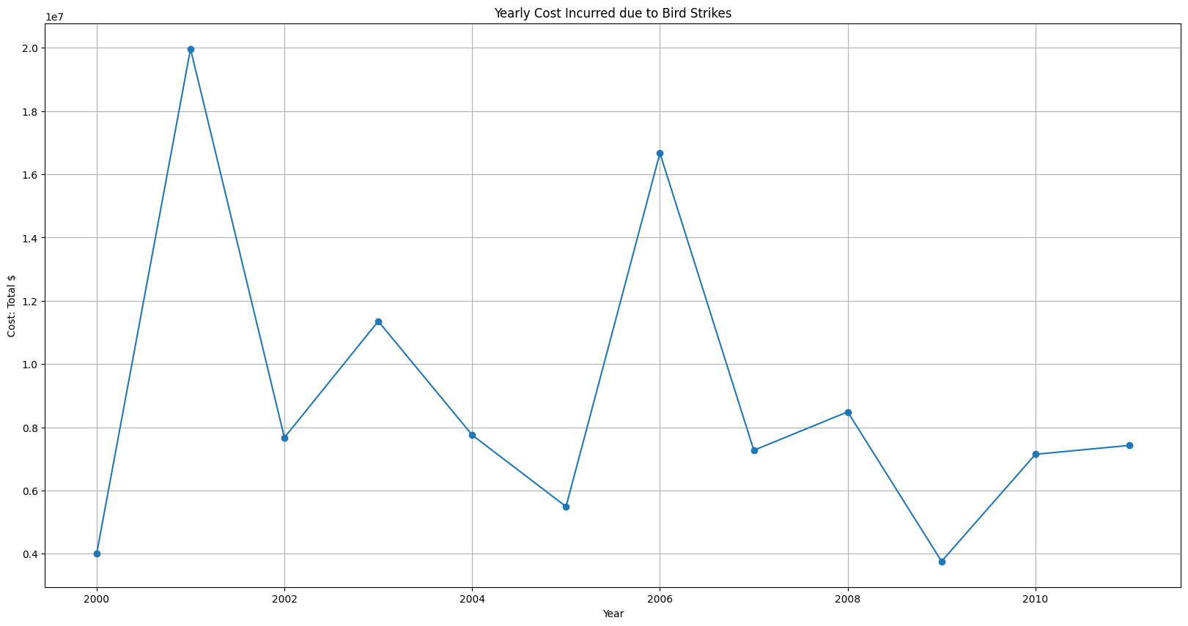
Yearly Cost Incurred due to Bird Strike

Slide 13
Yearly Cost Incurred due to Bird Strike
Visualization: Line chart showing the cost incurred of bird strikes per year.
Insight: In the 2000 have highest fluctuations in cost due to Bird Strikes.
Conclusion: As a result, we find that the cost decreases year after year owing to bird strikes.

Slide 14
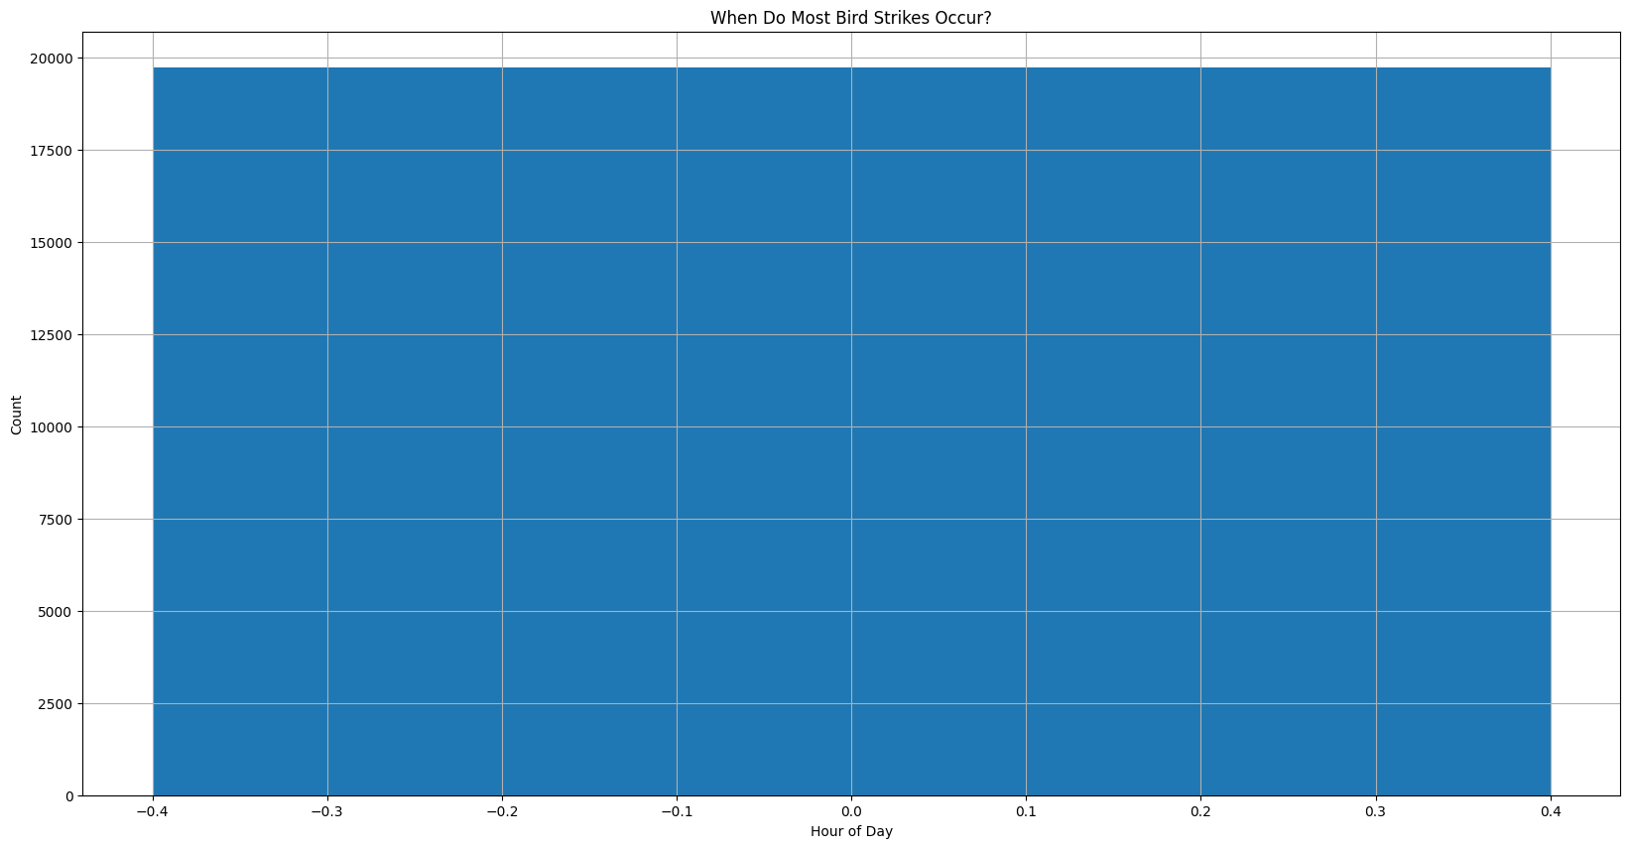
When do most Bird Strike occur?

Slide 15
When do most Bird Strike occur?
Visualization: Bar chart showing bird strikes by hour of the day.
Insight: Most bird strikes occur during specific hours, I.e. 12 ‘o’ clock at the mid night.
Conclusion: Schedule changes or more attentiveness are required during peak times.

Slide 16
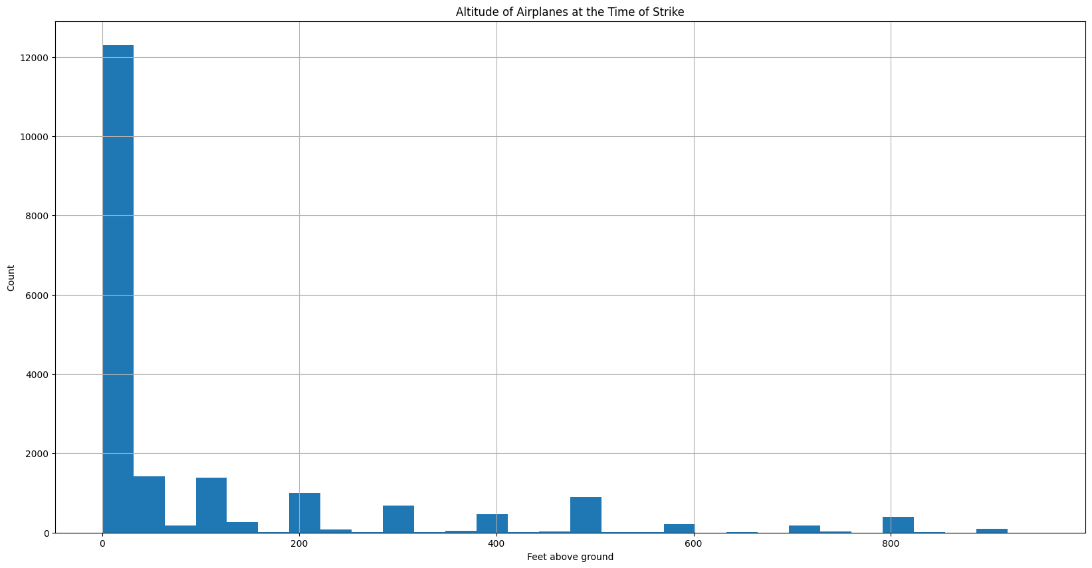
Altitude of Airplanes at the Time of Strike

Slide 17
Altitude of Airplanes at the Time of Strike
Visualization: Histogram showing the distribution of altitudes at the time of bird strikes.
Insight: Significant number of strikes occur at lower altitudes, around 12000 bird strike count occurs at lower feet.
Conclusion: Focus on take-off and landing phases for preventive measures.

Slide 18
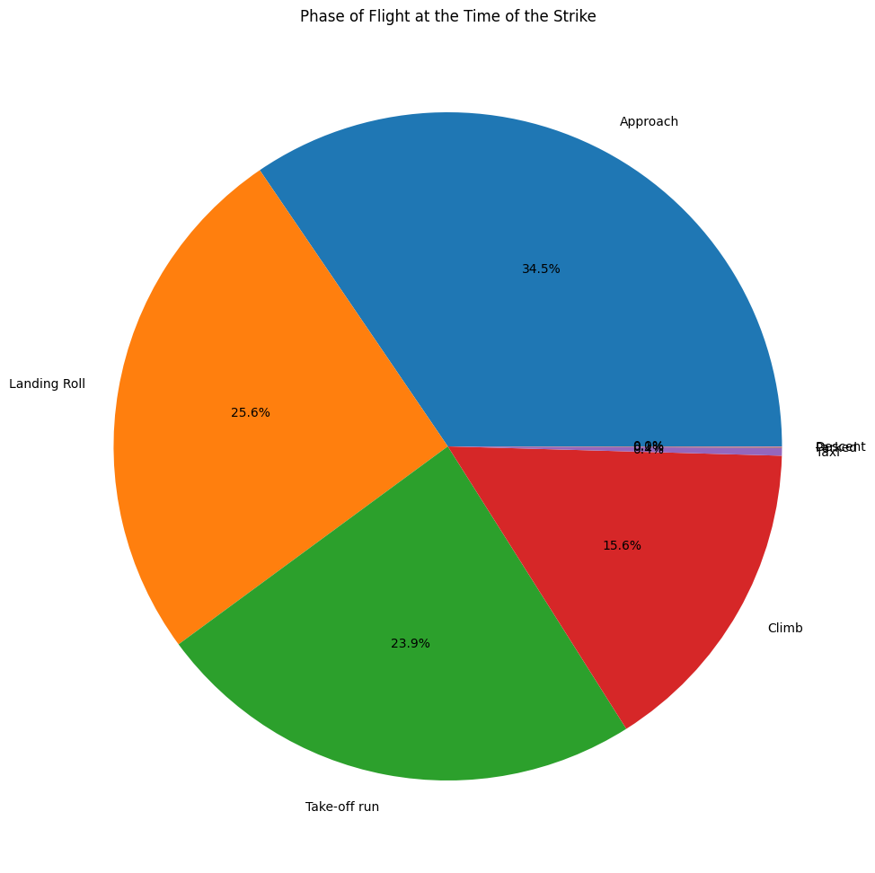
Phase of Flight at the Time of Strike

Slide 19
Phase of Flight at the Time of Strike
Visualization: Pie chart showing the phase of flight during which bird strikes occur.
Insight: Bird strikes occur roughly 34.3% of the time when flying in approach mode.
Conclusion: Enhanced preventive measures needed during these phases.

Slide 20
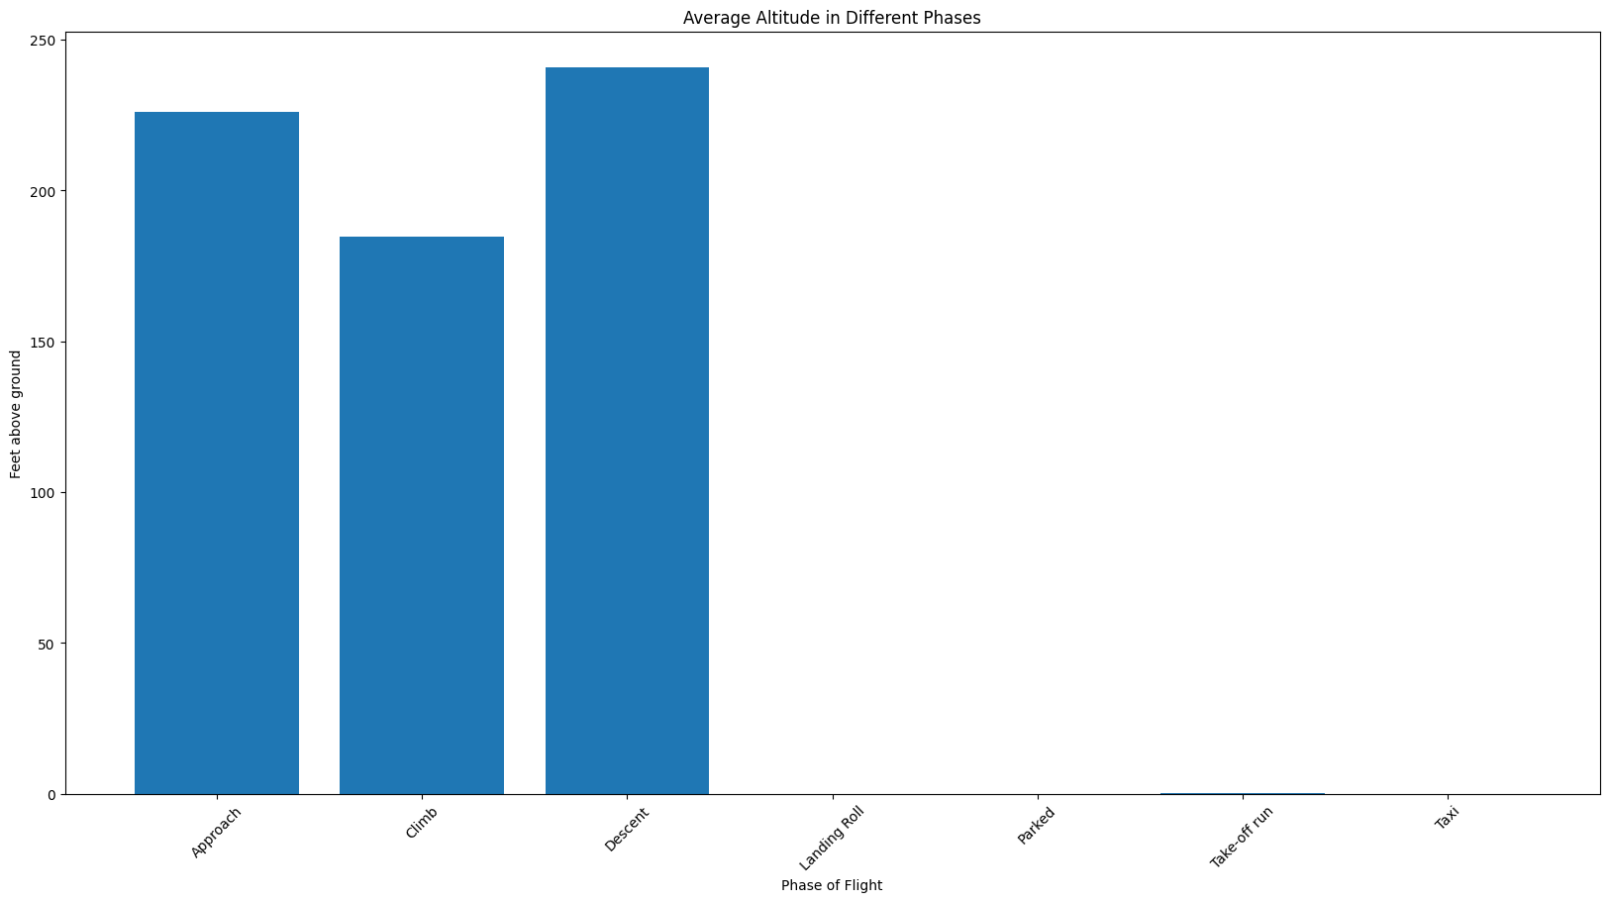
Average Altitude of Airplanes in Different Phases

Slide 21
Average Altitude of Airplanes in Different Phases
Visualization: Bar chart showing the average altitude during different flight phases at the time of bird strikes.
Insight: On and average bird strikes occurs at the phase of descent.
Conclusion: Different flight stages necessitate specific protective measures.

Slide 22
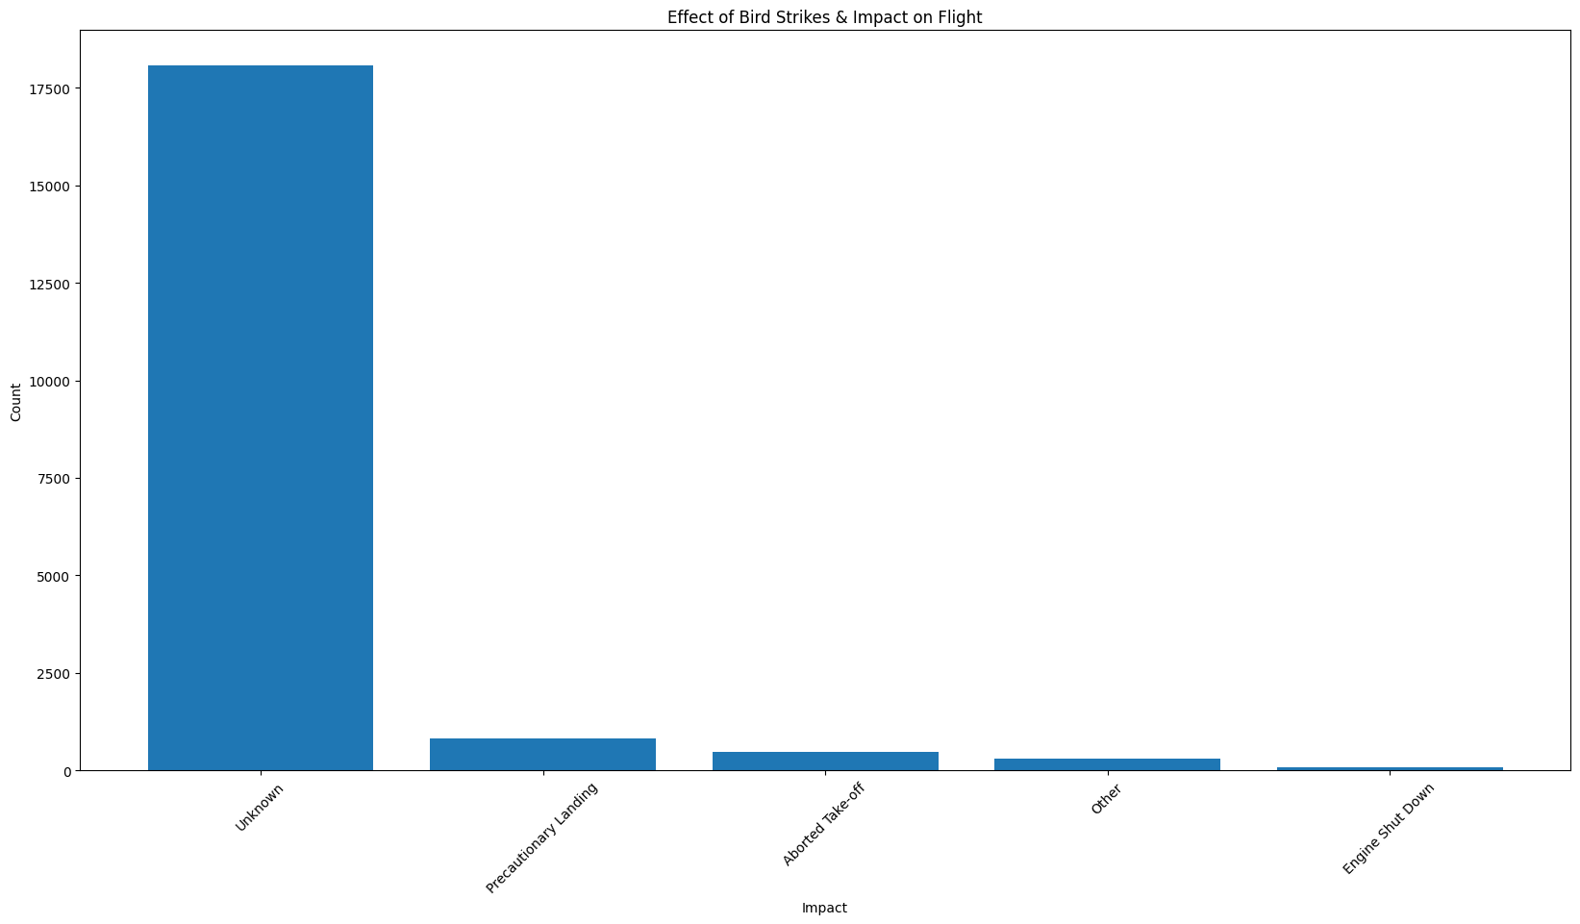
Effect of Bird Strike and Impact on Flights

Slide 23
Effect of Bird Strike and Impact on Flights
Visualization: Bar chart categorizing the impact of bird strikes on flights.
Insight: There is an unknow impact on flights while bird strike.
Conclusion: Bird strikes offer a variety of safety issues.

Slide 24
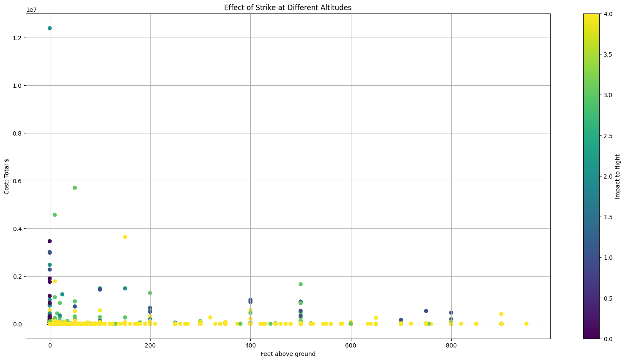
Effect of strike at different Altitude

Slide 25
Effect of strike at different Altitude
Visualization: Scatter plot showing the effect of strike at different Altitude.
Insight: Financial impact varies with altitude.
Conclusion: Strikes at certain altitudes may lead to higher costs.

Slide 26
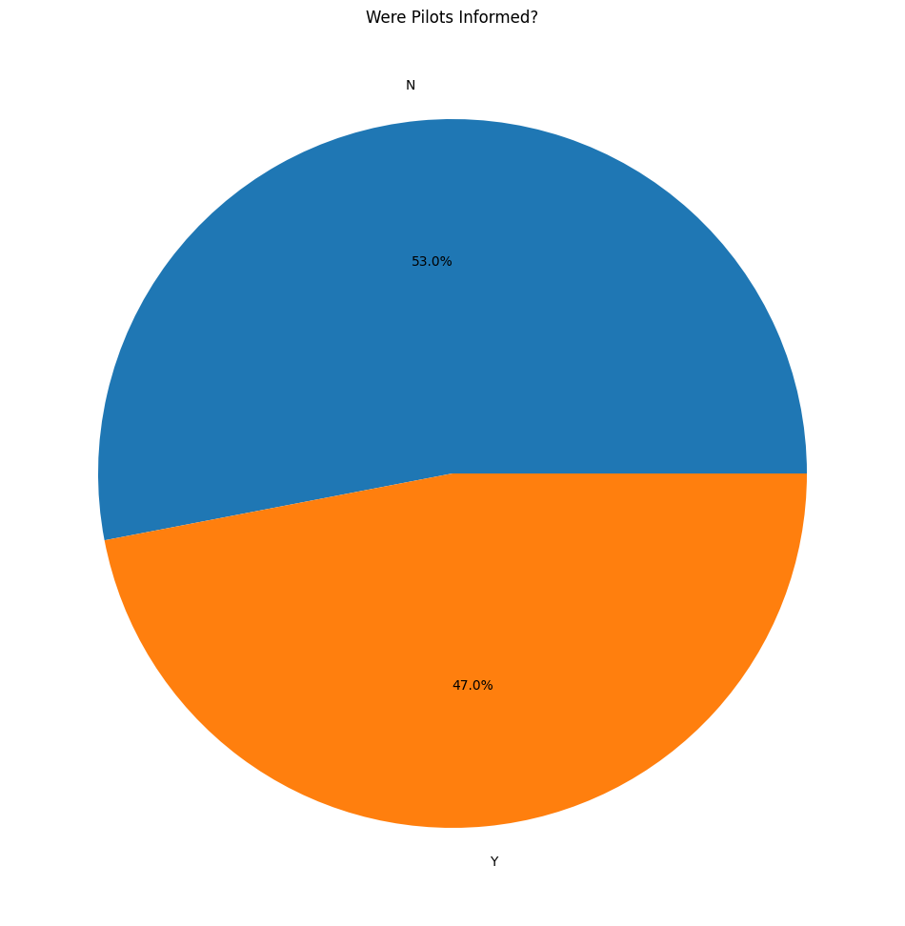
Were pilots Informed?

Slide 27
Were pilots Informed?
Visualization: Pie chart indicating whether pilots were warned of birds before the strike.
Insight: Many bird strikes occur without prior warning.
Conclusion: Better wildlife detection and communication systems needed.

Slide 28
Conclusion
Summary of Findings:
42.0% incidents where pilot was warned about the birds.
Prior warning to the pilot reduces the risk of damage to the aircraft.
52.78% of incidents have happened due to some small unknown bird.
72.9% incidents have happened when there is 1 bird/wildlife is struck in the airplane and caused damage.
90.31% incidents caused no damage while 9.69% incidents caused damage.
80.84% of bird strike incidents have happened when the altitude of airplane was <1000 ft and 19.16% have happened when altitude was >1000 ft.

