Slide 1



Predicting Solar Power Output Using Linear Regression by Sriram M K

Slide 2

Learning Objectives
This project aims to explore and understand how various environmental factors impact solar power generation.
The key learning objectives are:
i) Understanding Solar Power Generation: Learn how weather conditions, such as temperature, humidity, and solar radiation, influence energy production.
ii) Exploratory Data Analysis (EDA):Identify patterns, trends, and relationships between variables through statistical and visual analysis and Detect anomalies and outliers that could affect model performance.
iii) Building and Evaluating a Machine Learning Model: Develop a Linear Regression model to predict power output. Use performance metrics like R² score and Mean Absolute Error to assess model accuracy.
GOAL
Source :
www.freepik.com/

Slide 3
Slide 3: Methodology
Tools and Technology used
This project leverages various data science tools and machine learning frameworks for efficient analysis and model development.
Programming Language:
Python – widely used in data science for its extensive libraries and ease of implementation.
Libraries & Frameworks:
Pandas – Data loading, manipulation, and preprocessing.
NumPy – Numerical computing and handling large datasets.
Matplotlib & Seaborn – Data visualization and statistical analysis.
Scikit-learn – Machine learning model implementation, including Linear Regression.
Implementation Platform: Jupyter Notebook

Slide 4
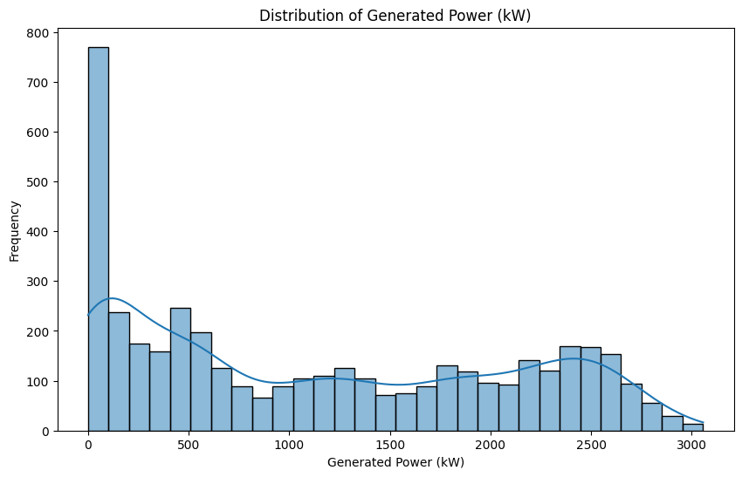
Methodology
1) Data Collection and Preprocessing:
The dataset was first explored to understand its structure after being read using pd.read_csv(). The shape and basic summary statistics were checked using df.shape and df.describe() to get an overview of the data.
Missing values were handled by checking for nulls (df.isnull().sum()) and duplicates (df.duplicated().sum()). However no missing or duplicate values were found.
Outliers were detected using box plots, and the Interquartile Range (IQR) method was used to remove them out.
The target variable, “generated_power_kw”, was visualized through a histogram to understand its distribution.

Slide 5
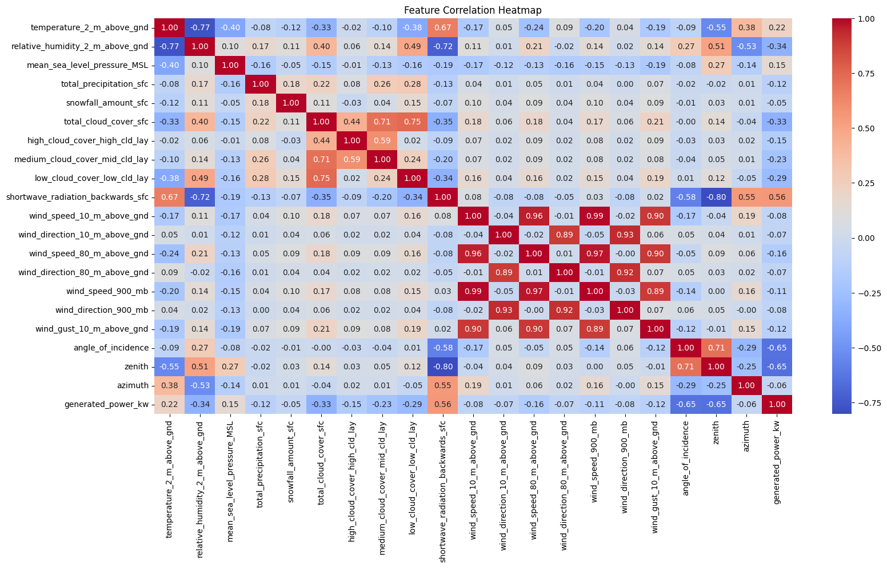
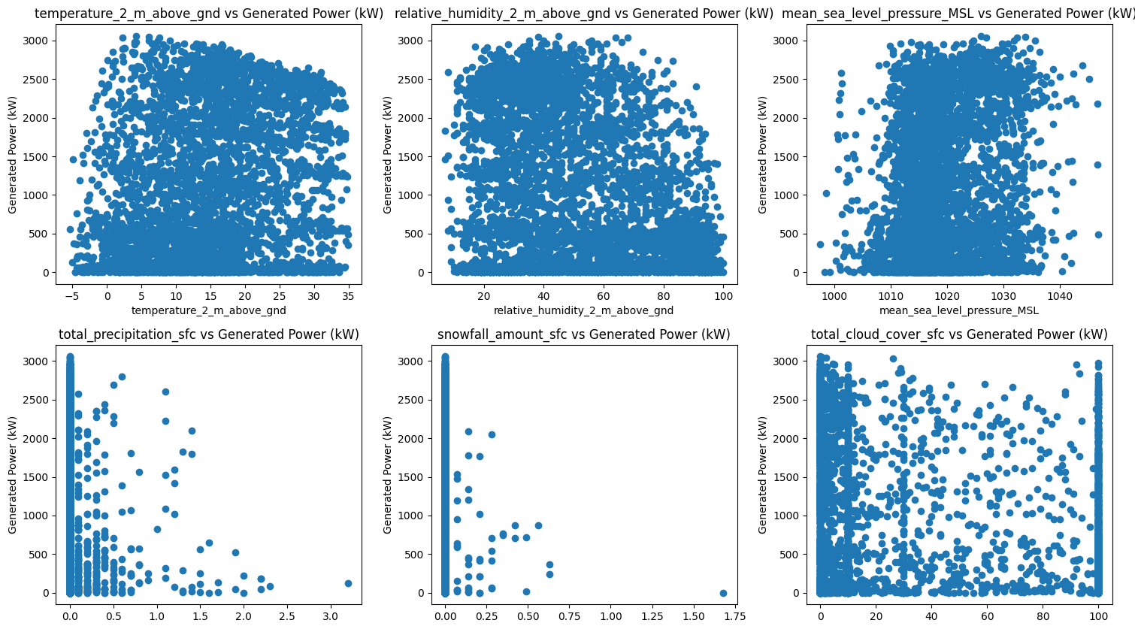
2) Exploratory Data Analysis (EDA):
Correlation Analysis:
A correlation matrix was created to identify relationships between features and the target variable. A heatmap was used for a visual representation of the correlations.
Highly correlated feature pairs (correlation above 0.75 ) were printed for further insight.
Bivariate Analysis:
Scatter plots were used to analyze the relationship between individual features and solar power generation.

Slide 6
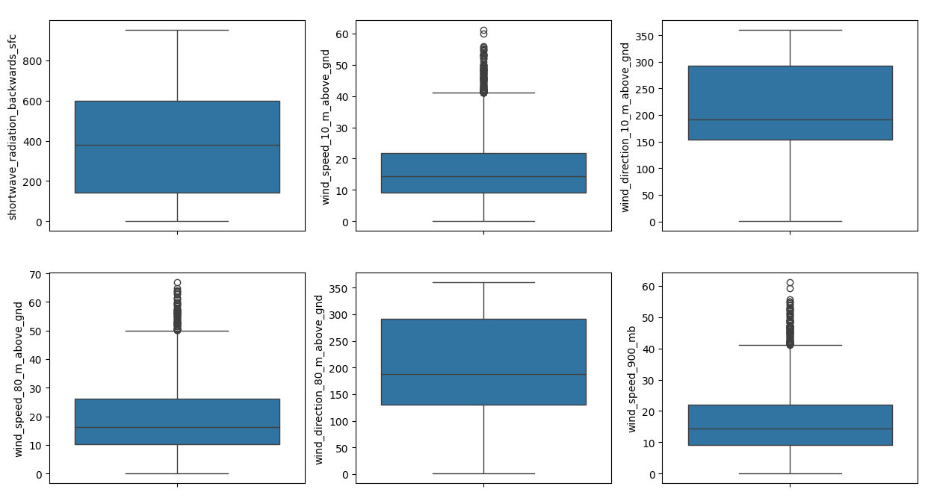
Handling Outliers:
i) Box plots were used to visualize the outliers present in each feature of the dataset.
ii)The IQR method was used to handle the outliers, so the model’s line can fit in a better manner IQR: Q1 = df.quantile(0.25)
Q3 = df.quantile(0.75)
IQR = Q3 - Q1
lower_bound = Q1 - 1.5 * IQR
upper_bound = Q3 + 1.5 * IQR
for feature in df.select_dtypes(include=['float64', 'int64']).columns:
df[feature] = df[feature].clip(lower=lower_bound[feature], upper=upper_bound[feature])

Slide 7
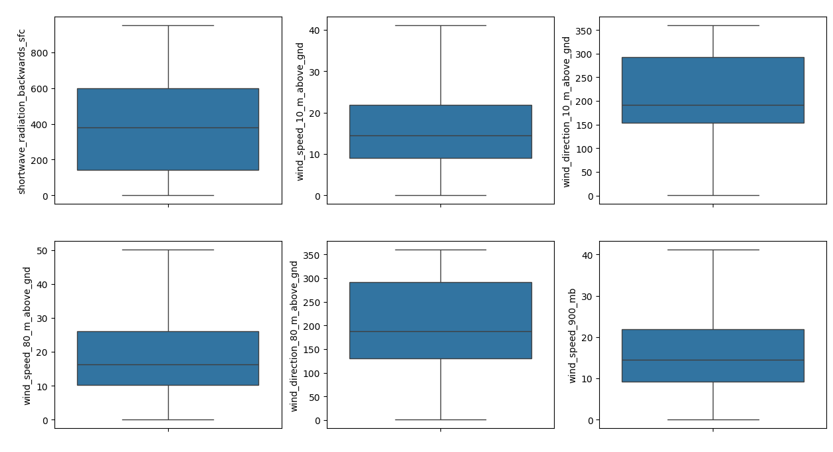
iii)Data outliers visualization after handling the outliers:

Slide 8
3) Model Development:
i) Feature Selection: The features were selected for training , excluding the target variable,” generated_power_kw”,which was defined as Y = df[‘generated_power_kw’].
ii) Train-Test Split: The dataset was split into training (80%) and testing (20%) subsets using the train_test_split() function with a test size of 0.2 and random state set to 30 to ensure reproducibility.
iii) Feature Scaling: The features were scaled using StandardScaler to standardize them from range(0-1), which is essential for ensuring that the linear regression model works effectively since each features of different range and units.
iv) Model Fitting: A linear regression model was then fitted to the training data using the LinearRegression() method from the sklearn library to the scaled training dataset x_train_scaled.
from sklearn.model_selection import train_test_split
from sklearn.preprocessing import StandardScaler, PolynomialFeatures
from sklearn.linear_model import LinearRegression
from sklearn.metrics import mean_squared_error, mean_absolute_error
from sklearn.metrics import r2_score
#spliting target and features
X = df.drop('generated_power_kw', axis=1)
y = df['generated_power_kw’]
#train test split
X_train, X_test, y_train, y_test = train_test_split(X, y, test_size=0.2, random_state=30)
#scaling
scaler = StandardScaler()
X_train_scaled = scaler.fit_transform(X_train)
X_test_scaled = scaler.transform(X_test)
# Train the model
model = LinearRegression()
model.fit(X_train_scaled, y_train)

Slide 9
4. Model Evaluation
i)Mean Absolute Error (MAE):
MAE was calculated for both the training and testing datasets to evaluate the accuracy of the model’s predictions.
# Evaluate the model - test
y_pred = model.predict(X_test_scaled)
mae = mean_absolute_error(y_test, y_pred)
print(f"Mean Absolute Error on Test Set: {mae}") Mean Absolute Error on Test Set: 385.4446828021914
# Evaluate the model on the training set
y_pred_train = model.predict(X_train_scaled)
mae_train = mean_absolute_error(y_train, y_pred_train)
print(f"Mean Absolute Error on Train Set: {mae_train}")
Mean Absolute Error on Train Set: 392.8470404490051
ii)R² Score:
The R² score was computed for both the training and testing datasets. This metric indicates how well the model explains the variance in the target variable.
# Compute R² score
r2_train = r2_score(y_train, y_pred_train)
r2_test = r2_score(y_test, y_pred)
Train R² Score: 0.7011086311604038 Test R² Score: 0.7293618471609269

Slide 10
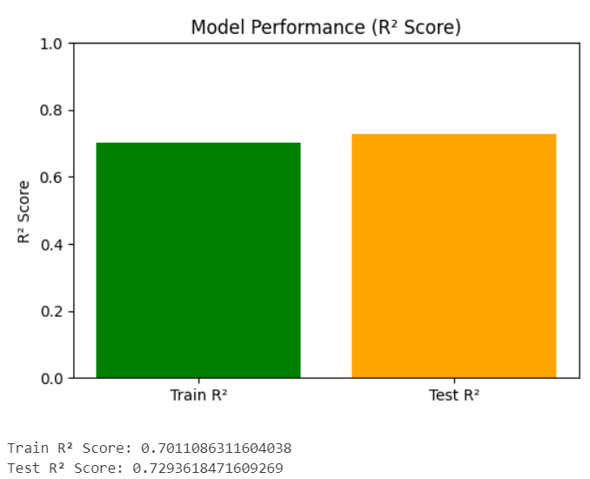
# Bar plot for R² scores
plt.figure(figsize=(6, 4))
plt.bar(["Train R²", "Test R²"], [r2_train, r2_test], color=["green", "orange"])
plt.ylim(0, 1)
plt.ylabel("R² Score")
plt.title("Model Performance (R² Score)")
plt.show()
print(f"Train R² Score: {r2_train}")
print(f"Test R² Score: {r2_test}")
The close R² scores indicates that the model not has been overfitted

Slide 11
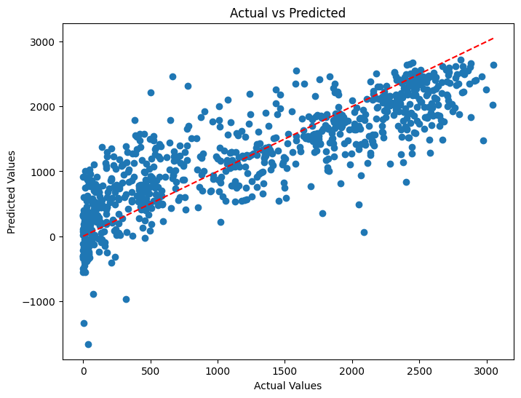
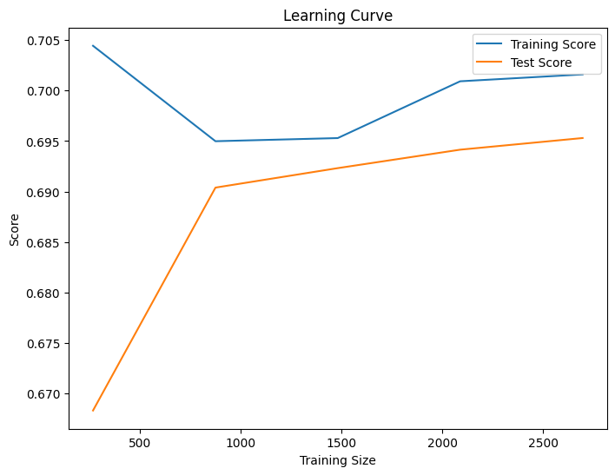
Residual Analysis:
A residual plot (Actual vs Predicted) was generated to check the assumptions of the linear regression model.
Learning Curve:
A learning curve was plotted to show the relationship between the training score and testing score as the number of training samples increased.

Slide 12
Problem Statement:
Develop a data-driven model that predicts solar power output based on environmental conditions,
Which helps Improve energy forecasting to support smart grid integration and decision-making.

Slide 13
Solution:
To Tackle the problem, we implemented a Linear Regression model following a structured approach:
i) Collected and analyzed historical data on solar power generation.
ii) Explored correlations between environmental factors and power output to identify key predictors.
Implementation Steps:
Step 1: Conducted Exploratory Data Analysis (EDA)
Created histograms and scatter plots to visualize relationships.
Used correlation heatmaps to identify significant features.
Step 2: Performance Optimization
Identified and removed outliers.
Optimized feature selection by eliminating less relevant variables.
Step 3: Built the Linear Regression Model
Split dataset into training (80%) and testing (20%) sets.
Trained the model on training data.
Evaluated performance using R² score and MAE.
Step 4: Model Interpretation
Visualized actual vs. predicted power output to assess accuracy.
Evaluated residuals to ensure the model was unbiased.
Results:
The Linear Regression model achieved an R² score of 0.72 on test dataset

Slide 14
Screenshot of Output:
a) R² score of the model
b) Residual plot of the model

Slide 15
Conclusion:
Environmental factors, such as temperature, humidity, and solar radiation, play a crucial role in predicting solar power generation, and feature selection combined with correlation analysis significantly impacts the accuracy of the model.
The Linear Regression model achieved an R² score of 0.72, meaning it explains 72% of the variance in the power output, and residual analysis confirmed that while the model provides reasonably accurate predictions, it may need further refinement. There are challenges and limitations, including the influence of weather fluctuations and the model's assumption of a linear relationship, which may not capture complex non-linear dependencies. To improve model accuracy, future work could involve experimenting with more advanced models such as Random Forest or Neural Networks, as well as incorporating time-series forecasting techniques.
Real-world implementation of the model could involve integrating it into solar farm monitoring systems for real-time predictions, as well as developing an interactive dashboard to assist energy companies in optimizing power generation.

