Slide 1

🌸 Cyber Safety: Safe & Smart Online Adventures 💻
Welcome, Class 11! Let's explore the digital world together, learn how to stay safe, and become responsible digital citizens.

Slide 2

What is Cyber Safety? 💖
Cyber safety is all about protecting yourself and your information while using the internet. Think of it as your digital superpower!
Protecting Yourself
Staying Smart
Why It Matters
Keeping your personal info safe from bad guys online.
Making good choices in the vast online world.
Ensuring your online experience is fun and worry-free!

Slide 3
⚠️ Online Threats to Watch Out :
The internet is amazing, but it has its tricky parts too. Let's learn about common dangers!
Malware 👾
Phishing 🎣
Fake Websites 🎭
Nasty software that can harm your devices.
Tricky messages trying to steal your passwords.
Sites designed to look real but are actually scams.
Identity Theft 👻
Scams & Fraud 💸
When someone steals your personal details.
Online tricks to get your money or information.

Slide 4
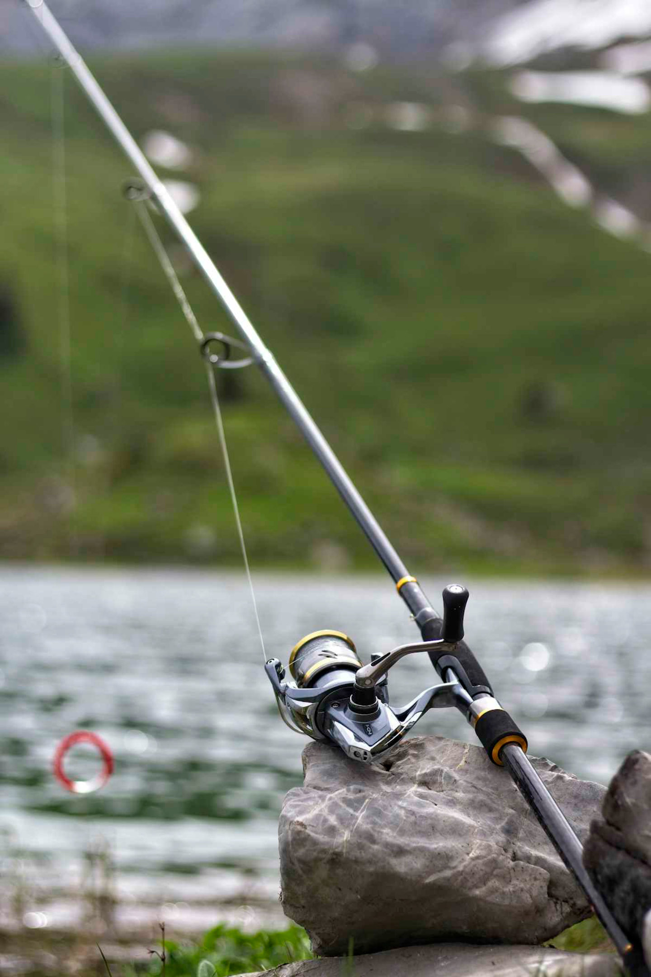
🎣 Phishing & Fraud: Don't Take the Bait!
Phishing is a sneaky way scammers try to get your personal information. Be smart!
What is Phishing?
1
Emails or messages designed to look like they're from trusted sources (like your bank or a famous company) asking for your info.
How They Trick You
2
They might say your account is locked, offer fake prizes, or pretend to be someone you know.
Safety Tips
3
Always check the sender, look for spelling errors, and never click suspicious links or attachments.

Slide 5
📱 Safe Social Media Practices
Social media is fun, but always remember to use it wisely!
Keep Accounts Private
Strong Passwords
Don't Overshare
Make them long and complex, a mix of letters, numbers, and symbols.
Avoid posting too much personal info like your address or daily routines.
Use privacy settings to control who sees your posts and profile.
Be Careful with Strangers
Report Harmful Behavior
Don't accept friend requests from people you don't known real life.
If you see something inappropriate, report it to the platform and tell an adult.

Slide 6
✨ Safe Browsing: Explore with Confidence!
The internet is a vast library, but some books are better than others. Browse smartly!
1
2
Trusted Websites Only
Look for HTTPS
Stick to sites you know and trust. If something feels off, leave the site.
Always check for "https://" at the start of a website address. The "s" means it's secure!
3
Don't Download Unknown Files
Be careful what you download. Unknown files can contain malware.

