Slide 1
PROGRESSIVE GIFT CARDS
Where We Go From Here
Doug, you asked us to come back with a clear recommendation. We've done that work — and what we found is that before we can responsibly point you in the right direction, one critical step has to happen first.

Slide 2
THE PROBLEM
Three Things Are True About Your Digital Business Right Now
Single Point of Failure
Delivery Is Fragile
Back-Office Doesn't Connect
Everything runs through one person — one set of scripts, one machine, one person's knowledge. If that person is unavailable, digital fulfillment stops entirely.
Encrypted email attachments trigger spam filters, customers lose passwords, and every failed delivery creates a support ticket. The move toward URL-based delivery is right — but the process is still manual.
Orders come in through a web form, generate an email, and someone manually creates an invoice in QuickBooks. No sync. No automation.

Slide 3

KEY INSIGHT
What We Learned Along the Way
Gift Cards Are Cash Equivalents
As we dug into what a solution looks like, our technical team flagged something that can't be overlooked.
The card numbers Progressive handles represent transferable monetary value — functionally the same as cash. That's not a minor detail. It changes the entire security conversation.
Any system that touches these card numbers must be treated with the same seriousness as a financial system — because that's exactly what it is.
This realization is what shapes everything that follows.

Slide 4
SECURITY REALITY
What That Means In Practice
Card data security is a first-class concern
Vendor workflows are more complex than they appear
Encryption, access controls, and audit logging are the baseline — not optional extras. Any system touching card numbers must start here.
Walmart, Amazon, Loblaws, Chapters — each vendor likely has different formats, validation rules, and delivery requirements.
URL-based delivery introduces its own risk surface
The current process carries risk too
Scripts on a local machine with card data in spreadsheets is not a secure baseline. Doing nothing is still a security decision.
Link-based retrieval requires signed URLs, expiration policies, and brute-force protection to be done securely.

Slide 5
OPEN QUESTIONS
Questions We Need to Answer Together
The answers to these questions directly shape what the right solution looks like. Before we can recommend anything responsibly, we need clarity on:
Risk Exposure
Insurance Coverage
Vendor Requirements
Past Incidents
What does Progressive's current risk profile look like for digital card operations?
Have there been any incidents — even minor — involving card data, failed deliveries, or unauthorized access?
Is there business insurance in place that covers digital gift card operations or data loss?
Have vendors raised security requirements or compliance expectations — formally or informally?

Slide 6
OUR REASONING
Why Discovery Has to Come First
We could sketch architectures and put price tags on them today. But the honest truth:
What We Don't Know Yet
Exactly what the scripts do for each vendor — inputs, outputs, edge cases
Whether vendor integrations involve APIs, file uploads, portal logins, or something else
What card data Progressive owns at each stage
Where security boundaries are today vs. where they need to be
Any solution we propose before fully understanding the vendor workflows and security posture is guesswork.
Guesswork leads to scoped-wrong builds, security gaps discovered after launch, and rework that costs more than getting it right the first time.

Slide 7

PHASE 1
Structured Discovery — What It Looks Like
A half-day working session with Lloyd at your office. Danny leads on-site, Spencer joins remotely. Every vendor workflow documented end-to-end.
Vendor Runbooks
Technical Specification
Security Assessment
Step-by-step documentation for every vendor. Mario or a new hire could follow them immediately. Standalone value regardless of what comes next.
A real recommendation with real numbers — informed by what actually happens in practice, not assumptions.
Where card data lives, how it moves, and what the risk profile looks like at every stage.

Slide 8
INVESTMENT
The Engagement Details
Why This Is the Right First Step
What
Half-day structured discovery session
This is the smallest commitment with the highest information value. It unlocks everything that follows — with confidence instead of guesswork.
Who
Danny (on-site), Spencer (remote), Lloyd, Mario (observer)
When
April 2026
Hours & Cost
$6,750 | 40 hours (prep, session, and deliverables)
Output
Vendor runbooks, technical spec, security assessment

Slide 9
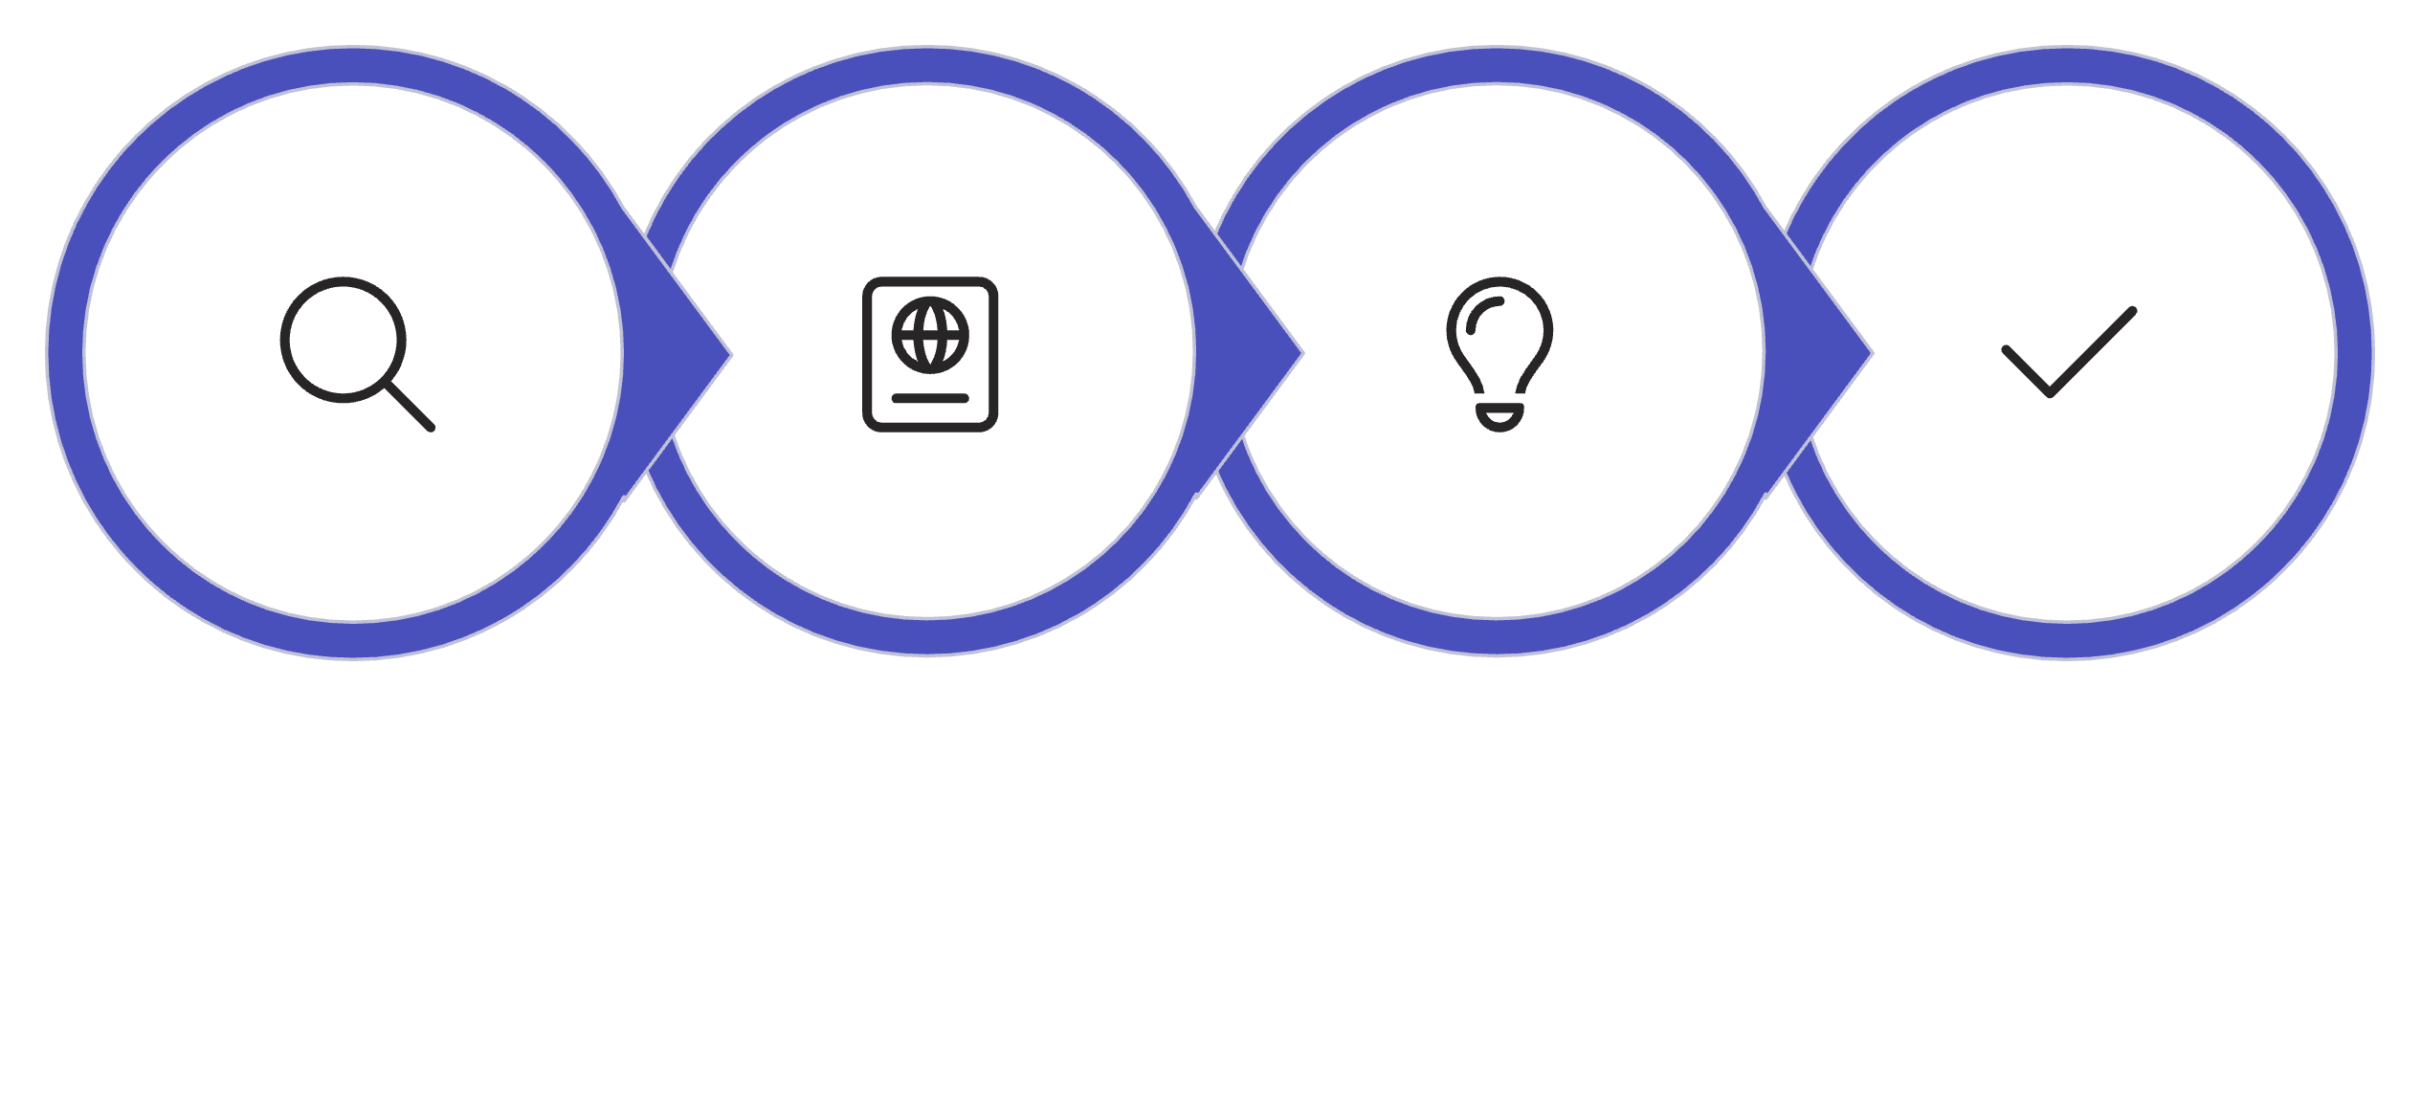
WHAT'S NEXT
What Happens After Discovery
Runbooks & Specs
Recommendation
Build with Confidence
Discovery
Everything discussed in January — the card generation tool, the order platform, the customer portal — is still on the table. Discovery is how we get there responsibly, with real numbers backed by real understanding.

Slide 10
The Single Action That Moves Everything Forward
📅 Schedule the Lloyd Session in April
One half-day. Three deliverables. A clear path forward. That's all it takes to go from uncertainty to a solution we can all stand behind.

