Slide 1

DATA ANALYSIS ON ONLINE SHOPPING TRENDS
Phase - 2

Slide 2
Summary
The raw dataset contained several data quality issues:
The raw dataset contained missing values, duplicates, and inconsistent data entries.
Some numerical columns were skewed while others were more balanced.
Categorical variables had inconsistent formats (e.g., “Yes” vs “yes”).
Customer ID (special column) had nulls, which made certain rows invalid.

Slide 3
Missing Values
Age, Review Rating (Numerical – Normally Distributed): Filled with Mean.
Purchase Amount (USD), Previous Purchases (Numerical – Skewed):
Filled with Median.
Categorical Columns (Gender, Category, Payment Method, etc.): Filled with Mode
(most frequent value).
Customer ID (Unique Identifier): Rows with missing values were dropped to
maintain data integrity.

Slide 4
Duplicates & Inconsistencies
Checked with .duplicated() → Removed duplicate rows.
Standardized categorical text (e.g., “Yes/yes” → “Yes”).
Ensured consistent values for Season, Payment Method, and Promo

Slide 5
Data Type Corrections
Converted numerical string columns (like Purchase Amount) to float.
Converted categorical features (like Gender, Location, Payment Method) to
category dtype.
Ensured Customer ID remained as string/object type.
Importance: Correct data types improve memory efficiency and accuracy of analysis.

Slide 6
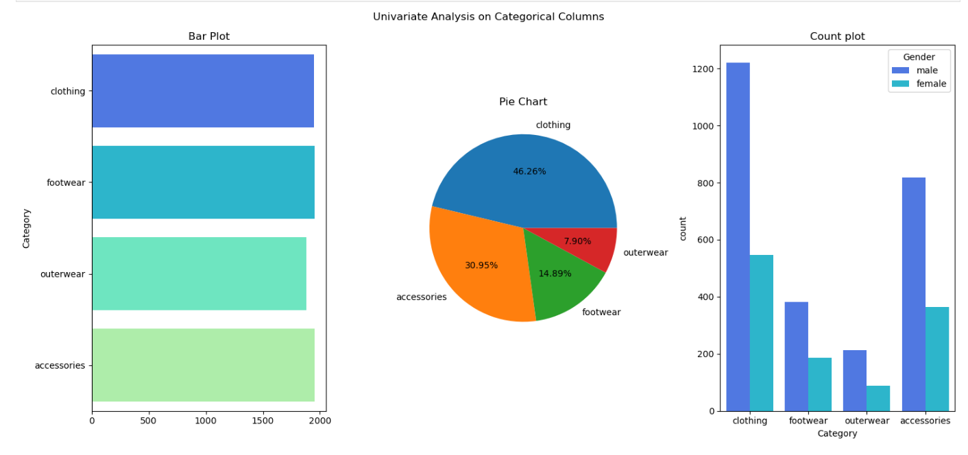
UniVariate Analysis

Slide 7
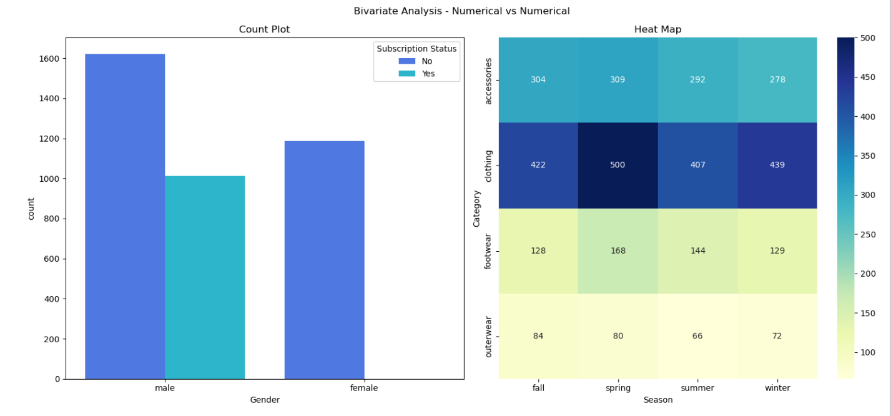
BiVariate Analysis

Slide 8
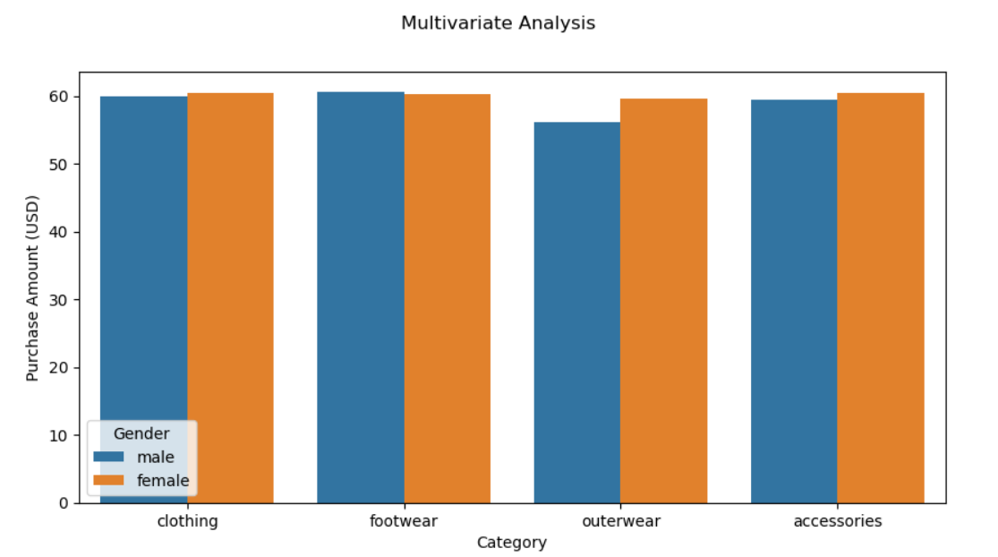
MultiVariate Analysis

Slide 9
Conclusion
All missing values, duplicates, and inconsistencies were handled.
Data types corrected for accurate analysis.
Dataset is now clean, structured, and analysis-ready.
Insights from bivariate analysis can guide marketing strategies, customer targeting
and seasonal product planning.

Slide 10

THANK YOU

