Slide 1
Infrastructure as code Ansible – Part 3
Srinivas Kantipudi

Slide 2
Agenda
Recap
Ansible on different OS
Deep-dive into Ansible structure
Ansible Vault to secure passwords
Deploying docker containers and EC2 instances using Ansible
Ansible Galaxy

Slide 3
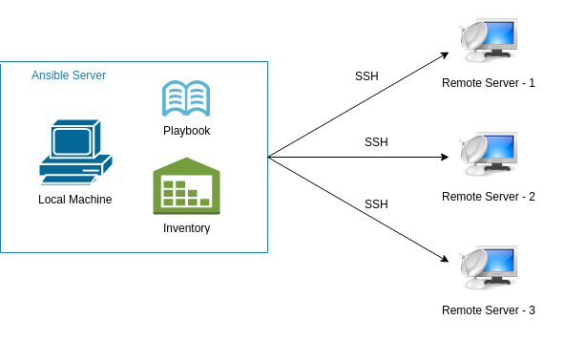
Introduction to Ansible
IT automation tool to configure systems
Provides stable infrastructure for provisioning the target environments
Agentless
Uses SSH
Idempotent (Declarative)
Focus on what instead of how
Uses YAML syntax

Slide 4
Install
Windows
Supports all Windows versions supported by Microsoft
Need PowerShell 3.0 or later, .NET 4.0 or later
Mac OS
Brew install ansible
Linux
Sudo pip install ansible
Sudo apt-get install ansible
Yum install ansible
Cygwin
Vagrant box with Linux
Windows subsystem for Linux
Windows as a Host:
Configure Windows as Ansible host:
https://docs.ansible.com/ansible/latest/user_guide/windows_setup.html#host-requirements

Slide 5
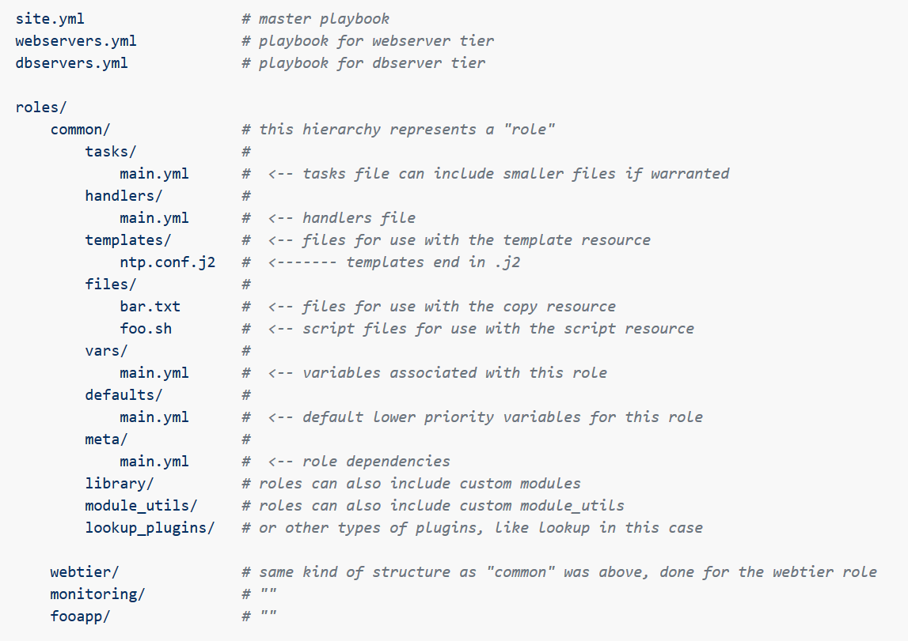
Ansible Structure
ansible-galaxy init common

Slide 6
Secret management with ansible

Slide 7
Ansible Vault
What:
Secret management to encrypt sensitive data
Comes as part of Ansible
Can encrypt variables, YAML files
Uses AES-256 encryption
Practically unbreakable
Why:
Never store passwords in plain text files
Need for provisioning
Notes:
256 bits, supports the largest bit size and is practically unbreakable by brute force based on current computing power, making it the strongest encryption standard

Slide 8
Ansible Vault – Basic commands
Create Encrypted file:
ansible-vault create pass.yml
Encrypt & Decrypt an existing file:
ansible-vault encrypt pass.yml
ansible-vault decrypt pass.yml
Encrypt a string:
ansible-vault encrypt_string 'srinivas' --name 'myname’
Viewing, Editing and Running Playbook with Encrypted strings/files:
Ansible-vault view demo.yml
Ansible-vault edit demo.yml
Ansible-playbook pass.yml –ask-vault-pass
ansible-playbook demo.yml --vault-password-file vault-password-file
Change password:
ansible-vault rekey mysecrets.yml

Slide 9
Managing ec2 and docker instances

Slide 10
Managing EC2 instances
EC2:
Docker:
What you need:
Boto and Boto3 installed
Amazon Web Services (AWS) SDK for Python
AWS account and API user
Operations:
Create instance
Start, Stop, Terminate instances
What you need:
Docker installed and started
Yum install docker-ce docker-cli
Systemctl start docker
Systemctl enable docker
Operations:
Pull image
Build image
Notes:
256 bits, supports the largest bit size and is practically unbreakable by brute force based on current computing power, making it the strongest encryption standard
https://www.tech693.com/2019/06/ansible-docker-example.html

Slide 11
Ansible Galaxy

Slide 12
Ansible Galaxy
Hub for finding and sharing Ansible content
https://galaxy.ansible.com/
Ansible-galaxy search “restassured”
Ansible-galaxy install restassured

Slide 13
Q&A

Slide 14
Task status
Requirements (on host that executes module)
python >= 2.6
docker-py >= 1.7.0
Docker API >= 1.20

Slide 15
Ansible – Modules & Playbooks
Playbook
Play 1
Play 2
Task 1
Task 2
Task 3
Task 4
Module 1
Module 2
Module 3
Module 1
Module 4
Module 5
Modules
Stand alone scripts
Hundreds of modules available
Users can write their own modules
Playbooks
Composed of one or more Plays
Written in YAML
Set of instructions
Contains one or more plays
Galaxy
Hub for Ansible content
Notes:
Playbooks are a completely different way to use ansible than in ad-hoc task execution mode.

Slide 16
Ansible structure - Example
Main_playbook.yml
Webservers.yml
AppServers.yml
DBSever.yml
Servers
Web servers
AppServers
DB
Tasks – Install
Tasks - Configure
Tasks - Start
Tasks – Install
Tasks - Start
Tasks - Configure
Tasks – Install
Tasks - Start
Tasks - Configure
Master playbook and playbook for each line of operation
Servers level

