Slide 1
Infrastructure as code Ansible – Part 2
Srinivas Kantipudi

Slide 2
Agenda
Install
Configuration
Introduction to YAML
Loops, Conditions and more
Ansible directory structure

Slide 3
Install
Check list after the installation
Ansible can run only on Unix systems
Use Yum, dnf, apt/apt-get or pip to install
“sudo yum install ansible”
Ansible modules require python
Ansible home - /etc/ansible
Should have ansible.cfg and hosts file
Check the version of Ansible
Ansible --version

Slide 4
Configure Hosts
Ungrouped hosts, Grouped hosts or Ranges
Supports all operating systems as hosts
Ansible all –m ping
Can change the inventory file name in ansible.cfg
# Ex 1: Ungrouped hosts, specify before any group headers.
## green.example.com
## blue.example.com
## 192.168.100.1
## 192.168.100.10
# Ex 2: A collection of hosts belonging to the 'webservers' group
## [webservers]
## alpha.example.org
## beta.example.org
## 192.168.1.100
## 192.168.1.110
# Pattern
## www[001:006].example.com
# Host ranges
## db-[99:101]-node.example.com

Slide 5
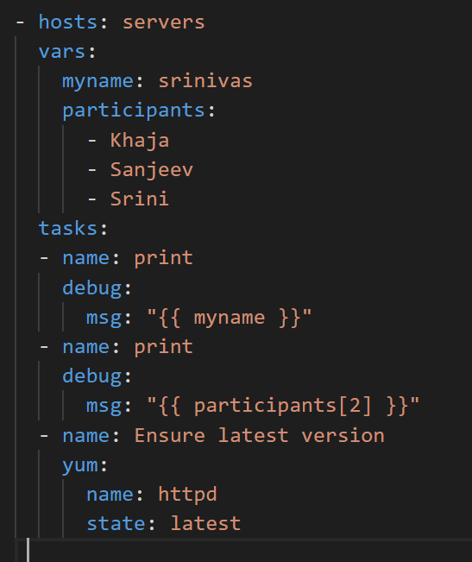
scalar
list
Understanding YAML
Ansible uses YAML
Superset of JSON
Much simpler to understand
Indent with spaces, not tabs
YAML files optionally begins with …
Lists and Dictionaries are the most important ones
dictionary

Slide 6
Loops, Conditions and more
Gather_facts
Loops
Conditions
Error handling
Includes
Handlers

Slide 7
Task status
ok - Task ran successfully, no changes were made
Changed - Task ran successfully, made changes
Failed - Task failed to run
Unreachable - Host was unreachable
Skipped - Task was skipped
ignored - Task was ignored

Slide 8
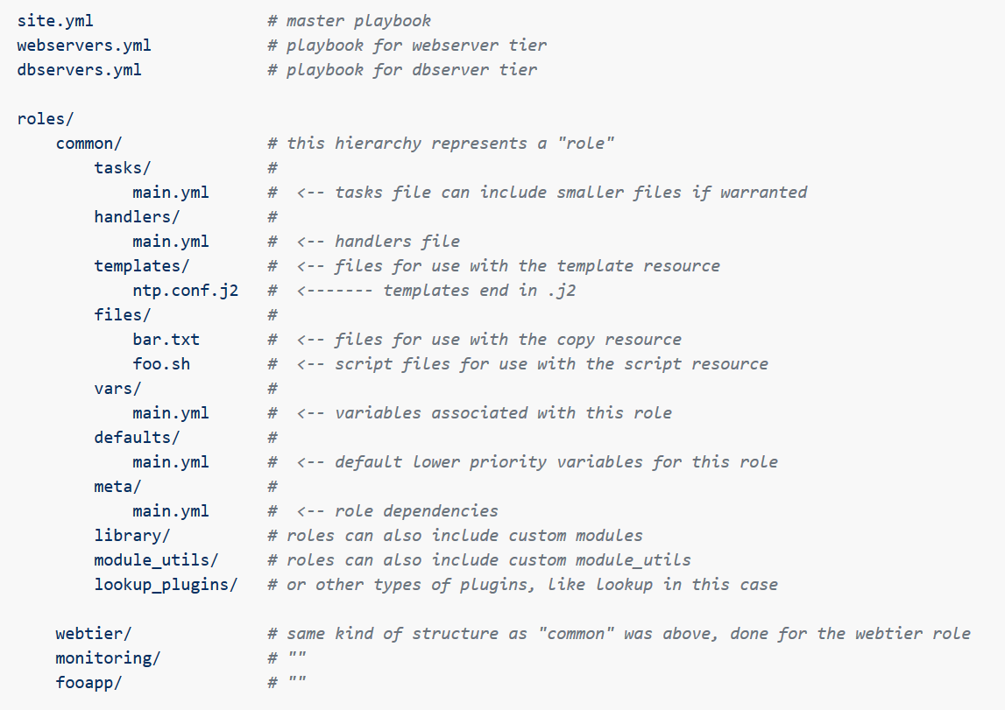
Ansible Structure
ansible-galaxy init common

Slide 9
Ansible structure - Example
Main_playbook.yml
Webservers.yml
AppServers.yml
DBSever.yml
Servers
Web servers
AppServers
DB
Tasks – Install
Tasks - Configure
Tasks - Start
Tasks – Install
Tasks - Start
Tasks - Configure
Tasks – Install
Tasks - Start
Tasks - Configure
Master playbook and playbook for each line of operation
Servers level

Slide 10
Demo

Slide 11
Q&A

Slide 12
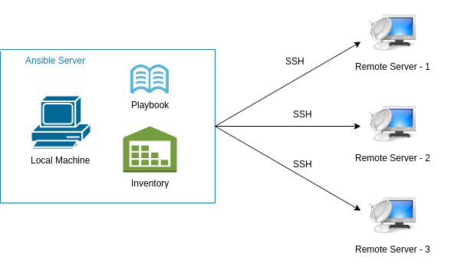
Introduction to Ansible
IT automation tool to configure systems
Provides stable infrastructure for provisioning the target environments
Agentless
Uses SSH
Idempotent (Declarative)
Focus on what instead of how
Uses YAML syntax

Slide 13
Ansible – Modules & Playbooks
Playbook
Play 1
Play 2
Task 1
Task 2
Task 3
Task 4
Module 1
Module 2
Module 3
Module 1
Module 4
Module 5
Modules
Stand alone scripts
Hundreds of modules available
Users can write their own modules
Playbooks
Composed of one or more Plays
Written in YAML
Set of instructions
Contains one or more plays
Galaxy
Hub for Ansible content
Notes:
Playbooks are a completely different way to use ansible than in ad-hoc task execution mode.

