Slide 1
Infrastructure as code Ansible – Part 1
Srinivas Kantipudi

Slide 2
Agenda – Overall and this session
Current session
Overall
Why IaC
IaC Tools
Go through Questions
Introduction to Ansible
My First Ansible script
Ansible
Three sessions
Packer
One or two sessions
Terraform
One or two sessions
End to end use case
One session
Other IaC tools
One session
Nothing fixed, we can change things as we go

Slide 3
Agile, Continuous Delivery and DevOps
Agile
Creating software that is always ready to release
Continuous Delivery
A software engineering approach in which teams produce software in short cycles, ensuring that the software can be reliably released at any time
DevOps
Natural extension for Agile and Continuous delivery
Combines development and operations
You build it. You run it
Development
IT Operations
Quality Assurance
DevOps

Slide 4
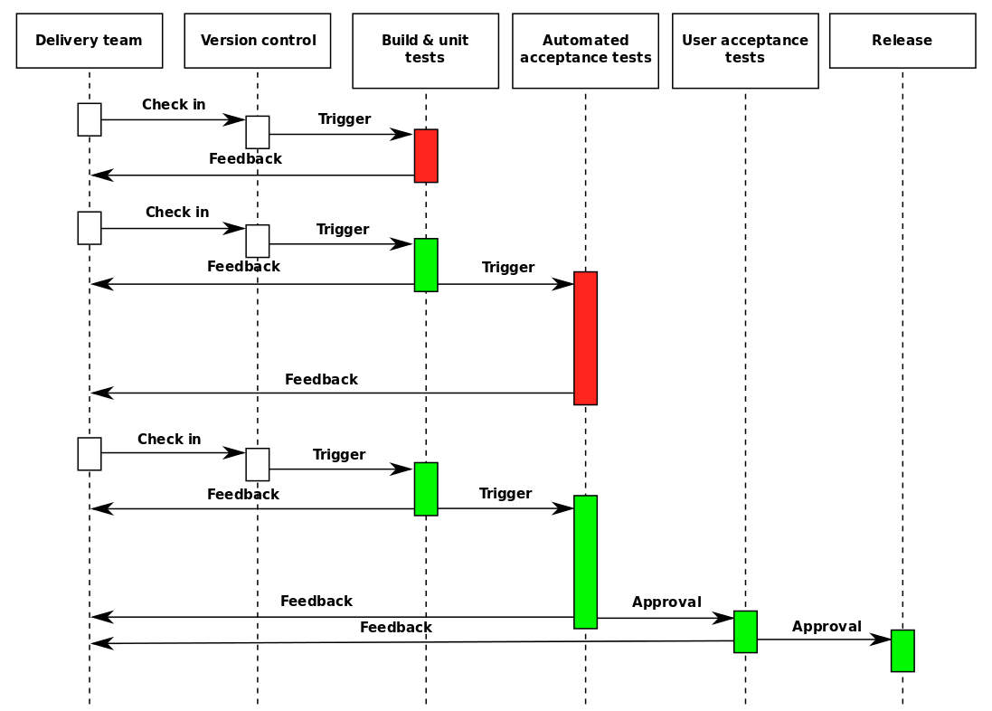
Continuous Delivery
Faster feedback
Should be Reliable
Tests
Infrastructure
Third part applications

Slide 5
Mutable Vs Immutable infrastructure
Mutable
Same servers used again and again
Manual process, can lead to differences
Immutable
Done through code
Multiple patches on same server

Slide 6
Infrastructure as Code
Process of managing and provisioning of infrastructure with software
Automate the creation and maintenance of servers
No manual intervention
Advantages
Immutable infrastructure
Speed
Efficiency
Accountability
Martin Fowler:
A server should be like a phoenix, regularly rising from the ashes.[1]
The primary advantage of using phoenix servers is to avoid configuration drift: ad hoc changes to a systems configuration that go unrecorded.

Slide 7
Tools
Provisioning
Packer
Terraform
Configuration Management
Ansible
SaltStack
Containerization
Docker
Vagrant
Puppet
Cloud Formation
Chef
Secret management
Vault
Azure Resource Manager

Slide 8
Questions from Registration link
Difference between Puppet, Chef and Ansible. Why is Ansible preferred?
I am new to this topic so anything is welcome ..
docker
Eager to learn this
how can we leverage Ansible, K8, Terraform in test automation ?
Overview and Key points for infra structure automation
Want to how much beneficial this course to a Test Engineer
These topics are new to me
Beginner
I want to complete details on IaC and why is it so popular now a days
Interested to know about ansible in detail
Related DevOps
Kindly explain about IAC
How i can use this setup with Test automation scripts
Terraform
Best Reporting(sharing automation test results) practices
learner of iac so no question till now

Slide 9

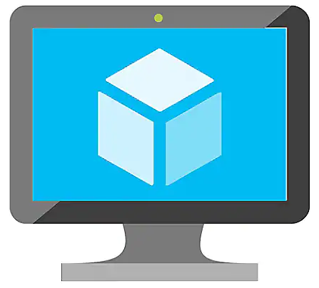
IaC flows
Packer
Builders & Provisioners
Ansible
VM
VM
VM with Product image, Java, .NET
VM with Product image
Terraform + Redis
Component team work

Slide 10
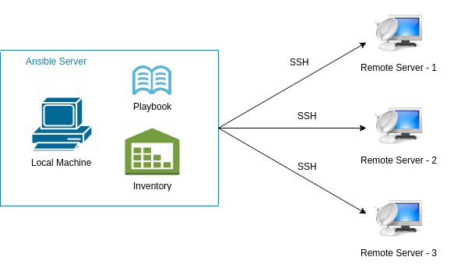
Introduction to Ansible
IT automation tool to configure systems
Provides stable infrastructure for provisioning the target environments
Agentless
Uses SSH
Idempotent (Declarative)
Focus on what instead of how
Uses YAML syntax

Slide 11
Ansible – Modules & Playbooks
Playbook
Play 1
Play 2
Task 1
Task 2
Task 3
Task 4
Module 1
Module 2
Module 3
Module 1
Module 4
Module 5
Modules
Stand alone scripts
Hundreds of modules available
Users can write their own modules
Playbooks
Composed of one or more Plays
Written in YAML
Set of instructions
Contains one or more plays
Galaxy
Hub for Ansible content
Notes:
Playbooks are a completely different way to use ansible than in ad-hoc task execution mode.

Slide 12
Demo

Slide 13
Q&A

