Slide 1

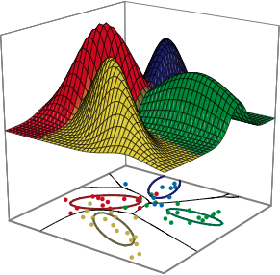
Pattern Classification
All materials in these slides were taken from
Pattern Classification (2nd ed) by R. O. Duda, P. E. Hart and D. G. Stork, John Wiley & Sons, 2000 with the permission of the authors and the publisher

Slide 2
Chapter 2 (Part 1):
Bayesian Decision Theory
(Sections 2.1-2.2)
Introduction
Bayesian Decision Theory–Continuous Features

Slide 3
Introduction
The sea bass/salmon example
  State of nature, prior
    State of nature is a random variable
    The catch of salmon and sea bass is equiprobable
      P(ω₁) = P(ω₂) (uniform priors)
      P(ω₁) + P( ω₂) = 1 (exclusivity and exhaustivity)
Pattern Classification, Chapter 2 (Part 1)

Slide 4
Decision rule with only the prior information
  Decide ω₁ if P(ω₁) > P(ω₂) otherwise decide ω₂
Use of the class –conditional information
P(x | ω₁) and P(x | ω₂) describe the difference in lightness between populations of sea and salmon
Pattern Classification, Chapter 2 (Part 1)

Slide 5
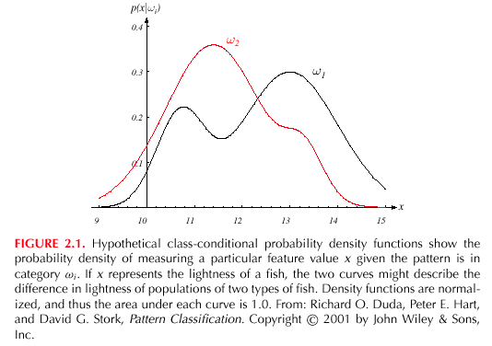
Pattern Classification, Chapter 2 (Part 1)

Slide 6
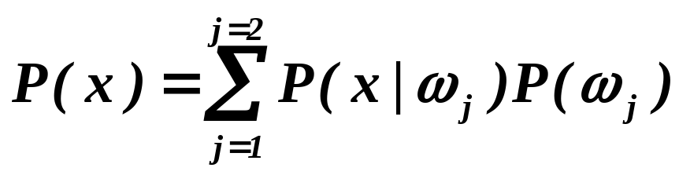
Posterior, likelihood, evidence
  P(ω_{j} | x) = P(x | ω_{j}) . P (ω_{j}) / P(x)
  Where in case of two categories
  Posterior = (Likelihood. Prior) / Evidence
Pattern Classification, Chapter 2 (Part 1)

Slide 7
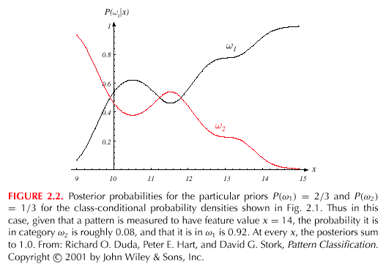
Pattern Classification, Chapter 2 (Part 1)

Slide 8
Decision given the posterior probabilities
X is an observation for which:
if P(ω₁ | x) > P(ω₂ | x) True state of nature = ω₁
if P(ω₁ | x) < P(ω₂ | x) True state of nature = ω₂
Therefore:
whenever we observe a particular x, the probability of error is :
P(error | x) = P(ω₁ | x) if we decide ω₂
P(error | x) = P(ω₂ | x) if we decide ω₁
Pattern Classification, Chapter 2 (Part 1)

Slide 9
Minimizing the probability of error
Decide ω₁ if P(ω₁ | x) > P(ω₂ | x);
otherwise decide ω₂
Therefore:
P(error | x) = min [P(ω₁ | x), P(ω₂ | x)]
(Bayes decision)
Pattern Classification, Chapter 2 (Part 1)

Slide 10
Bayesian Decision Theory – Continuous Features
Generalization of the preceding ideas
  Use of more than one feature
  Use more than two states of nature
  Allowing actions and not only decide on the state of nature
  Introduce a loss of function which is more general than the probability of error
Pattern Classification, Chapter 2 (Part 1)

Slide 11
Allowing actions other than classification primarily allows the possibility of rejection
Refusing to make a decision in close or bad cases!
The loss function states how costly each action taken is
Pattern Classification, Chapter 2 (Part 1)

Slide 12
Let {ω₁, ω₂,…, ω_{c}} be the set of c states of nature
(or “categories”)
Let {α₁, α₂,…, α_{a}} be the set of possible actions
Let λ(α_{i} | ω_{j}) be the loss incurred for taking
action α_{i} when the state of nature is ω_{j}
Pattern Classification, Chapter 2 (Part 1)

Slide 13
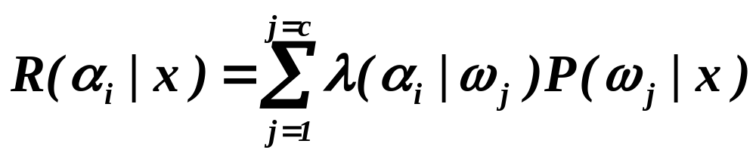
Overall risk
R = Sum of all R(α_{i} | x) for i = 1,…,a
Minimizing R Minimizing R(α_{i} | x) for i = 1,…, a
for i = 1,…,a
Conditional risk
Pattern Classification, Chapter 2 (Part 1)

Slide 14
Select the action α_{i} for which R(α_{i} | x) is minimum
R is minimum and R in this case is called the
Bayes risk = best performance that can be achieved!
Pattern Classification, Chapter 2 (Part 1)

Slide 15
Two-category classification
    α₁ : deciding ω₁
    α₂ : deciding ω₂
    λ_{ij} = λ(α_{i} | ω_{j})
loss incurred for deciding ω_{i} when the true state of nature is ω_{j}
Conditional risk:
R(α₁ | x) = λ₁₁P(ω₁ | x) + λ₁₂P(ω₂ | x)
R(α₂ | x) = λ₂₁P(ω₁ | x) + λ₂₂P(ω₂ | x)
Pattern Classification, Chapter 2 (Part 1)

Slide 16
Our rule is the following:
if R(α₁ | x) < R(α₂ | x)
action α₁: “decide ω₁” is taken
This results in the equivalent rule :
decide ω₁ if:
(λ₂₁- λ₁₁) P(x | ω₁) P(ω₁) >
(λ₁₂- λ₂₂) P(x | ω₂) P(ω₂)
and decide ω₂ otherwise
Pattern Classification, Chapter 2 (Part 1)

Slide 17
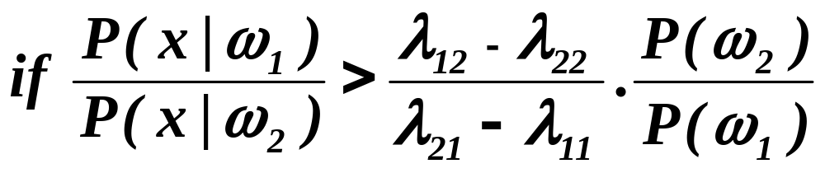
Likelihood ratio:
The preceding rule is equivalent to the following rule:
Then take action α₁ (decide ω₁)
Otherwise take action α₂ (decide ω₂)
Pattern Classification, Chapter 2 (Part 1)

Slide 18
Optimal decision property
“If the likelihood ratio exceeds a threshold value independent of the input pattern x, we can take optimal actions”
Pattern Classification, Chapter 2 (Part 1)

Slide 19
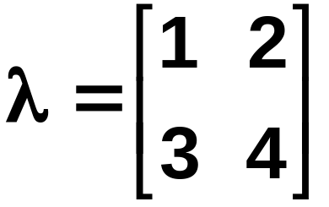
Exercise
Select the optimal decision where:
= {ω₁, ω₂}
P(x | ω₁) N(2, 0.5) (Normal distribution)
P(x | ω₂) N(1.5, 0.2)
P(ω₁) = 2/3
P(ω₂) = 1/3
Pattern Classification, Chapter 2 (Part 1)

