Slide 1
Relational Query Optimization
Notes:
1

Slide 2
Overview of Query Optimization
Plan: Tree of R.A. ops, with choice of alg for each op.
  Each operator typically implemented using a `pull’ interface: when an operator is `pulled’ for the next output tuples, it `pulls’ on its inputs and computes them.
Two main issues:
  For a given query, what plans are considered?
    Algorithm to search plan space for cheapest (estimated) plan.
  How is the cost of a plan estimated?
Ideally: Want to find best plan. Practically: Avoid worst plans!
We will study the System R approach.
Notes:
2

Slide 3
Highlights of System R Optimizer
Impact:
  Most widely used currently; works well for < 10 joins.
Cost estimation: Approximate art at best.
  Statistics, maintained in system catalogs, used to estimate cost of operations and result sizes.
  Considers combination of CPU and I/O costs.
Plan Space: Too large, must be pruned.
  Only the space of left-deep plans is considered.
    Left-deep plans allow output of each operator to be pipelined into the next operator without storing it in a temporary relation.
  Cartesian products avoided.
Notes:
2

Slide 4
Schema for Examples
Sailors (sid: integer, sname: string, rating: integer, age: real)
Reserves (sid: integer, bid: integer, day: dates, rname: string)
Similar to old schema; rname added for variations.
Reserves:
  Each tuple is 40 bytes long, 100 tuples per page, 1000 pages.
Sailors:
  Each tuple is 50 bytes long, 80 tuples per page, 500 pages.
Notes:
3

Slide 5
Motivating Example
sname
RA Tree:
bid=100
rating > 5
SELECT S.sname
FROM Reserves R, Sailors S
WHERE R.sid=S.sid AND
R.bid=100 AND S.rating>5
sid=sid
Cost: 1000+1000*500 I/Os
By no means the worst plan!
Misses several opportunities: selections could have been `pushed’ earlier, no use is made of any available indexes, etc.
Goal of optimization: To find more efficient plans that compute the same answer.
Reserves
Sailors
Plan:
(On-the-fly)
sname
bid=100
rating > 5
(On-the-fly)
(Simple Nested Loops)
sid=sid
Reserves
Sailors
Notes:
4

Slide 6
Alternative Plans 1
(No Indexes)
(On-the-fly)
sname
(Sort-Merge Join)
sid=sid
(Scan;
(Scan;
write to
bid=100
rating > 5
write to
Main difference: push selects.
With 5 buffers, cost of plan:
  Scan Reserves (1000) + write temp T1 (10 pages, if we have 100 boats, uniform distribution).
  Scan Sailors (500) + write temp T2 (250 pages, if we have 10 ratings).
  Sort T1 (2*2*10), sort T2 (2*3*250), merge (10+250)
  Total: 3560 page I/Os.
If we used BNL join, join cost = 10+4*250, total cost = 2770.
If we `push’ projections, T1 has only sid, T2 only sid and sname:
  T1 fits in 3 pages, cost of BNL drops to under 250 pages, total < 2000.
temp T1)
temp T2)
Reserves
Sailors
Notes:
5

Slide 7
Alternative Plans 2
With Indexes
sname
(On-the-fly)
rating > 5
(On-the-fly)
With clustered index on bid of Reserves, we get 100,000/100 = 1000 tuples on 1000/100 = 10 pages.
INL with pipelining (outer is not materialized).
(Index Nested Loops,
sid=sid
with pipelining )
(Use hash
Sailors
index; do
bid=100
not write
result to
temp)
Reserves
  Projecting out unnecessary fields from outer doesn’t help.
Join column sid is a key for Sailors.
  At most one matching tuple, unclustered index on sid OK.
Decision not to push rating>5 before the join is based on
availability of sid index on Sailors.
Cost: Selection of Reserves tuples (10 I/Os); for each,
must get matching Sailors tuple (1000*1.2); total 1210 I/Os.
Notes:
6

Slide 8
Query Blocks: Units of Optimization
SELECT S.sname
FROM Sailors S
WHERE S.age IN
(SELECT MAX (S2.age)
FROM Sailors S2
GROUP BY S2.rating)
An SQL query is parsed into a collection of query blocks, and these are optimized one block at a time.
Nested blocks are usually treated as calls to a subroutine, made once per outer tuple. (This is an over-simplification, but serves for now.)
Outer block
Nested block
For each block, the plans considered are:
  All available access methods, for each reln in FROM clause.
  All left-deep join trees (i.e., all ways to join the relations one-at-a-time, with the inner reln in the FROM clause, considering all reln permutations and join methods.)
Notes:
7

Slide 9
Cost Estimation
For each plan considered, must estimate cost:
  Must estimate cost of each operation in plan tree.
    Depends on input cardinalities.
    We’ve already discussed how to estimate the cost of operations (sequential scan, index scan, joins, etc.)
  Must estimate size of result for each operation in tree!
    Use information about the input relations.
    For selections and joins, assume independence of predicates.
We’ll discuss the System R cost estimation approach.
  Very inexact, but works ok in practice.
  More sophisticated techniques known now.
Notes:
8

Slide 10
Statistics and Catalogs
Need information about the relations and indexes involved. Catalogs typically contain at least:
  # tuples (NTuples) and # pages (NPages) for each relation.
  # distinct key values (NKeys) and NPages for each index.
  Index height, low/high key values (Low/High) for each tree index.
Catalogs updated periodically.
  Updating whenever data changes is too expensive; lots of approximation anyway, so slight inconsistency ok.
More detailed information (e.g., histograms of the values in some field) are sometimes stored.
Notes:
8

Slide 11
System Catalogs
For each index:
  structure (e.g., B+ tree) and search key fields
For each relation:
  name, file name, file structure (e.g., Heap file)
  attribute name and type, for each attribute
  index name, for each index
  integrity constraints
For each view:
  view name and definition
Plus statistics, authorization, buffer pool size, etc.
Catalogs are themselves stored as relations!
Notes:
18

Slide 12
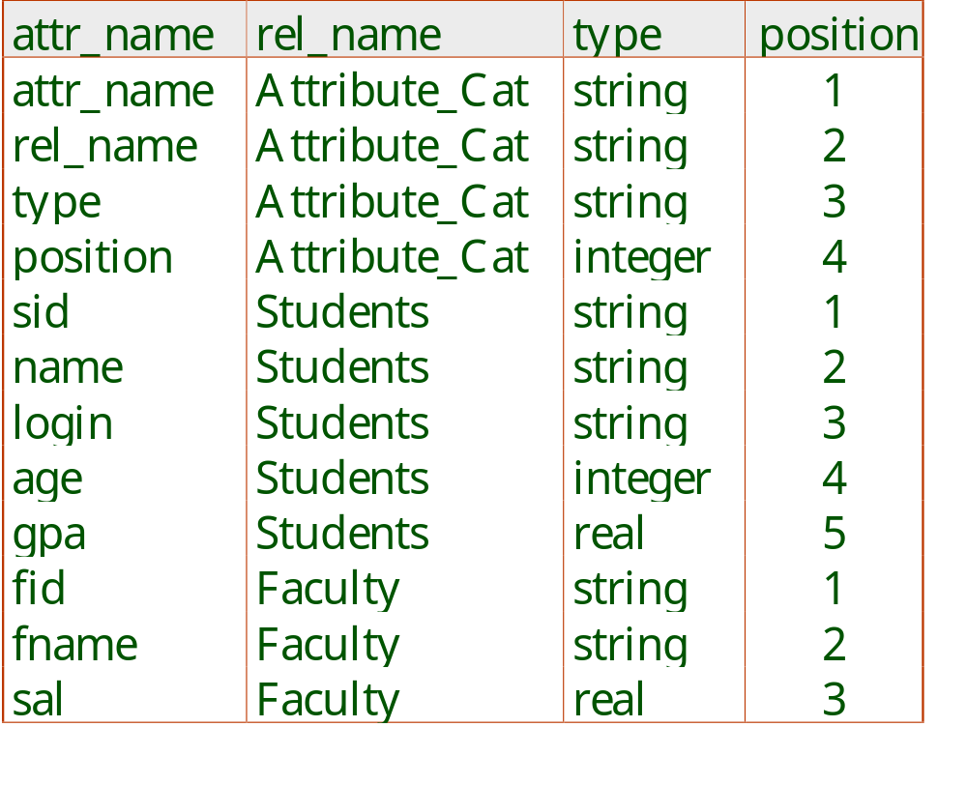
Attr_Cat(attr_name, rel_name, type, position)
Notes:
19

Slide 13
Size Estimation and Reduction Factors
SELECT attribute list
FROM relation list
WHERE term1 AND ... AND termk
Consider a query block:
Maximum # tuples in result is the product of the cardinalities of relations in the FROM clause.
Reduction factor (RF) associated with each term reflects the impact of the term in reducing result size. Result cardinality = Max # tuples * product of all RF’s.
  Implicit assumption that terms are independent!
  Term col=value has RF 1/NKeys(I), given index I on col
  Term col1=col2 has RF 1/MAX(NKeys(I1), NKeys(I2))
  Term col>value has RF (High(I)-value)/(High(I)-Low(I))
Notes:
9

Slide 14
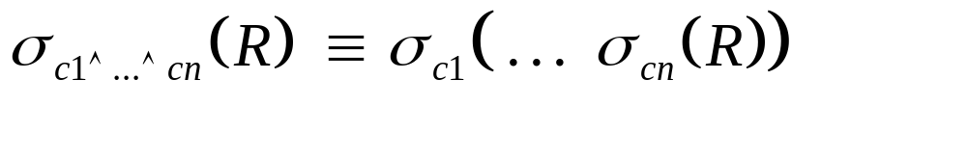
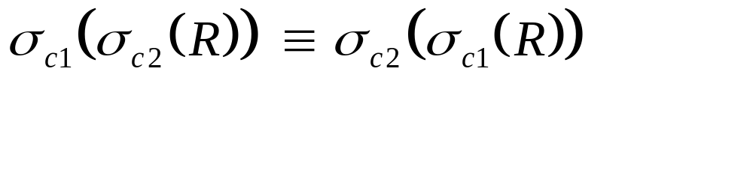
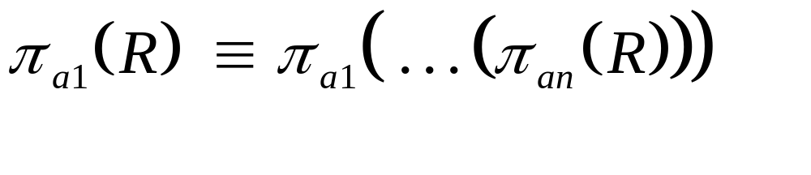




Relational Algebra Equivalences
Allow us to choose different join orders and to `push’ selections and projections ahead of joins.
Selections:
(Cascade)
(Commute)
Projections:
(Cascade)
Joins:
R (S T) (R S) T
(Associative)
(R S) (S R)
(Commute)
Notes:
10

Slide 15

More Equivalences
A projection commutes with a selection that only uses attributes retained by the projection.
Selection between attributes of the two arguments of a cross-product converts cross-product to a join.
A selection on just attributes of R commutes with R S. (i.e., (R S) (R) S )
Similarly, if a projection follows a join R S, we can `push’ it by retaining only attributes of R (and S) that are needed for the join or are kept by the projection.
Notes:
11

Slide 16
Enumeration of Alternative Plans
There are two main cases:
  Single-relation plans
  Multiple-relation plans
For queries over a single relation, queries consist of a combination of selects, projects, and aggregate ops:
  Each available access path (file scan / index) is considered, and the one with the least estimated cost is chosen.
  The different operations are essentially carried out together (e.g., if an index is used for a selection, projection is done for each retrieved tuple, and the resulting tuples are pipelined into the aggregate computation).
Notes:
12

Slide 17
Cost Estimates for Single-Relation Plans
Index I on primary key matches selection:
  Cost is Height(I)+1 for a B+ tree, about 1.2 for hash index.
Clustered index I matching one or more selects:
  (NPages(I)+NPages(R)) * product of RF’s of matching selects.
Non-clustered index I matching one or more selects:
  (NPages(I)+NTuples(R)) * product of RF’s of matching selects.
Sequential scan of file:
  NPages(R).
Note: Typically, no duplicate elimination on projections! (Exception: Done on answers if user says DISTINCT.)
Notes:
13

Slide 18
Example
SELECT S.sid
FROM Sailors S
WHERE S.rating=8
If we have an index on rating:
  (1/NKeys(I)) * NTuples(R) = (1/10) * 40000 tuples retrieved.
  Clustered index: (1/NKeys(I)) * (NPages(I)+NPages(R)) = (1/10) * (50+500) pages are retrieved. (This is the cost.)
  Unclustered index: (1/NKeys(I)) * (NPages(I)+NTuples(R)) = (1/10) * (50+40000) pages are retrieved.
If we have an index on sid:
  Would have to retrieve all tuples/pages. With a clustered index, the cost is 50+500, with unclustered index, 50+40000.
Doing a file scan:
  We retrieve all file pages (500).
Notes:
14

Slide 19
Queries Over Multiple Relations
Fundamental decision in System R: only left-deep join trees are considered.
  As the number of joins increases, the number of alternative plans grows rapidly; we need to restrict the search space.
  Left-deep trees allow us to generate all fully pipelined plans.
    Intermediate results not written to temporary files.
    Not all left-deep trees are fully pipelined (e.g., SM join).
D
D
C
C
A
B
C
D
A
B
A
B
Notes:
15

Slide 20
Enumeration of Left-Deep Plans
Left-deep plans differ only in the order of relations, the access method for each relation, and the join method for each join.
Enumerated using N passes (if N relations joined):
  Pass 1: Find best 1-relation plan for each relation.
  Pass 2: Find best way to join result of each 1-relation plan (as outer) to another relation. (All 2-relation plans.)
  Pass N: Find best way to join result of a (N-1)-relation plan (as outer) to the N’th relation. (All N-relation plans.)
For each subset of relations, retain only:
  Cheapest plan overall, plus
  Cheapest plan for each interesting order of the tuples.
Notes:
16

Slide 21
Enumeration of Plans (Contd.)
ORDER BY, GROUP BY, aggregates etc. handled as a final step, using either an `interestingly ordered’ plan or an addtional sorting operator.
An N-1 way plan is not combined with an additional relation unless there is a join condition between them, unless all predicates in WHERE have been used up.
  i.e., avoid Cartesian products if possible.
In spite of pruning plan space, this approach is still exponential in the # of tables.
Notes:
16

Slide 22
Cost Estimation for Multirelation Plans
SELECT attribute list
FROM relation list
WHERE term1 AND ... AND termk
Consider a query block:
Maximum # tuples in result is the product of the cardinalities of relations in the FROM clause.
Reduction factor (RF) associated with each term reflects the impact of the term in reducing result size. Result cardinality = Max # tuples * product of all RF’s.
Multirelation plans are built up by joining one new relation at a time.
  Cost of join method, plus estimation of join cardinality gives us both cost estimate and result size estimate
Notes:
9

Slide 23
Example
Sailors:
B+ tree on rating
Hash on sid
Reserves:
B+ tree on bid
sname
Pass1:
  Sailors: B+ tree matches rating>5, and is probably cheapest. However, if this selection is expected to retrieve a lot of tuples, and index is unclustered, file scan may be cheaper.
    Still, B+ tree plan kept (because tuples are in rating order).
  Reserves: B+ tree on bid matches bid=100; cheapest.
sid=sid
bid=100
rating > 5
Reserves
Sailors
Pass 2:
  We consider each plan retained from Pass 1 as the outer, and consider how to join it with the (only) other relation.
    e.g., Reserves as outer: Hash index can be used to get Sailors tuples
    that satisfy sid = outer tuple’s sid value.
Notes:
17

Slide 24
Nested Queries
SELECT S.sname
FROM Sailors S
WHERE EXISTS
(SELECT *
FROM Reserves R
WHERE R.bid=103
AND R.sid=S.sid)
Nested block is optimized independently, with the outer tuple considered as providing a selection condition.
Outer block is optimized with the cost of `calling’ nested block computation taken into account.
Implicit ordering of these blocks means that some good strategies are not considered. The non-nested version of the query is typically optimized better.
Nested block to optimize:
SELECT *
FROM Reserves R
WHERE R.bid=103
AND S.sid= outer value
Equivalent non-nested query:
SELECT S.sname
FROM Sailors S, Reserves R
WHERE S.sid=R.sid
AND R.bid=103
Notes:
18

Slide 25
Summary
Query optimization is an important task in a relational DBMS.
Must understand optimization in order to understand the performance impact of a given database design (relations, indexes) on a workload (set of queries).
Two parts to optimizing a query:
  Consider a set of alternative plans.
    Must prune search space; typically, left-deep plans only.
  Must estimate cost of each plan that is considered.
    Must estimate size of result and cost for each plan node.
    Key issues: Statistics, indexes, operator implementations.
Notes:
19

Slide 26
Summary (Contd.)
Single-relation queries:
  All access paths considered, cheapest is chosen.
  Issues: Selections that match index, whether index key has all needed fields and/or provides tuples in a desired order.
Multiple-relation queries:
  All single-relation plans are first enumerated.
    Selections/projections considered as early as possible.
  Next, for each 1-relation plan, all ways of joining another relation (as inner) are considered.
  Next, for each 2-relation plan that is `retained’, all ways of joining another relation (as inner) are considered, etc.
  At each level, for each subset of relations, only best plan for each interesting order of tuples is `retained’.
Notes:
20

