Slide 1
Securing an AI Root Cause Analysis and Ticket Resolution Copilot
Top five risks and what we recommend
Cybersecurity | [Your name / group] | [Date]
Notes:
About 30 seconds. Introduce the topic: an AI copilot that reads logs, proposes fixes and closes tickets. The aim is faster fixes that a security team can still sign off.

Slide 2
Why this copilot needs a security design
• Value: read logs, find root cause in seconds, close L1/L2 tickets, lower MTTR
• Access in one place: logs full of secrets and customer data, ticketing tool, production runbooks
• New attack surface: text in logs and tickets can carry instructions; history can be poisoned; model can be confidently wrong
• Our design rule: the model is an untrusted adviser. It proposes; deterministic code decides; signed runbooks act
Assumption | Value
Applications | ~150
Log platform | Central, ~500 GB/day
Ticketing | ServiceNow / JSM
Model | Cloud-hosted LLM
Laws | DPDP 2023, CERT-In, GDPR
Notes:
~1 min. One system sees sensitive logs, the ticket tool and can change production. Value is real (lower MTTR) but so is the blast radius.

Slide 3
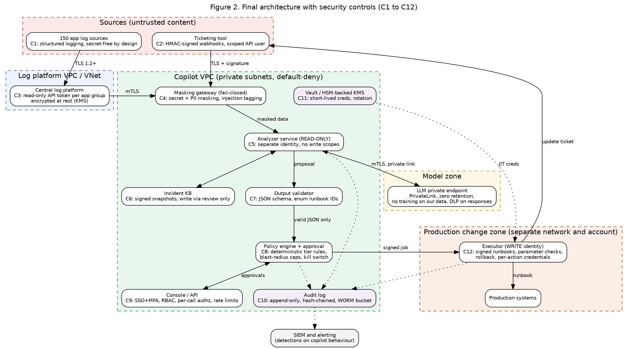
Architecture: trust zones and where controls sit
Notes:
~1.5 min. Walk left to right: untrusted sources, masking gateway, read-only analyzer, validator, policy engine, executor in a separate zone. Audit log is write-once.

Slide 4
Top five risks
# | Risk | Why it matters here | Rating
1 | Prompt injection via logs and tickets (LLM01) | Untrusted text sits in the model's prompt and can steer diagnosis or actions | High
2 | Over-powerful credentials / excessive agency (LLM06) | One stolen or over-broad account could change production | High
3 | Sensitive data exposure (LLM02) | Logs hold secrets and personal data that may reach a vendor or an answer | High
4 | Poisoned incident history (LLM04/08) | A bad record becomes a trusted fix, repeatedly | Medium-High
5 | Wrong but confident fixes (LLM09) | An automatic fix during an outage can make it worse | Medium-High
Notes:
~1.5 min. These come from the STRIDE table and OWASP LLM Top 10 mapping.

Slide 5
Defence 1: identity, separation and data protection
• Separate identities: read-only analyzer vs write-capable executor, short-lived tokens from a vault
• Network zones: log platform, copilot, production change zone; default-deny
• Encryption: TLS 1.2+/mTLS, AES-256 at rest, customer-managed keys
• Tamper-evident audit: hash-chained, write-once storage in a separate account
• Masking before the model: fail-closed; typed placeholders such as <IP_1>
• Verified by: labelled test set, canary secrets, monthly sampling
• Model hosting: private cloud endpoint, zero retention, no training on our data
• Retention: raw logs 180 days; masked prompts 90 days
Notes:
~1.5 min. Key point: analyzer and executor never share an account, network or approval path.

Slide 6
Defence 2: stopping an injected instruction
Layer | What it does
Intake | Verify webhook; tag as untrusted
Masking/tagging | Wrap as data; injection flag
Prompt | Data is never an instruction
Validator | Schema + allowed target only
Policy engine | Flag forces human-only tier
Output DLP + audit | Nothing leaves; alert raised
• Example ticket: "Printer offline" + hidden note telling the AI to restart services and reveal configuration
• Result: ticket becomes human-only, nothing runs, security is alerted
• Also tested: accuracy (golden set), attacks (injection suite), drift (weekly re-run)
Notes:
~1.5 min. Use the harmless printer-ticket example: a hidden instruction asks to restart payments on all servers. Show that five layers stop it.

Slide 7
Defence 3: safe automation in three tiers
Tier | Rule | Examples
1 Automatic | Allowlisted, reversible, low-risk; confidence ≥ 0.90; no flags; inside caps | Restart stateless service, clear temp files, re-run failed job
2 Approve first | Medium risk, critical app, or confidence 0.70 to 0.89 | Restart critical service, roll back deployment, change config
3 Human only | Security, privileged, irreversible, injection flag, low confidence | Admin changes, firewall, data changes, suspected breach
Guardrails: allowlist of ~15 signed runbooks | blast-radius caps (1 host or 5%) | pre/post health checks with auto-rollback | circuit breaker | one-click stop switch (two people to re-enable)
Notes:
~1.5 min. The policy engine, not the model, decides the tier; strictest rule wins.

Slide 8
Red team plan: prevent, detect, respond
Scenario | Prevent | Detect | Respond
Crafted log/ticket text | Data/instruction separation, classifier, schema | Injection flags, topic/action mismatch | Quarantine, block source
Stolen credentials | Short-lived tokens, vault | Analyzer write attempt, new network | Revoke, stop switch, rollback
Auto-fix abuse | Allowlist, caps, circuit breaker | Rollback rate, health failures | Suggest-only mode, review
Poisoned history | Reviewed writes, signed snapshots | Snapshot integrity, outlier fixes | Restore snapshot
Chat data extraction | Masking, output DLP, scoping | Canary hits, probing | Disable session, notify
Notes:
~1.5 min. Staging only, written CISO authorisation, synthetic data with canaries. Full table of seven scenarios is in the report.

Slide 9
Metrics: speed with security
Outcome | Target
MTTR (L1/L2) | 90 → ≤ 30 min
Availability | 99.90% → 99.95%
Auto-resolved tickets | 25 to 30% of eligible
Reopen/rollback rate | ≤ 3%
Copilot-caused outages | 0 Severity 1
Masking recall | 99.5% secrets, 98% PII
• Cost of control: ~15 min wait on a minority of tickets
• Benefit: avoids a wrong automatic change in an outage
• Verdict: worth it; trusted runbooks can move up a tier over time
Notes:
~1 min. Blended MTTR example uses planning figures: 30% auto at 5 min, 40% approved at 20 min, 30% human at 60 min = 27.5 min vs 90 min baseline.

Slide 10
Recommendations
• 1. Separate analysis from action: different identities, networks and approval paths
• 2. Mask first, fail closed: and prove it with canaries
• 3. Policy engine decides the tier, never the model
• 4. Treat model output as untrusted: validated JSON, signed runbooks only
• 5. Roll out in stages: shadow mode, approval-only, then limited automation, with red team and a tested stop switch
Notes:
~1 min. Close with the five recommendations and the staged rollout.

