Slide 1
origins
01 / 08
CSI-VITC · ORIGINS 2026
TRACK · [ AGENTIC FINANCE]
ORIGINS
a CSI-VITC hackathon · everything traces back to an origin
PROJECT TITLE
TEAM
EscrowGuard
CYBER CATALYSTS
ONE-LINE PITCH
Avanthika P — [ Email ]
Gowreesh V T— [ Email ]
Prodosh — [ Email ]
Sri Saidhakshini — [ Email ]
An autonomous milestone & escrow agent that verifies work, agrees payout with both sides, and releases the payment.
note: keep layout, colours & logos as-is — fill placeholders only

Slide 2
origins
02 / 08
CSI-VITC · ORIGINS 2026
Problem Definition
1
WHO & HOW OFTEN
Freelancers and clients, on every paid project — at each milestone hand-off.
2
TODAY'S WORKAROUND
Manual review and back-and-forth negotiation before either side agrees to release or accept payment.
3
WHY IT FALLS SHORT
It's slow and subjective — freelancers still risk non-payment, and clients still risk paying for unfinished or bad work.
4
EVIDENCE
60%+ of freelancers report late or non-payment, and over 50% of creative/software contracts face scope-creep disputes during milestone handoffs (Source: Freelancers Union & Independent Economy Reports).
answer in 2–3 lines · readable outside your track

Slide 3
origins
03 / 08
CSI-VITC · ORIGINS 2026
Proposed Solution
EscrowGuard — Autonomous Milestone & Escrow Agent
A pipeline of agents that checks whether freelance work is really done, agrees a fair payout by phone with both sides, and releases the bank payment automatically.
1
2
3
WHAT A USER DOES
WHY IT BEATS THE WORKAROUND
WHAT'S GENUINELY DIFFERENT
Submit the milestone, take a quick verification call, and get paid — or get paid out — the same day.
An Audit Agent checks the actual deliverable instead of taking anyone's word for it, and payout is calculated and released in minutes, not days.
A full agent chain — audit, pricing, verbal consent (ElevenLabs), and bank payout (Stitch API) — runs end-to-end with no human in the loop.
name it plainly · connect straight back to slide 2

Slide 4
origins
04 / 08
CSI-VITC · ORIGINS 2026
System Architecture
Milestone Submitted
[ Audit Agent ]
[ Strategy Agent ]
[ Voice Agent — ElevenLabs ]
Execution Agent — Payout (Stitch API)
1
2
3
KEY TECHNICAL DECISION
HARDEST PART TO BUILD
HOW YOU KNOW IT WORKS
Split the pipeline into separate agents (audit, pricing, voice, execution) so each step can be tested and audited on its own.
Getting binding agreement from both sides before money moves — solved with a live ElevenLabs voice call that captures verbal consent before payout triggers.
Ran sample milestones end-to-end and confirmed payout only fires after the audit passes and both parties verbally confirm on the call.
walk the full flow · name real services & models

Slide 5
origins
05 / 08
CSI-VITC · ORIGINS 2026
Feasibility & Scope
1
SCOPE
2
RUNNING COST
In: GitHub PR and document artifact verification, strategy-bound payout calculations, interactive voice confirmation via ElevenLabs, and instant bank payout execution using Stitch API.
Out: Legal contract dispute lawsuits, complex physical asset deliverables, and non-digital milestone verification.
~$0.05 per milestone run (API costs across ElevenLabs streaming voice, Stitch bank transaction fees, and LLM inference hosted on Nexus infrastructure).
3
RISKS & FALLBACK
4
AFTER THE HACKATHON
Risk: Voice audio drops or debtor refuses verbal confirmation mid-call.
Fallback: Agent pauses execution state graph, logs partial transcripts on Nexus, and routes request to Human-in-the-Loop (HITL) dashboard.
Expand integrations to Upwork/Figma webhooks, implement multi-currency FX payouts, and add smart-contract escrow vaulting.
a working slice with a known limit beats an over-promised demo

Slide 6
origins
06 / 08
CSI-VITC · ORIGINS 2026
Impact Metrics
1
WHAT MEASURABLY IMPROVES
[ 90% ]
Milestone payout speed accelerates from days to minutes, and milestone payment defaults drop close to 0%.
2
WHO ELSE COULD USE IT
Gig platforms (Fiverr, Upwork), B2B software agencies, contractor networks, and decentralized autonomous organizations (DAOs).
Reduction in milestone dispute-to-payout resolution time (from 5+ days down to under 10 minutes)
3
WHAT COULD GO WRONG / BE MISUSED
A user spoofing audio or attempting to trick the Audit Agent with fabricated code deliverables.
Estimated by timing a manual client-freelancer review cycle (avg. 120 hours) versus EscrowGuard’s automated workflow (avg. 6 minutes from PR submit to Stitch payout).
4
HOW YOU'D HANDLE THAT
Require cryptographic commit signatures, sandboxed CodeCrafters code test execution, and strict Human-in-the-Loop approval for payouts over $1,000.
show how the figure was measured, an estimate is fine

Slide 7
origins
07 / 08
CSI-VITC · ORIGINS 2026
References & Attribution
TYPE | SOURCE (author, title, year) | WHAT IT GAVE YOU | BORROWED / YOURS | LICENCE
Paper | Wu et al., "AutoGPT: An Empirical Study of Autonomous Agents," 2023 / LangGraph Design Papers | Design patterns for multi-agent state machines & Human-in-the-Loop interrupt primitives | Borrowed (Concepts & Patterns) | Open Access
Repository | langchain-ai/langgraph (GitHub, 2024–2026) | State graph orchestration framework for multi-agent routing and checkpointing | Borrowed (SDK Framework) | MIT
Documentation | Stitch Open Banking API Docs & ElevenLabs Conversational AI Docs (2026) | Payment initiation endpoints, webhook schemas, and real-time WebSockets voice SDK | Borrowed (APIs & Docs) | Proprietary / Open API
Dataset | Synthetic Financial Transaction & Milestone Dataset (Generated via Faker / Python) | Mock invoices, project deliverables, and bank account payloads for safe testing | Yours (Synthetically Generated) | CC0 (Public Domain)
Model Weights | OpenAI gpt-4o-mini / Meta Llama-3.1-8B-Instruct | Base reasoning, tool-calling capabilities, and intent extraction for agent nodes | Borrowed (API Model Weights) | Open Weights / Commercial API
one source per line · uncredited work is disqualifying

Slide 8
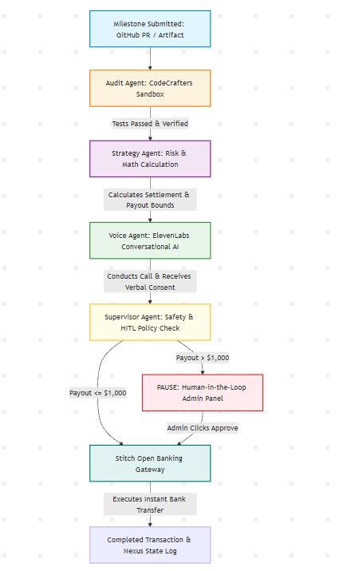
origins
08 / 08
CSI-VITC · ORIGINS 2026
Zero Math Hallucinations: All financial math and discount calculations are executed deterministically inside the CodeCrafters runtime environment, not raw LLM text generation.
Deterministic Guardrails: Hard-coded bounds prevent the Voice Agent from offering discounts higher than 15% or releasing funds without dual verbal consent.
Human-in-the-Loop (HITL) Gate: Any transaction over $1,000 automatically triggers an emergency pause, requiring a 1-click confirmation on the admin dashboard.
Data Privacy & Compliance: Uses synthetic banking telemetry and open-banking sandbox APIs with zero PII retention on LLM servers.

