Slide 1
Digital Lock System with Intruder Detection Using DE10-Lite FPGA and Raspberry Pi
By L Sri Sai Swathi (2414202)

Slide 2
Objective:
Design a digital lock system that ensures authorized access via passcode.
Detect unauthorized access by counting failed passcode attempts.
Lock the system and capture an image of the intruder using a Raspberry Pi camera module after 3 failed attempts.

Slide 3
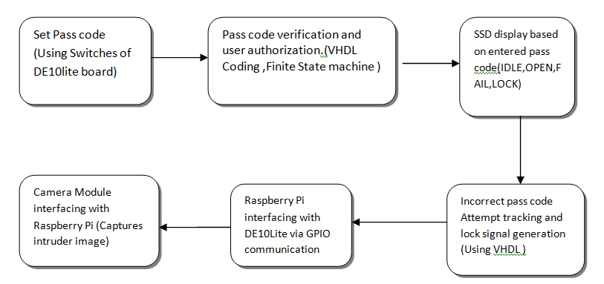
System Overview

Slide 4
KEY COMPONENTS:
DE10-Lite FPGA: Passcode verification and state control.
Raspberry Pi: Captures intruder images.
Camera Module: Takes pictures on lock.
SSDs: Displays system status.
Passcode Input: User passcode entry.
GPIO Pins: Connects components.
State Machine: Controls system states.

Slide 5
STATE TRANSITION FLOW :
IDLE
Waiting for user input (passcode entry).
Transition: Enter passcode → ENTER_PASS.
ENTER_PASS
System prompts user to input passcode.
Transition: User inputs passcode → CHECK_PASS.
CHECK_PASS
Compares entered passcode with stored correct passcode.
Transition:
If correct → PASS.
If incorrect → FAIL.
PASS
Access granted. Display OPEN.
Transition: Reset or remain in PASS.
FAIL
Displays FAIL. Increments failed attempts.
Transition:
If attempts < 3 → back to ENTER_PASS.
If attempts ≥ 3 → LOCK.
LOCK
System is locked after 3 failed attempts. Display LOCK.
Transition: System remains in LOCK until reset.

Slide 6
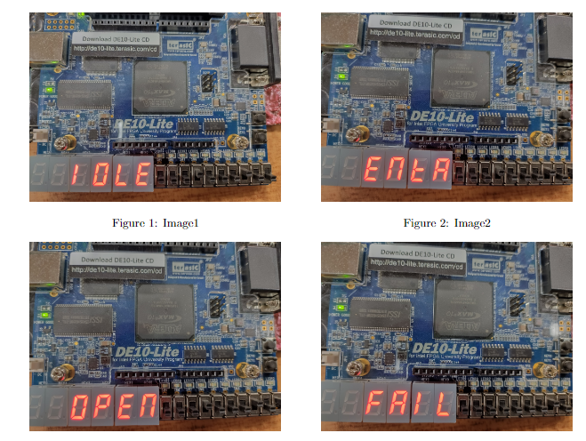
RESULTS:

Slide 7
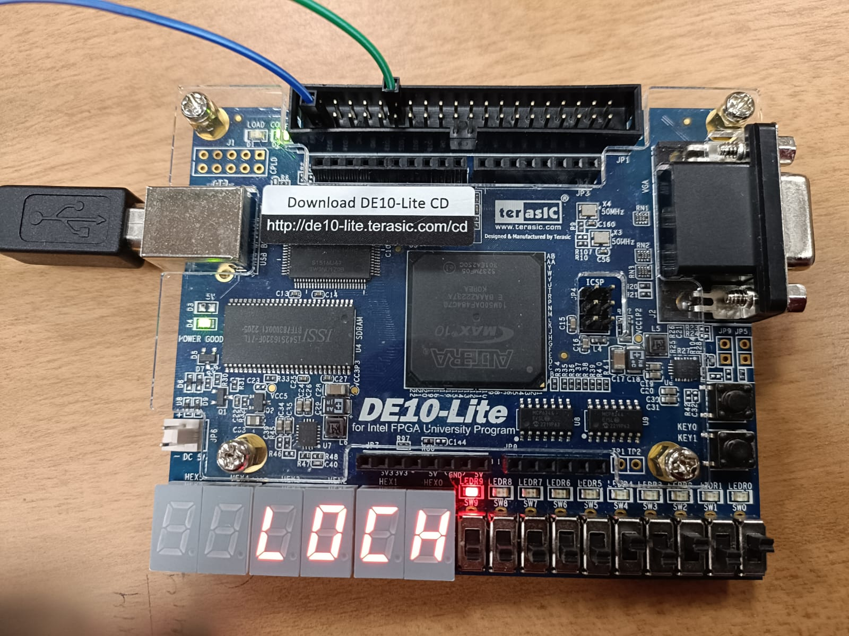
Results:

Slide 8
Conclusion:
This project combines FPGA and Raspberry Pi to build a secure digital lock system. It uses a state machine for passcode verification and intruder detection. Future upgrades could include remote access and biometric authentication.

Slide 9
References:
[1] A. Kumar,P.S.Singh, and R. Verma,“Design and implementation of a combinational lock state system usingVHDL,” ResearchGate, 2022. https://www.researchgate.net/publication/362751143D esignandimplementationofacombinat
[2] M. C. Chen, C. H. Lai, and J. H. Wu, “A new VHDL implementation of a digital lock system,” IEEE Xplore,2020. https://ieeexplore.ieee.org/document/9242688/
[3] J. S. Lee, S. W. Park, and J. H. Kim, “Smart Lock System using FPGA and VHDL,” IEEE Xplore, 2017.https://ieeexplore.ieee.org/abstract/document/8079785

Slide 10
THANK YOU

