Slide 1

USED CAR PRICE PREDICTION
POOJITHA VUPPALAPATI – 1339322
SALOMI KRISHNAMURTHY - 1325463
SRI SAKTICHARAN NIRMAL KUMAR – 1337576
MEGHA VAMSHI KRISHNA VEMALA – 1325438
SHRUTHI MANCHAPPANAHALLI BASAVARAJ – 1330334

Slide 2

PROJECT OBJECTIVE
Recently there has been a sudden increase in the demand for second-hand cars as consumers have been unable to afford brand-new cars due to a variety of factors, including high pricing, limited availability, financial inability, etc.
The second-hand automobile industry, however, is still in its development phase and is mostly controlled by the informal sector.
When buying a second-hand automobile, creates the possibility of fraud. In order to predict the price of a used automobile without favoring the consumer or the merchandiser, a high-accuracy model is needed

Slide 3
DATA DESCRIPTION
The Dataset is taken from kaggle
Link_kaggle: https://www.kaggle.com/code/celestioushawk/bmw-car-price-prediction/input?select=bmw.csv
The dataset used for this project consists of historical data on used car listings. It includes information such as the make, model, year, mileage, condition, location, and price of each car. The data was collected from various online sources, including classified ads websites and car dealership websites.
Scale = 10,782 rows × 9 columns
model (Categorical): The make and model of the car.
year (Numerical): The year the car was manufactured.
mileage (Numerical): The total distance the car has traveled (in miles).
mpg (Numerical): Miles per gallon (fuel efficiency).
Fuel Type (Categorical): The type of fuel the car uses (e.g., Diesel, Petrol).
transmission (Categorical): The type of transmission (e.g., Automatic, Manual).
tax (Numerical): The tax amount for the car (in US dollars).
engine Size (Numerical): The size of the car's engine (in liters).
price (Numerical): The price of the car (in US dollars).
Notes:
During the data collection process, issues such as missing values, outliers, and inconsistencies were encountered and addressed. Interesting examples from the data include luxury cars with low mileage being priced higher than similar models with higher mileage, and vintage cars appreciating in value over time

Slide 4
APPROACH
Technology used
Python
NumPy
Pandas
Matplotlib (Visualisations)
Seaborn (Visualisations)
Methodologies
Libraries in python
ML Algorithms to train & test data.

Slide 5
Methodology
Data Collection
Pre - Processing
Feature Extraction
Training Set
Random Forest Modelling
Testing Set
Evaluation
Prediction

Slide 6

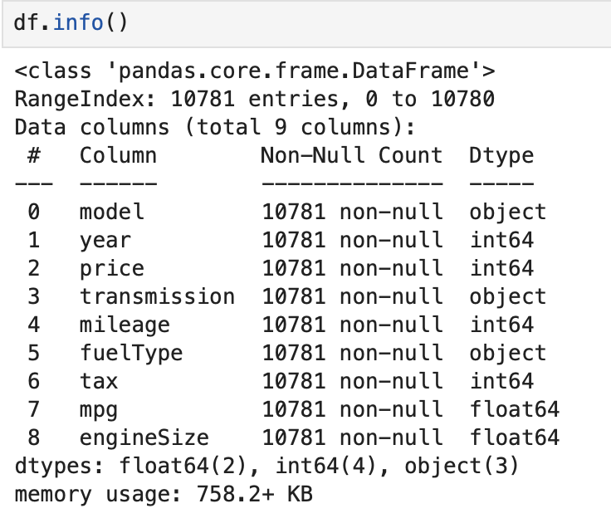
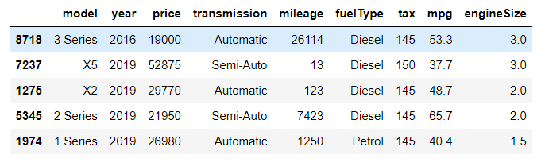
Pre-prOCESSING
1.DATA LOADING
The imported dataset below :

Slide 7
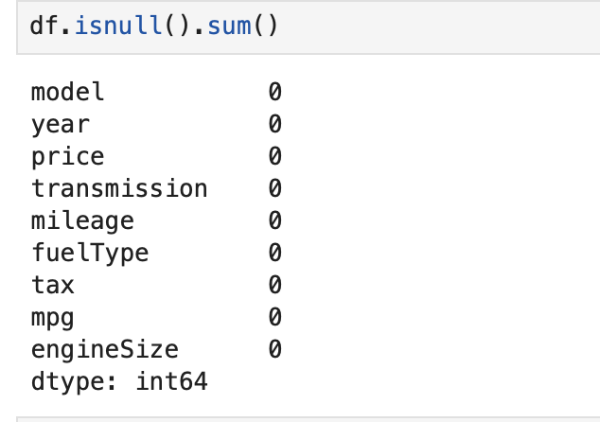
2.Handle missing Values
Check for missing values in each column of the dataset.
If any missing values are found, decide on an appropriate strategy to handle them. This could involve imputation (replacing missing values with a statistical measure such as the mean, mode), or removing rows or columns with missing values if they are negligible.

Slide 8
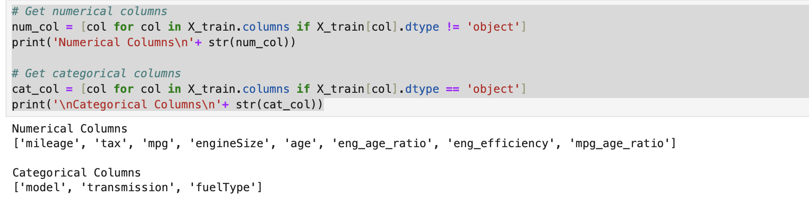
3.Showcase numerical and categorical value
By separating numerical and categorical data and applying appropriate preprocessing techniques to each, you can ensure that your machine learning model can effectively learn from and make predictions on the data.
Converting categorical variables into a numerical representation that the machine learning model can understand

Slide 9
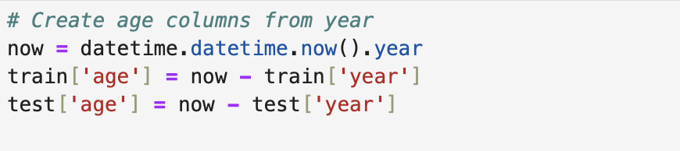
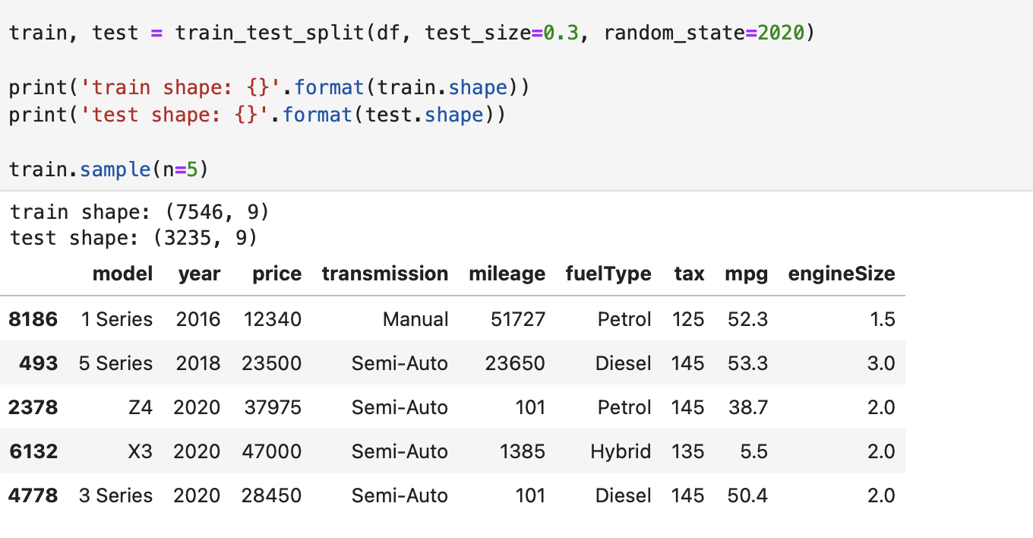
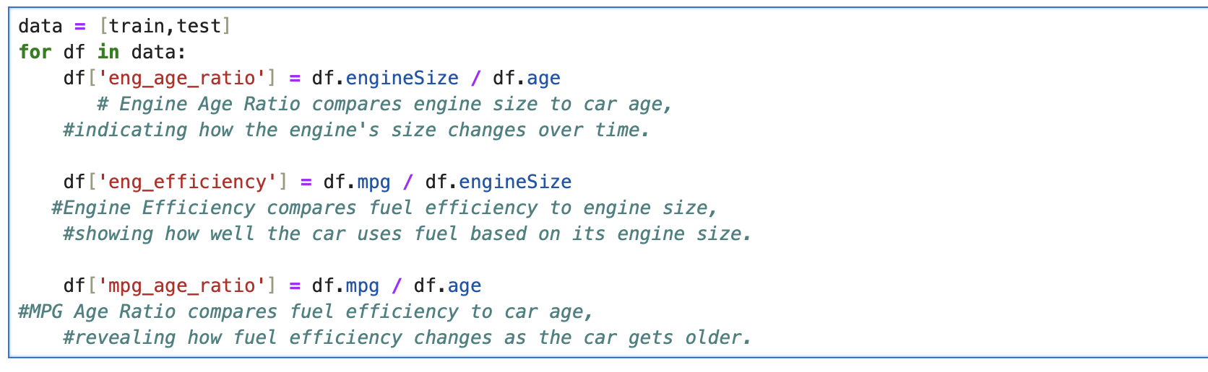
Feature Extraction
Train test split
Extract features from the existing features
Split train and test data

Slide 10
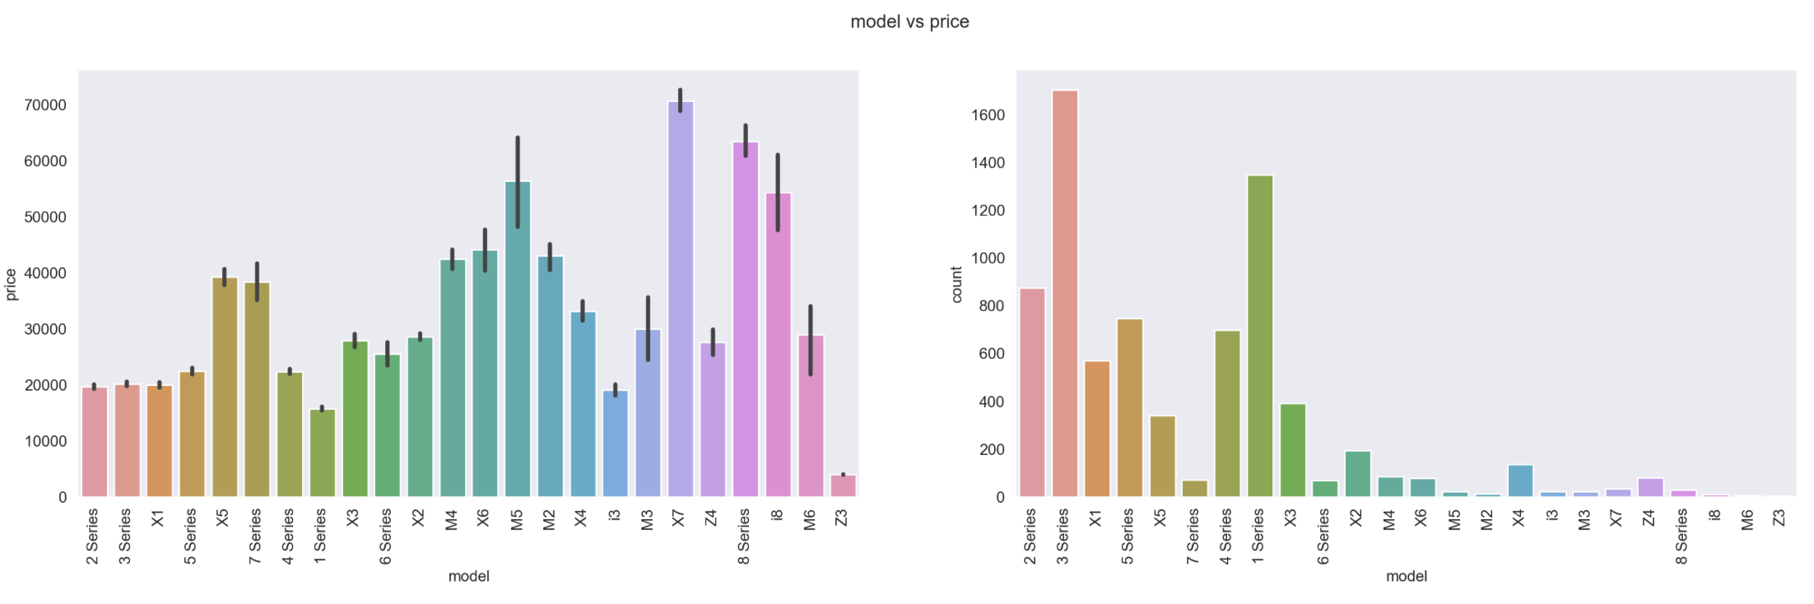
Data Visualisation
Visualize the relationship between different categorical and numerical features in the dataset and the 'price' .They provide insights into how different features may influence the target variable and help identify any patterns or trends in the data. Visualize the relationship between different categorical and numerical features in the dataset and the target variable 'price’. Below are some of these ,

Slide 11
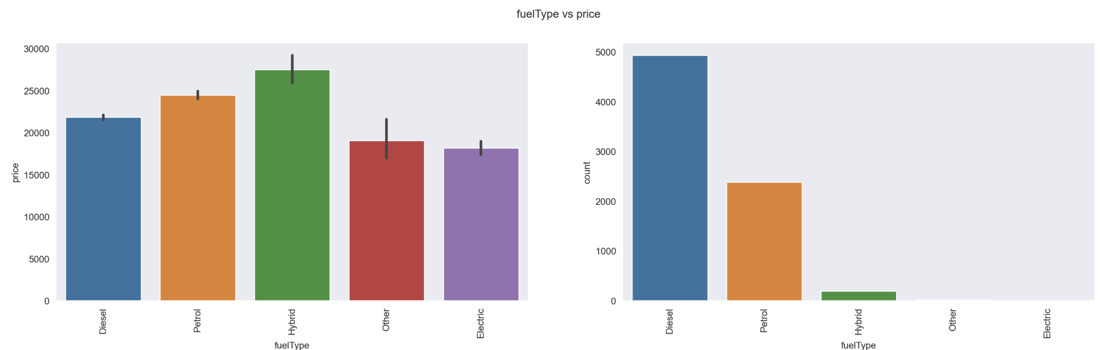
By visualizing these relationships, we can gain a better understanding of the dataset and make informed decisions when building predictive models or performing data analysis tasks

Slide 12
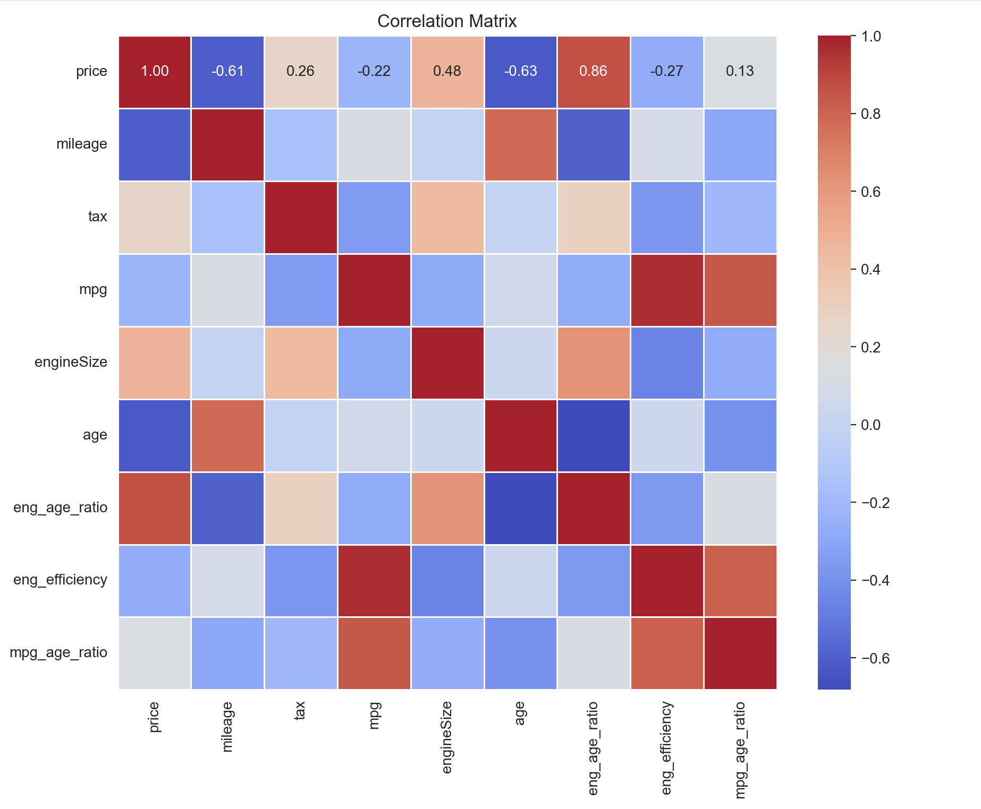
Correlation matrix
The correlation matrix summarizes relationships between car features. Higher values mean stronger relationships. Here are some findings:
Price tends to decrease as mileage increases (negative correlation).
Newer cars tend to have better gas mileage (negative correlation between mpg and age).
The correlation coefficient between price and mileage is -0.61. This indicates that there is a negative relationship between price and mileage. In other words, cars that are more expensive tend to have fewer miles on them

Slide 13
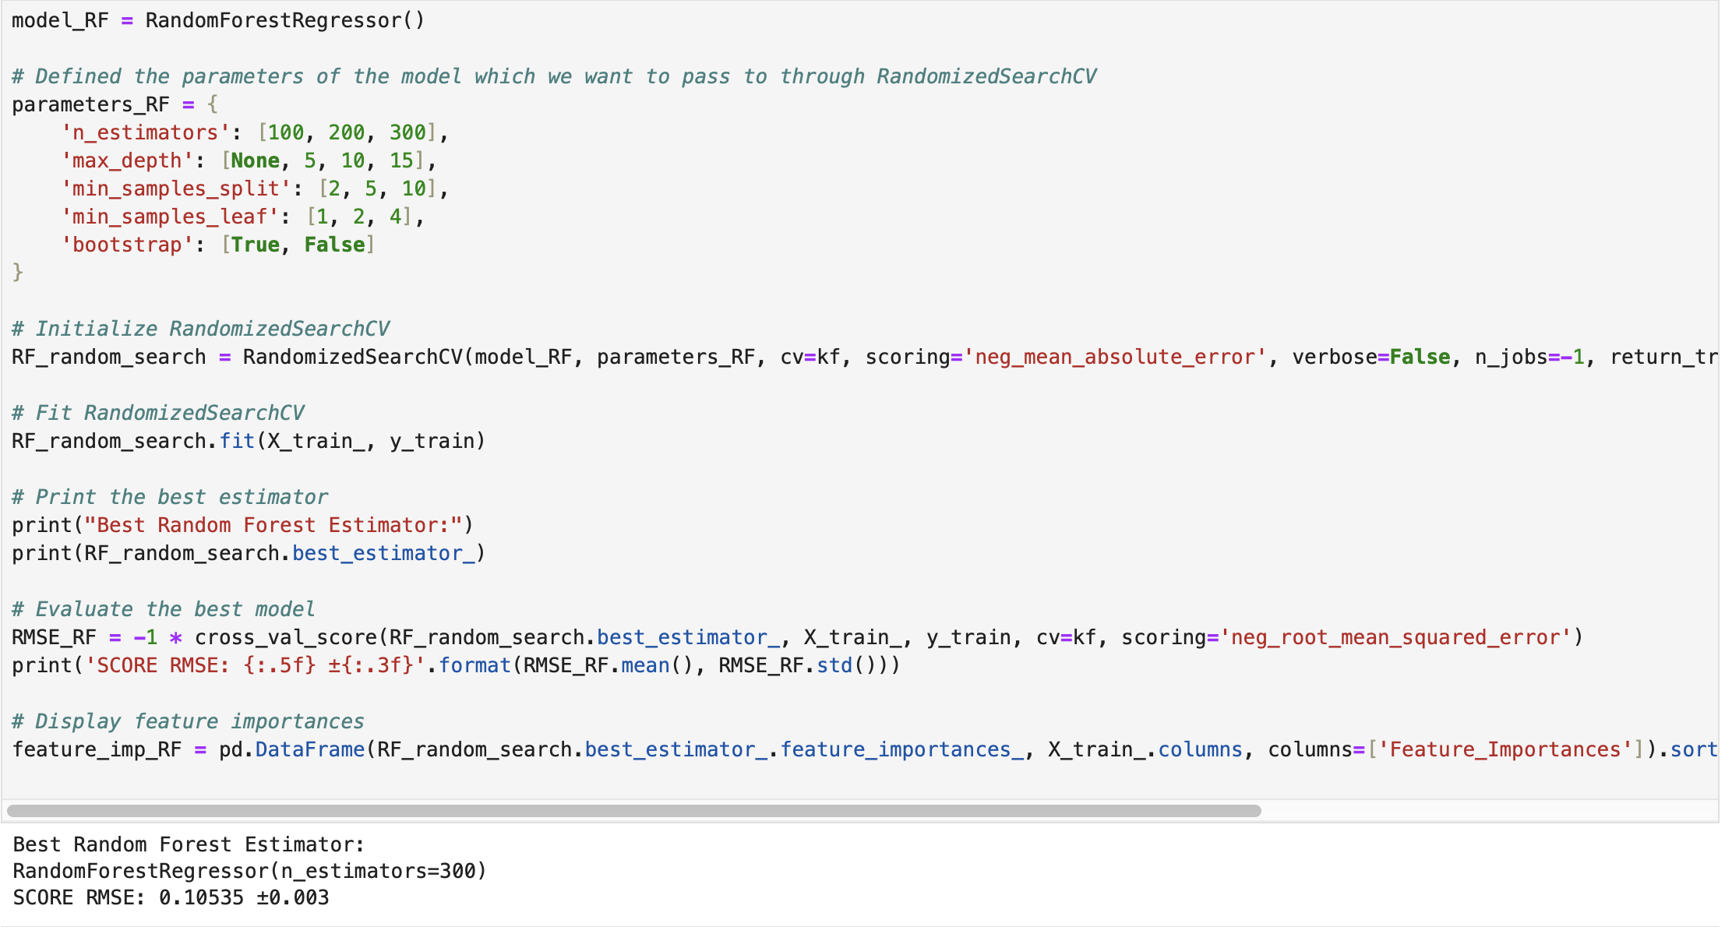
Model and Evaluation
Use a metric called RMSE (Root Mean Squared Error) to measure how close the model's predictions are to the actual prices.
Lower RMSE means the model's predictions are closer to the real prices, which is better.
Notes:
Sure, here are the simplified steps:
Initialize the Model: Start by setting up a Random Forest model.
Define Hyperparameters: Specify the hyperparameters you want to tune and the values to try out.
Setup Randomized Search: Use RandomizedSearchCV to search through different combinations of hyperparameters.
Fit the Model: Train the RandomizedSearchCV on your training data. This step will find the best combination of hyperparameters.
Get the Best Model: Once training is done, get the best-performing Random Forest model from the search results.
Evaluate the Model: Measure how well the best model performs using cross-validation. This helps you understand its accuracy and reliability.
Check Feature Importance: Finally, analyze which features are most important in making predictions. This helps you understand which factors influence the model's decisions the most.

Slide 14
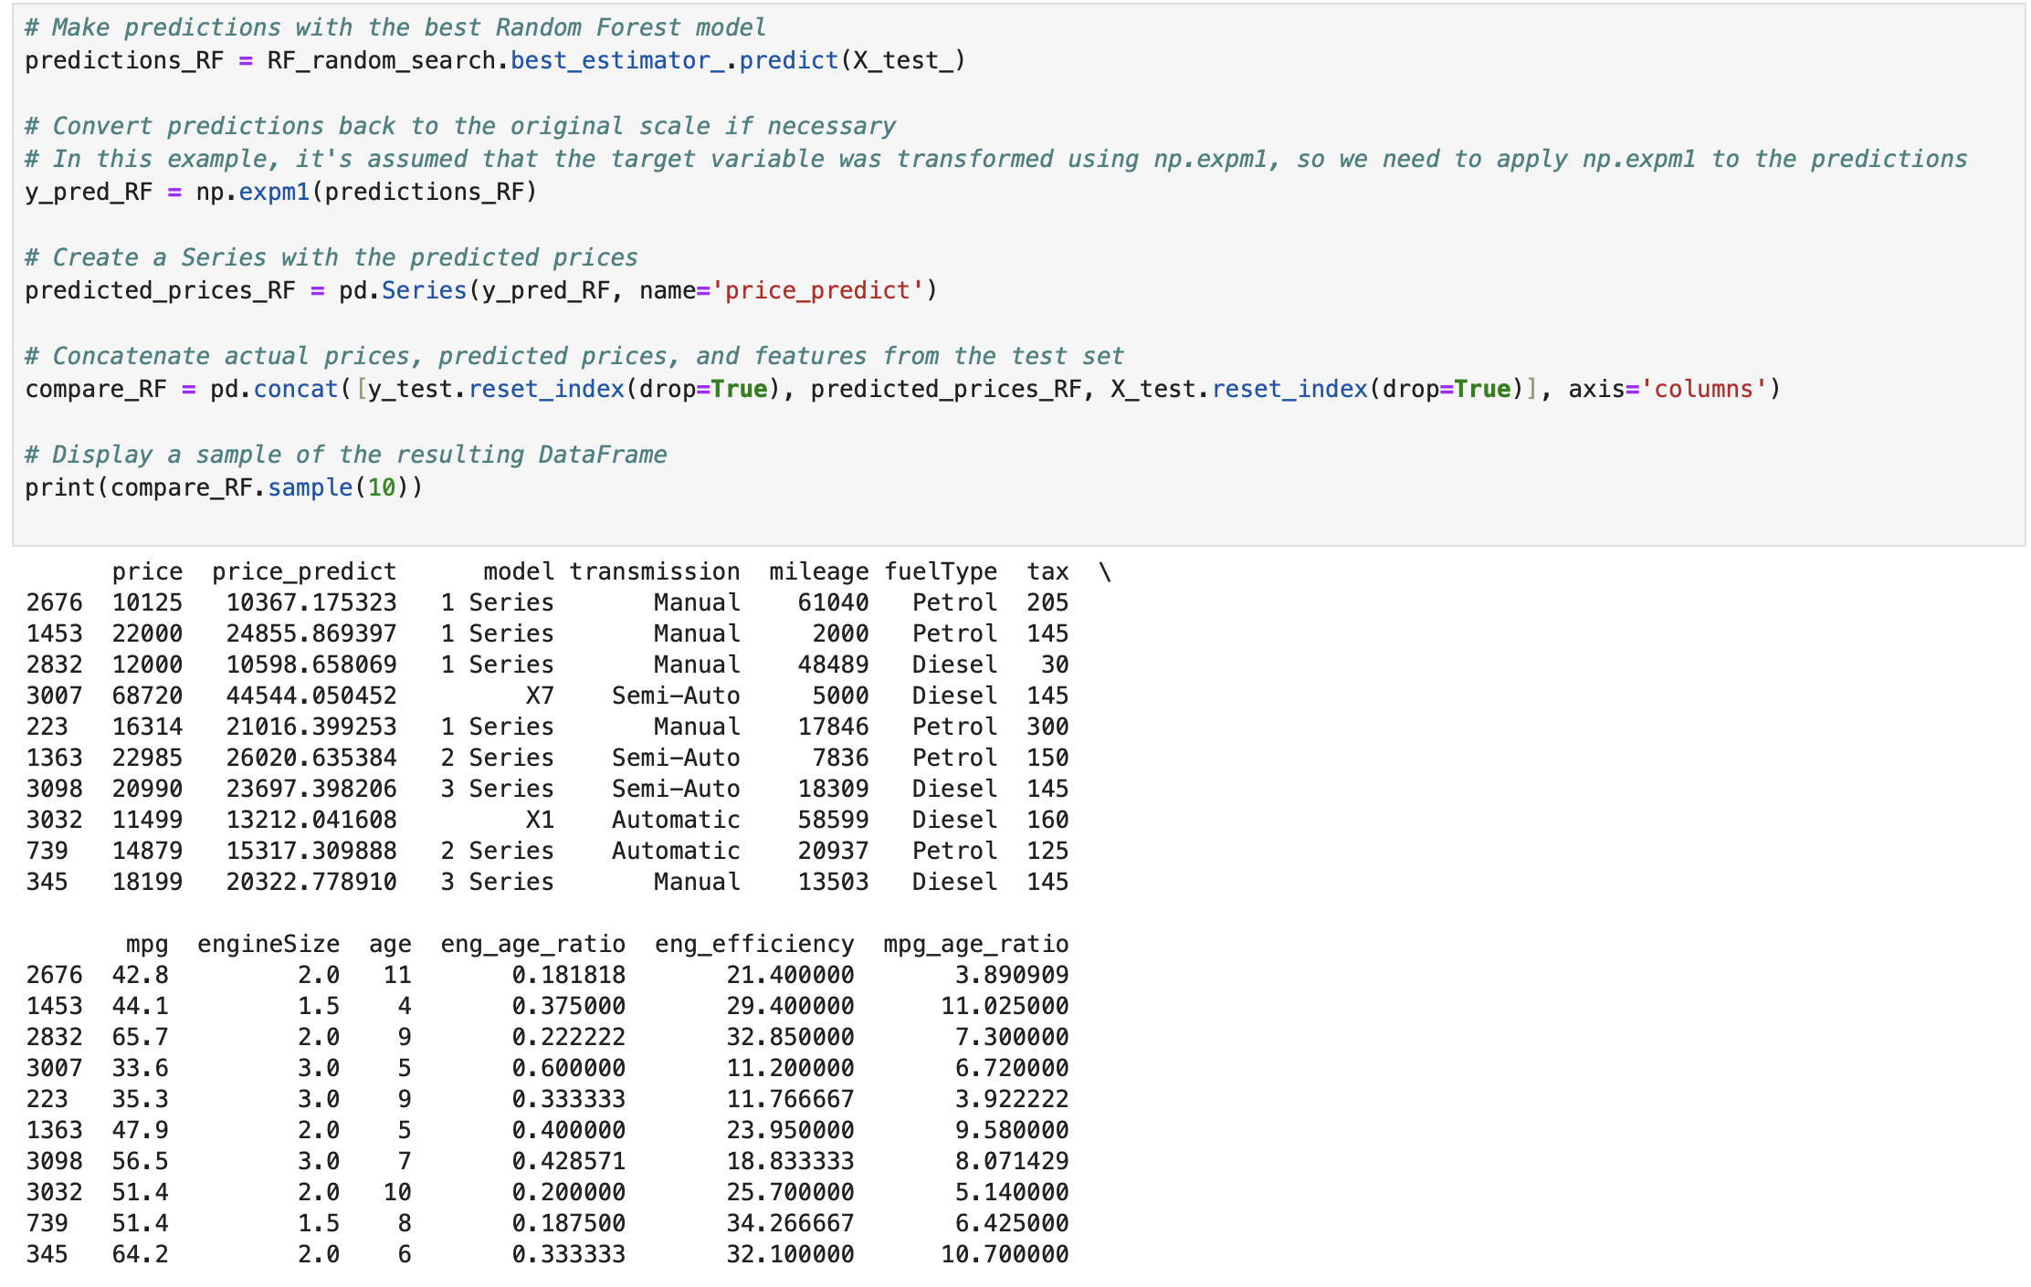
Results/ outcome
Making Predictions
Adjusting Predictions
Creating Predicted Prices
Comparing Predictions with Real Prices
Showing the Results
Notes:
Making Predictions: We use our best model to guess the prices of cars in our test dataset.
Adjusting Predictions:If we changed the prices before to make them easier to work with, we undo that change so our predictions match the original prices.
Creating Predicted Prices:We list out the prices our model guessed for the cars in the test dataset.
Comparing Predictions with Real Prices:We put together a table showing the actual prices of the cars in the test dataset and the prices our model guessed. This helps us see how close our guesses were.
Showing the Results:We display a small part of this table so we can quickly check if our model's guesses were close to the real prices.

Slide 15
Conclusion
This Project is aimed to develop a model to predict the prices of used cars. The results of the model helps to determine the important factors while predicting the prices of the used cars. Using the dataset available, a random forest model is developed that achieved an accuracy score on testing dataset. The model does suffer from overfitting. The importance of the features are determined using feature extraction done by random forest regressor. Some of the important features that does help in deciding the prices are Year, EngineSize, Mpg and mileage.

