Slide 1
QC
Quality Control

Slide 2

FASTQ format
http://en.wikipedia.org/wiki/FASTQ_format
lane:tile
(x,y) coordinates
Sequence of the multiplex tag
the member of a pair
@HWI-ST132_0410:7:1:15866:2488#ATCTCG/1
AGTCCATAACTGGTTTTTCTACTCCGGAGCTTTTGTGTTCCTCTGCTTTCCCTCTTCCCCTCCCTTGC
+HWI-ST132_0410:7:1:15866:2488#ATCTCG/1
gggggfggggggggggggggggggggegggggggggggggggggggggggegg_egegggfggfggeegdagdefff
Phred quality score
Notes:
Illumina 1.3+ format can encode a Phred quality score from 0 to 62 using ASCII 64 to 126 (although in raw read data Phred scores from 0 to 40 only are expected).
sequence of the multiplex tag
Flow cell lane: tile within flow cell

Slide 3
Paired and single reads
Forward read
DNA Fragment
Reverse read
Notes:
Illumina 1.3+ format can encode a Phred quality score from 0 to 62 using ASCII 64 to 126 (although in raw read data Phred scores from 0 to 40 only are expected).
sequence of the multiplex tag

Slide 4
We will use
FastQC
http://www.bioinformatics.babraham.ac.uk/projects/fastqc/
Widely used but not the only one

Slide 5
Our Goal
Get the best possible input for de novo assembler
Which data to use?
All or selected lanes?
Trimmed?
Quality filtered?

Slide 6
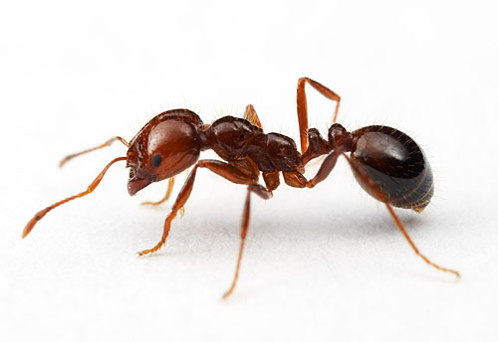
We expect
Highly
repetitive
Unique
23%
36%
41%
Moderately
repetitive
Solenopsis invicta
© Alex Wild
Notes:
Challenges to assembly as interspearsed repeats and challenges to predict gene models
591 Mb (reassociation kinetics), 753.3 Mb (flow cytometry), and 463 Mb (Feulgen image analysis densitometry)
Sinv is a hard genome: 36% unique seqs, 41% repeats interspearsed with unique seqs, and 23% of very repetitive seqs.

Slide 7
Input Files
Subsets of Illumina Hi-Seq lanes
Raw data
Non-redundant data
$ ls DNA-seq/Raw
$ ls DNA-seq/Nr

Slide 8
Launch FastQC
Process raw data
Process non-redundant data

Slide 9
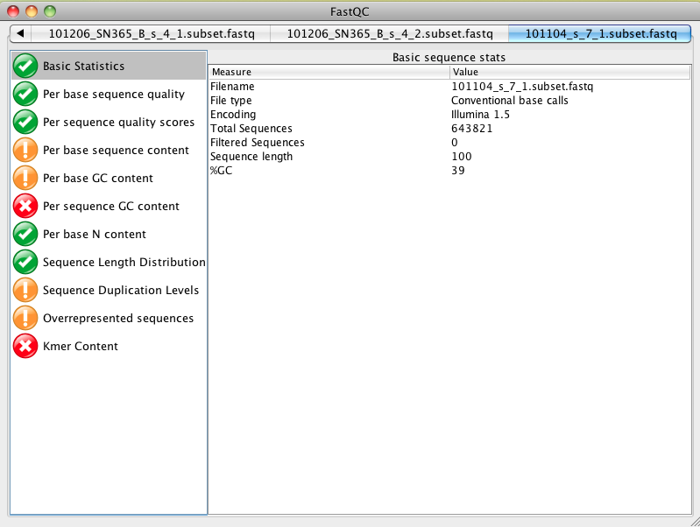

Slide 10
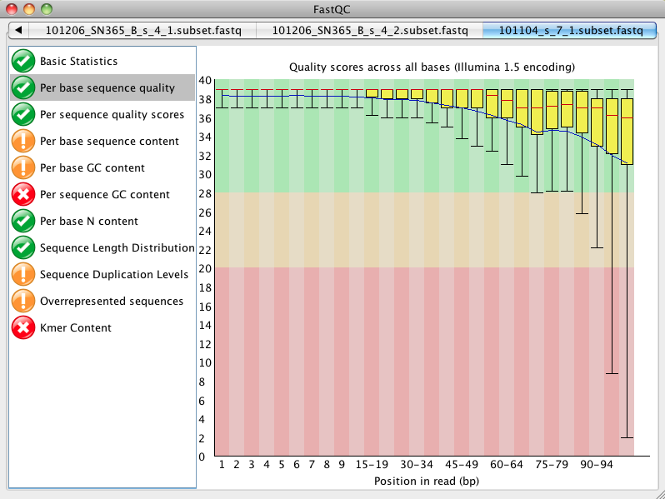

Slide 11
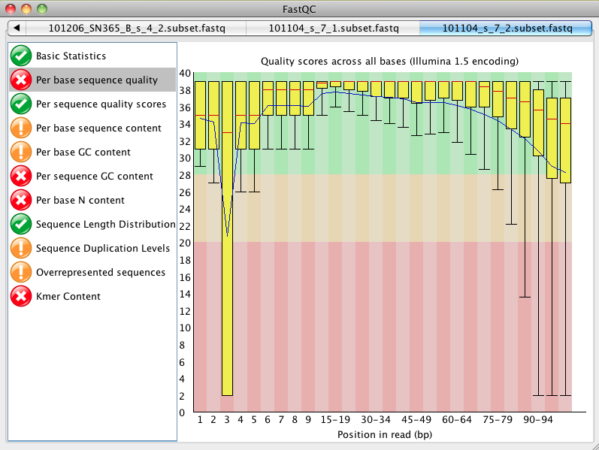

Slide 12
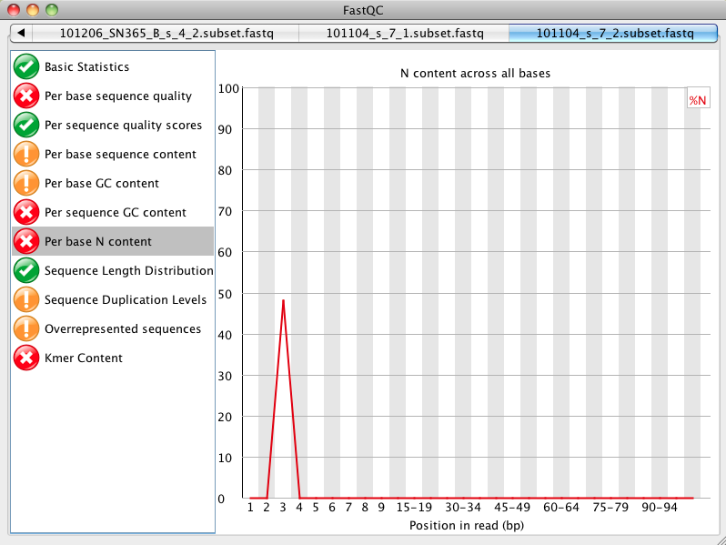

Slide 13
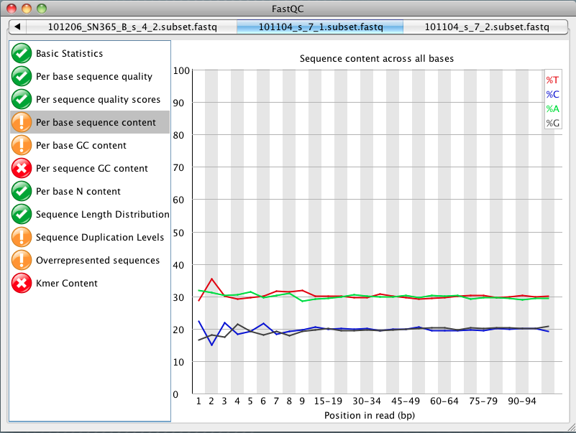

Slide 14
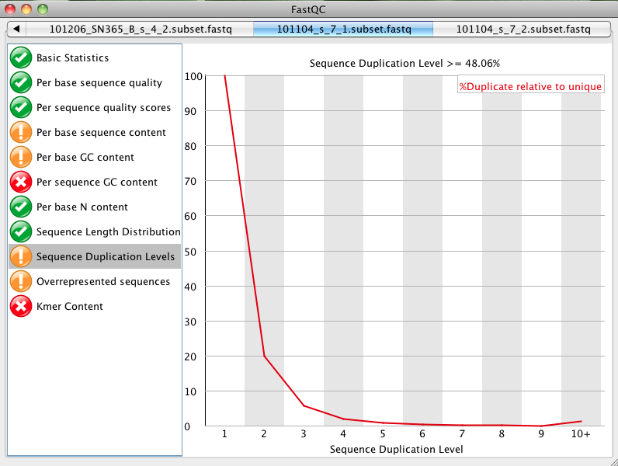
Notes:
Compare this to Nr files. How can you explain?

Slide 15
We will use
FASTX-Toolkit
http://http://hannonlab.cshl.edu/fastx_toolkit/
To trim and filter Illumina reads

Slide 16
FASTX-Toolkit
Trim by quality
$ fastq_quality_trimmer –h
Trim by coodinates
$ fastx_trimmer -h

Slide 17
Input Files
Process lanes of raw OR non-redundant data
$ ls DNA-seq/Raw
$ ls DNA-seq/Nr
Output to
$ DNA-seq/Clean

Slide 18
Keeping Track
#!/usr/bin/env bash
currentDir=${PWD}
inDir=$currentDir/DNA-seq/Nr
outDir=$currentDir/DNA-seq/Clean
mkdir -p $outDir
myFiles=(`find $inDir -name *.fastq`)
for inFile in ${myFiles[@]}
do
outFile=${inFile##*/}
fastx_trimmer -f 1 -l 100 -i $inFile -o $outDir/$outFile
done
exit 0

Slide 19
Genome
Assembly
De Novo

Slide 20
Best Practices
http://assemblathon.org/

Slide 21
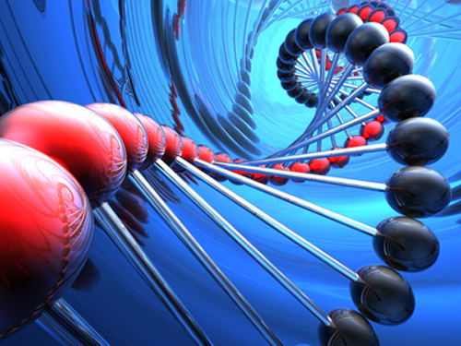
There’s no easy genome
Ian Korf
Notes:
Korf is one of the principal organizers of a genome assembly challenge known as the Assemblathon -- a competition to identify best practices in the de novo assembly of complex plant and animal genomes. Results of the first phase of the Assemblathon were recently published in Genome Research.

Slide 22
In Resume
Every genome is a special case
So, know your genome as much as you can BEFORE doing sequencing
Choose appropriate strategy based on what is known

Slide 23
Red Fire Ant
Very repetitive genome with some repeats being very long
Ideally: use libraries with insert size > repeat size

Slide 24
Hardest Way
We used long insert libraries for official genome release
You will try to see what happens when such libraries are not available

Slide 25
Assembly
We will use SOAPdenovo
http://soap.genomics.org.cn/soapdenovo.html
Notes:
344

Slide 26
SOAPdenovo
The package consists of 4 programs: pregaph, contig, map and scaff
With paired end data the simplest is to run all programs in a single command
$ SOAPdenovo-127mer all -s config_file -o output_prefix
Notes:
344

Slide 27
Config file
#maximal read length
max_rd_len=100
[LIB]
#average insert size
avg_ins=344
#if sequence needs to be reversed
reverse_seq=0
#in which part(s) the reads are used
asm_flags=3
#cut the reads from the current library to this length
rd_len_cutoff=100
#in which order the reads are used while scaffolding
rank=1
# cutoff of pair number for a reliable connection (default 3)
pair_num_cutoff=3
#minimal mapped length to contigs for a reliable read location (default 32)
map_len=60
Notes:
344

Slide 28
Config file
q1=lane4_pair1.fastq
q2=lane4_pair2.fastq
q1=lane7_pair1.fastq
q2=lane7_pair2.fastq
All our reads come from the same sequencing library, so we define only 1 LIB
Notes:
344

Slide 29
Keeping track
To find optimal parameters run multiple assemblies.
We will do at least 2 using launch scripts
$ ls SOAPdenovo/Assembly
conf01-lanes47_maplen60
Run_conf01-RL200D.sh
Notes:
344

Slide 30
#change THIS
myconf=conf01-lanes47_maplen60
#DO NOT CHANGE
mypref=`echo $myconf | cut -f1 -d'-'`
runDir=$PWD
myconf=$runDir/$myconf
#change THIS
L=200
#change THIS
for K in 35 65
do
# DO NOT CHANGE
mydir="$mypref"_K"$K"_R_L"$L"_D
mkdir -p "$mydir"
cd $mydir
SOAPdenovo-127mer all -p 1 -s "$myconf" -K "$K" -L "$L" -R -D -o out &> LOG
cd ..
done
Notes:
344

Slide 31
K-mer
The most influential parameter
Should be at least 1/3 of read length
Additional criteria may apply depending on the software used
Notes:
344

Slide 32
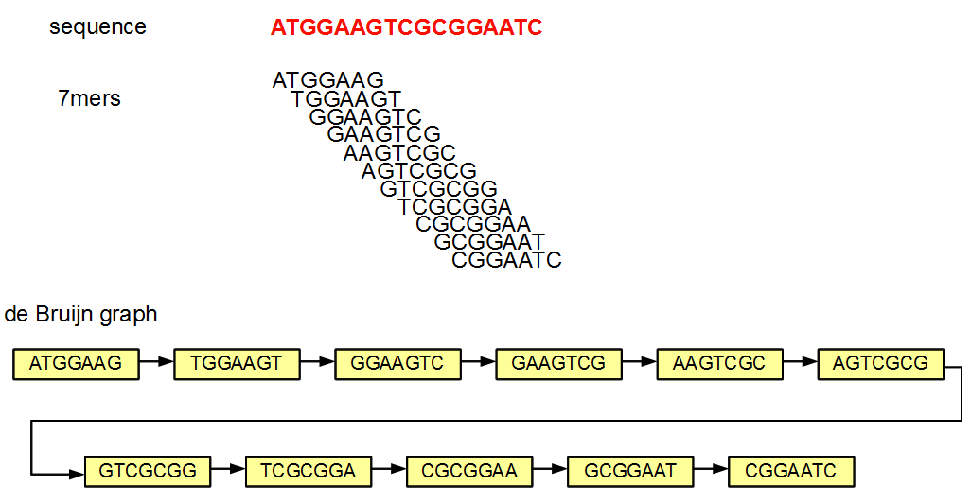
de Bruijn graph Construction
Source: http://www.homolog.us/blogs/2011/07/28/de-bruijn-graphs-i/
Notes:
In the above example, the sequence ATGGAAGTCGCGGAATC is split into overlapping K-mers (K=7), and a directed graph is constructed with those 7-mers as nodes. Edges are drawn between 7-mers adjacent on the original sequence. This method of construction also ensures that connected nodes have overlaps of 6 (=K-1) nucleotides.

Slide 33
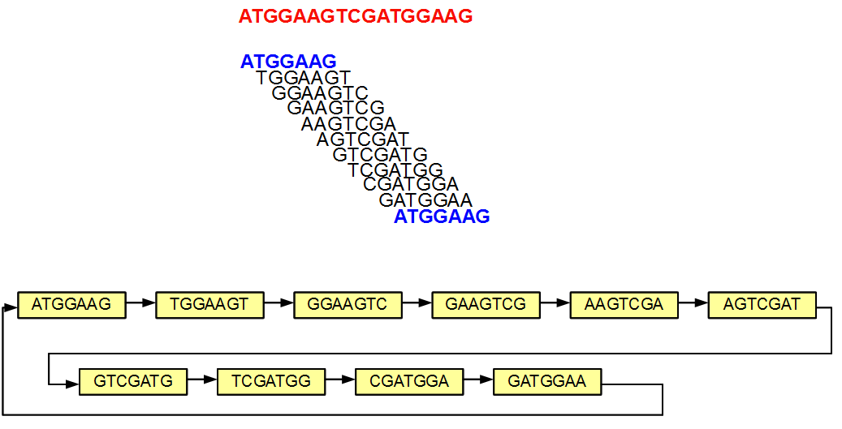
A loop in de Bruijn graph
Source: http://www.homolog.us/blogs/2011/07/28/de-bruijn-graphs-i/
Notes:
In the above example, the sequence ATGGAAGTCGCGGAATC is split into overlapping K-mers (K=7), and a directed graph is constructed with those 7-mers as nodes. Edges are drawn between 7-mers adjacent on the original sequence. This method of construction also ensures that connected nodes have overlaps of 6 (=K-1) nucleotides.

Slide 34
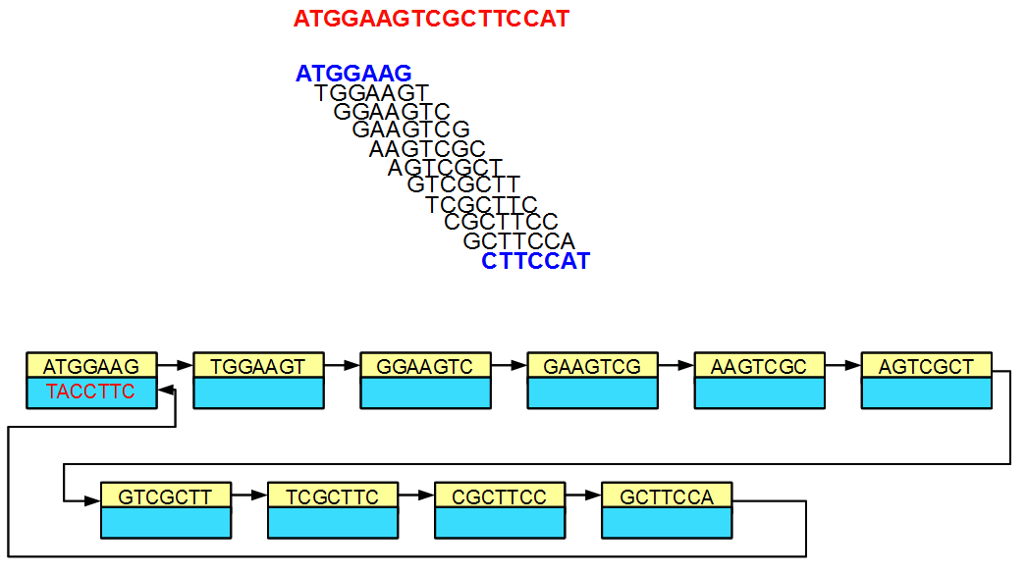
de Bruijn graph is double stranded
Source: http://www.homolog.us/blogs/2011/07/28/de-bruijn-graphs-i/
Notes:
In the above example, the sequence ATGGAAGTCGCGGAATC is split into overlapping K-mers (K=7), and a directed graph is constructed with those 7-mers as nodes. Edges are drawn between 7-mers adjacent on the original sequence. This method of construction also ensures that connected nodes have overlaps of 6 (=K-1) nucleotides.

Slide 35
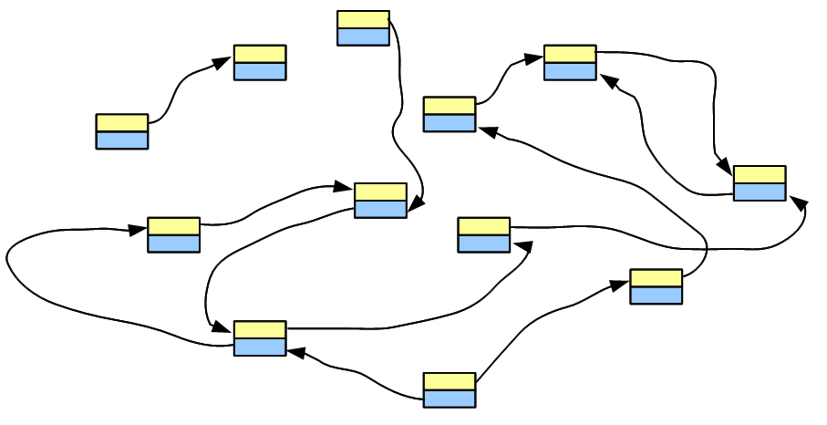
Assembly = golden path through de Bruijn graph
Source: http://www.homolog.us/blogs/2011/07/29/de-bruijn-graphs-ii/
Notes:
In the above example, the sequence ATGGAAGTCGCGGAATC is split into overlapping K-mers (K=7), and a directed graph is constructed with those 7-mers as nodes. Edges are drawn between 7-mers adjacent on the original sequence. This method of construction also ensures that connected nodes have overlaps of 6 (=K-1) nucleotides.

Slide 36
Config File
Keep config file name of the format conf01-whatever
Notes:
344

Slide 37
Run Time
$ cd SOAPdenovo/Assembly
$ ./Run_conf01-RL200D.sh
Notes:
344

Slide 38
Validation
Quantitative

Slide 39
N50 etc
We will use script from Abyss
$ abyss-fac -t 200 scaffold.fasta
$ cd SOAPdenovo/Assembly/
$ ./get.stats.sh > ../Statistics/stats

Slide 40
50 assemblies
Different data and configs
$ ls /scratch/cluster/monthly/oribagro/summer2012/SOAPdenovo/Assembly/

Slide 41
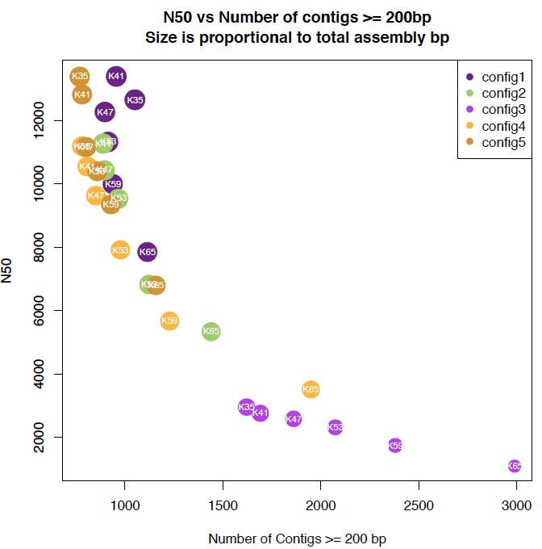

Slide 42
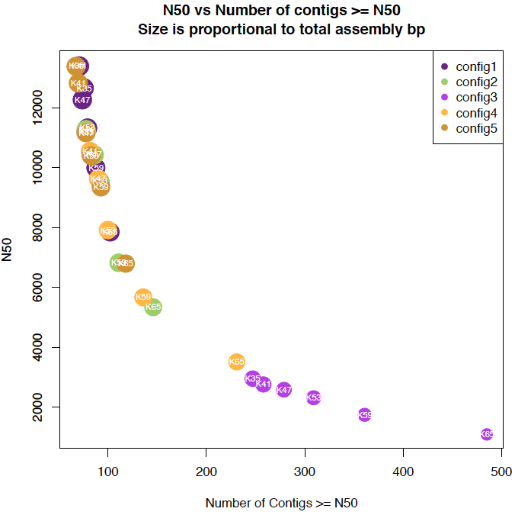

Slide 43
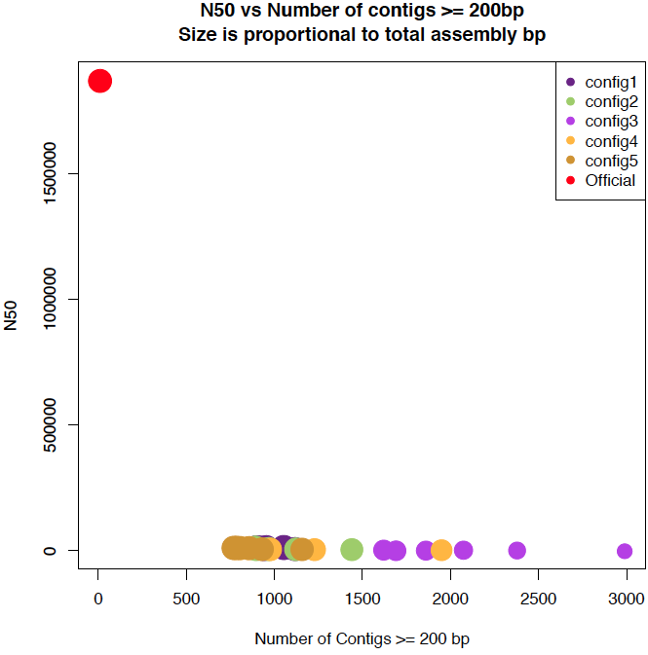

Slide 44
Validation
Qualitative

Slide 45
What is in there?
Use available independent sequences:
Conserved gene sets (for eukaryotes
http://korflab.ucdavis.edu/Datasets/cegma/)
Sequences in public databases
Independently assembled transcriptome

Slide 46
De Novo Transcriptome
We will use Trinity to assemble the transcriptome
http://trinityrnaseq.sourceforge.net/

Slide 47
RNA-Seq Data
$ cd /scratch/cluster/weekly/username
$ ls RNA-seq/Raw/
Pick 1 file to run Trinity on it
$ outDir=Trinity
$ mkdir -p $outDir
$ cd $outDir
$ Trinity.pl -h

Slide 48
Cross validation
Genome to transcriptome alignments

Slide 49
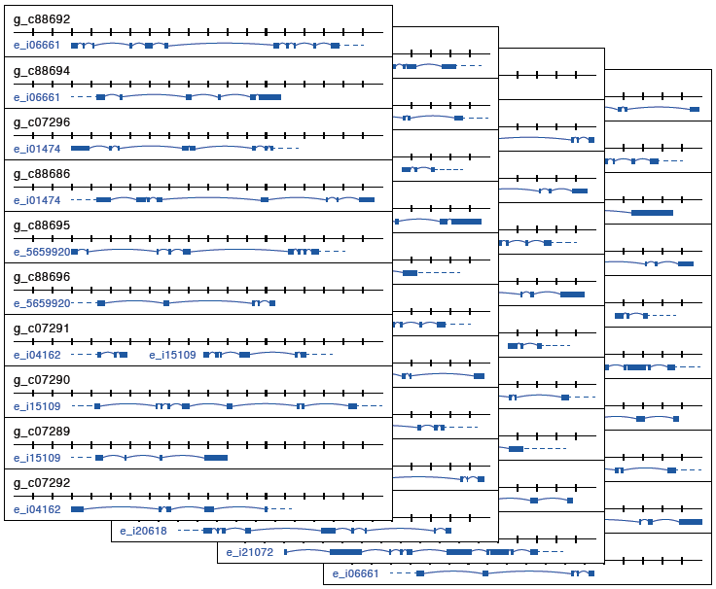
Transcript to genome alignments:
Where to look?

Slide 50
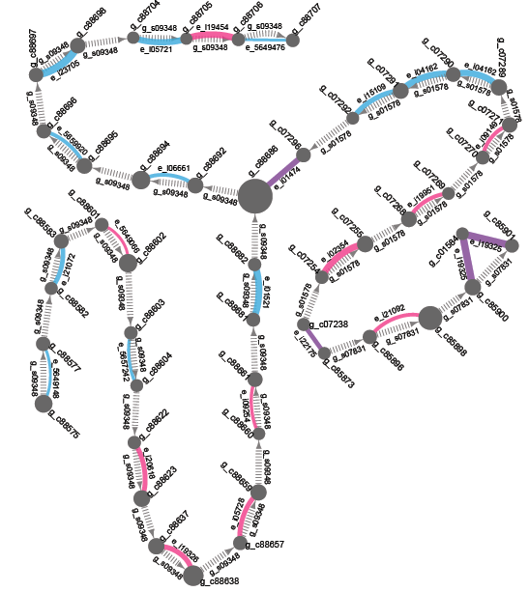
Network view
Global alignment view highlights conflicts
Riba-Grognuz et al. (2011) Bioinformatics

Slide 51
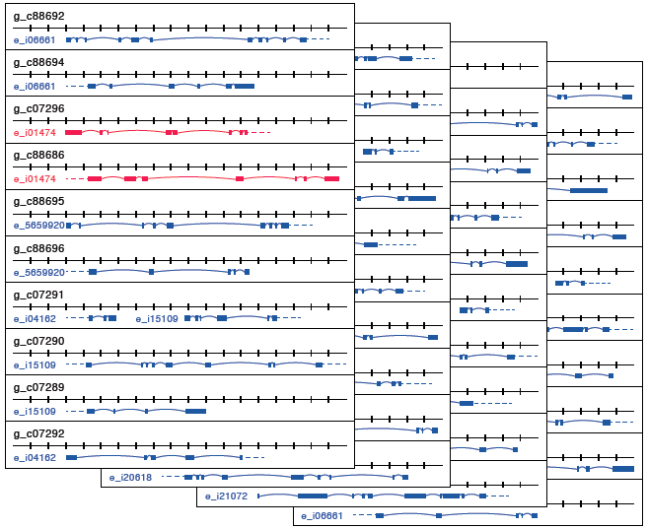

Slide 52
Assembly graphs
Contig 1
Contig 2
Contig 3
Contig 4

Slide 53
Circle size = Contig size
12Mpb
7Mbp
14Mbp
8Mbp

Slide 54
Connect by scaffold
GAP
GAP
GAP

Slide 55
Connect by transcript
Transcript A
Transcript B

Slide 56
What does this mean?
Transcript A
Exons of Transcript A
Gap
Contigs

Slide 57
Color by strand
+ +
- -
(+ -)

Slide 58
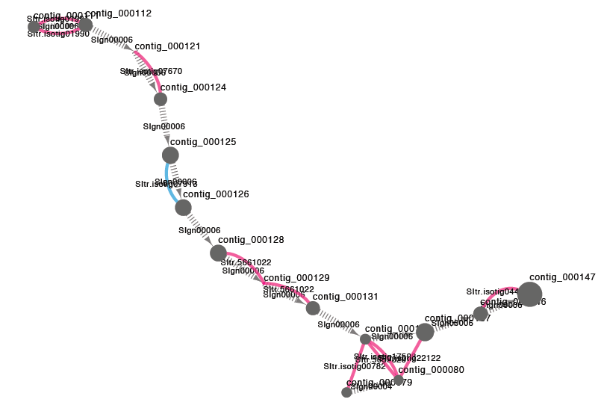
Network view

Slide 59
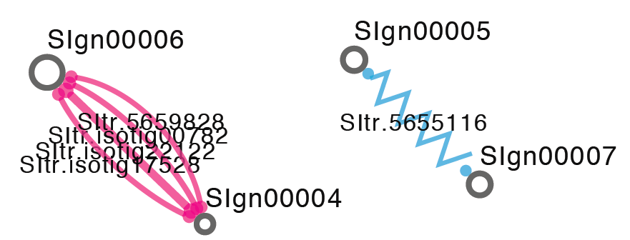

Slide 60
Input Files (subsets of hi-seq lane)
$ ls DNA-seq/Raw
Output directory
$ DNA-seq/Quality
FastQC command
$ fastqc -o DNA-seq/Quality file1.fastq file2.fastq
Find out more
$ fastqc -h
Use options if needed
e.g. –noextract

