Slide 1
Geography Activities (Me on the Map)
Here is where your presentation begins

Slide 2
Contents of this template

Slide 3
Introduction
Jupiter is a gas giant, the biggest planet in the Solar System and the fourth-brightest object in the night sky. It was named after the Roman god of the sky and lightning. It’s composed mostly of hydrogen and helium

Slide 4
Choose an option!
Curiosities
Activities

Slide 5
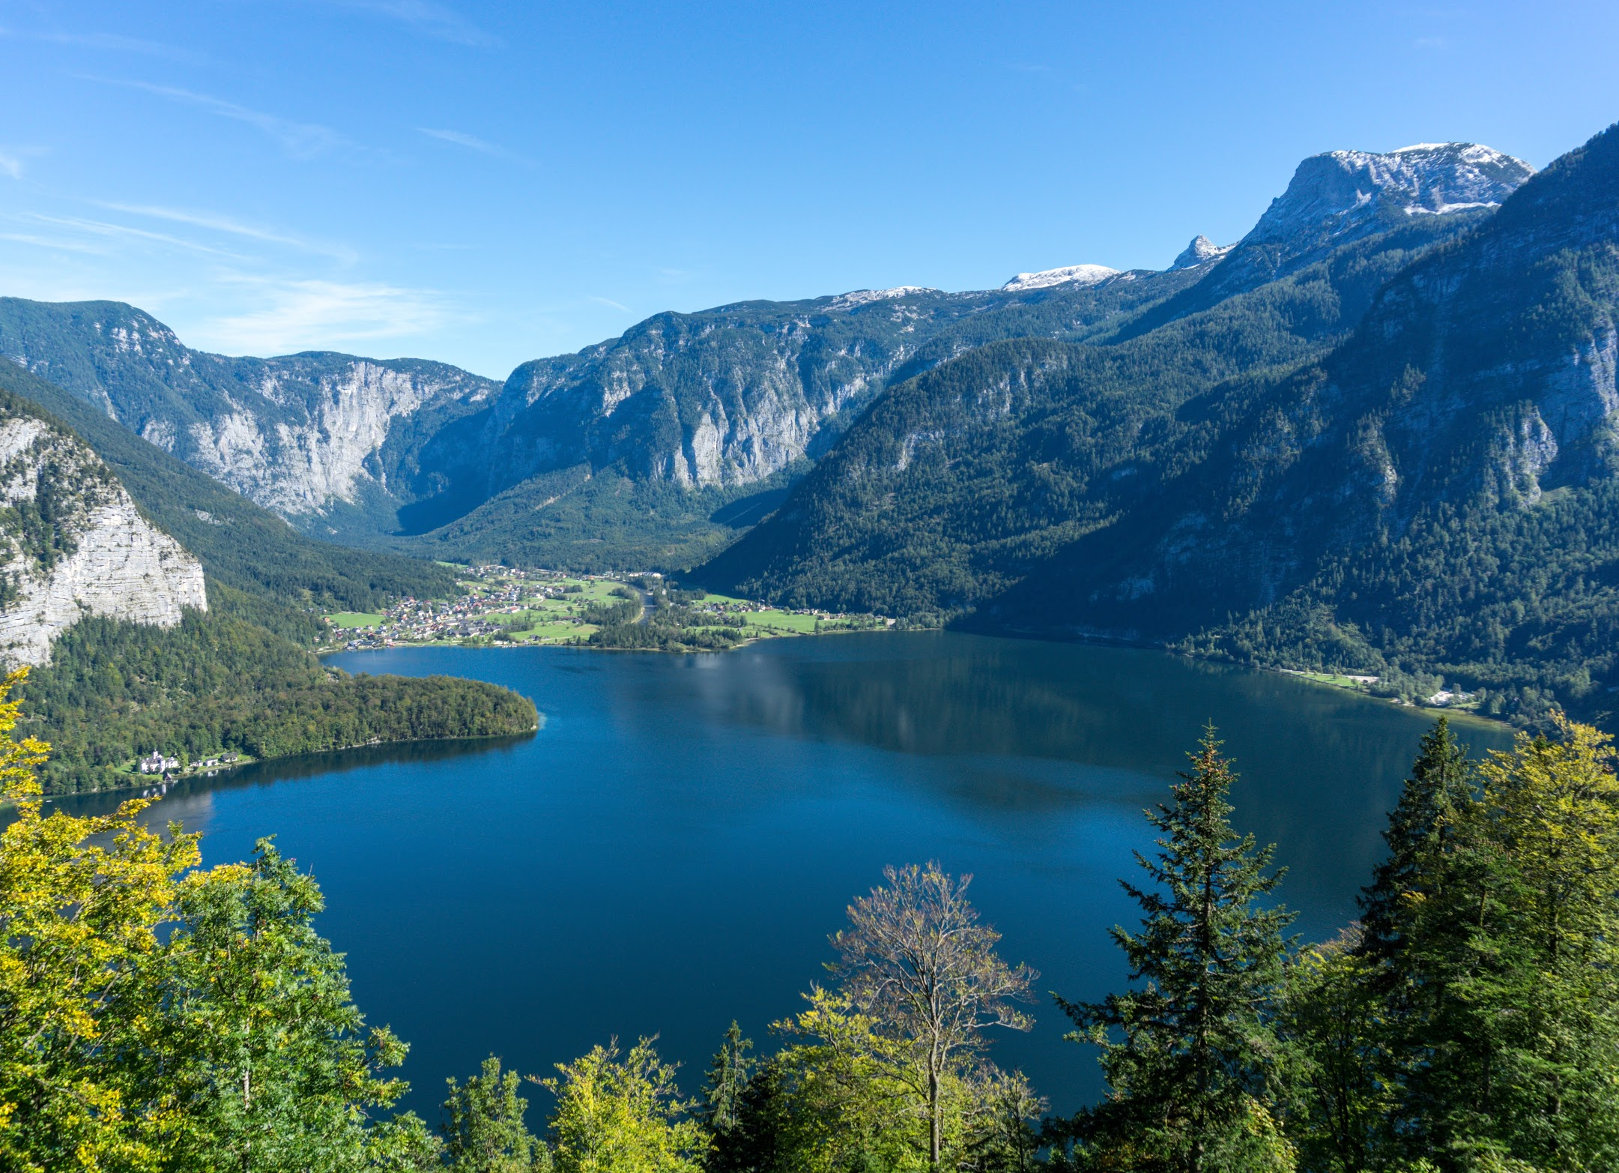
Did you know…?
The largest concentration of lakes is in Canada
Nine percent of Canada is a freshwater lake, and with 31,752 lakes, the country has more lakes than anywhere else in the world
Back
Activities

Slide 6
Activities
The fun way to learn geography!

Slide 7
Continents matching
Africa
Asia
Europe
Australia
Half of the world’s wine is from here
It's the largest continent on the planet
It’s the driest continent on the planet
The Sahara desert is in this continent

Slide 8
Cities matching
Spain
Ottawa
Canada
Madrid
Egypt
Cairo

Slide 9
Me on the map!
Me
My house

Slide 10
Where in the world do we live?

Slide 11
Choose a country!

Slide 12
The United States
Color your state blue
What is the largest state? Color it yellow
What is the smallest one? Color it orange
What states border Florida?
How many states have the word New in them?
What state is west of Kansas?
Back
Next

Slide 13
Complete the map
Belize
Guatemala
Honduras
El Salvador
Nicaragua
Costa Rica
Panama
Back
Next

Slide 14
Let’s learn about Spain
Can you place the following regions on the map?
Back
Next

Slide 15
France
Each pin is a French city. Put it on the map in the correct place!
Paris
Lyon
Toulouse
Amiens
Bordeaux
Marseille
Nantes
Nice
Back
Next

Slide 16
Complete the map
Lazio
Puglia
Back
Next

Slide 17
Map of China
4
1
Xinjiang
1
3
2
3
6
4
2
5
5
Back
More

Slide 18
It’s your turn!
Select the following countries on the map.
Here are some examples:
Venezuela
United States
Mexico
Argentina
Brazil
Peru

Slide 19
Monuments of Europe
Here you have some important monuments of Europe. Can you place them on the correct country?

Slide 20
World capitals
1
Angola
6
Zambia
Lusaka
Khartoum
2
Greece
Athens
7
Vietnam
Rome
Hanoi
Dublin
3
Ireland
8
Kosovo
Pristina
Luanda
4
Sudan
9
Cuba
Havana
Ankara
5
Turkey
10
Italy

Slide 21
Draw a line from the country to its name
Sweden
Brazil
Egypt
India
Canada
Argentina

Slide 22
Quiz yourself!
What ocean would you cross if you flew from Antarctica to Africa?
What ocean would you cross if you flew from Africa to Australia?
What continent would you land on if you flew south from South America?
What continent would you land on if you travel east from Asia?

Slide 23
Alternative resources

Slide 24
Resources
Vectors
Flat italy map infographic
Map of spain
Us map vector
Flat america map infographic
Colorful world monuments background
Multicolor flat european map separated by countries
World humanitarian day
Flat urban landscape
Diploma template with theme for child
Colored world map Free Vector
Map of china in tones of red

