Slide 1

Twitter Sentiment Analysis Cloud & Machine Learning - CSCI-GA 3030-025
Srishti Bhargava, Daniel Sabba
Courant Institute of Mathematical Sciences
New York University

Slide 2
Project Description
MOTIVATION: With billions of people in lockdown, their perception of reality is exclusively defined by information received through digital media.
LANDSCAPE: In this environment, a tool that uses machine learning algorithms to gather sentiment from this digital information would allow for uniquely precise representation of overall sentiment.
GOAL: Leverage the Kubernetes infrastructure to enable scalable and tailored-by-user sentiment analysis of tweets.

Slide 3
How does it work?
Two training containers (jobs) run text classification training into positive, negative, neutral tweets using Deep Sequential Neural Networks and Linear Support Vector Machines.
An inference container (deployment) performs inference in the pre-trained models saved in volumes mounted in each training container.
In a web-based User Interface, a selection can be made between machine learning models, and a new tweet can be provided for inference.

Slide 4
BackEnd of Cloud/ML Sentiment Analysis
Kubernetes Cluster (IBM Cloud)
Sequential Neural Nets Training
K8S Pod (Job)
Linear SVM Training
K8S Pod (Job)
Twitter Data Labeled for Sentiment
Run Twitter Classification
Training
Inference Container
K8S Pod (Deployment / Service)
User Input
Of Tweets & Model for
Classification
Testing
Run Twitter
Inference Specific to Model

Slide 5
Deep Sequential Neural Networks
Converted tweet text into one-hot matrices and made all tweets of same length
Used a 3 layer dense neural network with one layer each for input and output, along with a hidden layer.
Layer 1: 512 layer dense network which accepts one-hot matrix of specified length
Layer 2: 256 layer dense network (hidden layer)
Layer 3: 3 layer dense network, output layer with 3 possible outputs

Slide 6
Deep Sequential Neural Networks
Model uses 2 dropout layers which are used to randomly remove data which helps to avoid overfitting.
Activation Function : ReLU for layer 1 and 2, softmax for output layer
Optimizer: Adam, to update parameters and minimize the cost of the neural network
Loss function: Categorical crossentropy, calculates a score that summarizes the average difference between actual and predicted probability distributions for all classes

Slide 7
Linear Support Vector Machines
Popular machine learning algorithm to perform text classification.
Performed tf-idf transformation on the tweets before feeding them to the model.
Linear SVM performs classification by finding the best hyperplane to differentiate n classes in an n-dimensional space.
The hyperplane acts as a decision boundary for any new data point

Slide 8
Dataset & Model Observations
From the 15,000 labeled tweets, over 9,000 were labeled negative, leading Linear SVM to predict some tweets (including neutral) as negative.
Deep sequential neural networks exhibit better performance and superior ability to handle outliers.
The categorical crossentropy loss used in the Neural Network tends to perform well when aiming for highest percentage accuracy even with imbalances in the dataset.

Slide 9
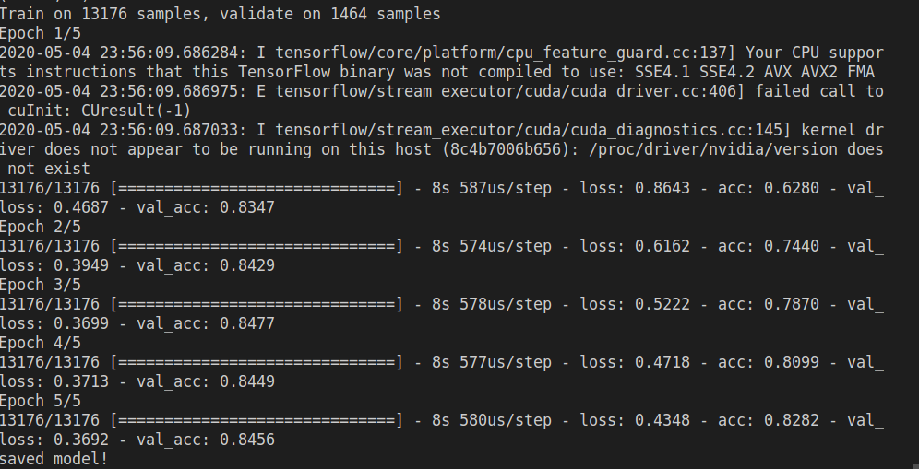
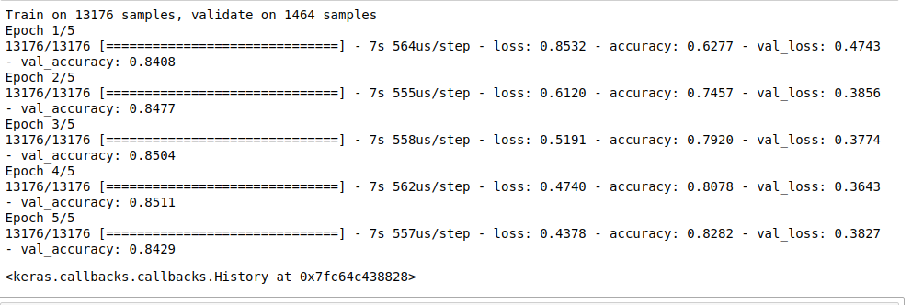
K(c)aas: Kubernetes (Container) as a service
We used IBM Cloud to host our Kubernetes cluster – this service is a hybrid of KaaS and CaaS.
We compared training performance with AWS containers, leveraging their CaaS capabilities. Performance between AWS and IBM Cloud was very similar.

Slide 10
Inference Container & User Interface
We created an inference container as a kubectl deployment as well as a service to allow that container to be accessed externally. This inference container accesses different trained models saved in volumes mounted in training containers to perform inference.
The user interface allows for a new tweet to be evaluated as well as for a training model to be selected.
This user interface will be hosted in a webserver and is accessing the inference container in Kubernetes external IP address and a NodePort.

Slide 11
Challenges & Lessons Learned
DATA: Over the course of project we realized how important it is to have “ready-to-use data” to be able to focus on substantive ML/Cloud aspects of the project. We realized this as we were dedicating a lot of time preparing raw data from the API.
CLUSTERING: We initially expected to be able to obtain meaningful results through clustering, and once this did not materialize, we decided looked for labeled datasets.
DATA CLASSIFICATION: We had intended to perform text classification (for example identifying topic) instead of sentiment identification. We were thwarted in that effort by the very limited amount of publicly available twitter datasets with topic labels.
MODEL SELECTION: We evaluated 4-5 training models, settling with the final two (SVM & SNN) for accuracy considerations. In hindsight, we could have not made an ex-ante selection of these two models, but instead kept all of them as independent containers the user could select based on whatever data is to be evaluated.

Slide 12
Conclusion & Future work
Throughout this project, we were able to experience the benefits of scalability of the Kubernetes infrastructure. It allowed us to make a job performed by source code into a dynamic living environment that is scalable, elastic and can be accessed everywhere.
These features are particularly relevant as, while the skeleton of the model is completed, we need to continue to improve the data environment and fine tune the models appropriately – this can be uniquely done in the Kubernetes cluster framework.

Slide 13
Conclusion & future work
LIVE DEMO: We intend to use our Google Cloud credits to maintain the UI & cluster running as we continue to refine the tool and collaborate on this idea. This will allow us to have a continued demo as well as a repository page for source code.
DYNAMIC: The Kubernetes framework allows us to create new clusters as we experiment with new models, while old modes can continue to run for comparison.
DATA: The precision of this model can be enhanced with more labeled twitter data. Now this project is done, we are exploring alternatives to scale this data up so the tool can be more effective and useful.
APPLICATION: One immediate commercial application would be on the design of systematic trading strategies to capitalize on heterogeneous sentiment clustering across different markets. Immediate applications would be global long short equity and fixed income relative value.

Slide 14
QUEStions & Comments are welcome
Srishti Bhargava, Daniel Sabba
Courant Institute of Mathematical Sciences
New York University

