Slide 1
Cute Hacks with PyGoocanvas
Presented By :-
Srishti Sethi
Contributor - GNOME

Slide 2
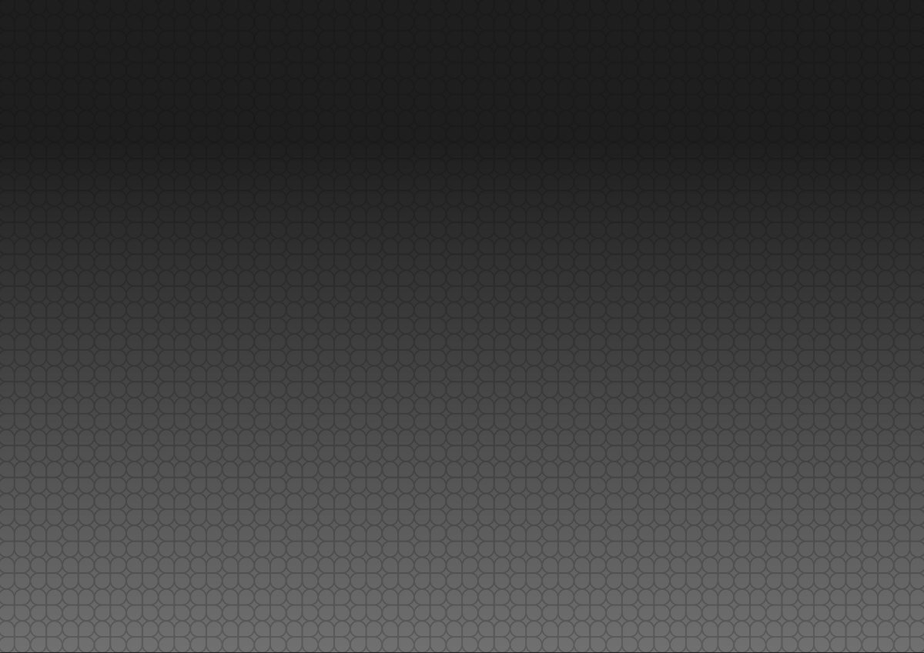

Contents
PyGoocanvas ?
Features
Documentation
Source Code
Three P's
A Simple Demo
Projects using the library
Advanced

Slide 3
PyGoocanvas ?
Python bindings for GooCanvas
Goocanvas : canvas widget for GTK+
Uses the cairo 2D library for drawing.

Slide 4

Features
Uses interfaces for items and views.
Basic items rect/ ellipse/ polyline/ text/ image/ grid/ group.
Path item, using SVG path specification strings.
Embedded GTK+ widgets.
Cascading styles - line width/style/dashes, colors, fill patterns.
Affine transformations for all items - rotations/scales/skews.
Simple animation.
Scalable - support for thousands of items over a large canvas area.

Slide 5

Documentation
Reference Manual
This reference describes the classes of the Python PyGooCanvas module.
http://people.gnome.org/~gianmt/pygoocanvas/

Slide 6
Source Code
Git: git clone git://git.gnome.org/pygoocanvas
Browse source in git: http://git.gnome.org/browse/pygoocanvas/
Examples: http://git.gnome.org/cgit/pygoocanvas/tree/demo
Tarballs: http://ftp.gnome.org/pub/GNOME/sources/pygoocanvas/

Slide 7
Three P's
Python
Ties everything together.
PyGTK
Interface between python and gtk
PyGoocanvas
Python bindings for goocanvas
Package : python-pygoocanvas

Slide 8
goocanvas.Canvas
Main widget containing a number of canvas items
goocanvas.Canvas()
Returns : A new goocanvas.Canvas

Slide 9
goocanvas.Ellipse
An Ellipse Item
center_x The x coordinate of the center of the ellipse. Default value: 0.
center_y The y coordinate of the center of the ellipse. Default value: 0.
radius_x The horizontal radius of the ellipse. Allowed values: >= 0. Default value: 0.
radius_y The vertical radius of the ellipse. Allowed values: >= 0. Default value: 0.
fill_color Fills color in the ellipse item.

Slide 10
goocanvas.Rect
A Rectangle Item
x The x coordinate of the rectangle. Default value: 0.
y The y coordinate of the rectangle. Default value: 0.
height The height of the rectangle. Allowed values: >= 0. Default value: 0.
width The width of the rectangle. Allowed values: >= 0. Default value: 0.
fill_color Fills background of item.

Slide 11
goocanvas.Item.animate
Animation Properties
x The final x coordinate.
y The final y coordinate.
scale The final scale.
degrees The final rotation.
Absolute If the x, y, scale and degrees values are absolute, or relative to the current transform
duration The duration of the animation, in milliseconds (1/1000ths of a second).
step_time The time between each animation step, in milliseconds.
type Specifies what happens when the animation finishes.

Slide 12
goocanvas.Svg
goocanvas.Svg(parent = self.root , svghandle = “piano.svg”,
svg_id = “#105”,
tooltip = “This is c2 Key)

Slide 13

Projects Using the Library
Glom Database designer and user interface.
GCompris Educational software for children from 2 to 10 years old.
Conduit A synchronization application for GNOME.
Libgnomedb Data bound widgets library.
Bond Database user interface builder.
OSM2Go An editor for openstreetmap.org map data for the Nokia n810.
PiTiVi A video editor.
Synthesia A project whose purpose is to create an Analogue modelling musical synthesizer.
Shutter A feature-rich screenshot program.

Slide 14
Mailing List
Goocanvas-list
http://mail.gnome.org/mailman/listinfo/goocanvas-list

Slide 15
Presentation Details
Git URL

Slide 16
Talk to me
Email : srishakatux@gmail.com
IRC nick : SrishAkaTux
Blog : http://srishtisethi.blogspot.com/
Gnome Space : https://live.gnome.org/SrishtiSethi_GCompris_Braille

Slide 17
Questions?

Slide 18


