Slide 1


<Blood Bank>
Team I
<11-02-2023>
© 2018 QuEST Global Services Pte Ltd. The information in this document is the property of QuEST Global Services Pte Ltd. and may not be copied or communicated to a third party or used for any purpose other than that for which it is supplied without the written consent of QuEST Global Services Pte Ltd.
1 | © 2018 QuEST Global Services Pte Ltd. Confidential

Slide 2
Coverage
Overview of the project
Requirement & GUIs
High Level Design
Individual contribution
Challenges faced & how it addressed
Experience gained

Slide 3
Overview
The Online Blood Bank Management system is a platform that connects blood donors with blood seekers in a more efficient and organized manner. The system includes various components such as user management, donor management, blood seeker management, blood bank management, and administration. The main aim of the system is to make the process of finding and donating blood easier and more accessible. The system maintains a database of blood donors and their blood types, which can be easily searched by blood seekers in need of blood. The system is designed to streamline the process of finding and donating blood, making it easier for those in need to find life-saving blood and for donors to donate blood and make a difference in someone's life.
2

Slide 4
High level design
HLD or High-Level Design is a detailed visual representation of the structure and organization of a software system.
1.Presents all of the design aspects and define them in detail
2.Describes the user interface being implemented
3.Describes the hardware and software interfaces
4.Describes the performance requirements
5.Includes design features and the architecture of the project
Web Application Architecture
Database design
6.Lists and describes the non-functional attributes like:
security
reliability
portability
5 | © 2018 QuEST Global Services Pte Ltd.
5
Confidential

Slide 5
Low level design
The goal of LLD or a low-level design document (LLD) is to give the internal logical design of the actual program code.
it signifies the procedure of the component-level design.
LLD states the particular efficient logic of the component
The input measure in low-level design is the reviewed HLD
5 | © 2018 QuEST Global Services Pte Ltd.
5
Confidential

Slide 6
Sample Code Snippets
@GetMapping("/Register")
public String showRegisterPage() {
return "/HTML/Register";
}
@GetMapping("/adminlogin")
public String showAdminLoginPage() {
return "/HTML/adminlogin";
}
@GetMapping("/popup")
public String showPopupPage() {
return "/HTML/popup";
}
@GetMapping("/Home")
public String showHomePage() {
return "/HTML/Home";
}
@GetMapping("/Home-login")
public String showHomeloginPage() {
return "/HTML/Home-login";
}
User Model:
Home Controller:
@Controller
public class HomeController {
@Autowired
private UserService userService;
@GetMapping("/")
public String showIndexPage() {
return "/HTML/Home";
}
@GetMapping("login")
public String showLoginPage() {
return "/HTML/login";
}

Slide 7
Sample Code Snippets
@GetMapping("/aboutus")
public String showAboutUsPage() {
return "/HTML/aboutus";
}
@GetMapping("/edituser")
public String showEditPage(HttpSession httpSession, Model model) {
Users user = userService.findById((Integer)httpSession.getAttribute("id"));
model.addAttribute("user", user);
return "/HTML/edituser";
}
@PostMapping("/edituser")
public String saveUser(@ModelAttribute Users user, HttpSession session) {
userService.saveMyUsers(user);
session.setAttribute("name", user.getFirstname());
return "redirect:/Home-login";
}
@GetMapping("/logout")
public String logout(HttpSession session) {
session.invalidate();
return "redirect:/login";
}

Slide 8
Sample Code Snippets
Login Controller:
@PostMapping("/login")
public String login(@RequestParam("username") String username, @RequestParam("password") String password,
HttpServletRequest request) {
Users users = userService.findByUsername(username);
Admin admin = adminService.findByUsername(username);
if (users != null && users.getPassword().equals(password)) {
HttpSession session = request.getSession();
session.setAttribute("name", users.getFirstname());
session.setAttribute("id", users.getId());
session.setAttribute("role", "user");
return "redirect:/Home-login";
} else if (admin != null && admin.getPassword().equals(password)) {
HttpSession session = request.getSession();
session.setAttribute("id", admin.getId());
session.setAttribute("role", "admin");
return "redirect:/Home-login";
} else {
return "/HTML/poperror";
}
}
@GetMapping("/passwordRequestPopup")
public String sendMailPassword() {
return "/HTML/passwordRequestPopup";
}

Slide 9
Sample Code Snippets
Login Controller:
@PostMapping("/forgotPassword")
public String sendPassword(@RequestParam String email) {
System.out.println(email);
Users users = userService.findByEmail(email);
System.out.println(users);
String msg = "Dear " + users.getFirstname() + " " + users.getLastname() + " ," + "\nYour Username : "+users.getUsername()
+ "\nand Password : " + users.getPassword();
mail.sendSimpleMail(msg, email);
return "redirect:/login";
}

Slide 10
Sample Code Snippets
Register Controller:
@PostMapping("Register")
public String saveUser(@ModelAttribute Users user) {
userService.saveMyUsers(user);
return "redirect:/popup";
}

Slide 11
Sample Code Snippets
@GetMapping("/Donor")
public String showDonorPage() {
return "/HTML/donor";
}
@PosttMapping("/donor")
public String showdonorPage() {
return "/HTML/donor";
}
@GetMapping("/popup")
public String showPopupPage() {
return "/HTML/popup";
}
Donor Model:
Home Controller:
@Controller
public class HomeController {
@Autowired
private UserService userService;
@GetMapping("/")
public String showIndexPage() {
return "/HTML/Home";
}
@GetMapping(“donor")
public String showDonorPage() {
return "/HTML/donor";
}

Slide 12
Sample Code Snippets
Seeker Controller:
@Controller
public class SeekerController {
@Autowired
SeekerService seekerService;
@Autowired
DonorService donorService;
@GetMapping("/seeker")
public String showSeekerPage() {
return "/HTML/seeker.html";
}
@PostMapping("/seeker")
public String showFindDonor(@ModelAttribute Seeker seeker, Model model) {
seekerService.save(seeker);
List<Donor> donors=donorService.listAllByBloodType(seeker.getSeekerBloodType());
model.addAttribute("donors", donors);
model.addAttribute("bloodType", seeker.getSeekerBloodType());
return "/HTML/findDonors.jsp";
}
}

Slide 13
Requirement & GUIs
Requirements:
User registration and login: To allow blood donors and staff to access the system, a registration and login system would be required.
Blood stock management: A system to track the blood type, quantity, and storage information of the blood in the bank.
Blood donation management: A system to manage blood donation appointments, including scheduling and tracking of donor information.
Blood request management: A system to manage blood requests from hospitals and other healthcare facilities, including tracking the status of requests and deliveries.
Reporting and data analysis: A system to generate reports on the blood stock, donation, and request data, including graphical representations of the data.
Admin panel: A system to manage the system, including managing user accounts, blood stock information, and system settings.

Slide 14
Requirement & GUIs
GUI:
Login page: A page for users to log in to the system using their credentials.
Dashboard: A page that displays the key information about the blood bankblood donations, and blood requests.
Blood request management page: A page where staff can view and manage blood requests.
Admin panel: A page where the system administrator can manage user accounts, blood stock information, and system settings.

Slide 15
Individual contribution
Srinivas Joshi
Arjun Mangal
User login
User register
Home Page
Send Password through email
Donor Module
Donor registration
Sending message through email
Chirag V
Anuruchi Shinde
User info ,create,update,delete
Seeker info create update delete
Donor info ,create, update, delete Approve
Seeker Page
Find Donor Page
Contact Page

Slide 16
Challenges faced & how it addressed
In User Model:
Authentication: Implementing robust authentication mechanisms, such as password-based authentication.
Session Management: Implementing secure session management, including logging users in and out, maintaining active sessions, and invalidating inactive sessions, can help to ensure the security of the system and prevent unauthorized access.
User Experience: Conducting user research and testing can help to ensure that the login and registration process is intuitive and user-friendly.
16 | © 2018 QuEST Global Services Pte Ltd.

Slide 17
Challenges faced & how it addressed
In Donor Module
Donor eligibility: Ensuring that only eligible donors can register and donate blood based on established criteria, such as age, weight, and health status.
Data accuracy: Ensuring the accuracy of data entered by donors, which can affect the availability and safety of blood products.
Privacy and confidentiality: Safeguarding sensitive information and personal data of donors, including medical history and contact information.
User-friendliness: Designing a user-friendly interface that is easy to navigate and accessible to individuals with varying levels of technological proficiency.
Compliance: Ensuring that the donor module adheres to legal and regulatory requirements, such as those related to data privacy, informed consent, and donation standards.
Donor retention: Encouraging repeat donations by implementing strategies to engage and retain donors, such as providing incentives, tracking donation history, and communicating impact.
Outreach and education: Implementing effective outreach and education programs to raise awareness about the importance of blood donation and encourage eligible individuals to donate.
17 | © 2018 QuEST Global Services Pte Ltd.
10

Slide 18
Challenges faced & how it addressed
Challenges faced & how it addressed
In Seeker Module
Data accuracy: Ensuring the accuracy of data entered by seekers, which can affect the availability and safety of blood products.
Security and confidentiality: Safeguarding sensitive information and personal data of donors and recipients.
Integration with other modules: Seamless integration with other modules in the blood bank management system, such as inventory and donor management.
User-friendliness: Designing a user-friendly interface that is easy to navigate and accessible to individuals with varying levels of technological proficiency.
Real-time updates: Ensuring that blood availability information is up-to-date and accessible in real-time to prevent errors and delays in blood product distribution.
Resource allocation: Managing the allocation of limited blood products and resources to meet the needs of diverse patient populations with different blood types and medical conditions.
Compliance: Ensuring that the seeker module adheres to legal and regulatory requirements, such as those related to data privacy and safety standards.
18 | © 2018 QuEST Global Services Pte Ltd.
18 | © 2018 QuEST Global Services Pte Ltd.
18 | © 2018 QuEST Global Services Pte Ltd.

Slide 19
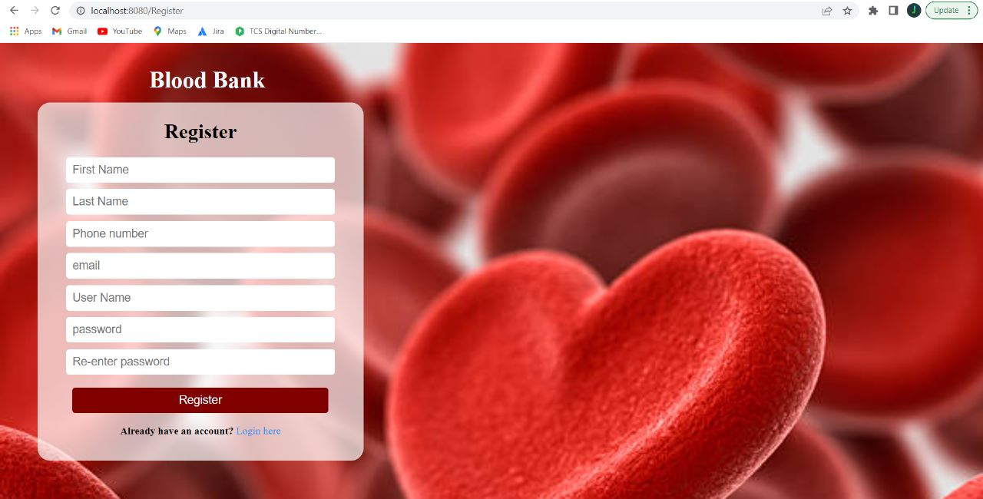
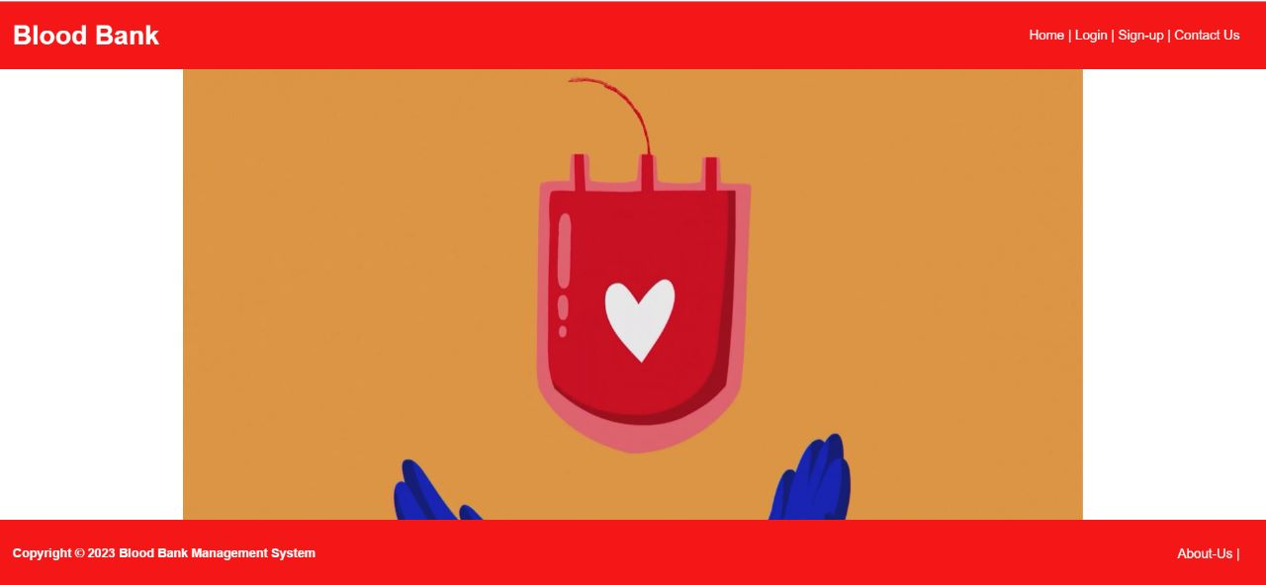
Demo
19 | © 2018 QuEST Global Services Pte Ltd.
19 | © 2018 QuEST Global Services Pte Ltd.
19 | © 2018 QuEST Global Services Pte Ltd.

Slide 20
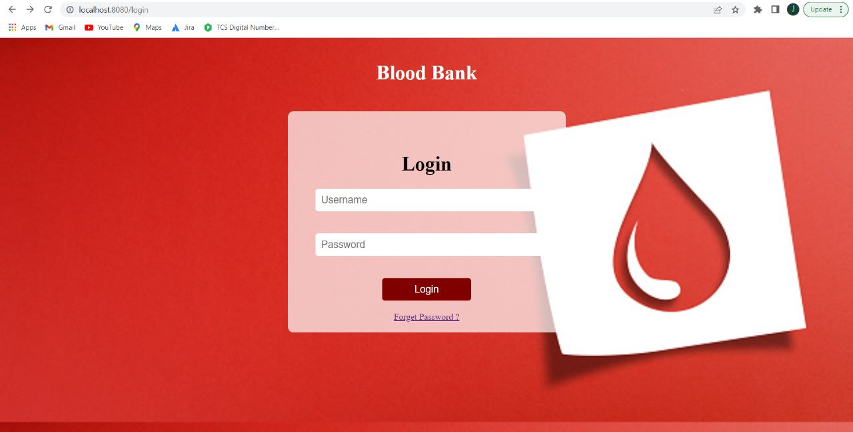
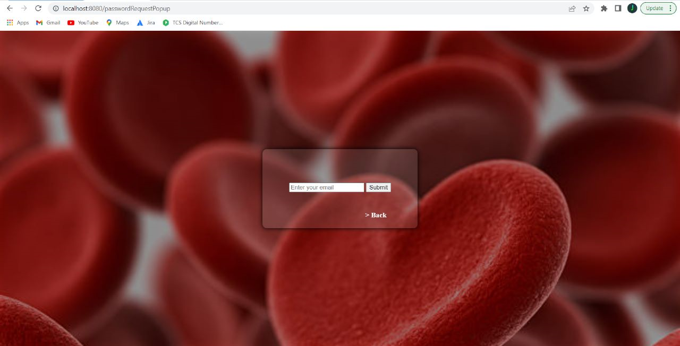
Demo
20 | © 2018 QuEST Global Services Pte Ltd.
20 | © 2018 QuEST Global Services Pte Ltd.
20 | © 2018 QuEST Global Services Pte Ltd.

Slide 21
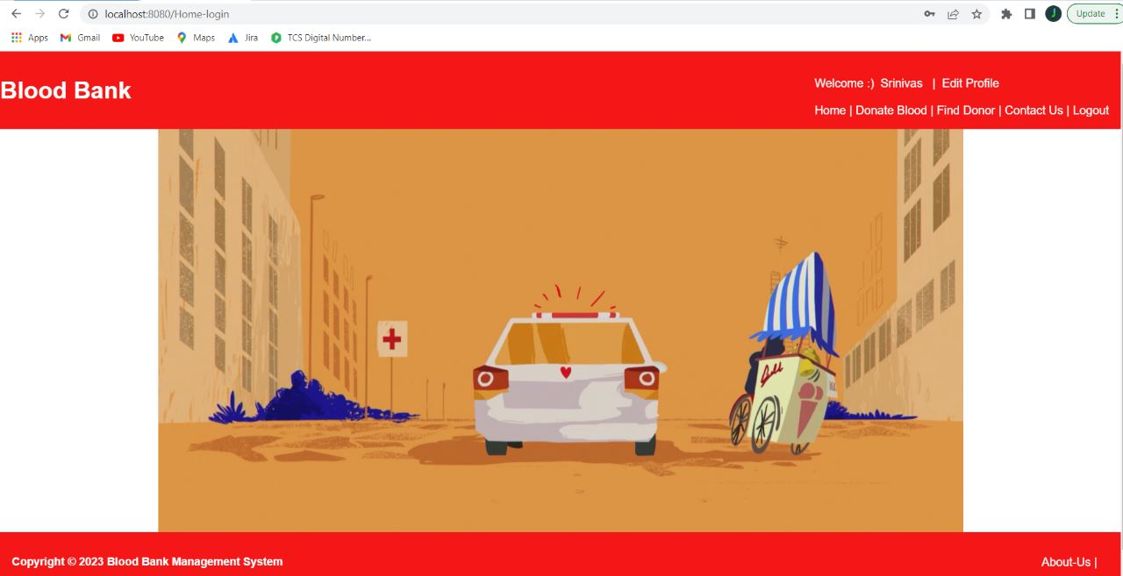
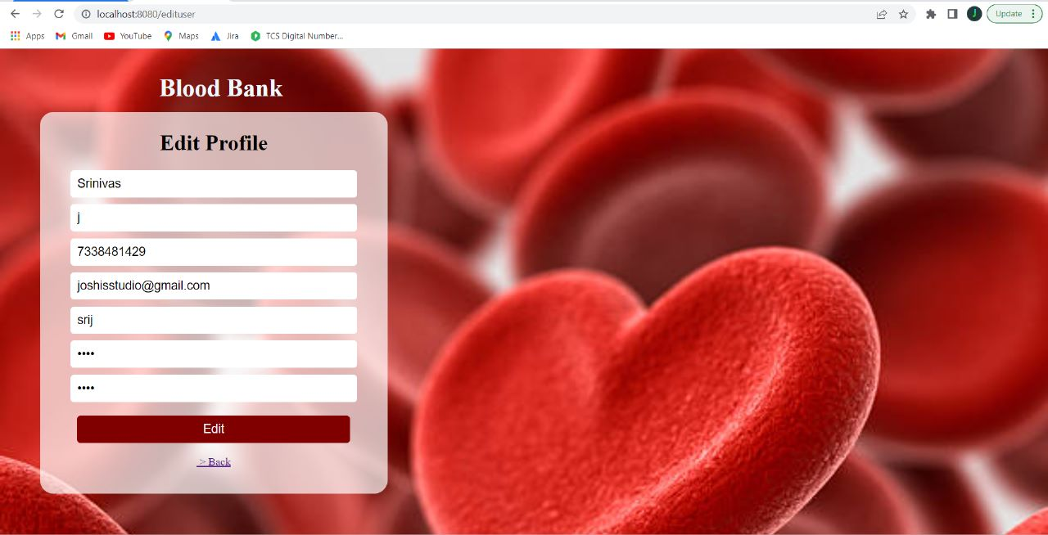
Demo
21 | © 2018 QuEST Global Services Pte Ltd.
21 | © 2018 QuEST Global Services Pte Ltd.
21 | © 2018 QuEST Global Services Pte Ltd.

Slide 22
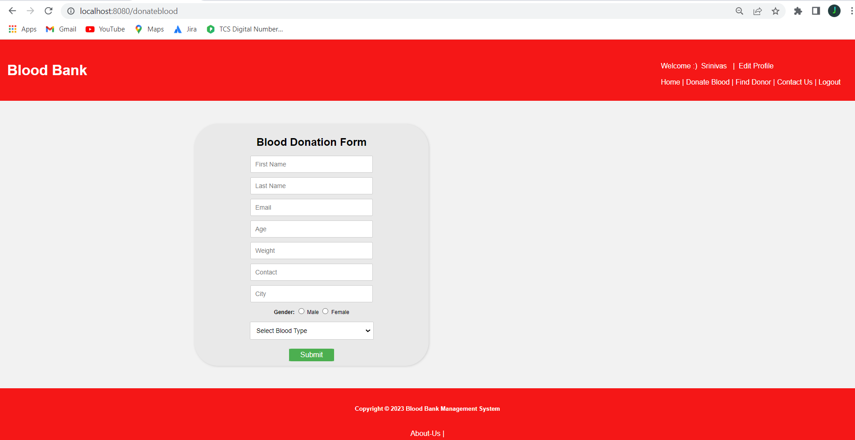
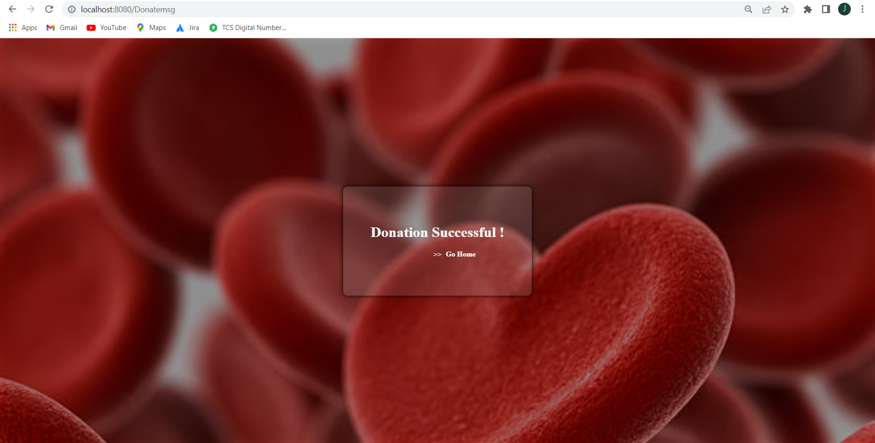
Demo
22 | © 2018 QuEST Global Services Pte Ltd.
22 | © 2018 QuEST Global Services Pte Ltd.
22 | © 2018 QuEST Global Services Pte Ltd.

Slide 23
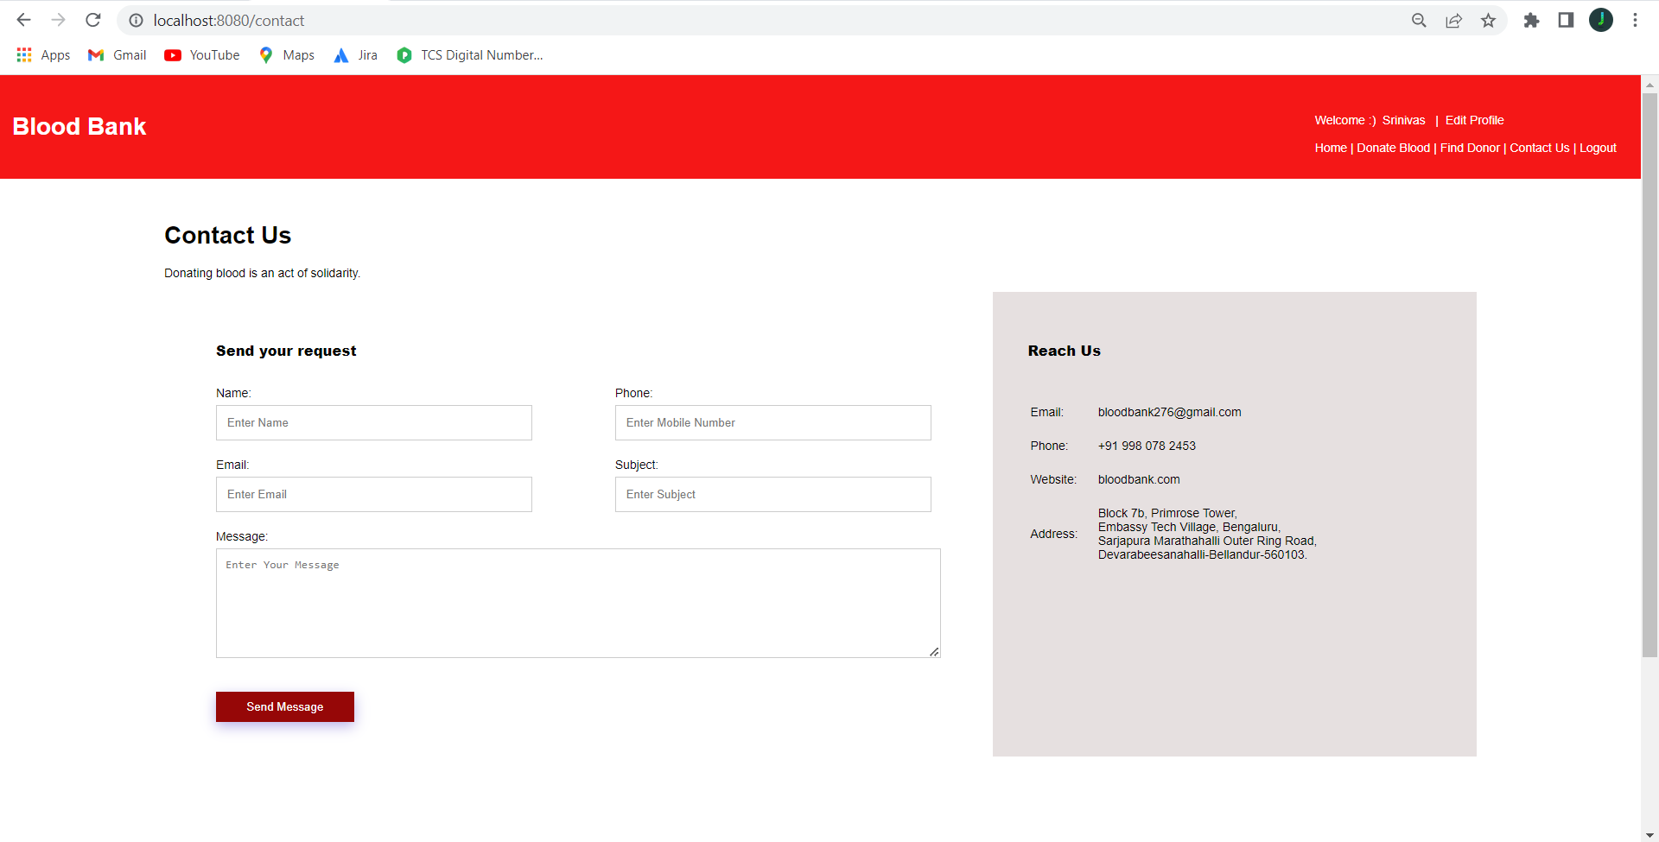
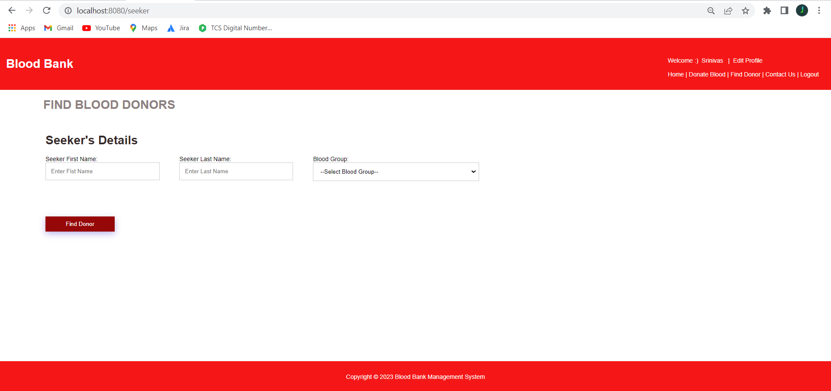
Demo
23 | © 2018 QuEST Global Services Pte Ltd.
23 | © 2018 QuEST Global Services Pte Ltd.
23 | © 2018 QuEST Global Services Pte Ltd.

Slide 24
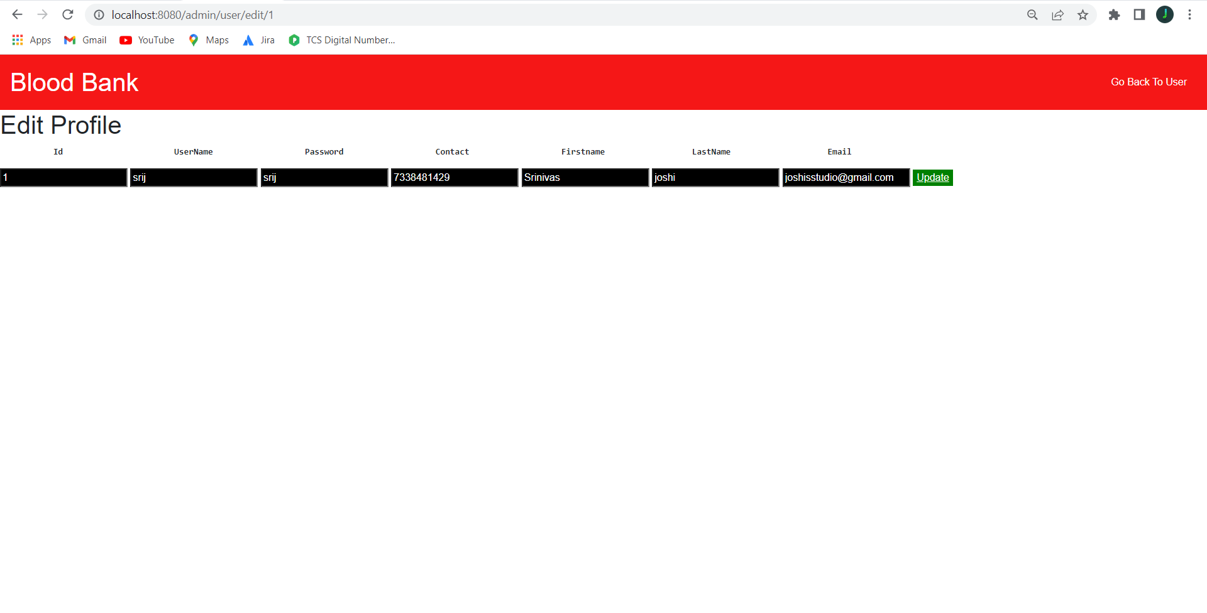
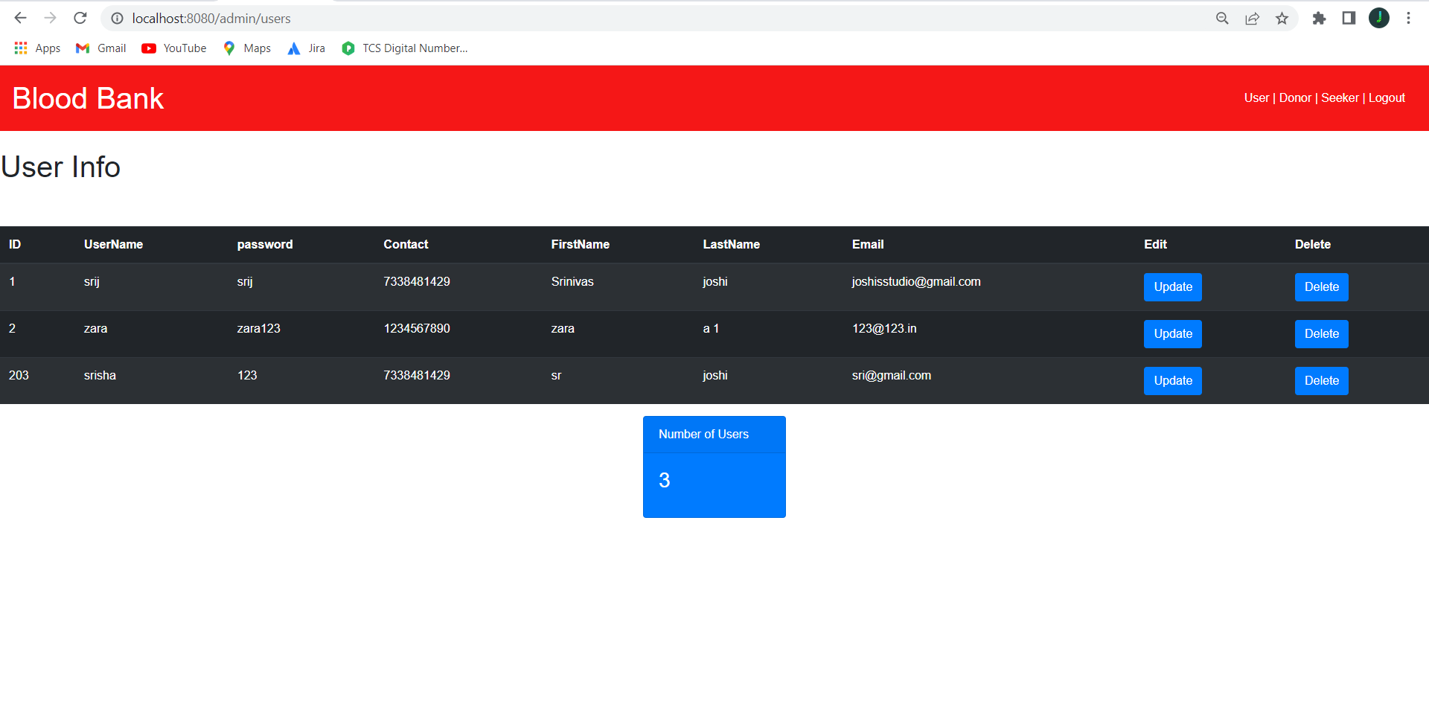
Demo
24 | © 2018 QuEST Global Services Pte Ltd.
24 | © 2018 QuEST Global Services Pte Ltd.
24 | © 2018 QuEST Global Services Pte Ltd.

Slide 25
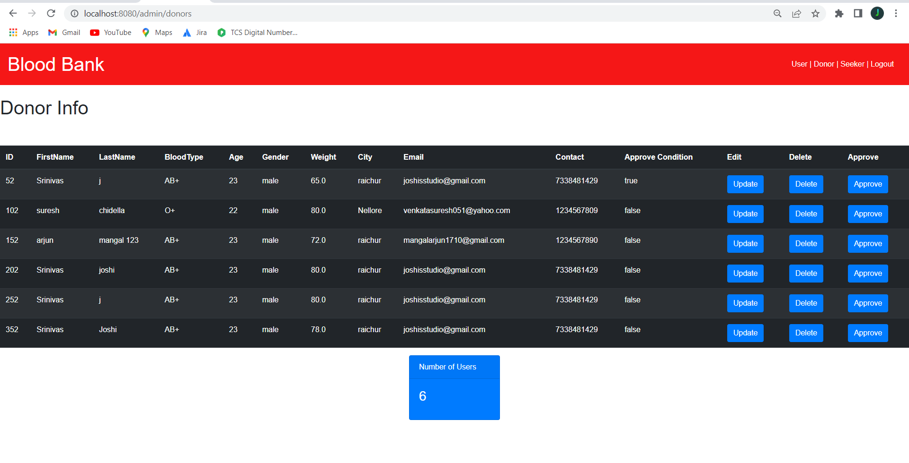
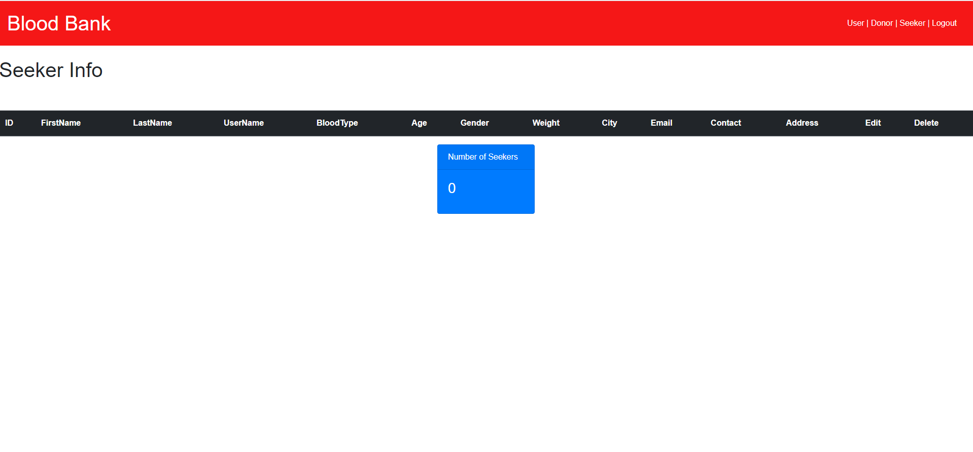
Demo
25 | © 2018 QuEST Global Services Pte Ltd.
25 | © 2018 QuEST Global Services Pte Ltd.
25 | © 2018 QuEST Global Services Pte Ltd.

Slide 26
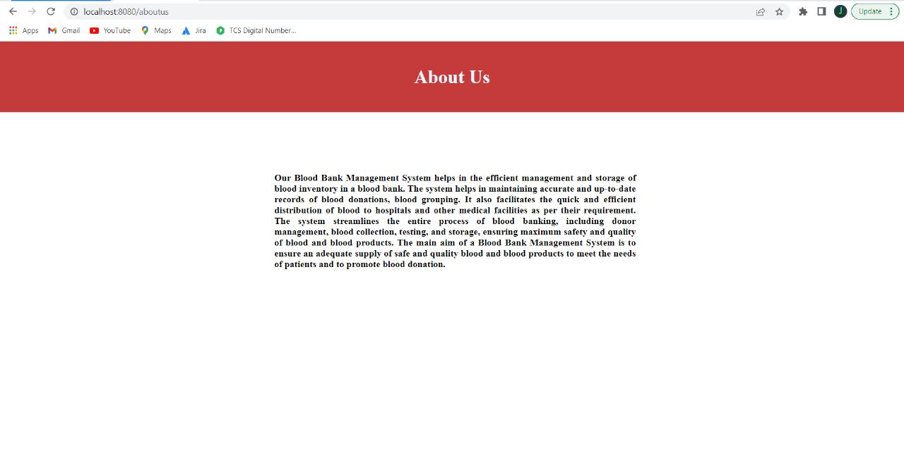
Demo
26 | © 2018 QuEST Global Services Pte Ltd.
26 | © 2018 QuEST Global Services Pte Ltd.
26 | © 2018 QuEST Global Services Pte Ltd.

Slide 27




Thank You
© 2018 QuEST Global Services Pte Ltd. The information in this document is the property of QuEST Global Services Pte Ltd. and may not be copied or communicated to a third party or used for any purpose other than that for which it is supplied without the written consent of QuEST Global Services Pte Ltd.
13 | © 2018 QuEST Global Services Pte Ltd. Confidential

