Slide 1

Basic Details of the Team and Problem Statement
Ministry/Organization Name/Student Innovation:
Government of Gujarat
PS Code: SIH1364
Problem Statement Title:
Fake Social Media Profile detection and reporting
Team Name: RavenTech – Fake profile spotter
Team Leader Name: Akshitha.K
Institute Code (AISHE): CMRN
Institute Name: CMR Engineering College
Theme Name: Blockchain & Cybersecurity

Slide 2
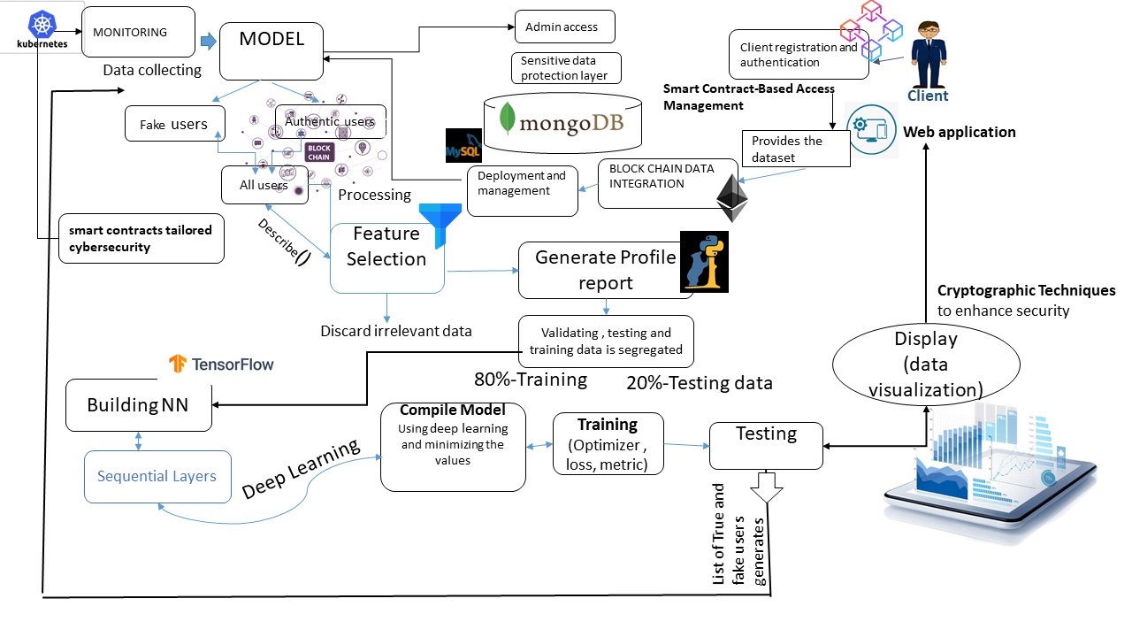

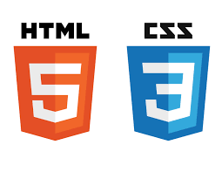
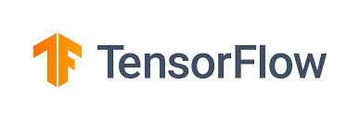










Idea/Approach Details:
Idea/solution/prototype:
Machine learning aids: It helps identify fake social media profiles by analyzing user behavior, content, and anomalies, adapting to evolving fraudulent tactics.
Blockchain-Based Identity Verification: User can opt to verify their identity, Their verified identity can be linked to their blockchain address for added trust. Decentralized Identity Management.
Smart Contract-Based Access Management
Machine Learning Algorithms: These algorithms are used to analyze and classify profiles based on their behavior and content.
Accuracy Prediction: Machine learning models predict the accuracy of profile authenticity assessments.
Designed Smart Contracts:
Develop smart contracts tailored cybersecurity se cases.
Data Visualization: It helps in visually representing and understanding the patterns and anomalies in social media data.
Machine Learning Model Improvement: Continuous model refinement is essential for better identification of fake profiles over time.
[object File][object File]
Technology Stack

Slide 3
Idea / Approach Details
Use Case's.
Behavioral Analysis: can be analyzed as part of behavioral analysis. For instance, rapidly accumulating a high number of followers with limited activity could be a sign of a fake account.
Determine the specific objectives and use cases for combining blockchain and cybersecurity in the model. For securing sensitive data, enhance authentication, or ensure the integrity of critical records.
Image and Profile Analysis: feature can be considered as part of profile analysis. Fake profiles may not use custom background images or may use generic images.
Continuous Monitoring: Monitoring changes in the values of these features over time can be an effective way to detect suspicious activity
User Education: User education is crucial to emphasize account verification and caution when encountering profiles with extreme feature values, enhancing online safety.
Data Interpretation
It focuses on detecting fake social media profiles using various machine learning methods. The dataset used includes profiles categorized as genuine and fake.
The analysis involves several machine learning models, including Neural Networks, Random Forest, and XG Boost, to determine the authenticity of social media profiles. These models are trained on features
The accuracy of the models is evaluated, with XG Boost achieving the highest accuracy of 99.46%. Random Forest and Artificial Neural Network (ANN) also demonstrate high accuracy levels.
Pre-processing of the dataset involves selecting numerical features and handling missing values. The models are trained and tested using appropriate optimizers, loss functions, and activation functions.
Blockchain for Data Integrity:
• Utilize block chain to store and secure the dataset used for training and testing machine learning models. This ensures that the data remains tamper-proof and can be verified by anyone.
Secure Communication: blockchain for secure communication channels.
Audit Trails and Transparency: for monitoring and verifying Cybersecurity
activities.
Cryptographic Techniques:
to enhance security. Implement encryption for data to protect from unauthorized access ,transactions and cybersecurity events to detect and respond to security threats promptly.
Through interaction flow, website combines user registration, authentication, real-time behavioural analysis, and machine learning model scoring to help clients identify and interact with genuine users while safeguarding against fake user profiles on your platform. The integration of blockchain ensures data security and transparency in the process.
Dependencies / Show Stoppers.
Data Quality and Quantity: Insufficient or noisy training data can lead to poor model performance.
Evolving Tactics: Fraudsters continually adapt their techniques to evade detection. Machine learning models may struggle to keep up with evolving tactics, requiring continuous model updates and retraining.
Feature Engineering: Selecting relevant features and creating meaningful feature representations can be challenging. The choice of features significantly impacts the model's ability to detect fake profiles.

Slide 4
Team Member Details
Team Leader Name: K Akshitha
Branch (Btech/Mtech/PhD etc): Btech Stream (ECE, CSE etc): CSE-(DataScience) Year (I,II,III,IV): III
Team Member 1 Name: M Srishanth
Branch (Btech/Mtech/PhD etc): Btech Stream (ECE, CSE etc): CSE-(DataScience) Year (I,II,III,IV): III
Team Member 2 Name: P Giridhar
Branch (Btech/Mtech/PhD etc): Btech Stream (ECE, CSE etc): CSE-(DataScience) Year (I,II,III,IV): III
Team Member 3 Name: K Sai Shivaji
Branch (Btech/Mtech/PhD etc): Btech Stream (ECE, CSE etc): CSE-(DataScience) Year (I,II,III,IV): III
Team Member 4 Name: V Harshitha
Branch (Btech/Mtech/PhD etc): Btech Stream (ECE, CSE etc): CSE-(DataScience) Year (I,II,III,IV): III
Team Member 5 Name: K.Bhavana
Branch (Btech/Mtech/PhD etc): Btech Stream (ECE, CSE etc): CSE-(DataScience) Year (I,II,III,IV): III
Team Mentor 1 Name: Dr. M Laxmiah
Category (Academic/Industry): Academic Expertise (AI/ML/Blockchain etc): Domain Experience (in years): 20+
Team Mentor 2 Name: Dr. Toran Verma
Category (Academic/Industry): Academic Expertise (AI/ML/Blockchain etc): ML,CS Domain Experience (in years): 20+

