Slide 1
zomato
Power BI Dashboard Project
BANGALORE RESTAURANT
ANALYTICS
End-to-end data analytics case study using the Zomato Bangalore
restaurants dataset — data cleaning, DAX measures, and an
interactive two-page dashboard.
Srishanth P | Computer science & engineering.

Slide 2
Project Objective
Bangalore has thousands of restaurants across dozens of localities, and the raw Zomato listings data is messy — duplicate names, inconsistent text, mixed data types. The goal was to clean this dataset and turn it into a dashboard that a business team could actually use to make decisions.
Dataset
Zomato Bangalore Restaurants (Kaggle)
~7,000 restaurants after cleaning · 92 locations · 15M+ votes
Clean the raw dataset
Build a data model
Fix column types, trim text, and remove noise in Power Query.
Structure the table for fast, reliable DAX calculations.
Design KPIs & visuals
Enable self-serve exploration
Surface the numbers that matter to restaurant owners and analysts.
Slicers for location, cuisine, rating, and more.

Slide 3
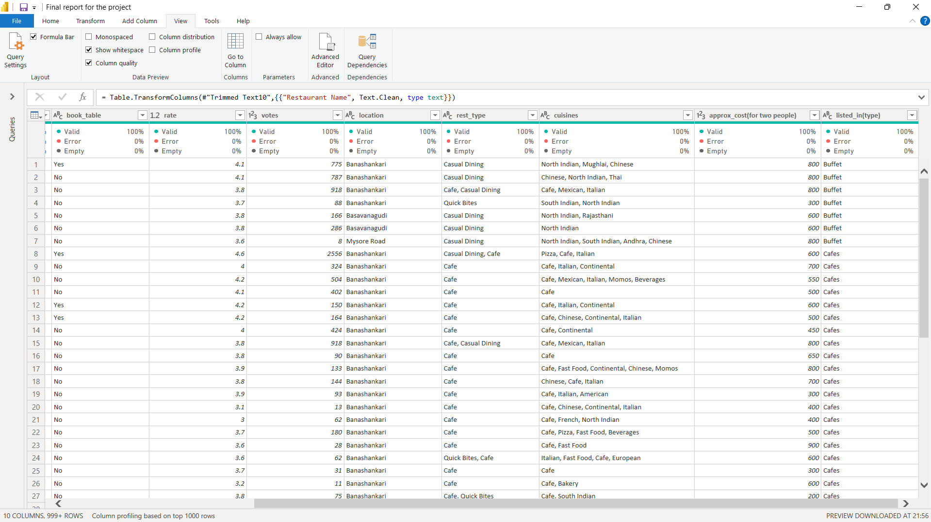
Step 1 — Cleaning the Raw Data
Worked in Power Query to fix data quality issues before the data ever reached the report.
What was done
Applied Text.Clean and Trim to strip hidden characters from every text column
Fixed data types across all 10 columns — rate, votes, and cost as numbers, not text
Column quality checks confirm 0% errors and 0% empty values
Standardized the rest_type and cuisines fields for consistent grouping

Slide 4
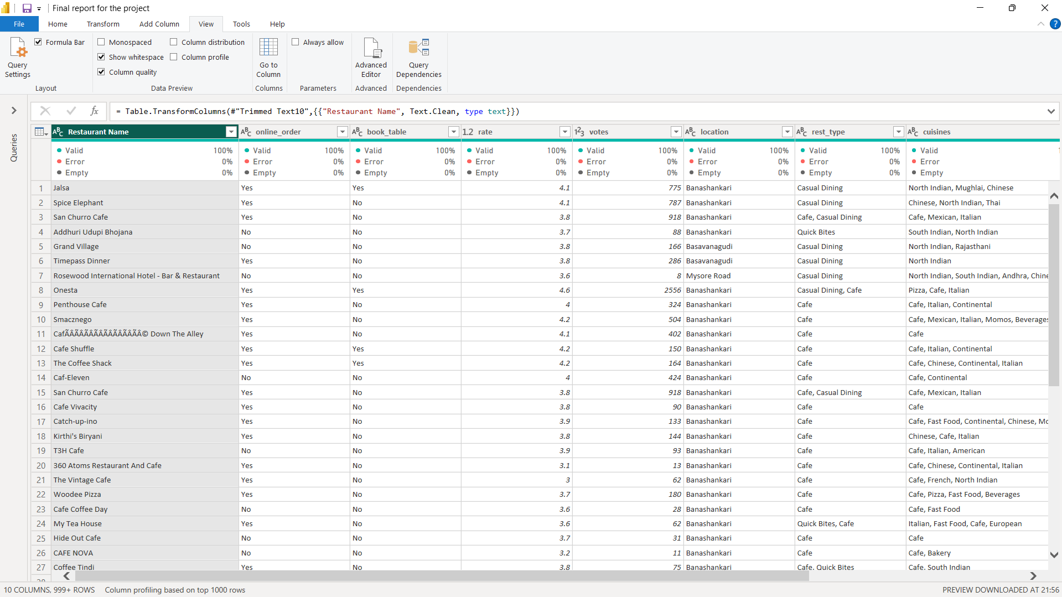
Step 2 — Structuring the Table
Once types were fixed, restaurant name, online order, and booking columns were added back in the right order for modeling.
What was done
Restaurant Name, online_order, and book_table brought in as clean, typed columns
Duplicate rows (e.g. repeated cafe entries) identified for the model to handle correctly
Encoding issues in restaurant names flagged for further cleanup
Final table: 11 columns, 50000z+ rows, ready for the data model

Slide 5
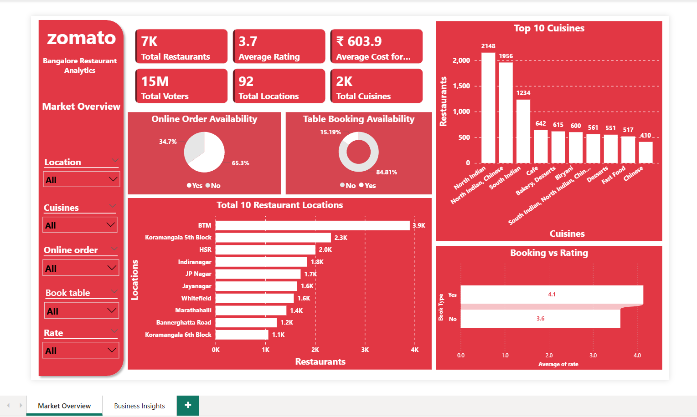
Dashboard — Market Overview
Page 1 of 2 · KPI cards, location breakdown, cuisine ranking, and online order / table booking split, all filterable by slicers on the left.

Slide 6
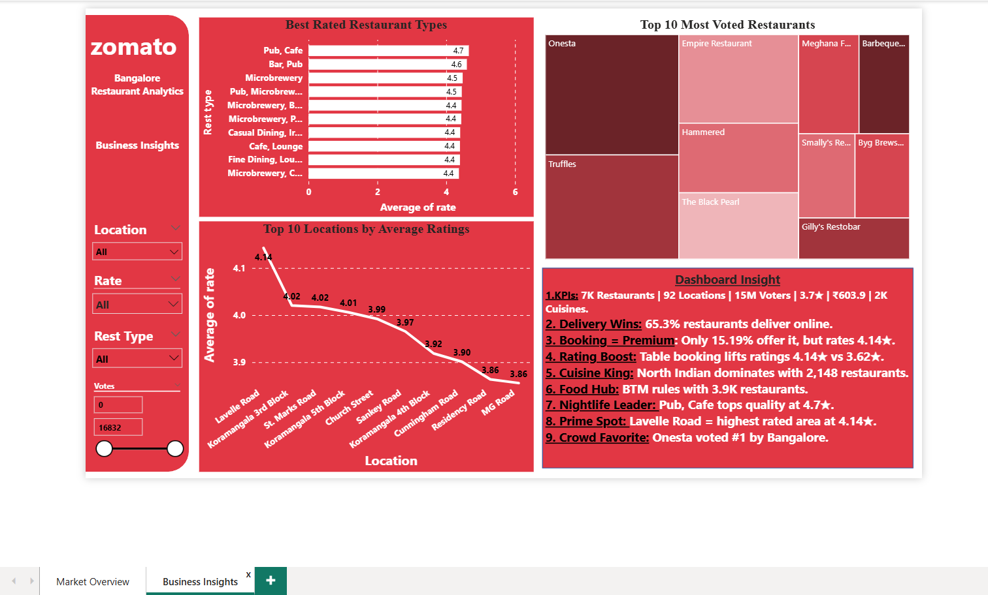
Dashboard — Business Insights
Page 2 of 2 · best-rated restaurant types, top locations by rating, most-voted restaurants, and a written insight summary for quick reading.

Slide 7
Key Insights
65.3%
4.14★ vs 3.62★
North Indian
of restaurants offer online ordering, but only 15.2% offer table booking
restaurants with table booking rate meaningfully higher than those without
is the most common cuisine, with 2,148 restaurants listing it
BTM
Pub, Cafe
Lavelle Road
has the highest restaurant density of any locality, at 3.9K listings
is the top-rated restaurant type combination, averaging 4.7★
is the highest-rated location in the city, at 4.14★ average

Slide 8
Tools & Skills Used
Power Query (M)
DAX Measures
Power BI Desktop
Data Cleaning
Dashboard Design
Slicers & Filters
Next Steps
Repository
• Push this .pbix, screenshots, and this report to GitHub with a clear README
• Add DAX measure documentation alongside the model
• Extend with a cost-vs-rating analysis in a future version
https://github.com/srishanthpaneerselvam-eng/Zomato-bangalore-restaurant-analytics
Suggested README sections: Overview, Dataset, Data Cleaning Steps, Dashboard Screenshots, Key Insights, Tools Used

