Slide 1
HTTP
HyperText Transfer Protocol
A Presentation by : Srishti Kainth
Roll No : 2301730175
Course : BTech CSE AIML – C
Topic : Computer Networks

Slide 2

What is HTTP?
HTTP stands for HyperText Transfer Protocol
It is the foundation of data communication on the Web
Defines how messages are formatted and transmitted
Works on the client-server model
Called the 'Language of the Web'

Slide 3
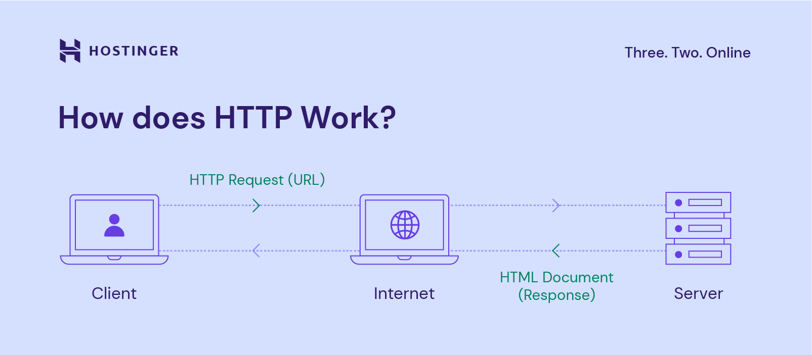
How HTTP Works?
1. Client (browser) sends an HTTP Request to server
2. Server processes the request
3. Server sends back an HTTP Response
4. Browser renders the received content
CLIENT
(Browser)
SERVER
Common HTTP Methods
GET – Retrieve data
POST – Submit data
PUT – Update data
DELETE – Remove data

Slide 4
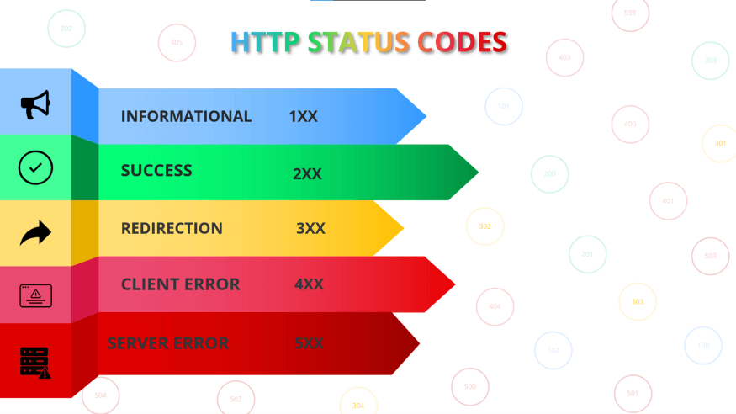
HTTP Status Codes
1xx
Informational
Request received, processing
4xx
Client Error
Bad request from client
404 Not Found, 403 Forbidden
2xx
Success
Request successfully processed
200 OK, 201 Created
5xx
Server Error
Server failed the request
500 Internal Server Error
3xx
Redirection
Further action needed
301 Moved Permanently

Slide 5
HTTP vs HTTPS
HTTP
HTTPS
No encryption
Data sent as plain text
Port 80
Faster but less secure
Used for non-sensitive data
SSL/TLS encryption enabled
Data is encrypted & secure
Port 443
Slightly slower but secure
Required for banking, login pages

Slide 6
ADVANTAGES & DISADVANTAGES
✔ Advantages
✘ Disadvantages
Simple and easy to use
Platform independent
Stateless – reduces server load
Supports multiple data formats
Widely used and well-supported
No encryption – data can be intercepted
Stateless – no session memory
Vulnerable to man-in-the-middle attacks
No data integrity check
Not suitable for sensitive transactions

Slide 7
Applications of HTTP
Web Browsing
Loading websites in Chrome, Firefox, etc.
REST APIs
Communication between web services and apps
File Transfer
Downloading files from web servers
Email Services
Webmail applications like Gmail
Streaming
Delivering audio and video content online
IoT Devices
Smart devices communicating over the web

Slide 8
THANK YOU!

