Slide 1


Presentation by: Varshini & Srishti
Supply chain attacks
Summer Internship
Dr. Nagasundhari
2024

Slide 2
Introduction
Supply chain attacks present a substantial threat to the software industry through the exploitation of security vulnerabilities in third-party suppliers, resulting in widespread breaches.
While efforts have focused on investigating the origins like the SolarWinds breach, there remains a need for advanced visualization tools to predict future vulnerabilities severity and a novel approach integrating dependency-based vulnerability assessments for threat mitigation is proposed in this study.

Slide 3
Objectives
VULNERABILITIY VISUALIZATION
Develop visual aids to comprehend and convey the spread and extent of vulnerabilities throughout cloud elements
NPM ADUIT
Leverage data obtained from npm audit to identify and showcase vulnerabilities in npm packages through visual representations, highlighting significant areas of concern within the npm ecosystem
SEVERITY PREDICTOR
Create a prognostic framework for evaluating and predicting the degree of vulnerabilities, and offer strategies for reducing their impact

Slide 4
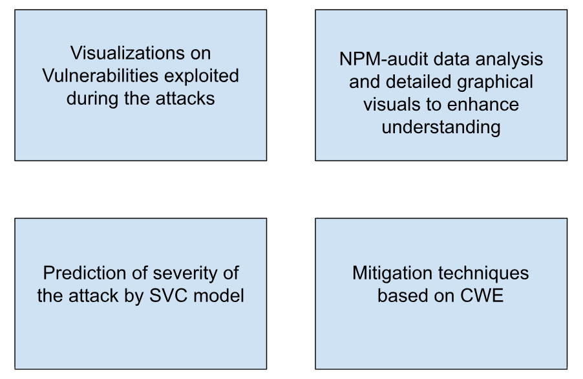
Implementation

Slide 5
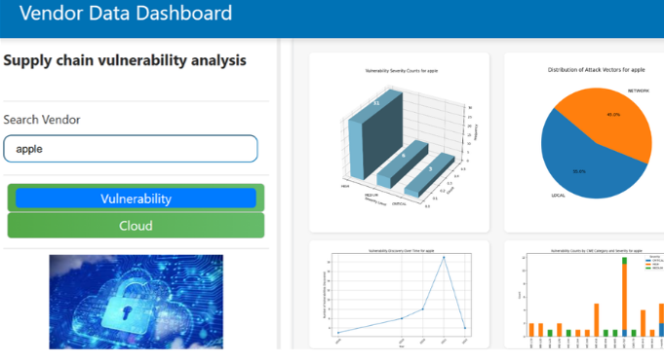
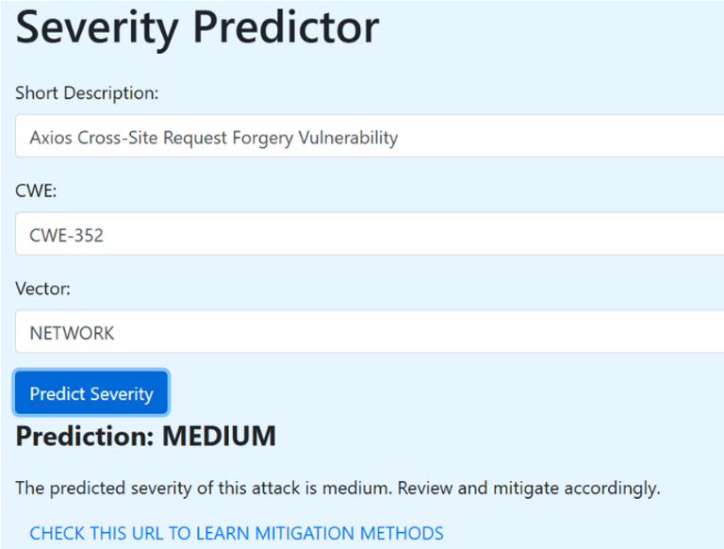
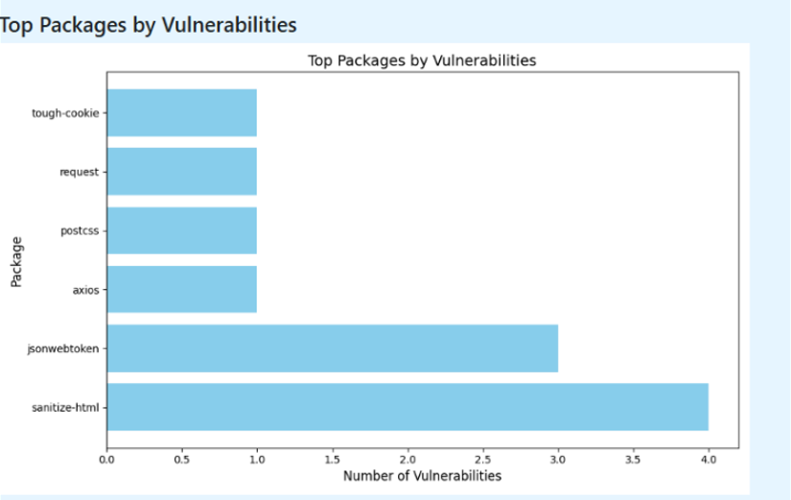
Results

Slide 6
Conclusion
The visualizations facilitate planning, detection, and analysis, creating an effective early warning system for CSPs and their third-party vendors. This enables proactive mitigation to protect computing systems from potential threats.
Analyzes vulnerability trends across packages and vendors, the system can identify weak links. This detector focuses on common attack entry points and vulnerable dependencies, enhancing mitigation strategies.

