Slide 1
CREDIT CARD FRAUD DETECTION
By
Srishti Chandrakar

Slide 2
Acknowledgement
I am thankful to IIT Kanpur for their constant throughout this learning process. I am thankful to Rahul Sir for guiding us and helping us to grab depth knowledge about Machine Learning. I am also thankful to Vinit sir for teaching and helping us understand the concept.
So, through this entire course I learned a lot about the world of Machine learning from basics to much more. Now, I am implementing my knowledge through this project of credit card fraud detection.

Slide 3
Aim Of The Project
The Credit Card Fraud Detection Problem includes modeling past credit card transactions.
This model contains fraud as well as normal transactions.
This model is then used to identify whether a new transaction is a fraud or not.
Our aim here is to detect 100% of the fraud transactions

Slide 4
Observations From The Dataset
The data set is highly imbalanced consisting of 492 frauds in a total of 284,807 observations.
We observed that only 0.172% of the data are fraud cases. Hence there are are a very few fraud cases as compared to normal cases.
The dataset consists of ‘Principal Component Analysis (PCA)’ transformed features, namely V1 to V28.
The ‘Time’ and ‘Amount’ features are not transformed data.
There is no missing value in the dataset.

Slide 5
Working
PreProcessing
In this dataset, feature scling is implemented tgo scle the values of the Amount column of the dataset.
Feture scaling is implemented to scale the values within the same proportional range. Typically, scale range is between 0 & 1 in case of normalization.
Normaliztion of the Amount is done using standard scaler.
Initializing
The dataset is initialized where:
x includes the columns excluding the class column
y includes the class column

Slide 6
Model Prediction
Random Forest
Random forests or random decision forests are an ensemble learning method for classification. Random forest algorithm creates decision trees on data samples and then gets the prediction from each of them and finally selects the best solution by means of voting.
On applying Random Forest Classification on the dataset we get:
accuracy score = 0.9995318516437859 i.e 99.95%

Slide 7
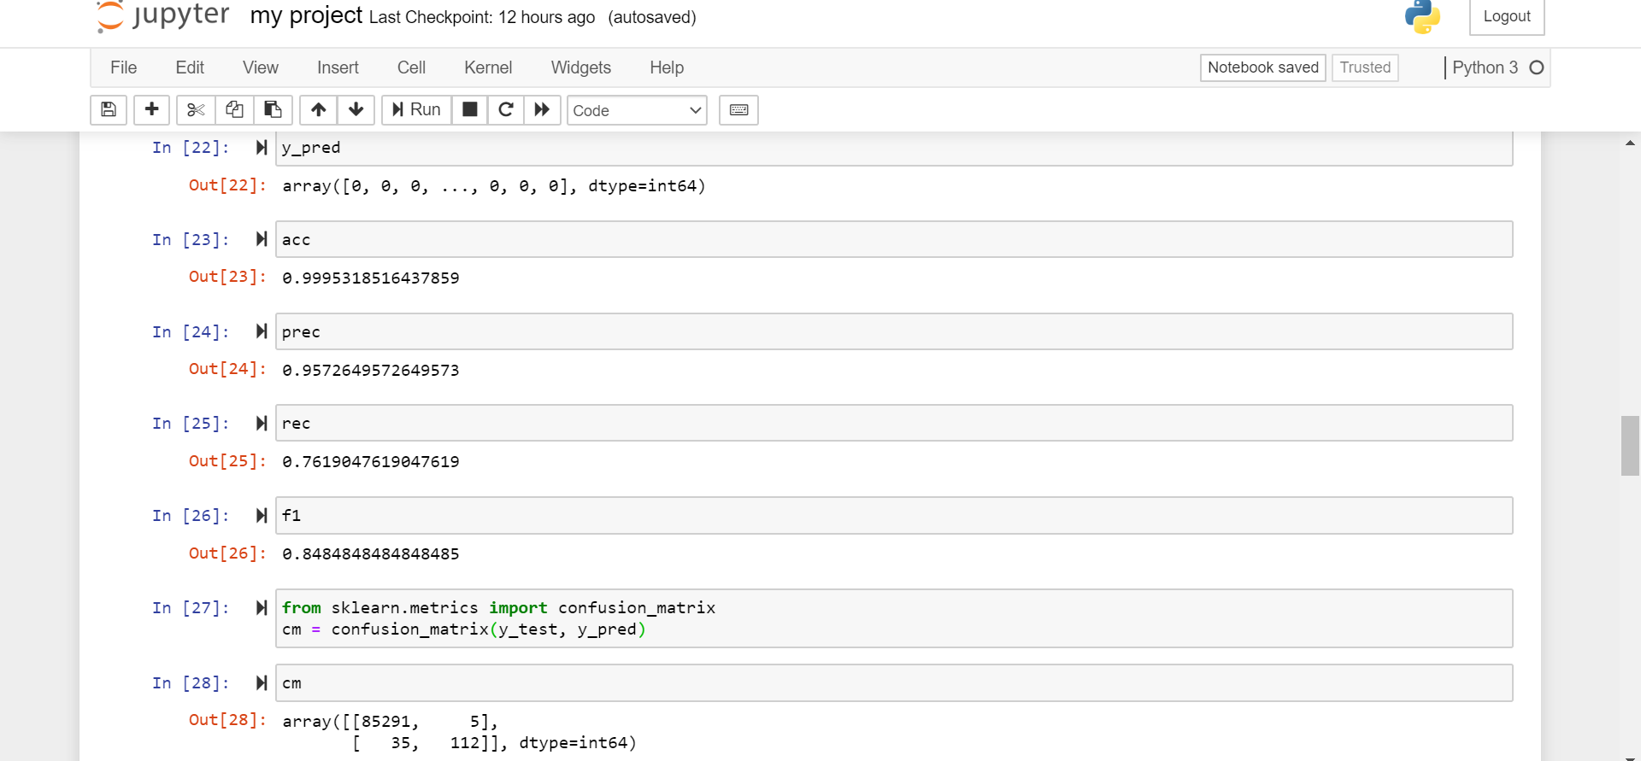

Slide 8
SVM
Support vector machines are supervised machine learning algorithms which are used both for classification and regression. An SVM model is basically a representation of different classes in a hyperplane in multidimensional space. The goal of SVM is to divide the datasets into classes to find a maximum marginal hyperplane.
On implementing svm in our dataset we get:
accuracy score = 0.9982795547909132 i.e 99.82%

Slide 9
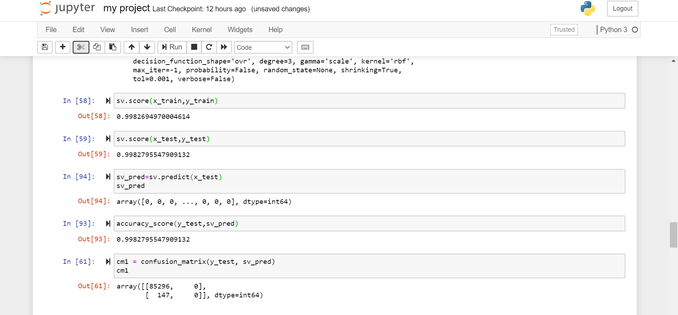

Slide 10
Logistic Regression
Logistic regression is a supervised learning classification algorithm used to predict the probability of a target variable.
On applying logistic regression in our dataset we get:
accuracy score = 0.9989817773252344 i.e 99.89%

Slide 11
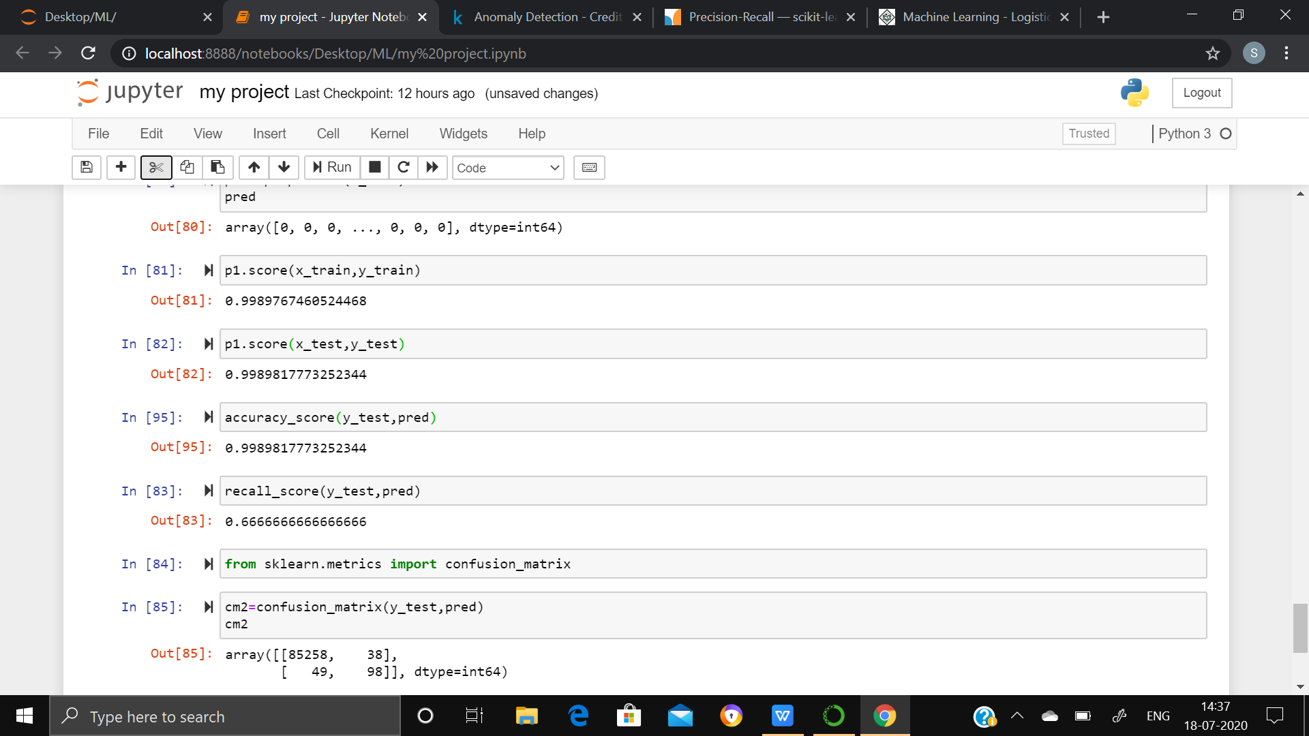

Slide 12
Counclusion
When comparing error and accuracy score for 3 models , the Random Forest performed much better than the SVM and Logistic Regression.
So, overall Random Forest Method performed much better in determining the fraud cases.

