Slide 1
Web Tech Project
EDGE
Website for learning, using and interacting with logic gates.
Srinjoy Das – 01FB15ECS309
Sristhi Mishra – 01FB15ECS310
Pooja - 01FB16ECS717

Slide 2
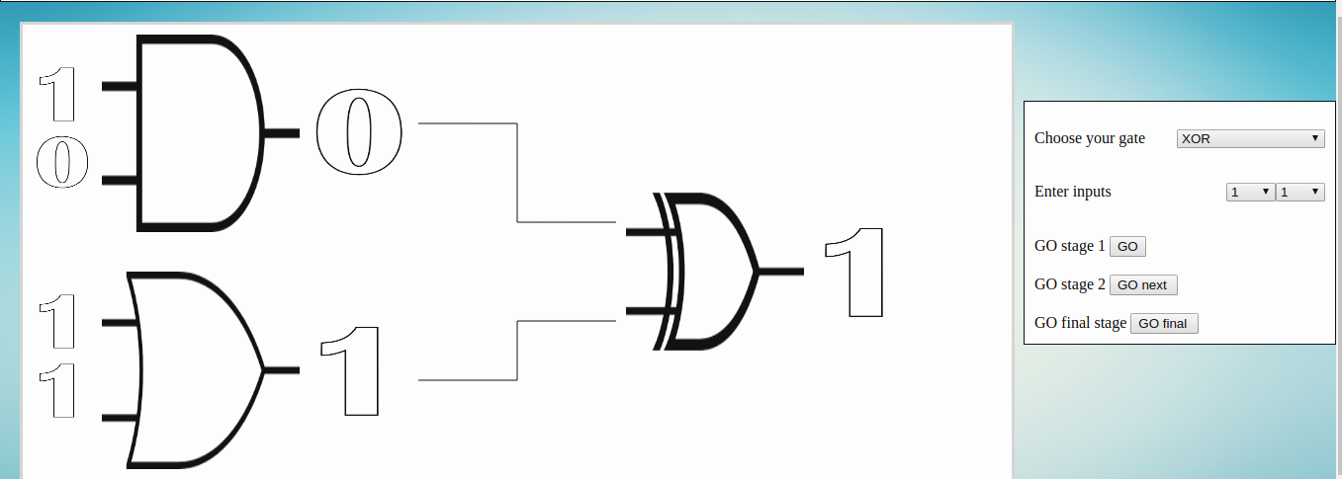
Logic Gate Calculator
The canvas is used for the logic gate calculator
Each 1, 0 and individual gates are separate images
The canvas is totally dynamic, with gates and values updating with every user input
4 inputs for now, but scaleabale for increase in gates and inputs.

Slide 3
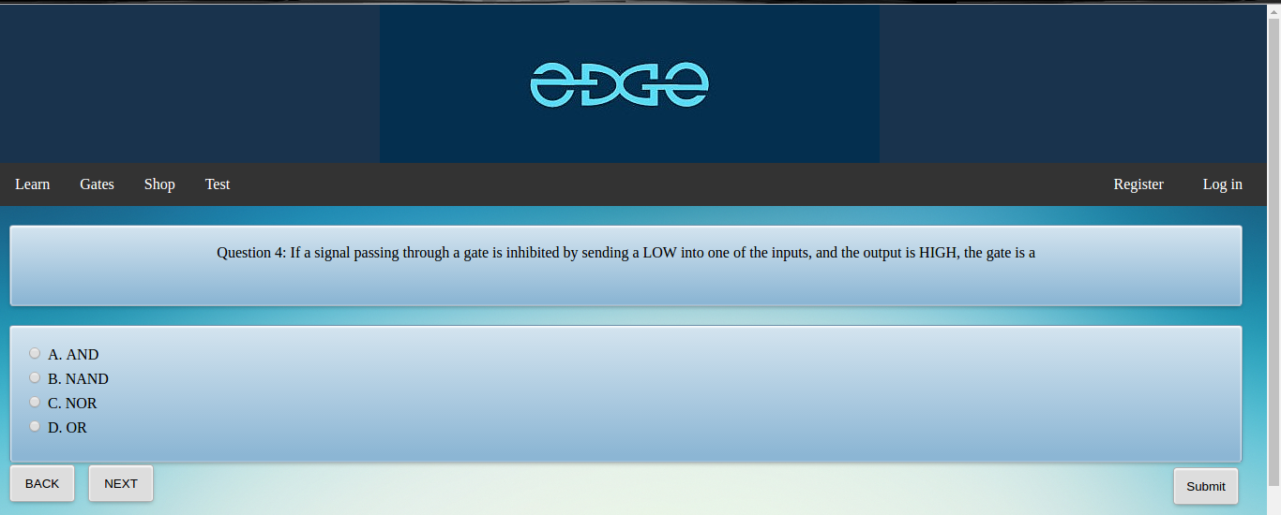
AJAX calls to get questions/options from server
Php + MySQL to get information from databse
JavaScript to keep a history of user answers and save answers

Slide 4
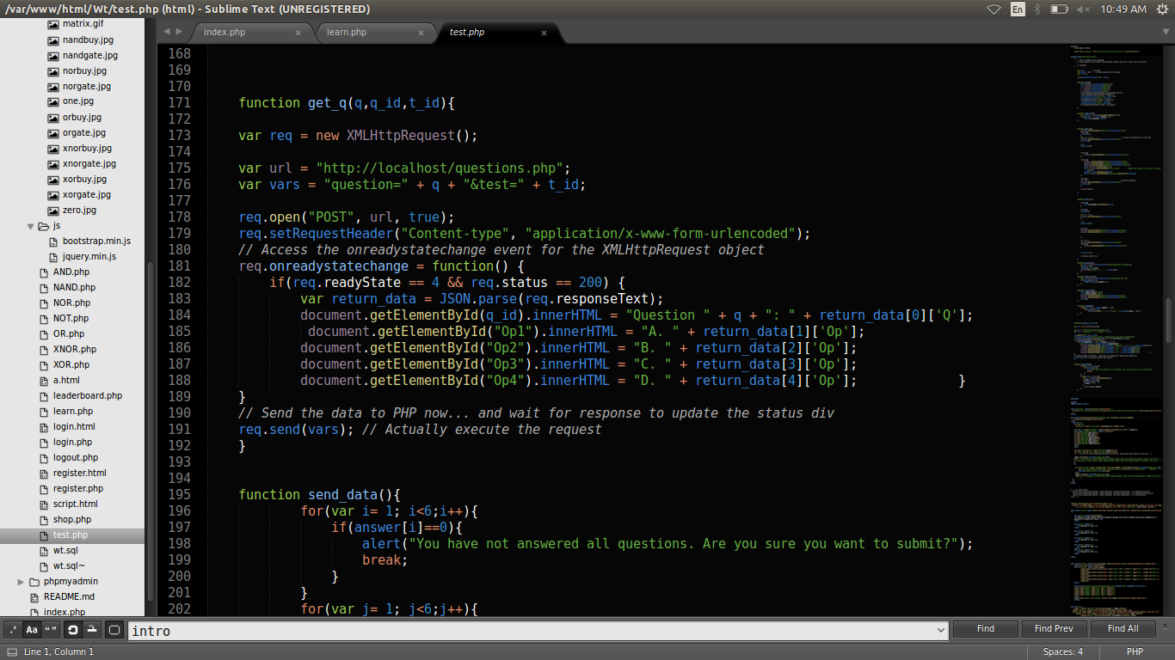
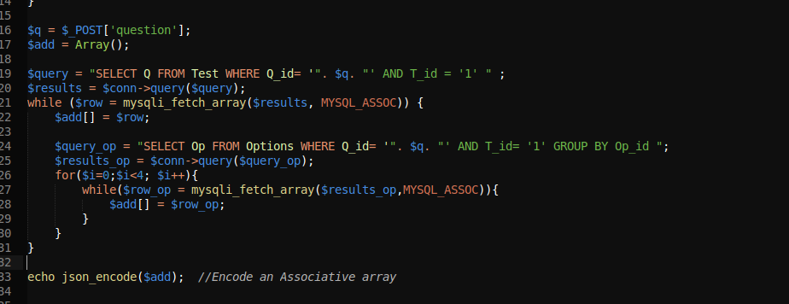
AJAX call and MySQL

Slide 5
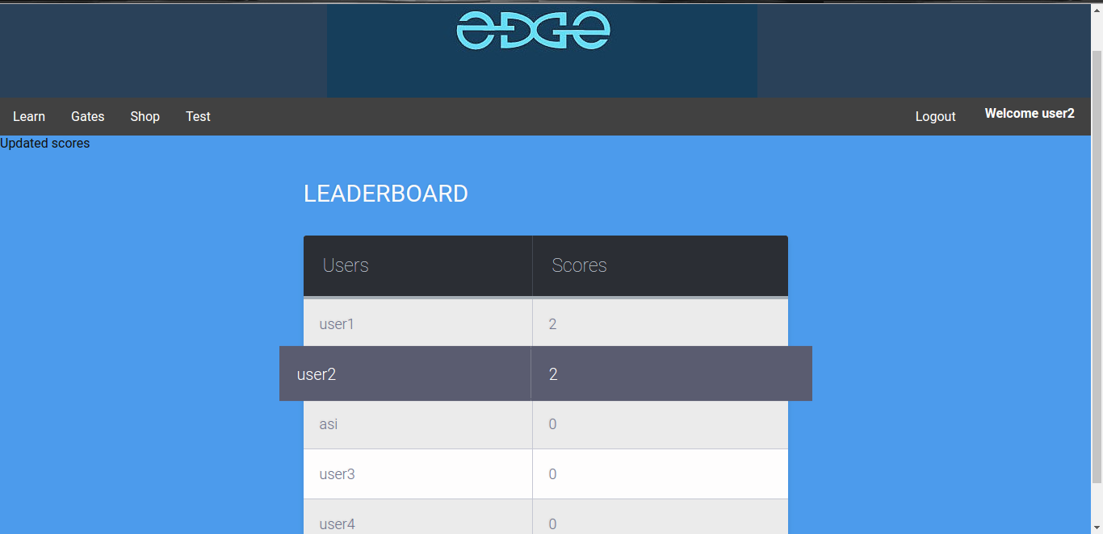
Php to calculate scores based on answer key in database
Php + MySQL to get information/user's scores from database

Slide 6
Technologies
HTML/ CSS used for design of pages using background images and gifs.
Nav bar with drop down menu designed using nav tag and css, using css hover: function
Javascript for interacting with the canvas and keeping a user history in the quiz.
Php for server-side processing and MySQL database management of user ids, quiz questions and answers.

Slide 7
Features
Circuit simulation using basic gates - HTML5 canvas to draw gates and paths. Javascript for logical functions and DOM manipulation.
Quizzes with leaderboard - Javascript to render questions and answers through an AJAX request to server. PHP and MySQL used to load questions, answers, check users' score, and return a table of top scores.

Slide 8
Features
User login - PHP and MySQL to start a sessions for a user and save their data while browsing on the site.
Shopping - Javascript, HTML, CSS to display products and links to buy them.
Info pages - HTML and CSS to display educational information on gates.

Slide 9
Future enhancements
Make the canvas more dynamic, with user inputs being taken dirtectly on the canvas and and gates updating values instantly without need of an external control box. Infinite scalability
Inlcude multiple categories of quizzes.
Add a shopping cart for each user.
Account verification through email.

Slide 10
Thank you!

