Slide 1
Smart Product Labeling and Traceability System for Quality Control Automation
SUBMITTED BY: MENTOR:
SHRUSTI PROF. SHOBHANA
ROOPA
VAISHNAVI S DHALI

Slide 2
INTRODUCTION
Definition of Smart Labeling
Smart labeling involves the use of innovative technologies such as QR codes, RFID, and IoT sensors to track products in real-time, enhancing visibility throughout the supply chain.
Importance of Traceability
Traceability is critical for ensuring product quality and safety. It allows companies to track products from origin to end-user, facilitating quick recalls when necessary.
Automation in Quality Control
Implementing automated systems in quality control processes minimizes human error, improves efficiency, and ensures consistent quality in manufacturing and distribution.

Slide 3
OBJECTIVES
Automate Product Labeling Process:
Implement smart labeling technologies (e.g., QR codes, RFID) to ensure accurate and consistent labeling of products in real-time.
Enhance Traceability:
Enable end-to-end tracking of products through the supply chain for better visibility, traceability, and accountability.
Improve Quality Control:
Integrate sensors, scanners, and data collection tools to monitor and verify product quality at each stage of production.

Slide 4
PROBLEM STATEMENT
In modern manufacturing and supply chain environments, ensuring product quality and traceability remains a critical challenge. Traditional labeling and tracking methods often involve manual data entry and disconnected systems, leading to issues such as mislabeling, data inconsistency, and limited visibility across the production process. These inefficiencies can result in quality control failures, costly product recalls, regulatory non-compliance, and reduced customer trust.

Slide 5
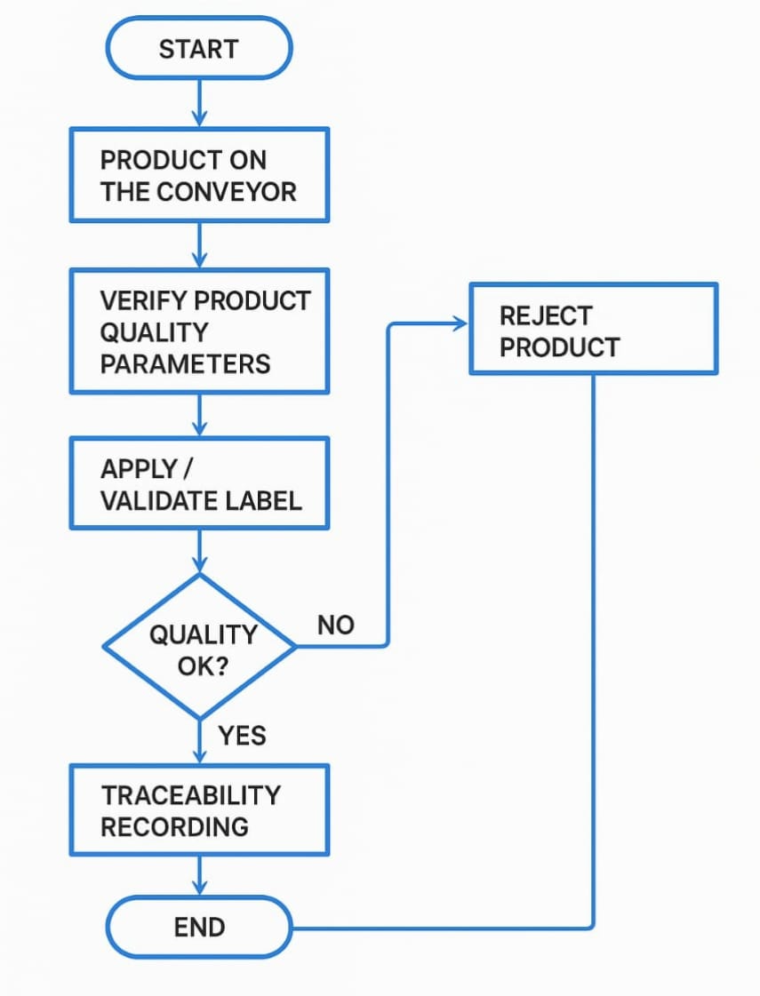
FLOW DIAGRAM

Slide 6
ADVANTAGES
Real-Time Quality Monitoring
Enhanced Traceability
Regulatory Compliance
Fater Recall Management
Improved Inventory and Supply Chain Management

Slide 7
APPLICATIONS
Pharmaceutical and Healthcare
Automotive Industry
Retail and E-commerce
Cosmetics and Personal Care
Electronics and High-Tech

Slide 8
CONCLUSION
The implementation of a Smart Product Labelling and Traceability System marks a significant advancement in automating quality control and supply chain transparency. By integrating technologies like RFID, QR codes, IoT sensors, and cloud-based tracking, organizations can ensure accurate, real-time monitoring of products from raw materials to end users.

Slide 9
THANK YOU

