Slide 1

PROJECT PRESENTATION “Voice-Based Email Service for Visually Challenged People”
Srishti Verma
Roll. No.: 201896
B-Tech CSE (Core), 4th Sem
Session: 2020-2021

Slide 2
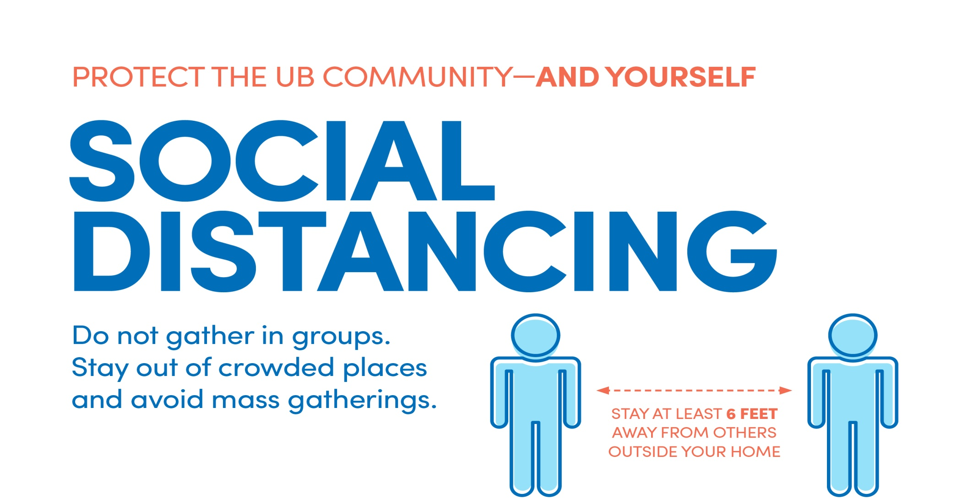
SAFETY SLIDE: COVID-19 PREVENTION

Slide 3
MOTIVATION Internet has dramatically revolutionized many fields. One such field is Communication, but for visually impaired people it’s impossible .so that intended me to work for it.
THIS PROJECT IS DONE UNDER THE GUIDANCE OF MY TEACHER.

Slide 4
OUTLINE
PROJECT OVERVIEW- OBJECTIVE
METHODOLOGY
SOURCES
CONCLUSION

Slide 5
PROJECT OVERVIEW/OBJECTIVE :
TO MAKE A WEB BASED APPLICATION FOR VISUALLY IMPAIRED PERSONS WHO CAN USE VOICE CONTROL BASED INTERACTION

Slide 6
METHODOLOGY
First step includes voice-controlled interface of the service. i.e:
conversion of the audio spoken from the microphone to text that can be used for our email, by using the speech recognition package.
The pyttsx3 module provided text-to-speech functionality to the program
The smtplib and the easyimap packages are used as an interface between our code and Gmail.

Slide 7
METHODOLOGY
Second step includes sending & receiving of emails.
Creation of a menu-based interaction between the program and the user which prompts the user to speak what action they want to perform.

Slide 8
SOURCES USED:
Python 3 for the development process and have utilized python’s rich library for the aid of this project.
Libraries used:
import speech_recognition as sr
import easyimap as e
import pyttsx3
import smtplib

Slide 9
SOURCES USED:
To use the speech recognition,
Use of another python module pyaudio so as to take the audio input from the microphone. After taking the audio input, it is converted to the text by the speech recognition and then that text is used for the further execution of the program.

Slide 10
CONCLUSION
The email system can be used by any physically challenged person easily
by enabling one to one chat with another physically challenged person or any normal person.
System aids to reduce the obstacles faced by physically challenged person by avoiding the use of keyboard.
System will also reduce cognitive load taken by blind to remember and type characters using keyboard.
This system is very useful for blind or physically challenged people to move one step forward towards their betterment.

Slide 11
Thank you

