Slide 1

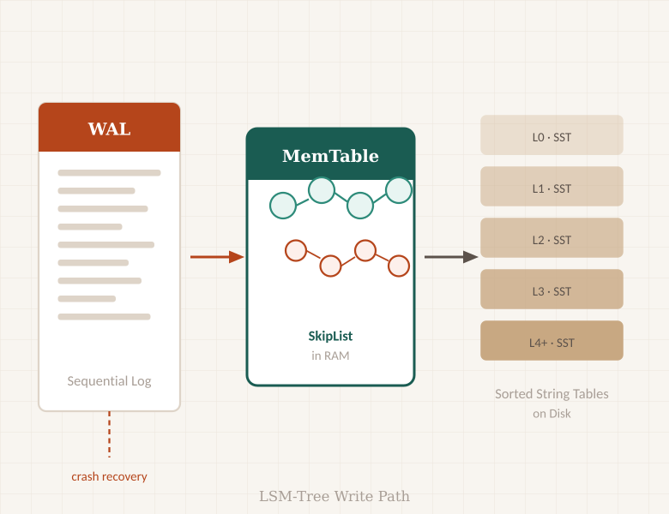


Write-Ahead Log
Instrumentation & Analysis
Reverse-engineering durability, performance, and fault
tolerance in the RocksDB WAL subsystem
Srishti Lamba · Nikita Sharma
Team Sigma & Spark · BDE Course · DA-IICT
RocksDB by

Slide 2
OVERVIEW
Agenda
01
02
Problem Statement
Methodology
The WAL's role in LSM-Tree durability and the three key design decisions we investigated
Source-code tracing, telemetry injection, and benchmark design across 5 instrumentation points
03
04
Key Findings
Experiments
Safety Tax · Block Fragmentation · Recovery Modes · Group Commit Amplification
Five isolated benchmarks, execution pipeline, and quantitative results

Slide 3
01 / PROBLEM STATEMENT
The WAL Durability Dilemma
What is the WAL?
Three Design Decisions
A sequential on-disk log that records every write before it reaches the in-memory MemTable. In RocksDB's LSM-Tree, it is the sole durability guarantee — without it, any crash discards all uncompacted data.
Sync Policy
db_impl_write.cc:2264
The Core Tension
Every WAL design choice trades off safety against speed. Enabling fsync() guarantees crash durability but collapses throughput by ~300×. These tradeoffs are buried in C++ internals with no external documentation of their quantitative cost.
Group Commit
write_thread.cc:440
Research Question
Block Alignment
Can we instrument the RocksDB source to quantify the exact performance cost of each durability decision, and identify which recovery mode minimises MTTR?
log_writer.cc:320

Slide 4
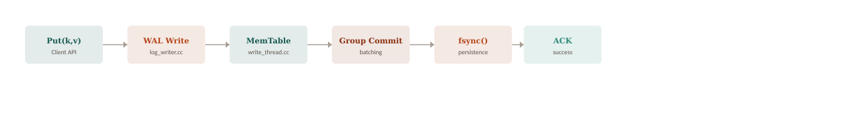
01 / CONTEXT
LSM-Tree Architecture — Where WAL Fits
Key Concepts
⚛
Atomicity
🔒
Durability
🔄
Recovery
A Put() either fully persists (WAL + MemTable) or doesn't appear after recovery. Partial writes are detected via CRC-32C checksums.
fsync() flushes the kernel buffer to physical media. Without it, a power cut silently discards everything in OS page cache.
On restart, RocksDB replays the WAL sequentially to rebuild the MemTable. Speed depends on the WALRecoveryMode enum.

Slide 5
02 / METHODOLOGY
Source Instrumentation Approach
1
Trace the Write Path
5 Instrumentation Points
Read db_impl_write.cc → write_thread.cc → log_writer.cc to map the full Put() execution path before touching any code.
db_impl_write.cc:2264
Sync control flag
2
Inject Telemetry
log_writer.cc:320
Added std::atomic counters and std::chrono timestamps at 5 key callsites. No logic was altered — purely observational instrumentation.
Physical record emit
db_impl_open.cc:1129
3
Isolated Benchmarks
Recovery timing
Compiled 5 standalone C++ programs (sync_bench, fragment_bench, recovery_bench, batch_bench, skew_bench), each varying one variable.
write_thread.cc:440
Batch group leader
4
Visualise Results
comparison.ipynb reads results/wal_performance_telemetry.csv and renders comparison plots via pandas + matplotlib + seaborn.
log_reader.cc:326
CRC-32C validation

Slide 6
03 / KEY FINDING
The Safety Tax — Sync vs. Buffered Write
~500K
~500K
~1,600
ops / sec
ops / sec
ops / sec
Buffered write
(sync = false)
No-WAL write
(disableWAL = true)
Strict sync
(fsync = true)
The Takeaway
fsync() forces writes past the OS page cache to physical storage — pinning performance to hardware limits.
Result: roughly
300× throughput reduction. This is the measurable cost of crash durability.

Slide 7
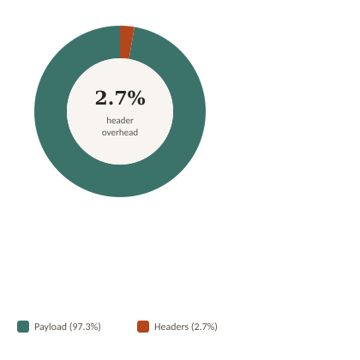
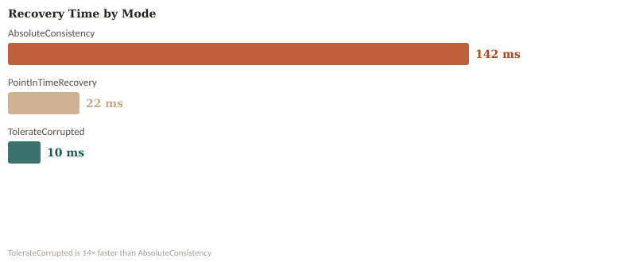
03 / KEY FINDING
Block Fragmentation & Recovery Modes
Study 2 · 32 KB Block Alignment
Study 3 · Recovery Mode Timing
Fixed 32 KB blocks introduce 2.7% header overhead for hardware-aligned I/O — a fixed storage tax for SSD compatibility.
14× faster recovery with TolerateCorrupted vs AbsoluteConsistency.
Choosing the right mode directly bounds your system's MTTR.

Slide 8
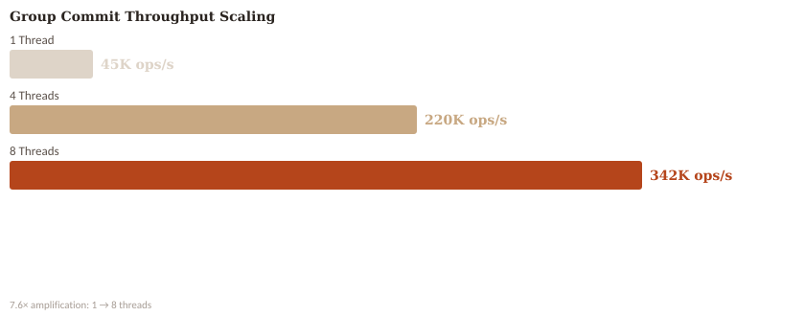
03 / KEY FINDING
Group Commit & Concurrency Scaling
7.6×
throughput gain
1 → 8 threads. Not linear, because one fsync() serves all writers in a batch window.
O(n)
Mechanism: write_thread.cc:440 — the batch leader collects all pending writers into one group and issues a single fsync() on their behalf.
MTTR scaling
Study 5: WAL recovery time grows linearly with volume. Periodic checkpointing is mandatory.

Slide 9
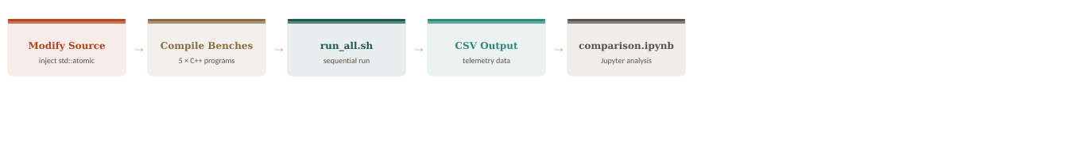
04 / EXPERIMENTS
Execution Pipeline & Study Summary
Study Summary
Study
Benchmark File
Variable Isolated
Key Finding
Study 1
sync_bench.cc
sync flag
fsync = ~300× throughput cost
Study 2
fragment_bench.cc
block alignment
2.7% header overhead
Study 3
recovery_bench.cc
WALRecoveryMode
TolerateCorrupted: 14× faster
Study 4
batch_bench.cc
thread count
7.6× throughput @ 8 threads
Study 5
skew_bench.cc
WAL volume
Linear O(n) recovery scaling

Slide 10
Conclusion
Every WAL configuration is a negotiation between safety, speed, and recoverability.
⚡
Safety vs Speed
📦
Alignment Overhead
fsync() guarantees crash durability at a ~300× throughput penalty. Buffered writes rely on OS page cache — fast but not crash-safe.
Fixed 32 KB block alignment costs 2.7% storage as header metadata. A small, predictable price for hardware-aligned I/O.
🔄
Recovery Flexibility
🚀
Group Commit Efficiency
kTolerateCorruptedTailRecords is 14× faster than kAbsoluteConsistency. Recovery mode selection is a direct MTTR control.
A single fsync() serves an entire batch of concurrent writers. 8 threads deliver 7.6× throughput with zero code changes.
github.com/srishti7103/rocksdb-WAL · branch: wal-experiments · Team Sigma & Spark · DA-IICT

