Slide 1


Spring Part-1

Slide 2
Objectives
Introduction of Spring Framework
Spring Framework Architecture
Spring Container
Spring Bean Scope
Spring Bean Life Cycle
Spring Dependency Injection

Slide 3
Introducing the Spring Framework
What is Spring?
It is a lightweight open source framework
Created by rod Johnson.
Based on the concept of IOC (Inversion of Control ) and AOP (Aspect Oriented Programming ).
Aims to minimize the dependence of application code on its framework.
Use of simple JavaBeans (POJOs) to implement the business logic.
Notes:
At the end of this course, you will
understand the inherent complexity involved in software systems and will gain the knowledge of handling such complex software systems
be able to differentiate between the two programming styles – Structured Programming and Object Oriented Programming
learn the different features of Object Oriented Technology

Slide 4
Features of Spring
Spring is a modular framework and has the following features
Pluggability
Dependency Injection (DI)
Aspect-Oriented Programming (AOP)
Container
Lightweight

Slide 5
Features of Spring (Contd..)
Pluggability:
Spring allows you to associate business layer objects with each other, using XML configuration files.
When the application is executed, Spring automatically creates and instantiates all the object relationships on demand.
In a Spring-enabled application, you can plug in new services or modify existing ones easily.
These application objects are, therefore, called pluggable objects.

Slide 6
Features of Spring (Contd..)
Dependency Injection (DI)
The Spring framework promotes the concept of loose coupling through DI.
With DI, you do not need to create the business layer objects yourself or associate them with each other in your code.
The Spring framework creates the business layer objects and associates them with each other, as defined in the configuration file.
DI eliminates the need for code lookup, allows pluggability and reuse of existing code, and eases maintenance and testing of the application.

Slide 7
Features of Spring (Contd..)
Aspect Oriented Programming(AOP)
It separates the application logic from the system-level services, such as transaction management, logging, and security.
These services are called cross-cutting concerns as they cut across a wide range of objects within the application.
It is used to modularize and separate these concerns in the form of aspects.
Aspect is defined as modularization of the system wide concerns whose implementations cut across multiple objects within the application.
An aspect encapsulates a behavior that needs to be implemented in multiple objects of the application.

Slide 8
Features of Spring (Contd..)
Container:
The Spring framework is a container that holds all the application objects.
It is also responsible for managing the life cycle and configuration of all the application objects.
You only need to describe how the application objects will be created, configured, and associated with each other.
The container will create those objects and associate them together.

Slide 9
Features of Spring (Contd..)
Lightweight:
Spring is a lightweight framework that makes it easy to configure and create complex applications.
It consists of several well-defined modules, built upon the concept of DI and AOP.
These modules provide a platform for writing loosely coupled application code.
The developer has the choice of using all the modules or any specific module, as per the application requirements.

Slide 10
Introducing the Spring Architecture
The Spring framework:
Has a layered architecture made up of seven well-defined modules.
Allows you to choose only those modules that suit your application needs and leave out those not required for your application.

Slide 11
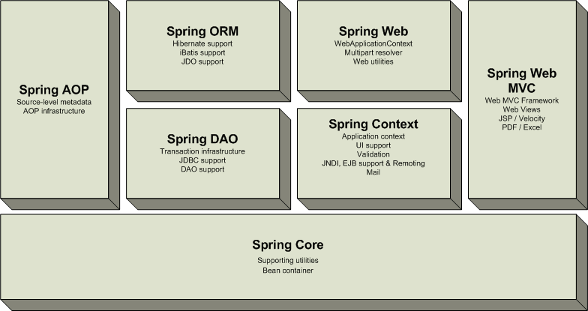
Introducing the Spring Architecture(Contd..)

Slide 12
Core
The core module:
Provides the fundamental functionality of the Spring framework.
Contains the most important component of the Spring framework, the bean factory container.
The bean factory container:
Forms the basis for implementing DI within the application.
Is responsible for creating the beans as per the bean definition given by the user.
To implement the core module within your Web application, you need to use the org.springframework.core package.

Slide 13
DAO
The DAO module:
Aims to standardize data access work through technologies, such as Hibernate, JDO, or JDBC.
Enables you to write simple database code without worrying about tasks, such as opening and closing the database connection.
To implement the DAO module in your Web application, you need to use the org.springframework.dao package.

Slide 14
ORM
The ORM module:
Enables developers to integrate the Spring framework with several other ORM tools, such as Hibernate, iBatis, and JDO, as required for the application.
Is built upon the DAO module to provide an easy way to build DAOs for the ORM tool, as required by the application.
Is implemented by using the org.springframework.orm package.

Slide 15
AOP
The AOP module:
Provides support for implementing aspects within your Web application.
Supports loose coupling of the application objects.
Enables you to separate the application logic from the system-level services, called cross-cutting concerns.
Enables you to apply declarative enterprise services in your applications with the help of XML configuration files.
Is implemented by using the org.springframework.aop package.

Slide 16
Managing Application Objects
In the Spring-enabled applications, an external entity provides all the objects with their necessary dependencies at run time.
This entity is called the Spring container.

Slide 17
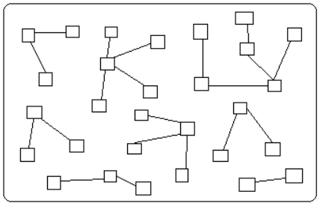
Managing Application Objects (Contd..)
All the application objects reside inside the Spring container. In addition, the Spring container enables the application objects to collaborate with each other for achieving the required application needs.
The following figure shows a Spring container containing various application objects.
The Spring container creates all the required application objects and helps them to collaborate with each other to implement the business logic of the application

Slide 18
Managing Application Objects (Contd..)
The Spring container is based on the concept of DI for managing the application objects.
You do not need to create the objects; you just have to describe as to how the objects will be created.
The container creates them automatically, whenever required.
The container also creates association between the collaborating objects.

Slide 19
Managing Application Objects (Contd..)
The Spring framework provides the following types of containers:
Bean factory:
Is a simple container that provides support for DI.
Is defined by the org.springframework.beans.factory.BeanFactory interface.
Application context:
Has been built upon the concept of the bean factory container.
Provides other functionalities, such as easy integration with Spring AOP features and support for internationalization.
Is defined by the org.springframework.context.ApplicationContext interface.

Slide 20
Introducing Bean Factory
In Spring, a bean can be any Java object or a class instance that is created and managed by the Spring container.
The bean factory container is used to:
Instantiate, configure, and manage objects (beans) for the application.
Define relationships between different objects, as and when they are being instantiated.
The objects created by the bean factory are:
Fully configured.
Ready to use.
Aware of their relationships with the other application objects

Slide 21
Introducing Bean Factory (Contd..)
The Spring framework provides several implementations of the bean factory that support various levels of functionalities in an application.
The most commonly BeanFactory is implemented by org.springframework.beans.factory.xml.XmlBeanFactory class.
The XML bean factory loads the beans on the basis of the bean definitions given in an XML file.
This XML file is also called the bean configuration file.
The configuration file is the key for setting up any Spring-enabled application.
The following code snippet represents the syntax of a bean configuration file:
<?xml version="1.0" encoding="UTF-8"?> <beans xmlns="http://www.springframework.org/schema/beans" xmlns:xsi="http://www.w3.org/2001/XMLSchema- instance" xsi:schemaLocation="http://www.springframework.org /schema/beans http://www.springframework.org/schema/beans/spring -beans-3.0.xsd"> </beans>

Slide 22
Spring Bean Definition
A bean definition contains basic information about a bean that a container must know, such as:
The process for creating a bean.
The details about the bean life cycle.
The various dependencies for that bean.
In a bean configuration file, each bean is defined by using the <bean> tag within the <beans> tag.

Slide 23
Spring Bean Definition (Contd..)
The <bean> tag contains the following attributes to define the bean:
id Is used to uniquely identify a bean in the Spring container.
name Is used to specify an alias name for the bean.
class Is used to specify the fully-qualified (package name + bean name)
name of the bean class.
scope Is used to define the scope of the bean being defined. It can have any
of the two values, singleton or prototype.

Slide 24
Spring Bean Definition(Contd..)
For example:
<?xml version="1.0" encoding="UTF-8"?> <beans xmlns="http://www.springframework.org/schema/beans" xmlns:xsi="http://www.w3.org/2001/XMLSchema-instance" xsi:schemaLocation="http://www.springframework.org/schema/beans http://www.springframework.org/schema/beans/spring-beans-3.0.xsd ">
<bean id=“emp" class=“com.Employee"/>
</beans>
Denotes the Employee class, which has been declared inside the com package as a bean with ID as emp.

Slide 25
Loading and Instantiating Bean
To instantiate a bean factory in your Web application, you need to load the bean configuration file.
This is done by using a Resource object, defined by the org.springframework.core.io.Resource interface.
The Resource object provides the bean configuration file to the bean factory to load the beans by reading the bean definitions from the configuration file.
You can load the bean configuration file from different places, such as:
File system
Classpath
External URL

Slide 26
Loading and Instantiating Bean (Contd..)
For example:
Resource res = new ClassPathResource("Sport/Spring- Config.xml");
After loading the configuration file into a Resource object, you need to create an instance of the XML bean factory, as shown in the following code snippet:
BeanFactory factory = new XmlBeanFactory(res);
Denotes the class path to load the Spring-Config.xml file in the res object. The Spring-Config.xml file is stored inside the Sport package.

Slide 27
Loading and Instantiating Bean (Contd..)
A bean factory does not instantiate the beans, as and when they are loaded into the container.
The bean factory loads all the bean definitions immediately, but the beans are not instantiated until they are actually required by the user.
You can retrieve an instance of a bean registered under a given name from the bean factory by using the getBean() method.
This method takes the ID of the bean as a string value.

Slide 28
Loading and Instantiating Bean (Contd..)
For example:
Employee empObj = (Employee)factory.getBean(“emp”);
empObj.print();
When the getBean() method is called, the bean factory container instantiates the bean and set its properties through DI.
Now, the life of the bean begins inside the Spring container

Slide 29
Introducing Application Context
Application context is an advanced container that provides several enterprise-level functionalities, some of which are:
Providing a means for resolving text messages, including support for internationalization of those messages.
Providing a generic way to load file resources, such as images.
Publishing events to beans, which are registered as listeners.

Slide 30
Introducing Application Context (Contd..)
It inherits all the capabilities of the BeanFactory interface, such as:
Creating the beans.
Associating them with each other.
Dispersing them to the users as per requests.
Bean factory is used in cases where certain resources (such as memory space) are scarce.

Slide 31
Introducing Application Context (Contd..)
The Spring framework provides the following commonly used implementations of the application context container:
ClassPathXmlApplicationContext
FileSystemXmlApplicationContext
XmlWebApplicationContext
XmlWebApplicationContext
Is used to load the bean configuration file located at the specified class path. available in the specified file system. from the location specified by the contextConfigLocation context parameter in the web.xml file.

Slide 32
Introducing Application Context (Contd..)
Loading the application context:
To use the application context container for managing your application objects, you have to load a particular ApplicationContext implementation.
Implementing ClassPathXmlApplicationContext
ApplicationContext appContext = new ClassPathXmlApplicationContext(“com/Spring-Config.xml”);
Loads the bean configuration file from the specified class path, com/Spring-Config.xml.
Implementing FileSystemXmlApplicationContext
ApplicationContext appContext = new FileSystemXmlApplicationContext(“c:/Emp/Spring-Config.xml”);
If you want to implement XmlWebApplicationContext in your application, you can use the following code snippet:
XmlWebApplicationContext appContext = new XmlWebApplicationContext();
Loads the applicationContext.xml file stored in the WEB-INF folder of the Web application

Slide 33
Introducing Application Context (Contd..)
Difference between the application context container and the bean factory container:
The bean factory container loads all the beans lazily, which means that the beans are created only when you call the getBean() method.
The application context container does not wait for the getBean() method to be called; it preloads all the beans as soon as the application context starts up.
ApplicationContext provides supports for AOP I18N etc..
Preloading of the beans ensures their availability, as and when they are required by the application.

Slide 34
Bean Scope
Bean factory also helps you to control the number of instances of a particular bean to be created - whether one instance for the entire application, or one instance per request.
This is done by defining the scope for the beans.
Bean factory supports the following types of bean scopes:
Singleton Only one instance of bean per spring container(Default).
Prototype A new instance every time bean is requested.

Slide 35
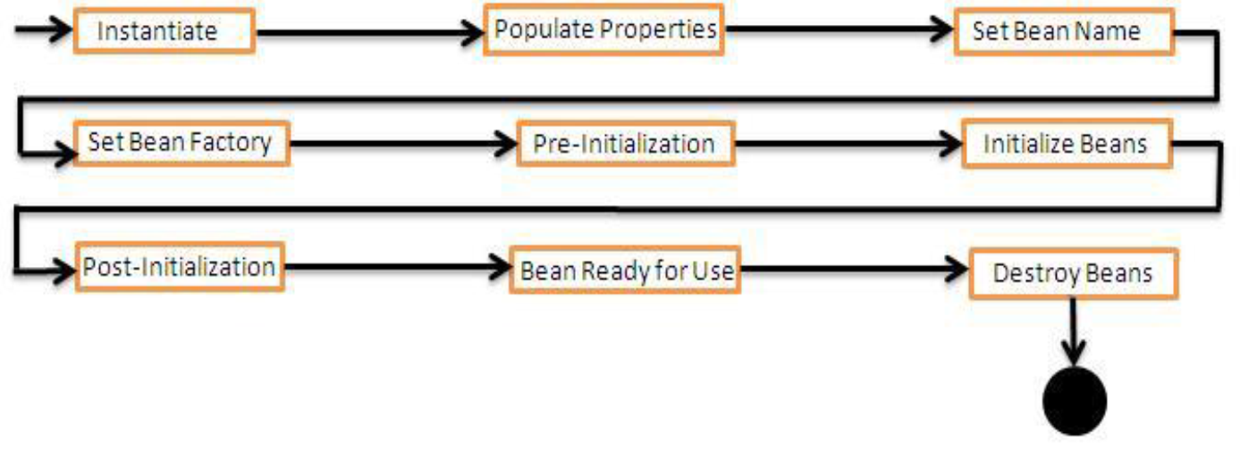
Bean Life Cycle
Spring bean factory is responsible for managing the life cycle of beans created through spring container. The life cycle of beans consist of call back methods which can be categorized broadly in two groups:
Post initialization call back methods
Pre destruction call back methods
Life cycle of a bean inside bean factory:
When you load a bean in the bean factory container, it goes through various steps -- right from its instantiation till its destruction.
The following figure displays the life cycle of the bean inside the bean factory container.

Slide 36
Bean Life Cycle
Spring provides following ways for controlling life cycle events of bean:
InitializingBean and DisposableBean callback interfaces
Other Aware interfaces for specific behavior
custom init() and destroy() methods in bean configuration file
@PostConstruct and @PreDestroy annotations

Slide 37
DI( Dependency Injection)
Dependency Injection is the act of injecting dependencies into an Object.
Dependency injection is where the control of the application is inverted to the framework. This control is configured in the framework with an XML file.
Spring object linking is defined in XML files, allowing easy changes for different application configurations thus working as a plug in architecture.
Container injects needed dependencies into the object using setters or constructor

Slide 38
Without DI
Object B
creates
Object A
Object C
creates
An object creating its dependencies without IoC leads to tight object coupling.

Slide 39
With Dependency-Injection
Object B
setB(IB)
Object A
Object C
setC(IC)
Object A contains setter methods that accept interfaces to objects B and C. This could have also been achieved with constructors in object A that accepts objects B and C.

Slide 40
Forms of Dependency Injection
Setter Based DI
Accomplished by the container calling setter methods on your beans after invoking a no-argument constructor.
Constructor Based DI
Accomplished when the container invokes a class constructor with a number of arguments, each representing a dependency on other class.

Slide 41
DI (Contd..)
Setter Based Injection:
<beans>
<bean name="person" class=“com.spring.Employee">
<property name="email“ valuemy@email.address </property>
</bean>
</beans>
Interpretation of the above code:
Employee emp = new Employee();
emp.setEmail(“my@email.address”);
This code creates a Employee object and calls the setEmail() method,
passing in the string defined as a value.

Slide 42
DI (Contd..)
Constructor based injection
In this type of injection spring container uses constructor of the bean class for assigning the dependencies.
In spring config xml, we need to inform the container about constructor injection by using <constructor -arg />
In spring bean class, if both constructor and setter injection applied for same property then constructor injection will be overridden by setter injection.

Slide 43
DI(Cont..)
Dependency in the form of object
public class DemoBean {
public SampleBean sb;
public DemoBean(SampleBean sb) {
this.sb = sb;
}
}
In the xml
<bean id="id1" class="DemoBean">
<constructor-arg ref="sb" />
</bean>
<bean id="sb" class="SampleBean" />

Slide 44
DI(Contd..)
Injecting Collection Object
Allows passing Multiple data values. Four ways to inject collections
Element | Description
<list> </list> | This helps in wiring ie injecting a list of values, allowing duplicates.
<set> </set> | This helps in wiring a set of values but without any duplicates.
<map> </map> | This can be used to inject a collection of name-value pairs where name and value can be of any type.
<props> </props> | This can be used to inject a collection of name-value pairs where the name and value are both Strings.

Slide 45
Summary
In this session, we will Covered:
Spring Framework Architecture
Spring Container and it’s types
Spring Bean life cycle
Spring Bean Scope
Spring Dependency Injection and it’s types

Slide 46
Thank You

Slide 47

www.infogain.com
Infogain Corporation, HQ
485 Alberto Way Los Gatos, CA 95032 USA
Phone: 408-355-6000
Fax: 408-355-7000
Pune
7th Floor, Bhalerao Towers, CTS No.1669 - 1670, Behind Hotel Pride,
Shivaji Nagar, Pune - 411005
Phone : +91-20-66236700
Infogain Irvine
41 Corporate Park, Suite 390 Irvine, CA 2606 USA
Phone: 949-223-5100
Fax: 949-223-5110
Infogain Austin
Stratum Executive Center Building D 11044 Research Boulevard Suite 200
Austin, Texas 78759
Noida
A-16, Sector 60, Noida Gautam Budh agar, 201301 (U.P.) India
Phone: +91-120-2445144
Fax: +91-120-2580406
Dubai
P O Box 500588 Office No.105, Building No. 4, Dubai Outsource Zone,
Dubai, United Arab Emirates
Tel: +971-4-458-7336

