Slide 1

POLLFRENZY
Institute of Engineering & Technology

Slide 2
POLLFRENZY TEAM
Submitted to:
Mr. Sharad Gupta (Assistant Professor)
TEAM MEMBERS:
Lav Varshney
(181500350)
Shruti Sharma
(181500692)
Srishti Daga
(181500725)

Slide 3
ABOUT POLLFRENZY
The aim is to automate its existing manual system by the help of computerized equipment’s and full-fledged computer software, fulfilling their requirements, so that their valuable data/information can be stored for a longer period with easy accessing and manipulation of the same. Basically, the project describes how to manage for good performance and better services for the clients.

Slide 4
Features of the project Event Management System
Product and Component based.
Creating & Changing Issues at ease.
Query Issue List to any depth.
Reporting & Charting in more comprehensive way.
User Accounts to control the access and maintain security.
Simple Status & Resolutions.
Multi-level Priorities & Severities.
Targets & Milestones for guiding the programmers.
Attachments & Additional Comments for more information.
Robust database back-end.
Various level of reports available with a lot of filter criterions.
It contains better storage capacity.
Accuracy in work.
Easy & fast retrieval of information.
Well-designed reports.
Decrease the load of the person involve in existing manual system.
Access of any information individually.
Work becomes very speedy.
Easy to update information.

Slide 5
REQUIREMENTS
Hardware:
External Hard Drives or DVDs for Backup
Internet
Minimum 2GB RAM
i3 Processor
1024x765 Display
Software:
Operating System (Windows, Linux, Mac)
Front End
HTML
CSS
JAVASCRIPT
BOOTSTRAP
jQuery
Back End
DBMS
My SQL/Oracle
MongoDB

Slide 6
Future Scope of the Project
In a nutshell. it can be summarized that the future scope of the project circles around maintaining information regarding:
We can add printer in future.
We can give more advance software for Event Management System including more facilities.
We will host the platform on online servers to make it accessible worldwide.
Integrate multiple load balancers to distribute the loads of the system.
Create the master and slave database structure to reduce the overload of the database queries.
Implement the backup mechanism for taking backup of codebase and database on regular basis on different servers.
The above-mentioned points are the enhancements which can be done to increase the applicability and usage of the project. Here we can maintain the records of Event and Booking. Also, as it can be seen that now-a-days the players are versatile, i.e. so there is a scope for introducing a method to maintain the Event Management System. Enhancements can be done to maintain all the Event, Booking, Customer, Employee, Enquiry.
We have left all the options open so that if there is any other future requirement in the system by the user for the enhancement of the system then it is possible to implement them. In the last we would like to thanks all the persons involved in the development of the system directly or indirectly. We hope that the project will serve its purpose for which it is develop there by underlining success of process.

Slide 7
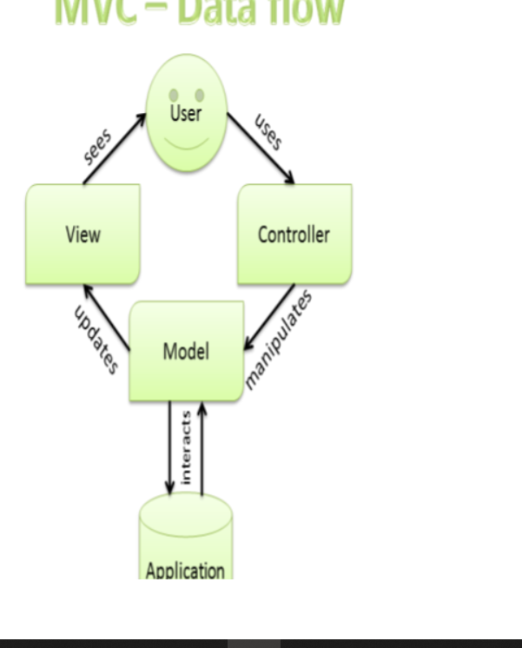

Slide 8
Implementation Methodology
Model View Controller or MVC as it is popularly called, is a software design pattern for developing web applications A Model View Controller pattern is made up of the following three parts:
Model - The lowest level of the pattern which is responsible for maintaining data.
View - This is responsible for displaying all or a portion of the data to the user.
Controller - Software Code that controls the interactions between the Model and View.
MVC is popular as it isolates the application logic from the user interface layer and supports separation of concerns. Here the Controller receives all requests for the application and then works with the Model to prepare any data needed by the View. The View the uses the data prepared by the Controller to generate a final presentable response.

Slide 9
Existing System of Event Management System:
In the existing system the exams are done only manually but in proposed system we have to computerize the exams using this application.
• Lack of security of data.
• More man power.
• Time consuming.
• Consumes large volume of paper work.
• Needs manual calculations.
• No direct role for the higher off

Slide 10
Future Scope of the Project In a nutshell. it can be summarized that the future scope of the project circles around maintaining information regarding: We can add printer in future. We can give more advance software for Event Management System including more facilities. We will host the platform on online servers to make it accessible worldwide. Integrate multiple load balancers to distribute the loads of the system. Create the master and slave database structure to reduce the overload of the database queries. Implement the backup mechanism for taking backup of codebase and database on regular basis on different servers. The above-mentioned points are the enhancements which can be done to increase the applicability and usage of the project. Here we can maintain the records of Event and Booking. Also, as it can be seen that now-a-days the players are versatile, i.e. so there is a scope for introducing a method to maintain the Event Management System. Enhancements can be done to maintain all the Event, Booking, Customer, Employee, Enquiry. We have left all the options open so that if there is any other future requirement in the system by the user for the enhancement of the system then it is possible to implement them. In the last we would like to thanks all the persons involved in the development of the system directly or indirectly. We hope that the project will serve its purpose for which it is develop there by underlining success of process.

Slide 11
Data Dictionary
This is normally represented as the data about data. It is also termed as metadata some times which gives the data about the data stored in the database. It defines each data term encountered during the analysis and design of a new system. Data elements can describe files or the processes.
Following are some major symbols used in the data dictionary:
= equivalent to
+ and
[] either/or
() Optional entry
Following are some rules, which defines the construction of data dictionary entries:
Words should be defined to understand for what they need and not the variable needs by which they may be described in the program.
Each word must be unique. We cannot have two definition of the same client.
Aliases or synonyms are allowed when two or more enters shows the same meaning. For example, a vendor number may also be called as customer number.
A self-defining word should not be decomposed. It means that the reduction of any information in to subpart should be done only if it is really required that is it is not easy to understand directly.
Data dictionary includes information such as the number of records in file, the frequency a process will run, security factor like password which user must enter to get excess to the information.

Slide 12
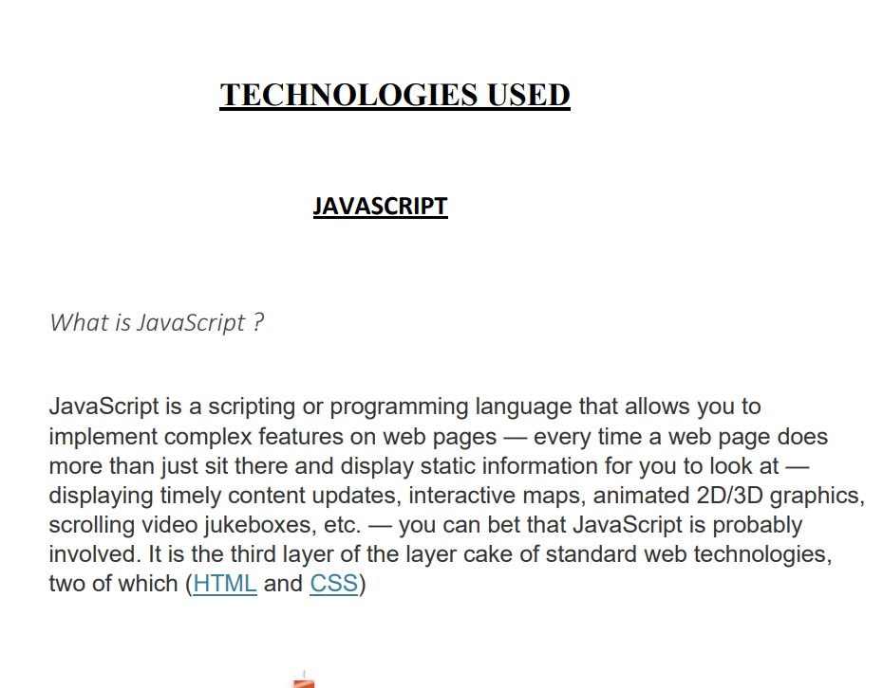

Slide 13
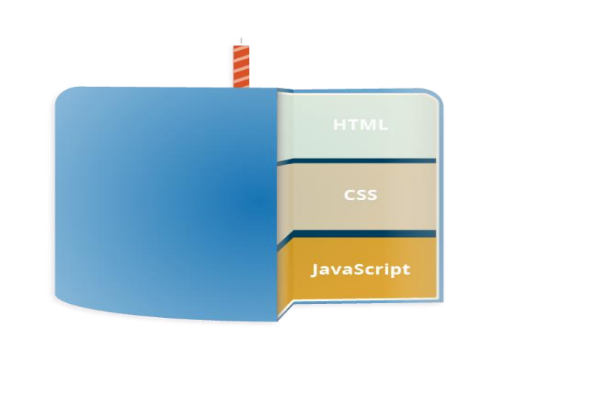
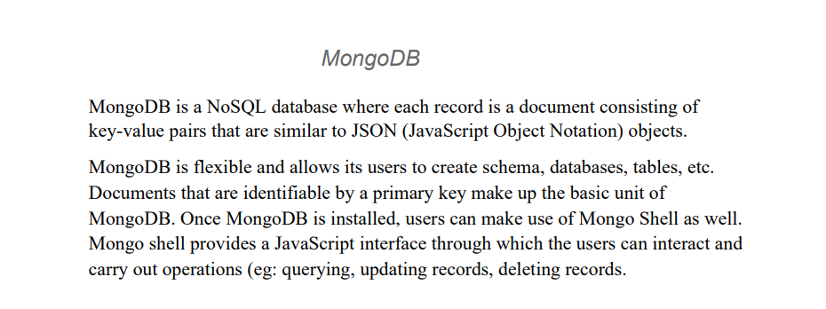

Slide 14
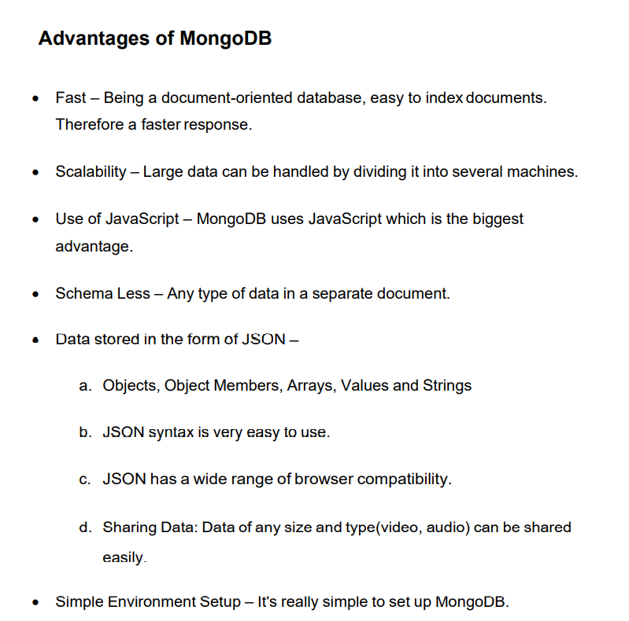

Slide 15
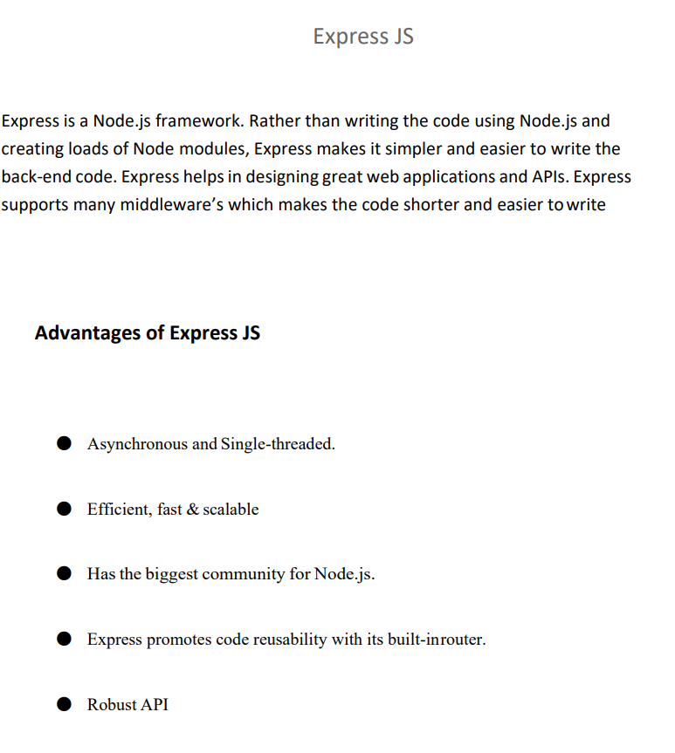

Slide 16
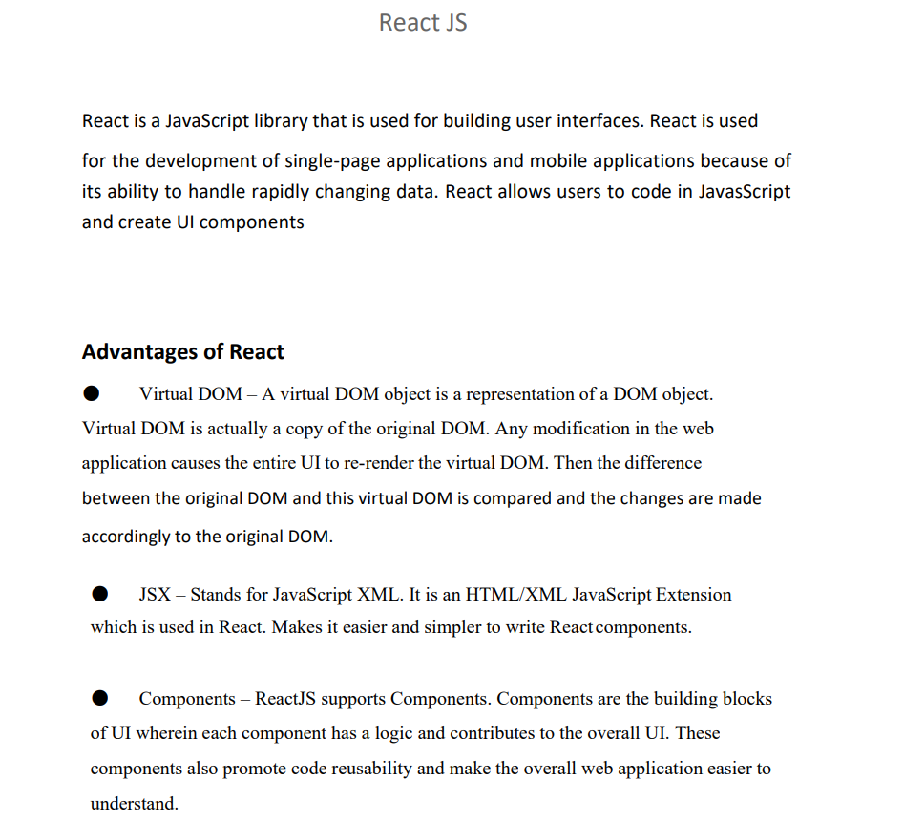

Slide 17
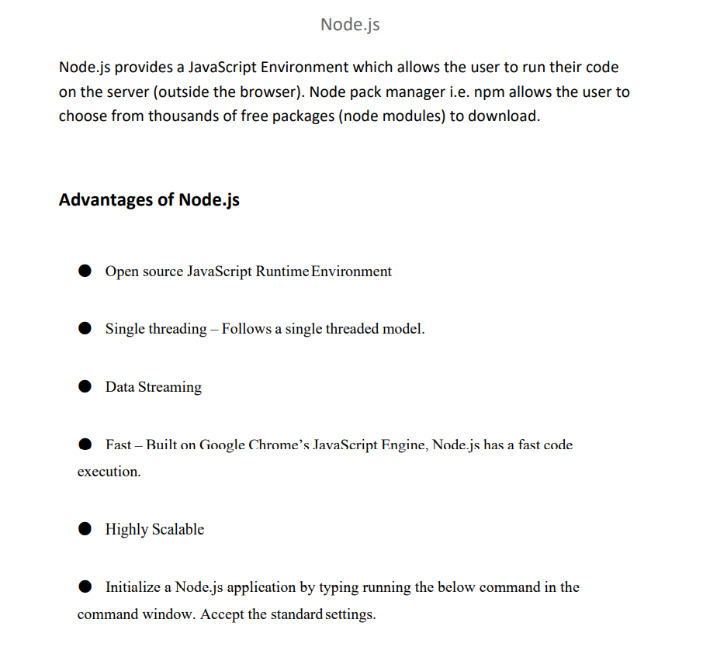

Slide 18
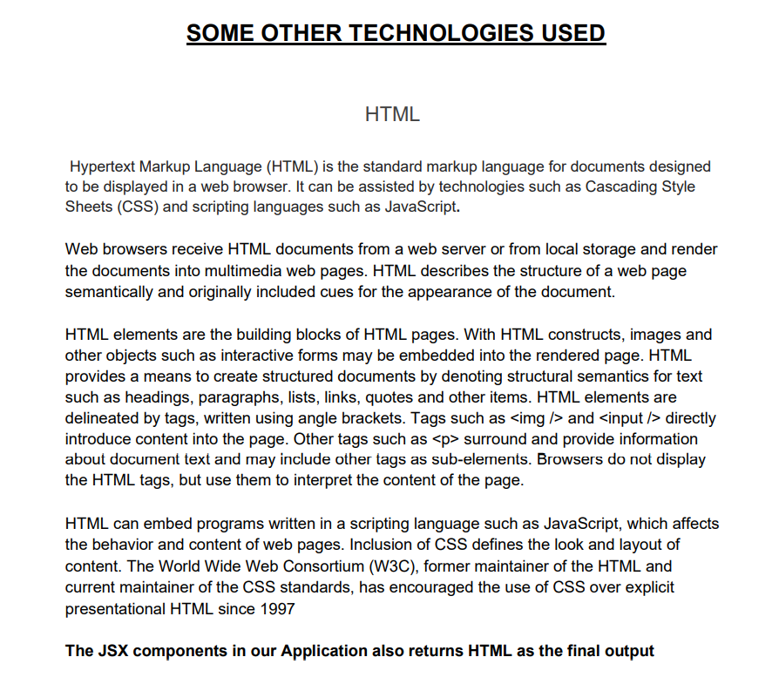

Slide 19
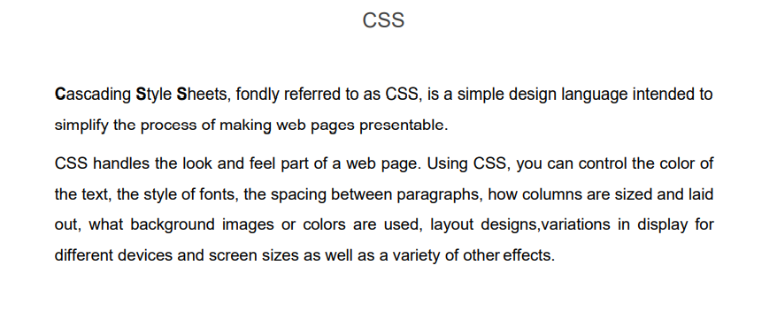
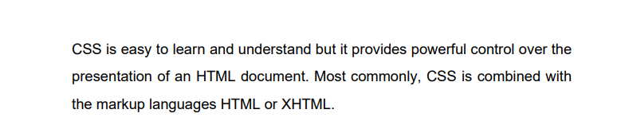

Slide 20
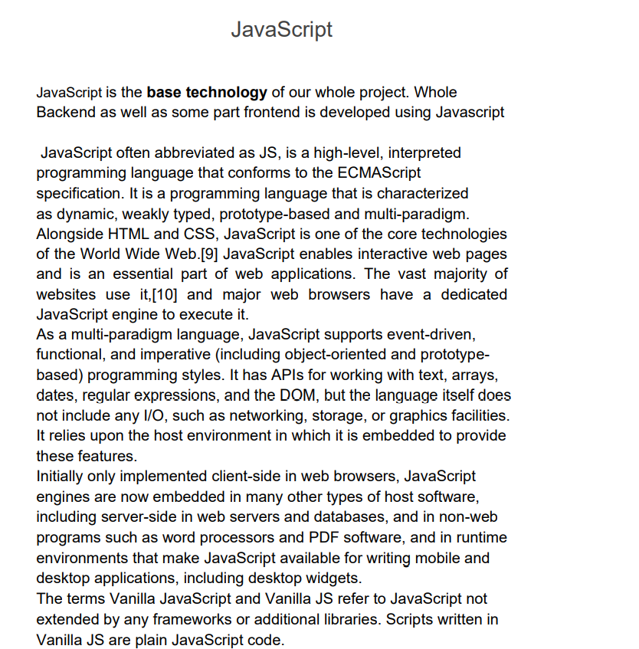

Slide 21
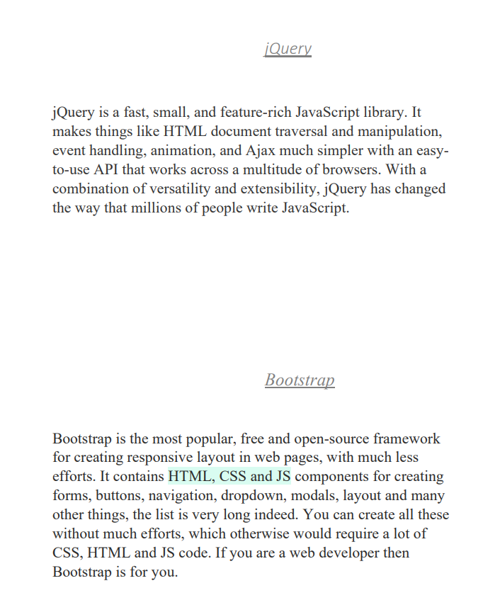

Slide 22
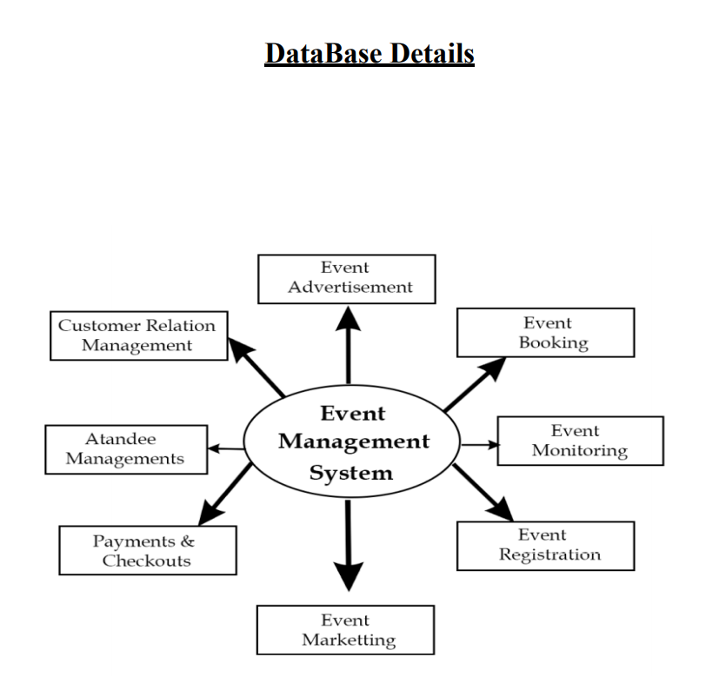

Slide 23
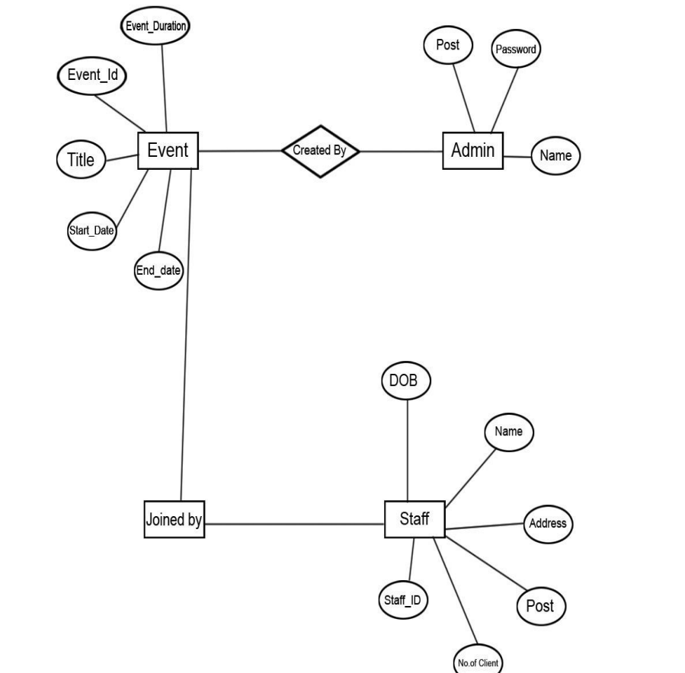

Slide 24
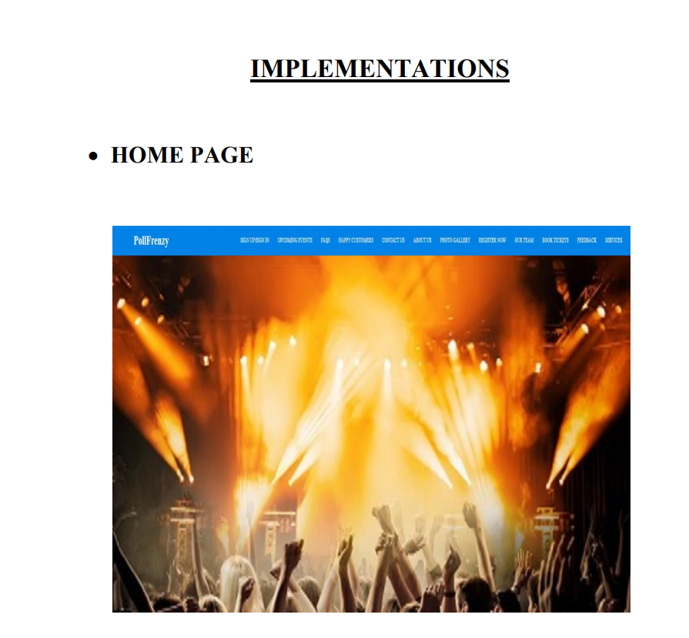

Slide 25

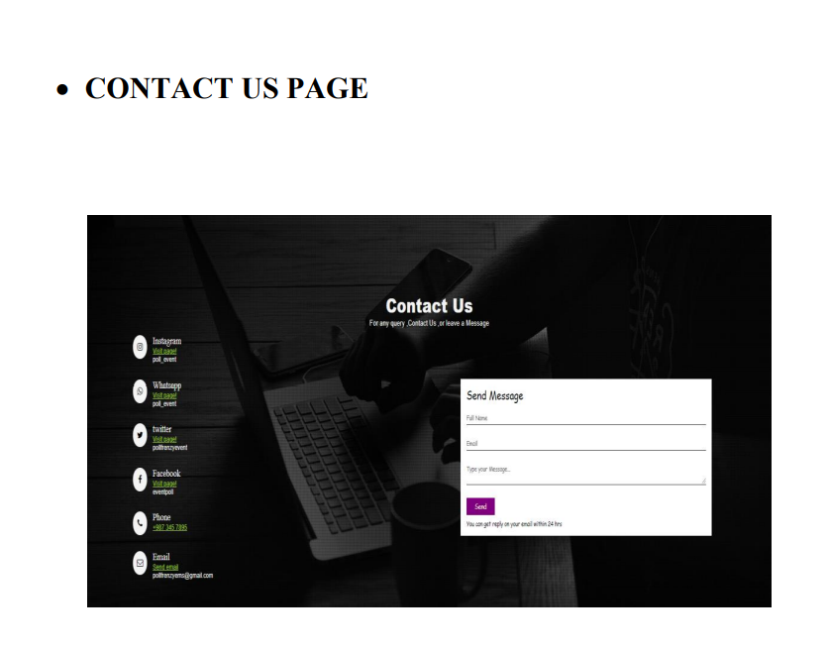

Slide 26
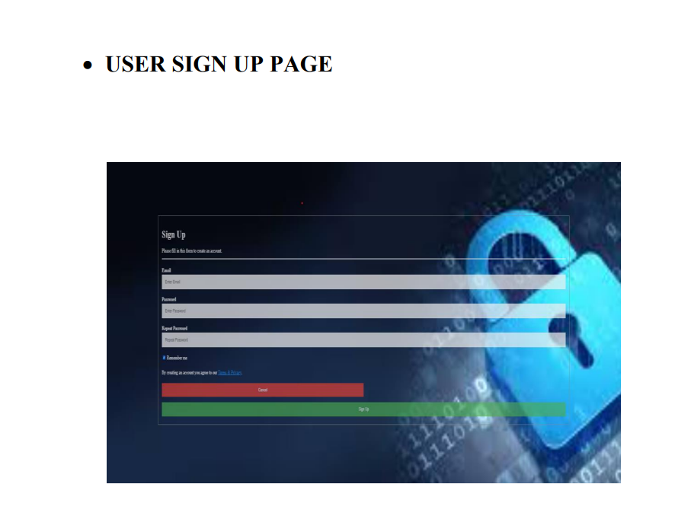
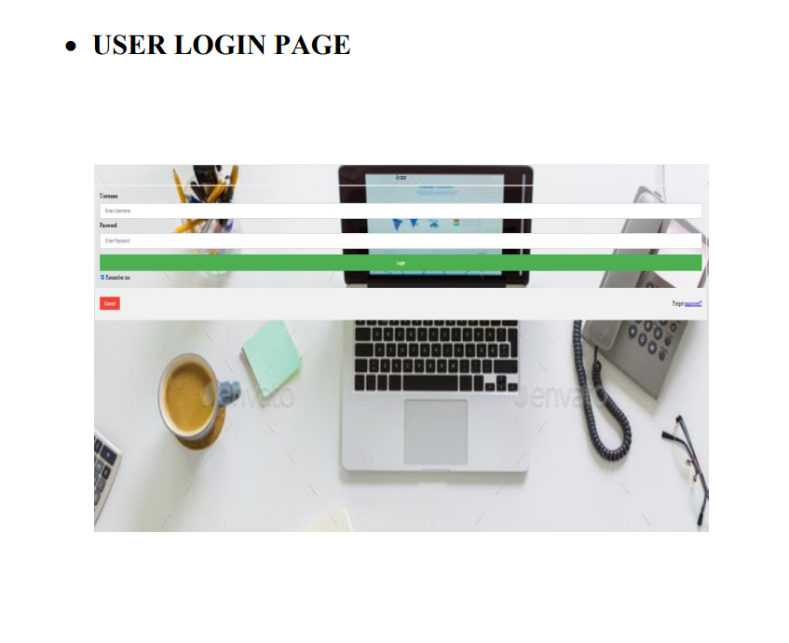

Slide 27
Conclusion of the Project Event Management System
Our project is only a humble venture to satisfy the needs to manage their project work. Several user friendly coding have also adopted. This package shall prove to be a powerful package in satisfying all the requirements of the school. The objective of software planning is to provide a frame work that enables the manger to make reasonable estimates made within a limited time frame at the beginning of the software project and should be updated regularly as the project progress.
At the end It is concluded that we have made effort on following points.
A description of the background and context of the project and its relation to work already done in the area.
Made statement of the aims and objectives of the project.
The description of Purpose, Scope, and applicability.
We define the problem on which we are working in the project.
We describe the requirement Specifications of the system and the actions that can be done on these things.
We understand the problem domain and produce a model of the system, which describes operations that can be performed on the system.
We included features and operations in detail, Including screen layouts.
We designed user interface and security issues related to system
Finally, the system is implemented and tested according to test cases.

Slide 28
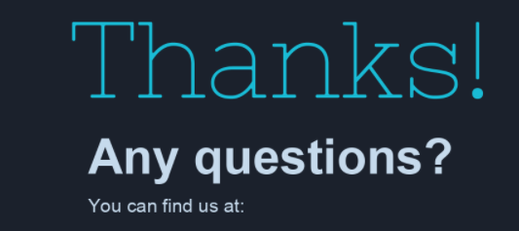
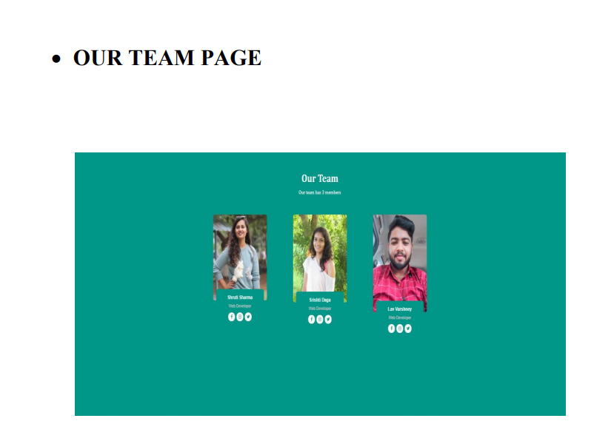
Lav.Varshney_cs18@gla.ac.in
shruti.sharma_cs18@gla.ac.in
Srishti.daga_cs18@gla.ac.in

