Slide 1
Restaurant Ordering System
CSE Python Project
By Srishti
Reg No.: 25BAI10321

Slide 2
Introduction
GUI-based restaurant billing system
Created using Python 3 and Tkinter
Display of Kolkata-style food items
Calculates Subtotal, Tax, and Total
Simple interface for beginners

Slide 3
Menu Categories
Starters
Main Course
Drinks
Desserts
Sample items:
Hilsa Bhapa, Kosha Mangsho,
Macher Chop, Mishti Doi

Slide 4
Features
Checkboxes for selection
Quantity entry boxes
Automatic bill calculation
Order summary window
Reset & Exit buttons
Smooth UI handling

Slide 5
How It Works
1. User selects food items
2. Enters required quantity
3. Click 'Calculate Bill'
4. Program generates summary
5. User can reset or exit

Slide 6
Technologies Used
Python 3
Tkinter GUI
Dictionaries & Variables
Basic arithmetic operations
Event-driven logic

Slide 7
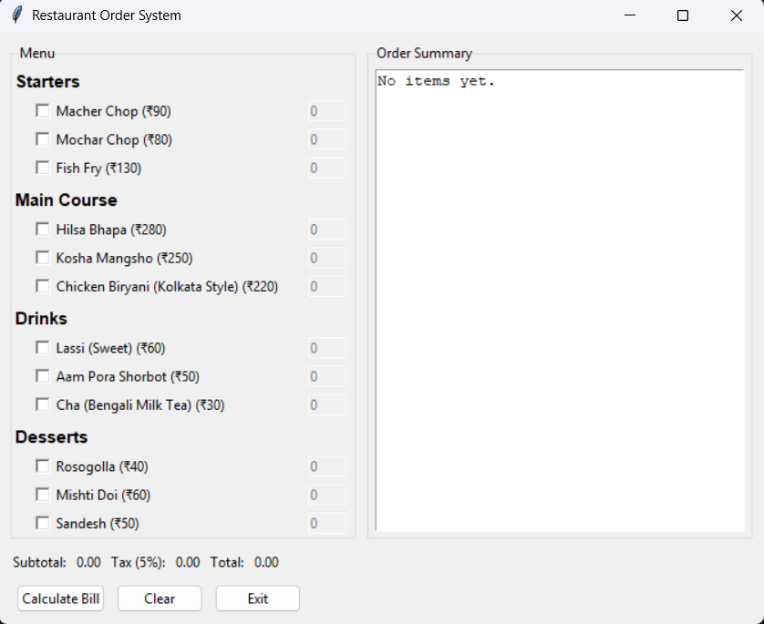
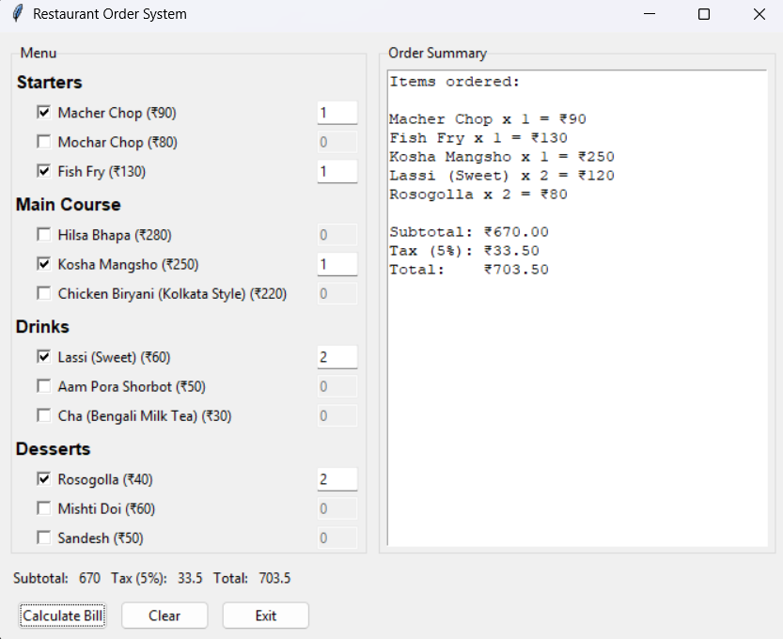
GUI Preview

Slide 8
Conclusion
Good beginner Python project
Teaches GUI programming basics
Contains realistic restaurant workflow
Clean output and easy to understand

