Slide 1
Steganography
Submitted by: Srishti Goyal
GU-2020-4246

Slide 2
Contents
Introduction
Dissecting Steganography
Block diagram
Types
Features
Methods
Objectives
Steganography vs Cryptography
Combined Crypto and Steganography
Steganalysis
DFD Levels
Advantages and Disadvantages
Uses of Steganography
Conclusion
Bibliography

Slide 3
Introduction
Steganography is the technique of hiding secret data within an ordinary, non-secret, file or message in order to avoid detection; the secret data is then extracted at its destination. The use of steganography can be combined with encryption as an extra step for hiding or protecting data.
The word steganography is derived from the Greek words steganos meaning hidden and graph meaning to write.
Steganography can be used to conceal almost any type of digital content, including text, image, video, or audio content; the data to be hidden can be hidden inside almost any other type of digital content.

Slide 4

The content to be concealed through steganography -- called hidden text -- is often encrypted before being incorporated into the innocuous-seeming cover text file or data stream.
Steganography can be used by those wishing to convey a secret message or code.

Slide 5
Evolution of Steganography
The evolution of steganography involves the following parameters:
Code breakers
Invisible ink
Microdots
Codebreakers: The code breakers explain the battle of codes and ciphers.
Invisible ink: A general letter may have a different message written in between the lines with the invisible ink and the invisible ink may be milk, vinegar, fruit juice, or urine.
Microdots: The technology of microdots was developed by the Germans and this applied science also works in the hiding of messages.

Slide 6
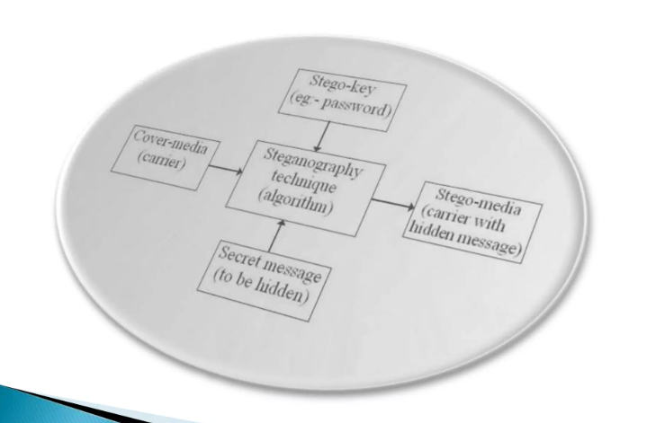
Block diagram

Slide 7
Dissecting Steganography
All the color pixels are created with a combination of red, green, and blue mode i.e. RGB mode, and each RGB component has eight bits. If the letters in the ASCII are needed to be represented in the color pixels then the least significant bit which is abbreviated as LSB i.e. the rightmost bit has to be changed. For example, if it is necessary to hide the word ‘digit’ in an image then the LSB of every color is taken and each bit of the word is hidden in its RGB combination.

Slide 8
Types
Text steganography
Image steganography
Audio steganography
Video steganography

Slide 9
Features
To produce security tools based on steganography techniques.
To explore techniques for hiding data using the encryption module of this project.
To extract techniques for getting secret data using a decryption module.

Slide 10
Methods
LSB Substitution method:
Deals with substituting LSB bits of corresponding pixels in image to store the text message or another image as a message.
Block method:
Blocks of the image are considered and DCT (Discrete Cosine Transform) is done to break them.
Each block is then subdivided into 64 parts (DCT Coefficients).
These coefficients are modified i.e. the color gets modified a little by storing some text or another image in it.
Pallete Modification:
Every image uses a set of color values. Palette modification replaces the unused colors within an image’s color palette with colors that represent the hidden message.

Slide 11
Objectives
To produce security tools based on steganography techniques.
To explore techniques for hiding data using the encryption module of this project.
To extract techniques for getting secret data using a decryption module.

Slide 12
Steganography | Cryptography
Unknown message passing | Known message passing
Steganography prevents discovery of the very existence of communication | Encryption prevents an unauthorized party from discovering the contents of a communication
Little known technology | Common technology
Technology still being develop for certain formats | Most of algorithm known by all
Once detected message is known | Strong current algorithm are resistant to attacks ,larger expensive computing power is required for cracking
Steganography does not alter the structure of the secret message | Cryptography alter the structure of the secret message

Slide 13
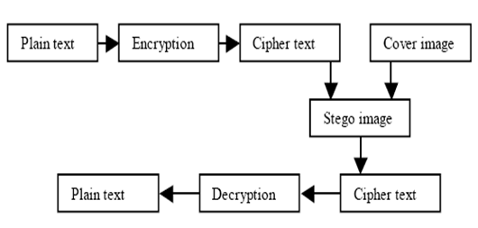
Crypto and Steganography combined

Slide 14
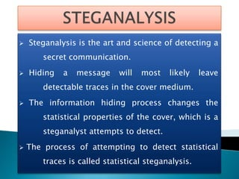

Slide 15
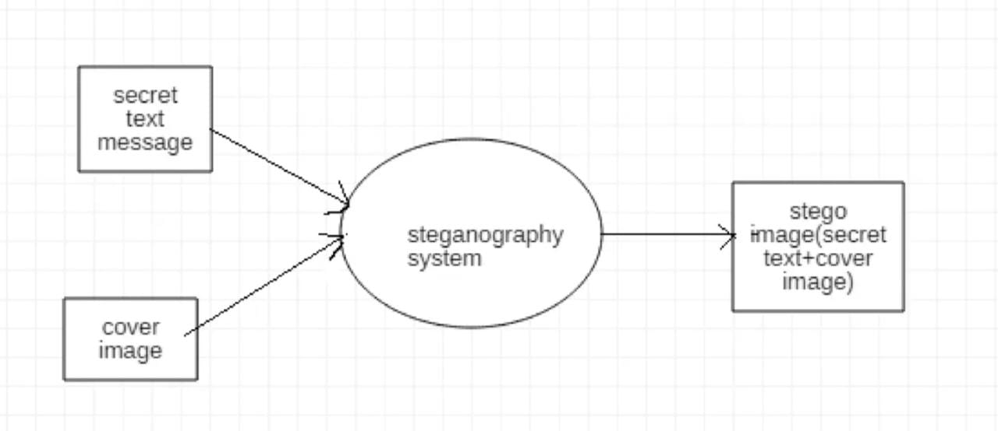
Data flow Diagram level 0
Steganography system takes inputs as a secret text messages as well as cover images and generates stego image

Slide 16
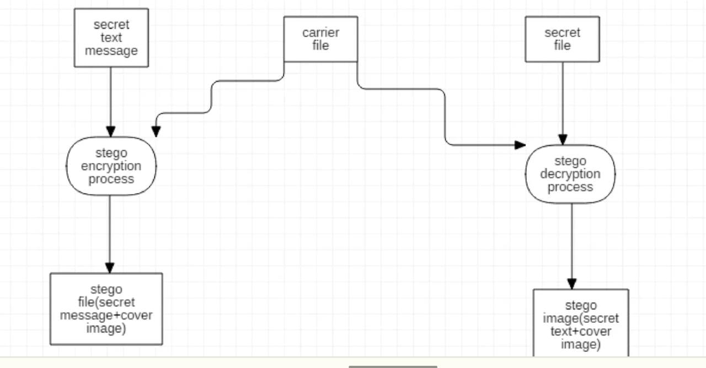
Data flow diagram level 1
In DFD Level 1 the main task that is performed is the secret message is added to the image by replacing some of the bits and it is sent to the receiver’s side through E-mail

Slide 17
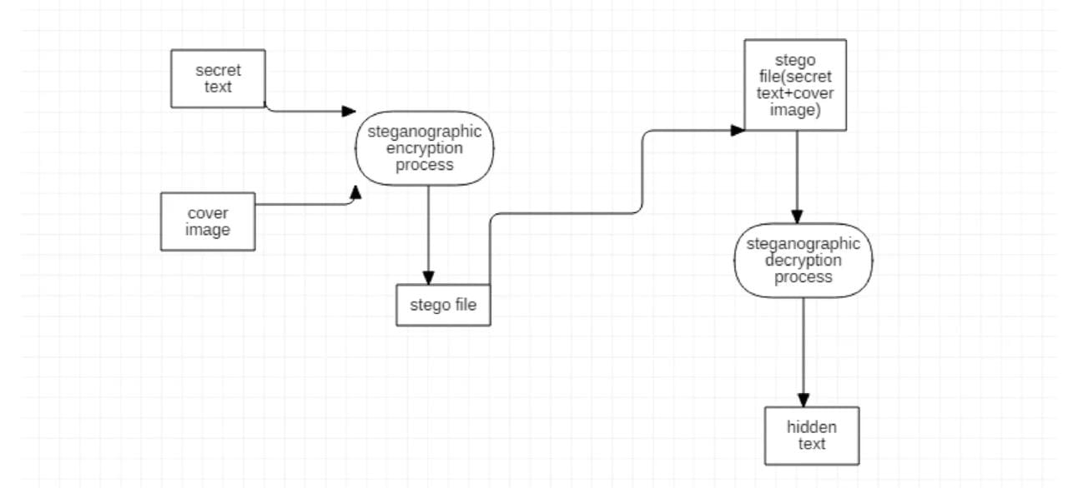
Data flow diagram level 2
Secret text is added to the image by replacing the Least Significant Bit(LSB) in which least significant bits are replaced and a stego file is created

Slide 18
Advantages and Disadvantages
Advantages:
No one suspects existence of message
Highly secure
Disadvantages:
It requires a lot of overhead to hide a relatively few bits of information

Slide 19
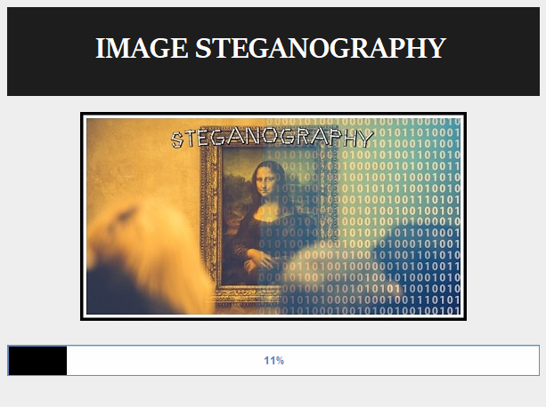
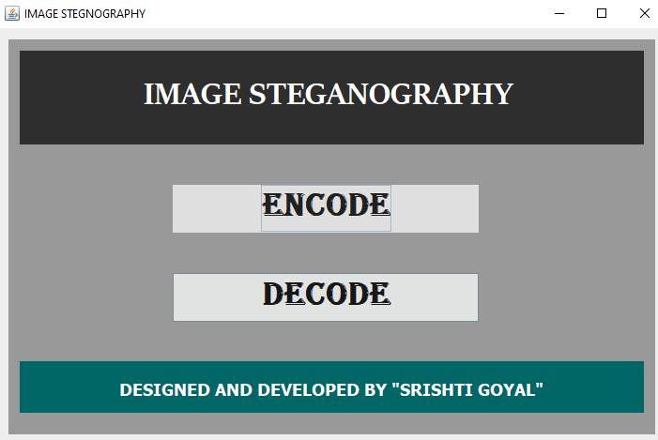
Project Snapshots

Slide 20
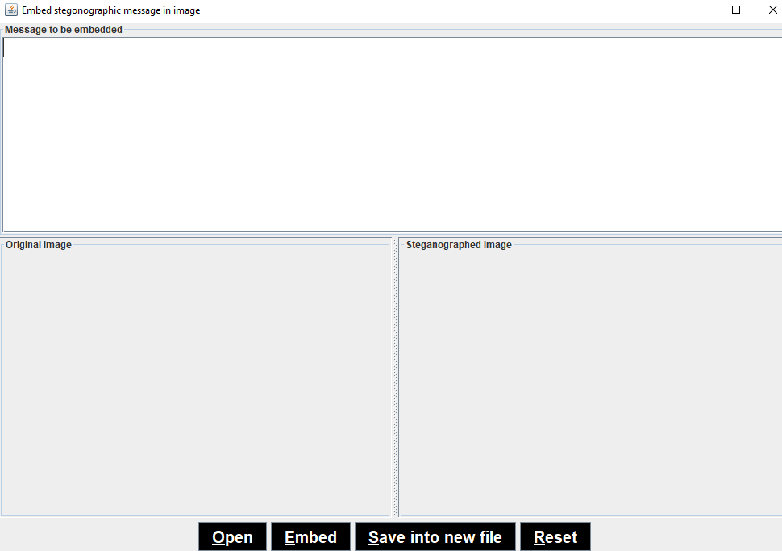
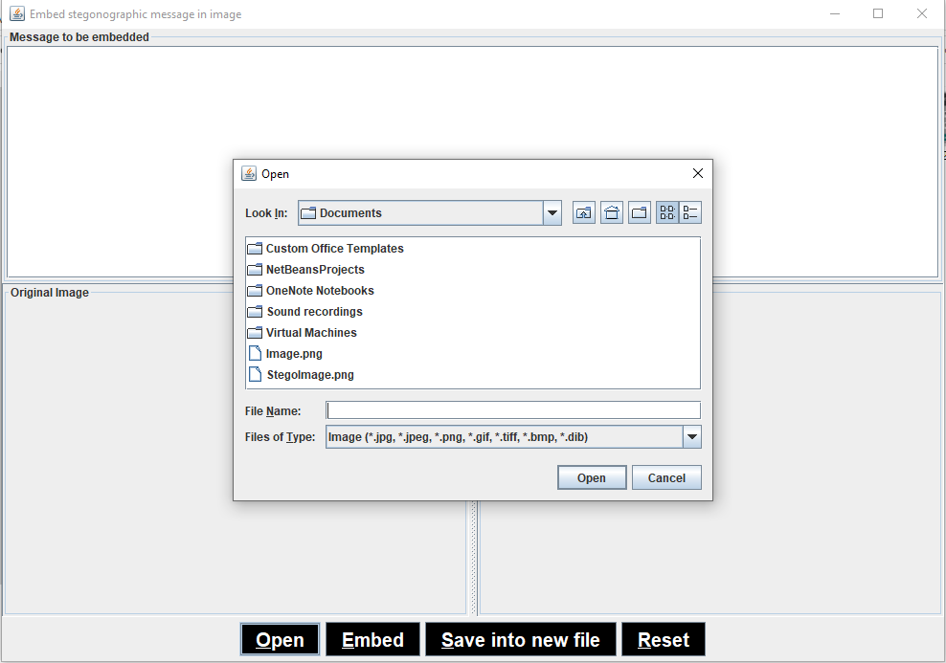

Slide 21
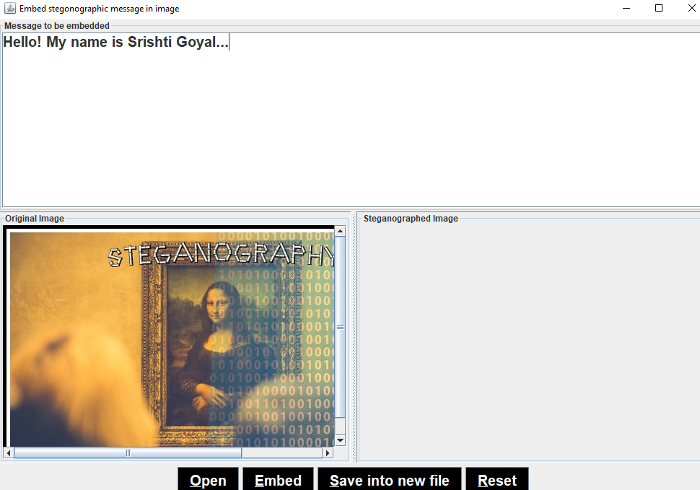
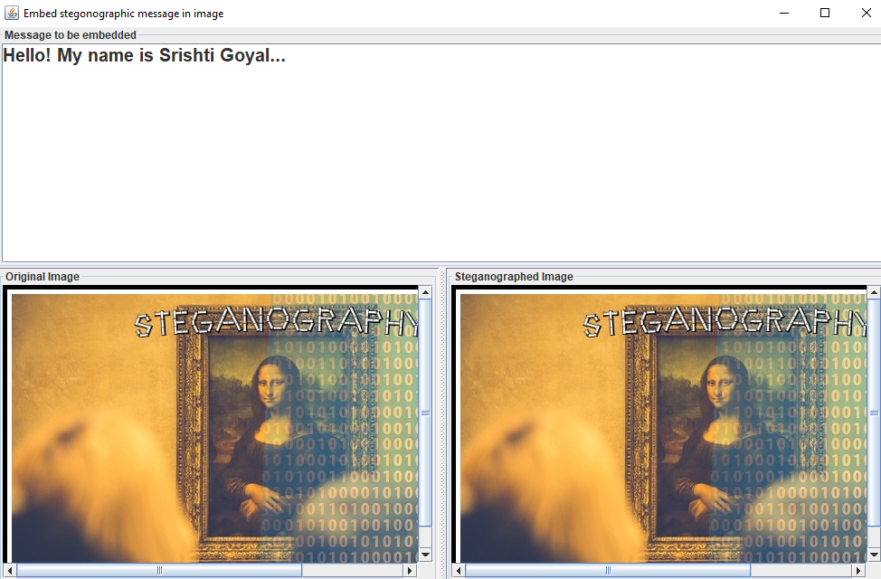

Slide 22
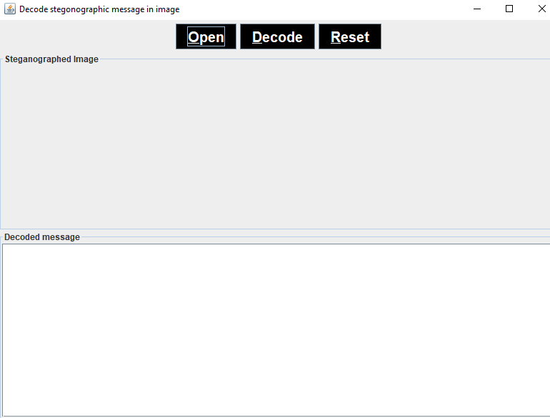
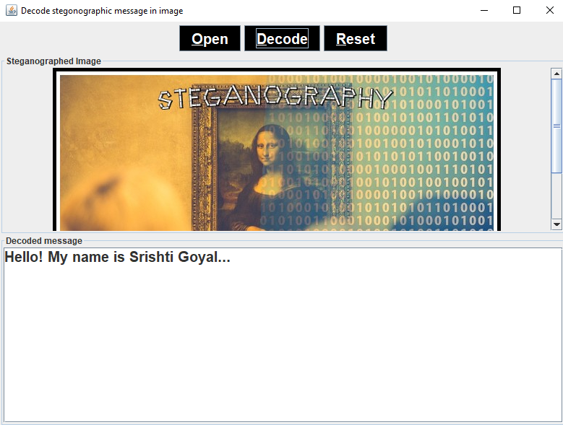

Slide 23
Uses of Steganography
Steganography can be a solution that creates it applicable to send news and data without being censored and without the fear of the messages being prevented and traced back to us.
It is also applicable to simply use steganography to save data on a location. For example, several information sources like private banking information, and some military secrets, can be saved in a cover source.
When it is required to unhide the secret data in the cover source, it can simply reveal the banking information and it will be impossible to validate the existence of the military secrets inside.

Slide 24
Conclusion
The ease in use and abundant availability of steganography tools has low enforcement concerned in trafficking of illicit material via web page images, audio, and other transmissions over the Internet.
Where standard cryptography and encryption is outlawed, steganography can be used.
Formerly, just an interest of the military, steganography is gaining popularity among the masses.

Slide 25
Bibliography
Literature survey,
http://www.ijetajournal.org/volume2/issue-5
Design-related research,
https://www.researchgate.net/publication/314116270imagesteganography.ImageSteganography
http://repository.root-me.org/Steganography

