Slide 1
SDG 2 | ZERO HUNGER
FoodLoop
Applied AI for evidence-led food rescue planning
Sector-flow ML benchmark + human-reviewed redistribution demo

Slide 2
The coordination gap
A local matching problem: surplus, recipient need, and pickup timing must line up.
Donors have limited time to find a suitable recipient.
Recipient capacity and pickup windows change quickly.
Manual calls and messages make timely handoffs hard to coordinate.
PROJECT HYPOTHESIS
A ranked, time-aware offer can reduce coordination time and increase completed pickups.
Validate the problem with local donors and recipient coordinators before claiming impact.

Slide 3
How the prototype works
Keep the workflow simple and every handoff human-confirmed.
01
02
03
04
LIST
FILTER
RANK
CONFIRM
Food type, quantity, pickup window
Eligibility, capacity, availability
Fit, distance, urgency
Recipient accepts; coordinator checks pickup

Slide 4
AI / ML plan
Start with an explainable baseline; earn the right to train a model with pilot data.
MVP: eligibility rules + weighted ranking
Offline ML benchmark
Exclude recipients who cannot safely accept the category.
Rank by category fit, capacity fit, distance, and deadline urgency.
Show the factors behind each recommendation.
Ridge regression predicts log1p(FlowAmount kg) in EPA modeled national sector flows.
Validation tunes alpha; test split holds out producing-sector codes.
It does not predict local surplus or recipient acceptance.

Slide 5
Model benchmark
EPA 2018 method 2 · hold out complete producing-sector codes
Lower error is better · log1p(kg)
TEST R²
0.730 vs -0.001
MAE
Ridge model
0.942
Median baseline
1.980
1,642 held-out rows
1,025 producing-sector groups
Best alpha: 10
RMSE
Ridge model
1.258
Median baseline
2.425
Exploratory fit to EPA modeled 2018 flows. This is not a local waste forecast or a donation acceptance model.
Test metrics are on log1p(FlowAmount in kg); compare only within this benchmark.

Slide 6
Pilot and measures
Use a supervised pilot with one donor cluster and one trusted recipient partner.
Rescued quantity
Acceptance
kg or portions in completed handoffs
accepted offers / offers sent
Completion
Match time
completed pickups / accepted offers
minutes to confirmed recipient
Targets are hypotheses. Establish a manual baseline; report counts, dates, and missing data.

Slide 7
Safety, privacy, and failure handling
AI recommends; people decide whether food is safe and whether a handoff is complete.
Human checks recipient eligibility, handling conditions, and pickup.
Use synthetic records during development; label them clearly.
Collect minimal operational data and restrict contact-detail access.
Show ranking reasons, allow overrides, and watch for uneven offer distribution.
If data or messaging fails, fall back to coordinator phone / SMS workflow.

Slide 8
Four-week student build
A manageable scope for a mini applied AI project.
WEEK 1
Interview partners; map accepted food, capacity, and pickup rules.
WEEK 2
Build listing form, rules, ranked offers, and confirmation flow.
WEEK 3
Test synthetic scenarios and edge cases; refine the workflow.
WEEK 4
Run a supervised pilot only with partner approval; otherwise demo simulation.
Decision gate: partner need confirmed + safe pickup process agreed.

Slide 9
The question to test first
Can trusted local partners complete more timely surplus handoffs with less coordination effort?
Build the smallest workflow that answers that question.
Next step: recruit one donor and one recipient partner for discovery interviews.

Slide 10
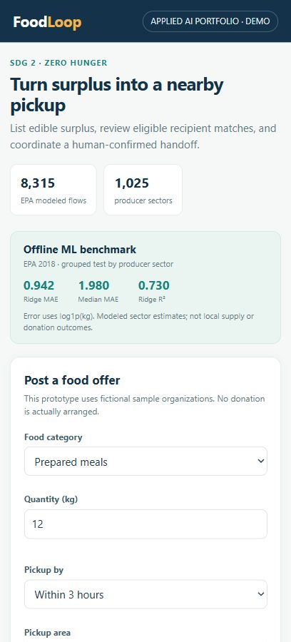
Prototype screenshot: create an offer
Running local demo · responsive mobile view
Set the food category, quantity, pickup window, and area. The page labels its sample data.
Sample organizations and offers are fictional. No message is sent and no donation is arranged.

Slide 11
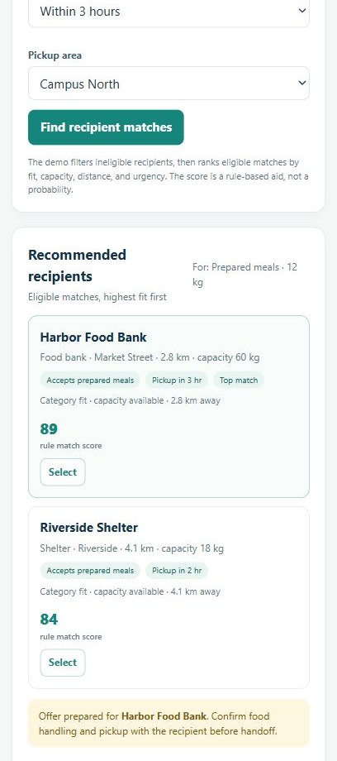
Prototype screenshot: review matches
Running local demo · responsive mobile view
Review eligible recipients and the score factors, then prepare a human-confirmed handoff.
Sample organizations and offers are fictional. No message is sent and no donation is arranged.

