Slide 1
Unemployment in the labor force IN NEW YORK
BY: SRISHTI PATIL

Slide 2
Importance of the forecast
Understanding Trends and Patterns:
Helps to analyze unemployment trends in the labor force over time.
Government and Policymaker Benefits:
Aids in planning interventions such as employment programs, welfare policies, and job training initiatives.
Economic and Business Implications:
Anticipates potential labor shortages or surpluses.
Influences hiring decisions, salary adjustments, and resource allocation.
Social Implications:
Provides insights into the broader effects of unemployment, such as impacts on crime, and societal well-being.
Enables more targeted community support.
Company Benefits:
Helps in adjusting hiring strategies and identifying potential skills gaps.
Prepares businesses for fluctuations in the availability of labor.

Slide 3
Data description
Monthly employment data from the year 1976-2022.
Variable | Description
FIPS Code | A unique identifier representing geographical areas, typically used in the U.S. to identify counties or cities.
State/Area | The name of the state or area being referred to in the dataset.
Year | The year in which the data was recorded.
Month | The month in which the data was recorded, represented as a number from 1 (January) to 12 (December).
Total Civilian Non-Institutional Population in State/Area | The total civilian population in the state or area, excluding those in institutions.
Total Civilian Labor Force in State/Area | The total number of civilians in the labor force (both employed and unemployed) in the state or area.
Percent (%) of State/Area's Population | The percentage of the state's or area's population that makes up the total civilian labor force.
Total Employment in State/Area | The total number of people employed in the civilian labor force within the state or area.
Percent (%) of Labor Force Employed in State/Area | The percentage of the civilian labor force that is employed.
Total Unemployment in State/Area | The total number of unemployed civilians in the labor force in the state or area.
Percent (%) of Labor Force Unemployed in State/Area | The percentage of the civilian labor force that is unemployed.

Slide 4
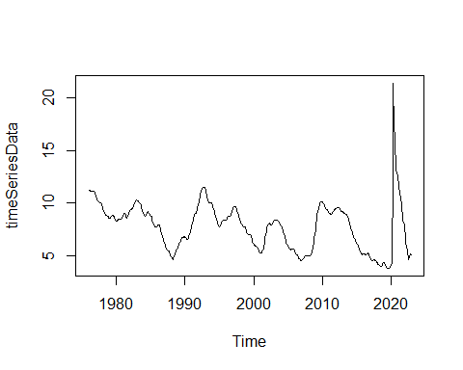
Exploratory data analysis
Time series plot:
Shows there are cyclical patterns in the unemployment rate in New York over time, with peaks and troughs occurring periodically
General trend shows periods of both high and low unemployment, corresponding to economic cycles.

Slide 5
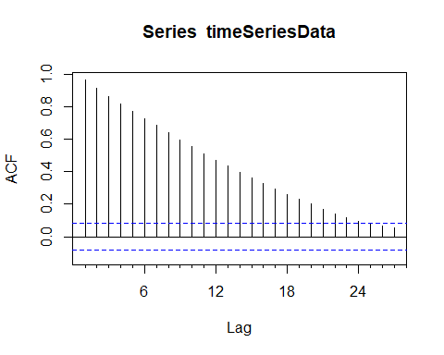
Exploratory data analysis
ACF:
Gradual decline indicates strong autocorrelation, suggesting seasonality or persistent trends in unemployment.
Slow decay implies non-stationarity, requiring trend or seasonality modeling.

Slide 6
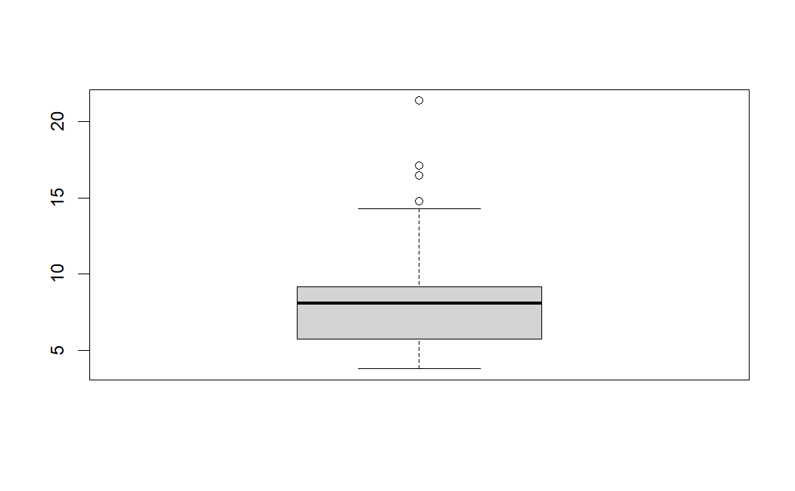

Exploratory data analysis
Summary and Boxplot:
Boxplot shows there are a few outliers
Interquartile range (IQR) is relatively narrow, indicating consistency in the majority of the data.

Slide 7
Accuracy measure
Mean Absolute Percentage Error (MAPE)
MAPE simplifies interpretation: It expresses forecast error as a percentage, making it easy for stakeholders (policymakers, economists, businesses) to understand and evaluate forecast accuracy.
Penalizes large errors: MAPE emphasizes large errors, reflecting their proportional impact and ensuring the model corrects significant inaccuracies.
Real-world impact: In unemployment forecasting, reducing large errors prevents resource misallocation and improves policy planning.
Indicates model accuracy: A lower MAPE suggests the model effectively captures trends, leading to better unemployment predictions.
Supports informed decisions: Accurate forecasts with lower MAPE enable targeted labor policies and workforce initiatives.
Normalized comparison: MAPE adjusts for varying unemployment levels, providing a consistent measure of model accuracy across contexts.

Slide 8
FORECASTING METHODS

Slide 9
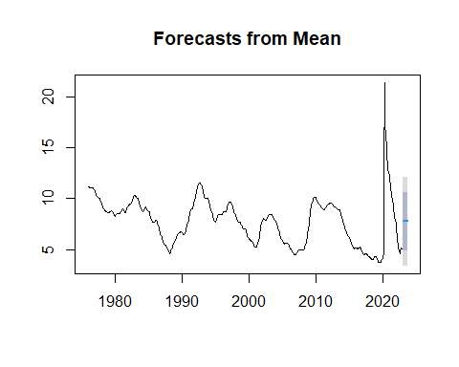
Mean Forecasting

Slide 10
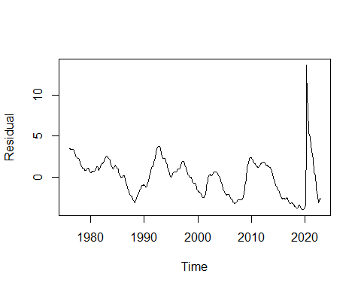
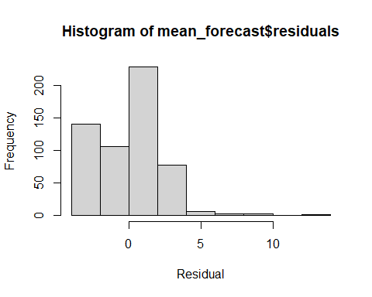
Residual Analysis

Slide 11
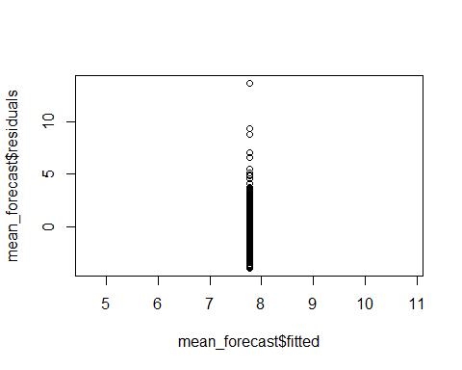
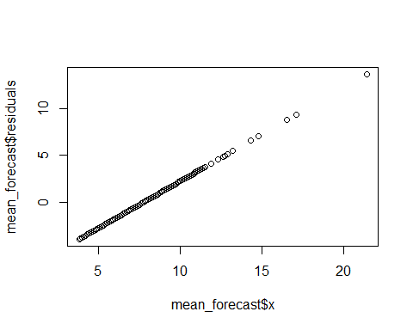
Residual Analysis

Slide 12
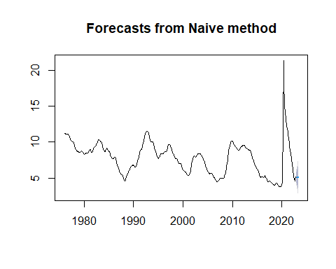
Naïve Forecast

Slide 13
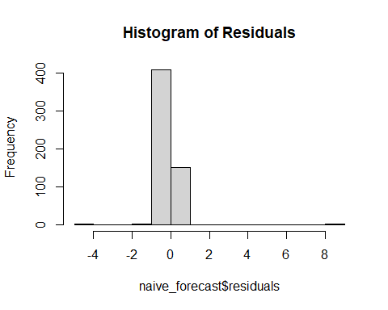
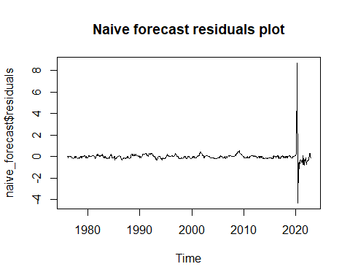
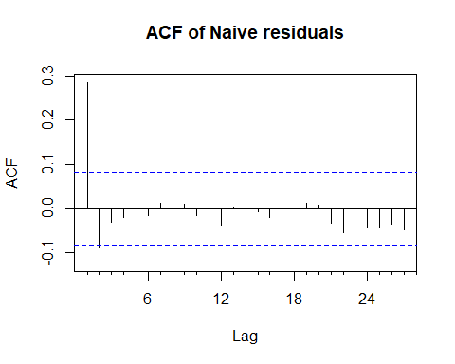
Residual Analysis

Slide 14
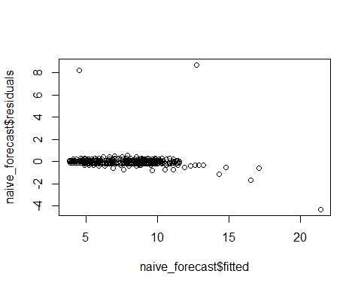
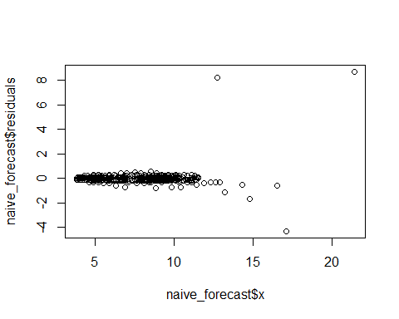
Residual Analysis

Slide 15
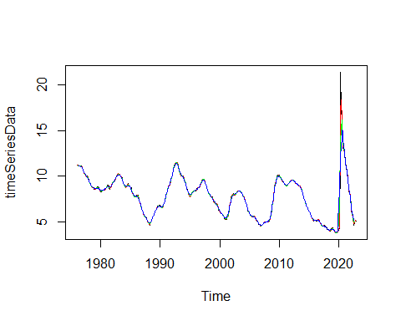
Moving averages

Slide 16
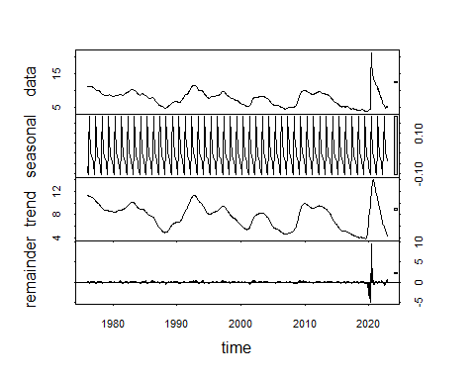
decomposition

Slide 17
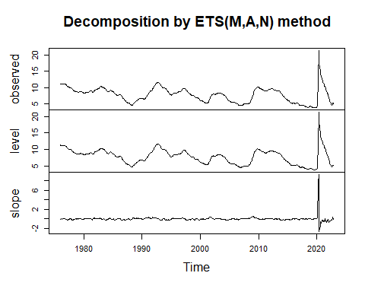
Exponential Smoothing Methods

Slide 18
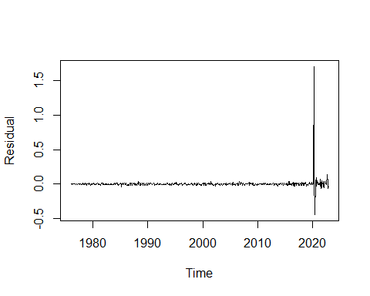
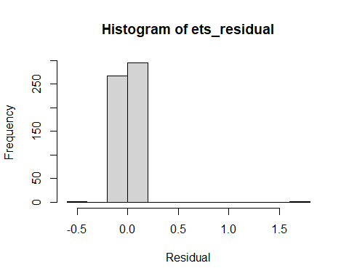
Residual Analysis

Slide 19
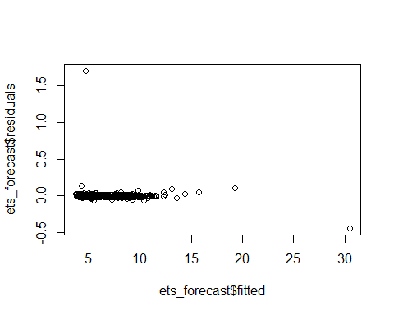
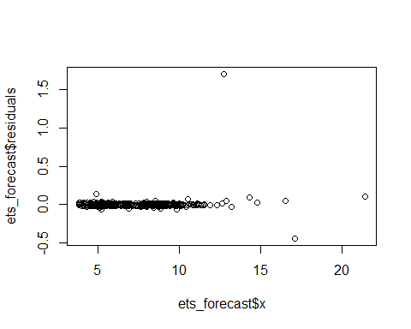
Residual Analysis

Slide 20
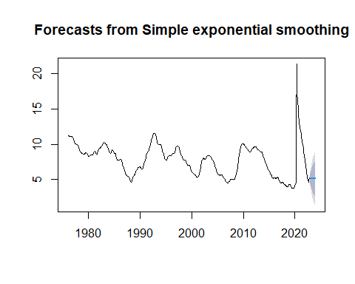
Simple exponential smoothing

Slide 21
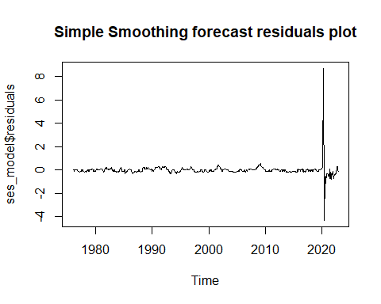
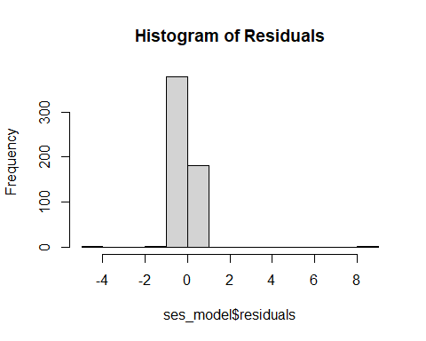
Residual Analysis

Slide 22
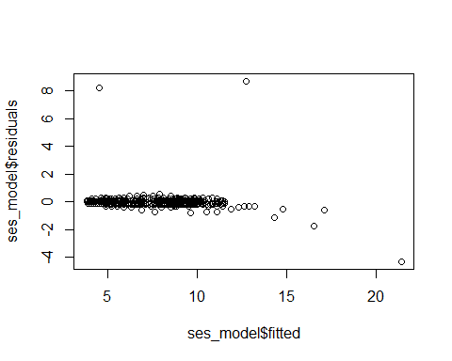
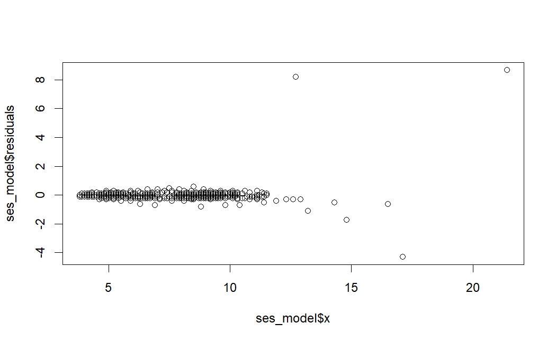
Residual Analysis

Slide 23
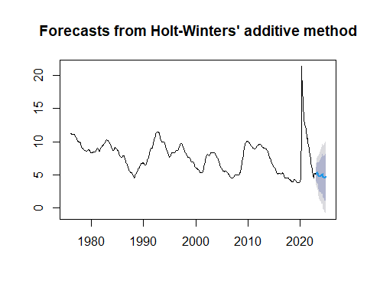
HoltWinters

Slide 24
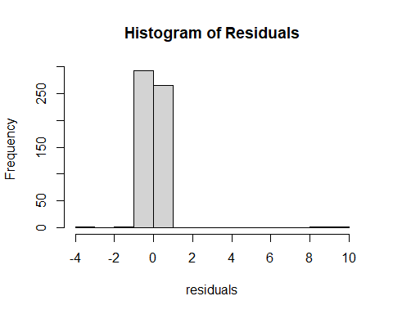
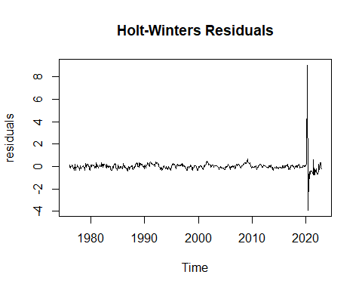
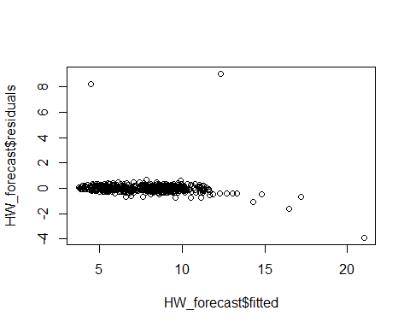
Residual Analysis

Slide 25
Accuracy comparison
Model | ME | RMSE | MAE | MPE | MAPE | MASE | ACF1
Mean Forecast | -2.984247e-18 | 2.222627 | 1.803226 | -9.125461 | 26.7602 | 1.34275 | 0.9642393
Naïve Forecast | -0.01083481 | 0.566015 | 0.1571936 | -0.260081 | 1.822557 | 0.1170523 | 0.2870979
SES Model | -0.01081135 | 0.5655293 | 0.1569322 | -0.2596054 | 1.819525 | 0.1168576 | 0.2871729
ETS Forecast | -5.77345e-07 | 0.6731741 | 0.1116492 | 0.07488355 | 1.202059 | 0.08313824 | -0.08833626
HW Forecast | 0.005347043 | 0.5811476 | 0.1874316 | -0.03797169 | 2.228681 | 0.1395687 | 0.3138823

Slide 26
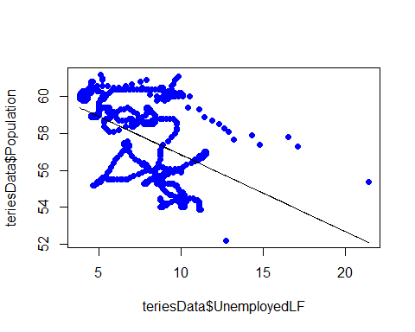
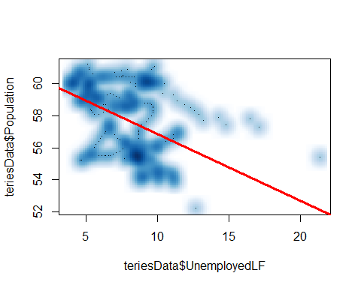
regression
For every unit increase in the unemployed labor force, the population decreases by 0.4157 million (or approximately 416,000 people).
This negative relationship suggests that higher unemployment correlates with a decline in population, potentially due to out-migration or other factors.

Slide 27
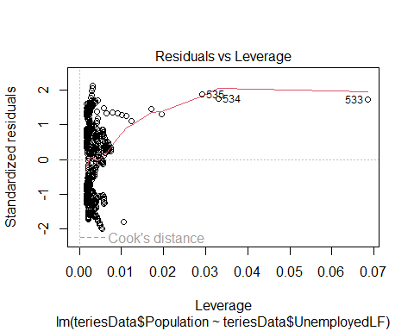
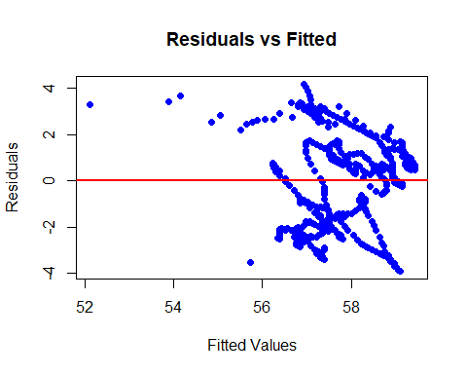
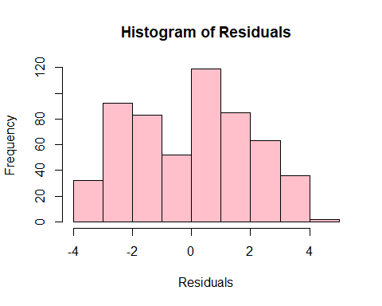
Residual Analysis

Slide 28
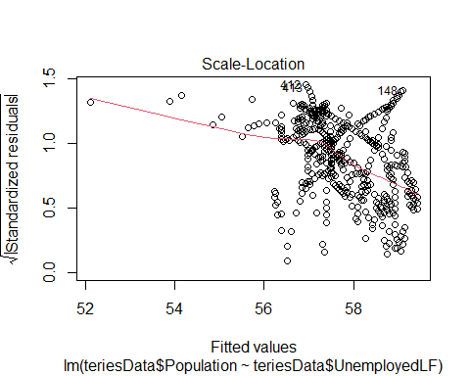
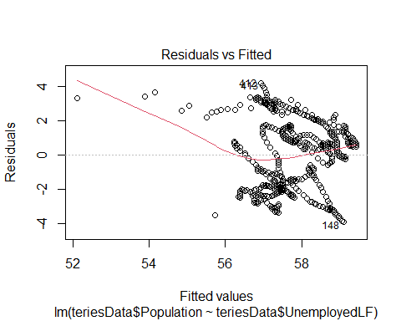
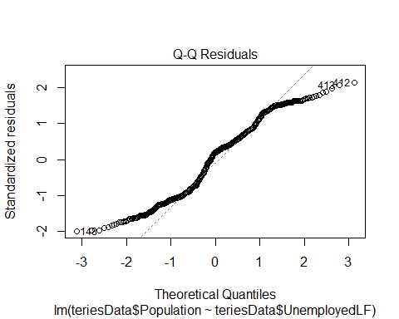
Residual Analysis

Slide 29
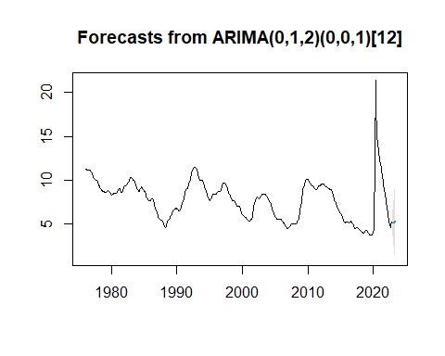
arima
The output states that the model accounts for short-term trends using the two MA terms and one seasonal MA term and the seasonal patterns are identified based on the periodicity of 12.

Slide 30
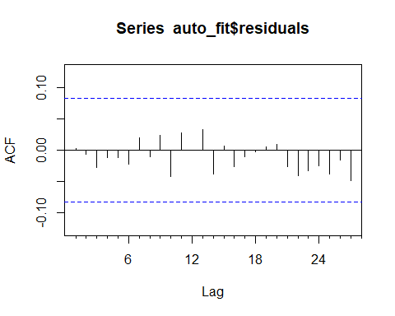
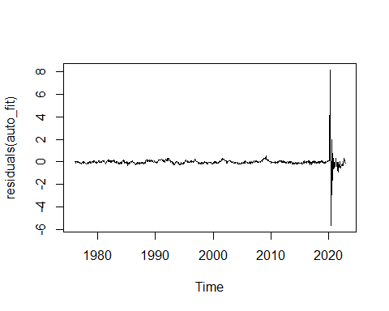
Residual Analysis

Slide 31
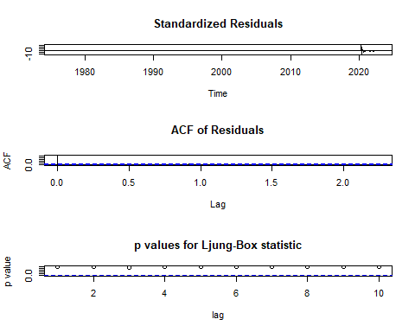
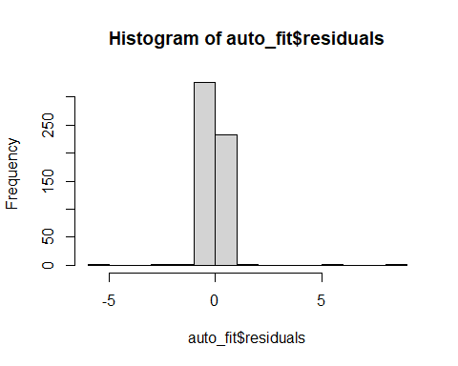

Slide 32
DECISION BASED ON ANALYSIS
Unemployment in New York follows a cyclical pattern with seasonal fluctuations.
Long-term trends should be monitored for structural shifts in the labor market.
Seasonal insights help policymakers plan interventions and address challenges effectively.
ETS(M,A,N) and Holt-Winters models are reliable but require periodic updates for accuracy.

Slide 33
Ideas to improve forecasts
Monitor trends for significant long-term changes in unemployment rates.
Incorporate economic factors like GDP, inflation, and consumer confidence into the analysis.
Consider demographic factors such as population size, age structure, and migration patterns.
Account for impacts of labor laws, wage adjustments, and unemployment benefits on the labor market.
Identify and address outliers caused by extraordinary events using robust statistical methods.
Utilize more granular data (e.g., weekly or daily) for detailed insights.
Improve visualization techniques for better pattern identification and decision-making.

