Slide 1

Electric Vehicle Market Analysis
This presentation outlines the key performance indicators (KPIs) and charts for a comprehensive analysis of the electric vehicle market.
By: Srishti Patil & Tanush Bhaskar Shetty

Slide 2

Dataset and Data Cleaning
The initial data set contained some variables that needed cleaning. We removed null values for City, County, Postal code, Legislative District and other key attributes.
The key columns utilized for the analysis are state, county, model, make & CAFV eligibility.

Slide 3
Columns in dataset
VIN (Vehicle ID): Unique identifier for each vehicle.
County: County within the state where the vehicle is registered.
City : Name of the Cities from where the data is gathered.
State: U.S. state where the vehicle is registered.
Postal code : The postal code from where the data is gathered.
Model Year: Year the vehicle was manufactured or released.
Make: Manufacturer or brand of the vehicle (e.g., Tesla, Nissan).
Model: Specific model of the vehicle (e.g., Model 3, Leaf).
Electric Vehicle Type: Type of EV (e.g., BEV - Battery Electric Vehicle,
PHEV - Plug-in Hybrid Electric Vehicle).
CAFV Eligibility: Indicates eligibility for Clean Alternative Fuel Vehicle incentives.
Electric Range: Distance the vehicle can travel on a full charge (in miles).
Base MSRP: Manufacturer’s Suggested Retail Price for the base model.
DOL Vehicle ID : A unique identifier assigned to each vehicle by the Department of Licensing (DOL).It helps track individual vehicle registrations in official databases.

Slide 4

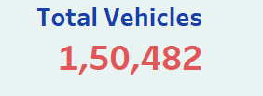

KPIs
Total Vehicles
Average Electric Range
Average electric range of the electric vehicles in the dataset to gauge the efficiency of the EVs.
Total size of the market

Slide 5
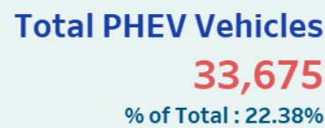
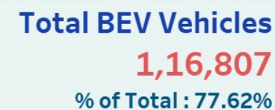

BEV and PHEV Analysis
Total BEV Vehicles
Total PHEV Vehicles
Total number of Battery Electric Vehicles (BEVs) in the dataset.
Total number of Plug-in Hybrid Electric Vehicles (PHEVs) in the dataset.

Slide 6
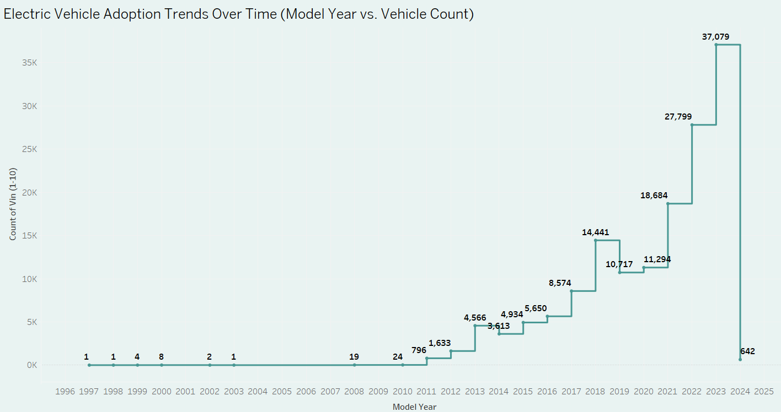
Electric Vehicle Adoption Trends Over Time
Notes:
Exponential Growth: EV adoption grew rapidly after 2010, particularly accelerating from 2018 onward, indicating a shift in consumer preference and advancements in EV technology.2023 Peak: The count of 37,079 vehicles in 2023 is the highest recorded, reflecting strong momentum in EV adoption.2024 Data Caveat: The sharp drop to 642 vehicles in 2024 suggests incomplete or provisional data rather than a decline in adoption trends.

Slide 7
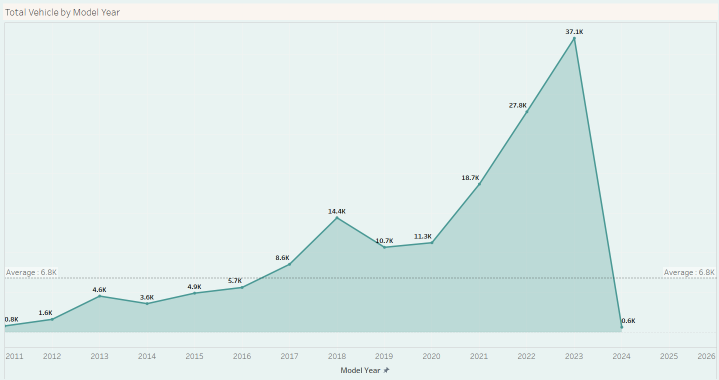
Total Vehicles by Model Year
Notes:
Steady Growth Until 2016 : From 2011 to 2016, the total vehicles per model year showed gradual growth, peaking at 5.7K in 2016.
Significant Increase Post-2017 : The data experienced a sharp rise starting in 2017, reaching 14.4K in 2018. Although 2019 saw a decline to 10.7K, the trend remained above the long-term average (6.8K).
Peak in 2023 : The most significant surge occurred between 2021 and 2023, with 27.8K in 2022 and a peak of 37.1K in 2023. This suggests a substantial increase in vehicle production or reporting.
Drastic Decline in 2024 : In 2024, the total vehicles dropped sharply to 0.6K, far below the average and the previous years.
The average value across all years is 6.8K, and most years before 2020 were below this benchmark.

Slide 8
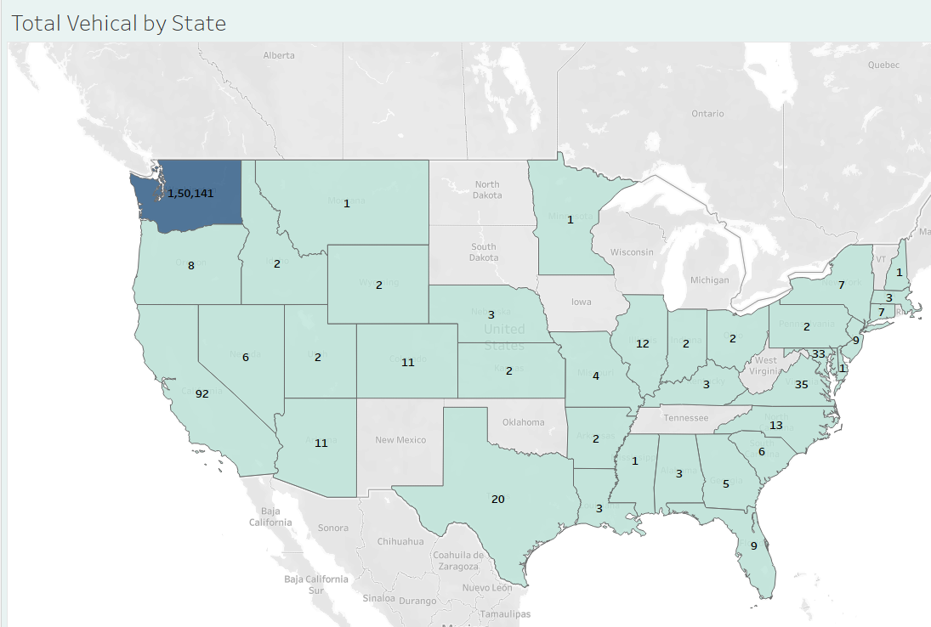
Total Vehicles by State
Notes:
Washington State has the highest vehicle count at 1,150,141, significantly outpacing all other states.
Texas (20), Virginia (35), and Georgia (3) also show relatively high vehicle totals.
In contrast, states like North Dakota (1), South Dakota (1), and Nebraska (2) report minimal vehicle counts.

Slide 9
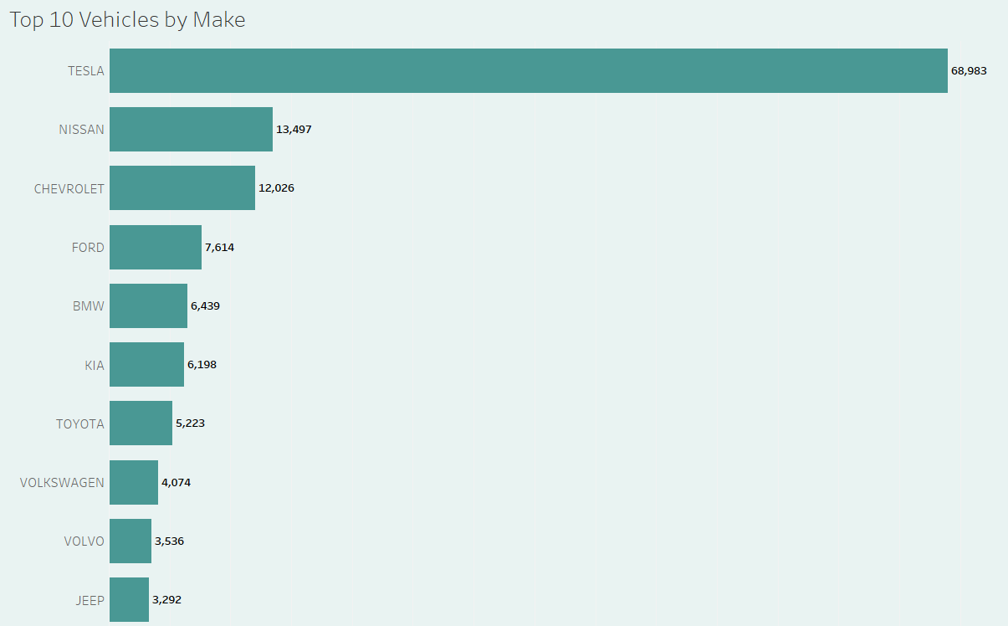
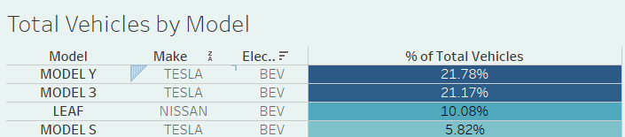
Top vehicles by make & model
Notes:
Tesla clearly dominates both by make and model, accounting for a significant share of total vehicles. Combined, Tesla's Model Y, Model 3, and Model S make up nearly 50% of the market.
While Nissan's Leaf ranks third, it significantly lags behind Tesla's top two models. BEVs are clearly driving consumer preferences, with other automakers like Nissan maintaining a distant second position.

Slide 10
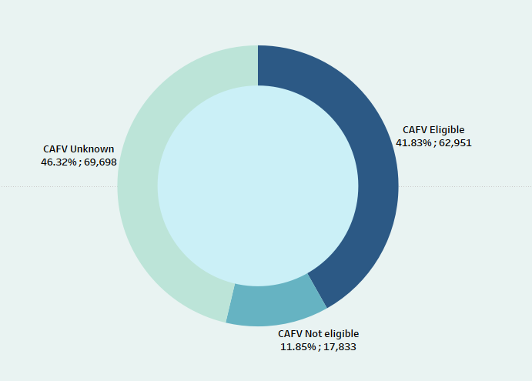
Total Vehicles by CAFV (Clean Alternative Fuel vehicle) Eligibility
Notes:
CAFV Eligibility:
A significant portion of vehicles (41.83%) are CAFV Eligible, reflecting a growing shift towards cleaner fuel alternatives.
The 11.85% CAFV Not Eligible vehicles highlight a smaller segment with low battery range.
Data Gaps:
The 46.32% Unknown category is substantial, indicating a lack of clarity or incomplete data on many vehicles' CAFV eligibility.
Potential Focus Area:
The Unknown category presents an opportunity to enhance data collection efforts, which could provide a clearer picture of clean vehicle adoption.

Slide 11
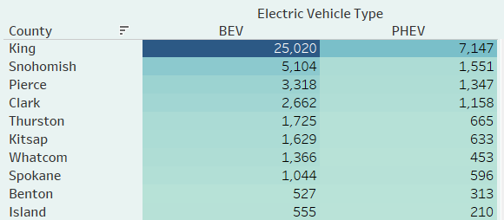
Geographical Distribution of EVs
Electric vehicle adoption by county
Notes:
Doing an even more granular analysis of the King County is the clear leader in EV adoption, accounting for the majority share in both BEVs and PHEVs. Snohomish and Pierce Counties also demonstrate significant EV adoption. The consistent preference for BEVs over PHEVs across all counties reflects the growing shift toward fully electric vehicles.

Slide 12
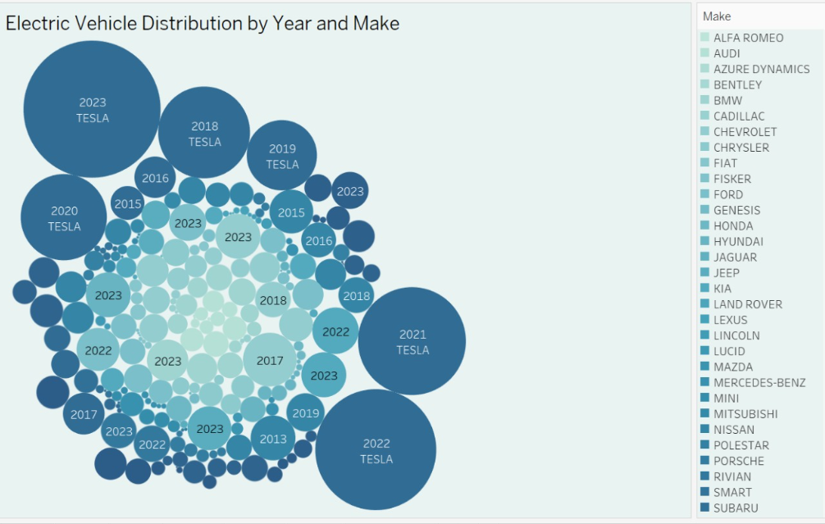
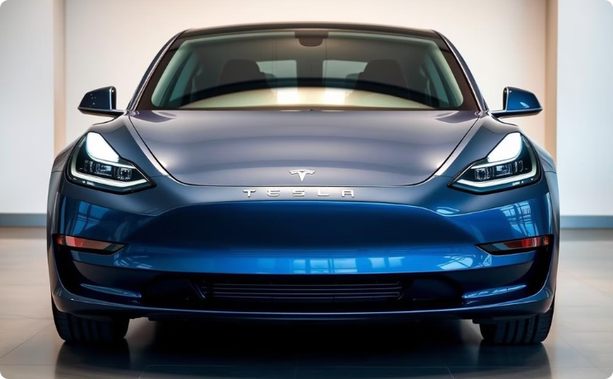
Electric vehicle distribution by Year & make
Notes:
Tesla holds a dominant position in EV distribution, particularly in 2023, but the market is gradually diversifying with contributions from other automakers. The growth in EV adoption is visually represented by the increasing bubble sizes in recent years, particularly post-2015.

Slide 13
Thank you

