Slide 1

THIRD EYE FOR BLINDS
MADE BY-
SRISHTI JAISWAL
(RA1611008030006)
ANANT MITTAL
(RA1611008030034)

Slide 2
ABSTRACT
Third eye for blinds is an innovation which helps the blinds people to navigate with speed and confidence by detecting the nearby obstacles using the help of ultrasonic waves and notify them with buzzer sound or vibration. They only need to wear this device as a band or cloth.
According to WHO 39 million peoples are estimated as blinds worldwide. They are suffering a lot of harder ship in there daily life. The affected ones have been using the traditional white cane for many years which although being effective, still has a lot of disadvantages. Another way is, having a pet animal such as a dog, but it is really expensive. The aim of the project is to develop a cheap and more efficient way to help visually impaired to navigate with greater comfort, speed and confidence.

Slide 3
INTRODUCTION
This is the first wearable technology for blinds which resolves all the problems of existing technologies. Now a days there are so many instruments and smart devices for visually impaired peoples for navigation but most of them have certain problems for carrying and the major drawbacks is they need a lot of training to use. The one of the main peculiarity of this innovation is, it is affordable for everyone, the total cost being less than $25 (~1500INR). There are no such devices available in the market that can be worn like a cloth and having such a low cost and simplicity. When used on a large scale, with improvements in the prototype, it will drastically benefit the community.

Slide 4
FEATURES
The first wearable technology for people who are blind
Using ultrasonic waves to detect the obstacles
Notifying the user through vibrations/buzzer sound
Cheap and more efficient
Affordable for everyone, the total cost being less than $25 (~1500INR)

Slide 5
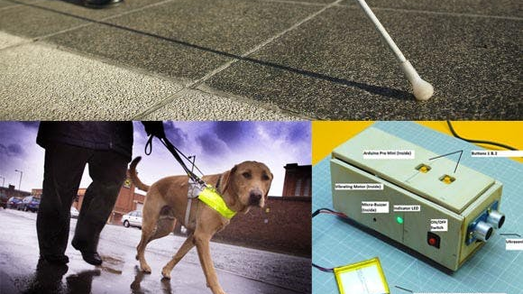
EXISTING SYSTEMS
White cane
Pet dog
Smart devices (eg : Vision a torch for blinds)

Slide 6
PITFALLS IN EXISTING WORK
White cane - May easily crack/break. The stick may get stuck at pavement cracks of different objects.
Pet dog - Huge cost (~$42,000 / 280000Rs )
Common Disadvantages (Including the the smart devices) Cannot be carried easily, needs a lot of training to use.

Slide 7
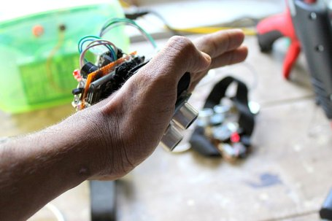
PROPOSED WORK
We have designed a special wearable device based on the Arduino board which can be worn in the hand like a GLOVE.
This device is equipped with ultrasonic sensor.
When the ultrasonic sensor detects obstacle the device will notify the user through vibrations and sound beeps.

Slide 8
METHODOLOGY
We have designed a special wearable device based on the Arduino board which can be worn like a glove for blinds. This device is equipped with ultrasonic sensor, consisting of module which is connected to the hand. Using the ultrasonic sensor, blind can detect the objects around them and can easily travel anywhere. When the ultrasonic sensor detects obstacle, the device will notify the user through vibrations and sound beeps. The intensity of vibration and rate of beeping increases with decrease in distance and this is a fully automated device.

Slide 9
TOOLS USED
Arduino pro mini
Ultrasonic sensor
Pref board
Vibrating motor
Buzzers
Red LEDs
Switches
Male and female header pins
Jumper cable
One power bank
One 3.3 volt old mobile battery
Glove(to stick it for wearing)

Slide 10
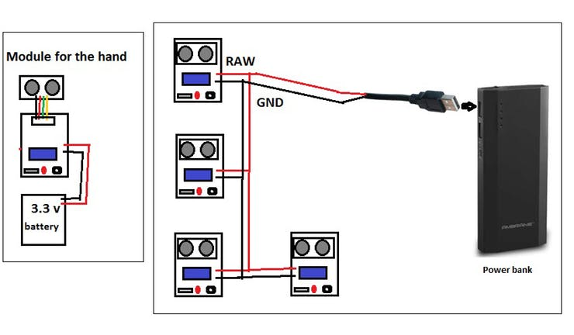
CIRCUIT DIAGRAM

Slide 11
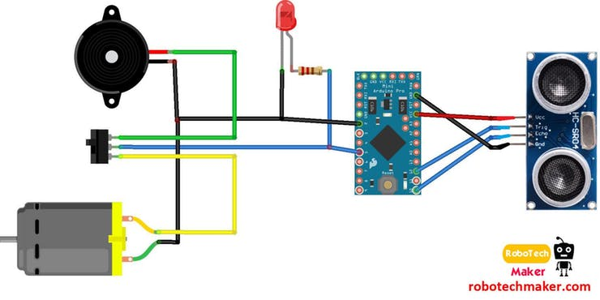
CONT.

Slide 12
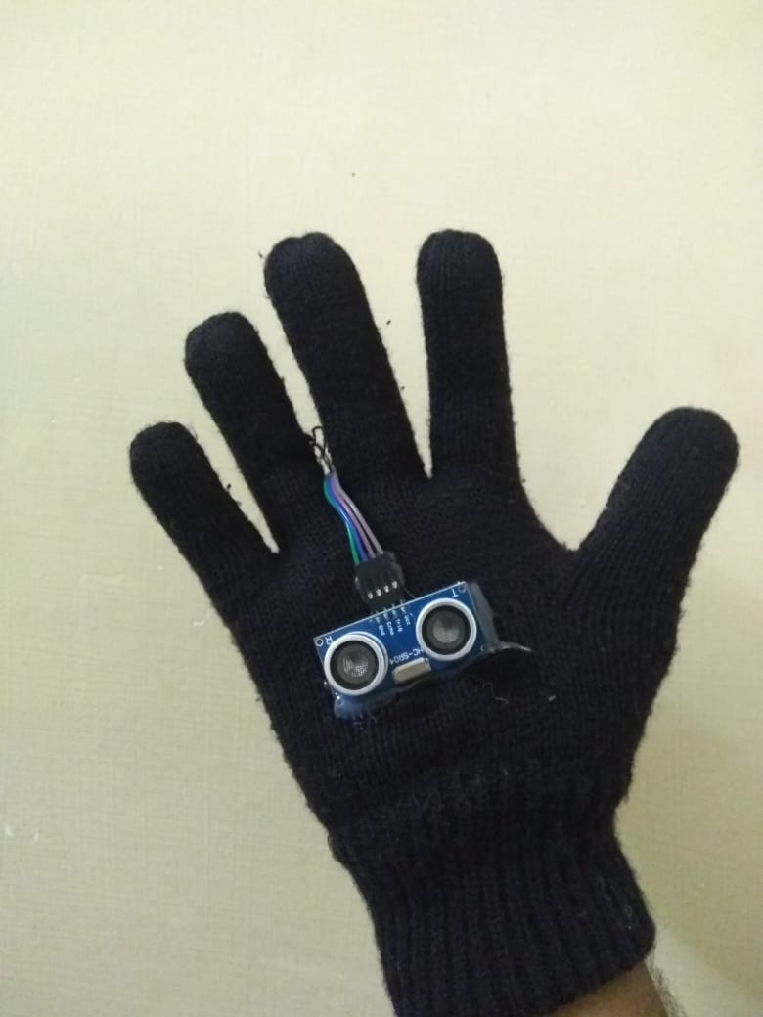
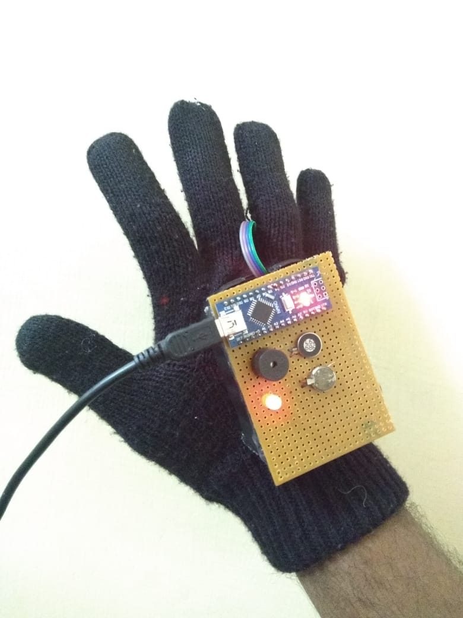
RESULT

Slide 13
CONCLUSION
Third eye for blinds is an innovation which helps the blinds people to navigate with speed and confidence by detecting the nearby obstacles using the help of ultrasonic waves and notify them with buzzer sound or vibration. They only need to wear this device as a band or cloth.
This is the first wearable technology for blinds which resolves all the problems of existing technologies. Now a days there are so many instruments and smart devices for visually impaired peoples for navigation but most of them have certain problems for carrying and the major drawbacks is those need a lot of training to use.

Slide 14
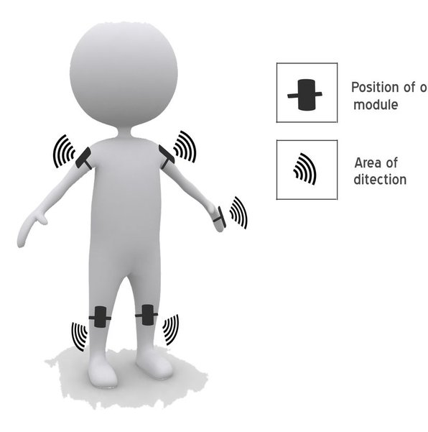
FUTURE SCOPE
The entire project can be made in the form of jacket by using multiple modules at different locations of the body, so that the device doesn't need to be wear in hand.
Use of specially designed boards instead of Arduino and high quality ultrasonic sensors makes faster response which make the device capable of working in crowded.

Slide 15
REFERENCES
https://www.hackster.io/muhammedazhar/third-eye-for-the-blind-8c246d
https://www.instructables.com/id/THIRD-EYE-FOR-BLINDS-an-Innovative-Wearable-Techno/

Slide 16
THANK YOU!!

