Slide 1

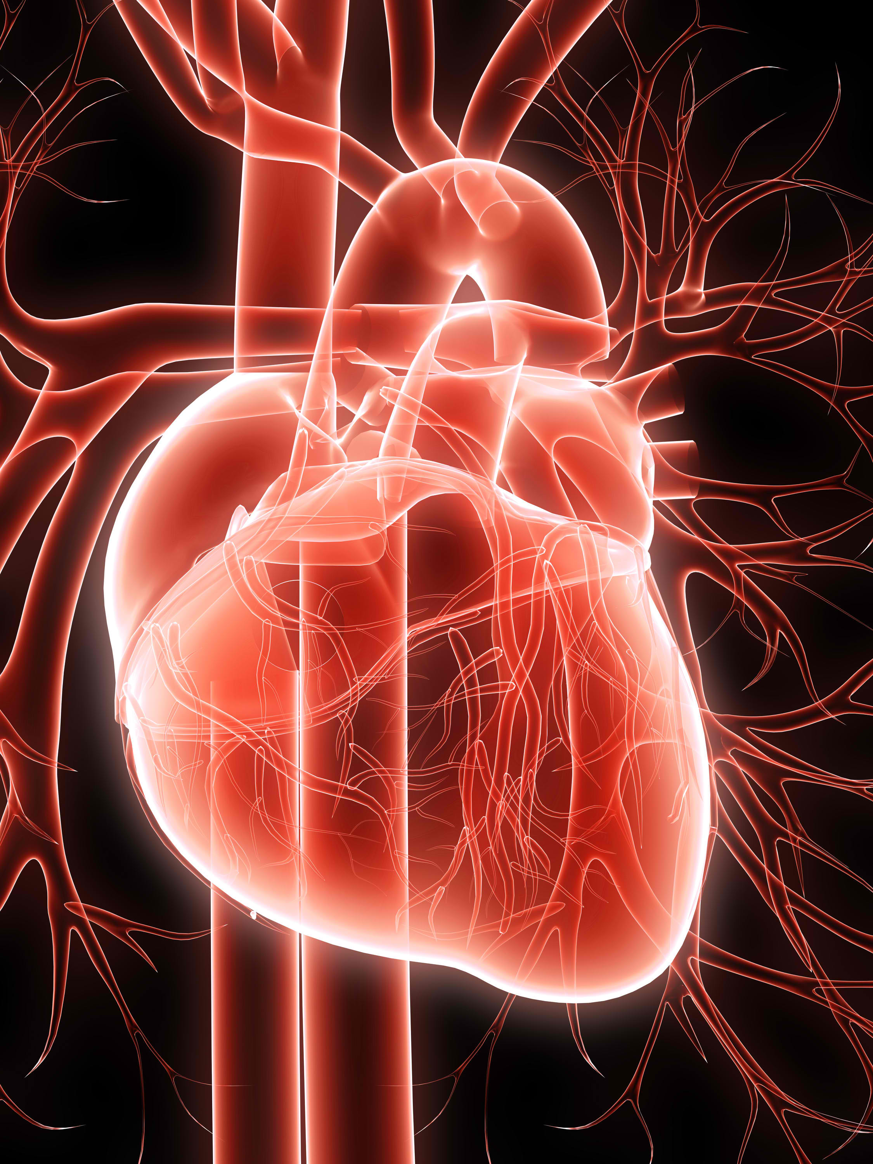
HEART STROKE PREDICTION
Submitted by:-
SRISHTI MITTAL

Slide 2

Executive Summary
The Heart Stroke Prediction Project was undertaken to develop a predictive model for early detection of heart strokes utilizing data science methodologies. This report encapsulates the comprehensive process, from data preparation to model evaluation, and presents the key findings and insights gained through this analysis.

Slide 3

Introduction
Heart stroke prediction is a critical application of data science and healthcare analytics. It involves utilizing machine learning algorithms and statistical models to assess the likelihood of an individual experiencing a heart stroke based on various health-related factors. Early detection of this potential risk is of paramount importance for timely medical intervention and prevention.

Slide 4

OBJECTIVES The primary objectives of this project were: Build a predictive model for heart stroke detection. Achieve high accuracy and reliability in predictions.

Slide 5
Data Collection and Preparation 1. Data Sources The dataset used in this project contains information on health-related features including age, blood pressure, cholesterol levels, etc. The target variable is binary, indicating the likelihood of a heart stroke. 2. Data Cleaning The data underwent comprehensive preprocessing to ensure its quality and suitability for analysis. This involved: 1.Handling missing values. 2.Encoding Categorical variables. 3.Normalizing Numerical Features.

Slide 6
Exploratory Data Analysis (EDA) 1. Descriptive Statistics for Age (in years), Systolic Blood Pressure (in mm Hg), Cholesterol Levels (in mg/dL), Body Mass Index (BMI) Mean: [Mean Value] Median (50th Percentile): [Median Value] Mode: [Mode Value] Standard Deviation: [Standard Deviation Value] Minimum: [Minimum Value] Maximum: [Maximum Value] for Smoking Status (0: Non-Smoker, 1: Smoker), Diabetes Status (0: Non-Diabetic, 1: Diabetic) Percentage of Non-Smokers: [Percentage] Percentage of Smokers: [Percentage]

Slide 7

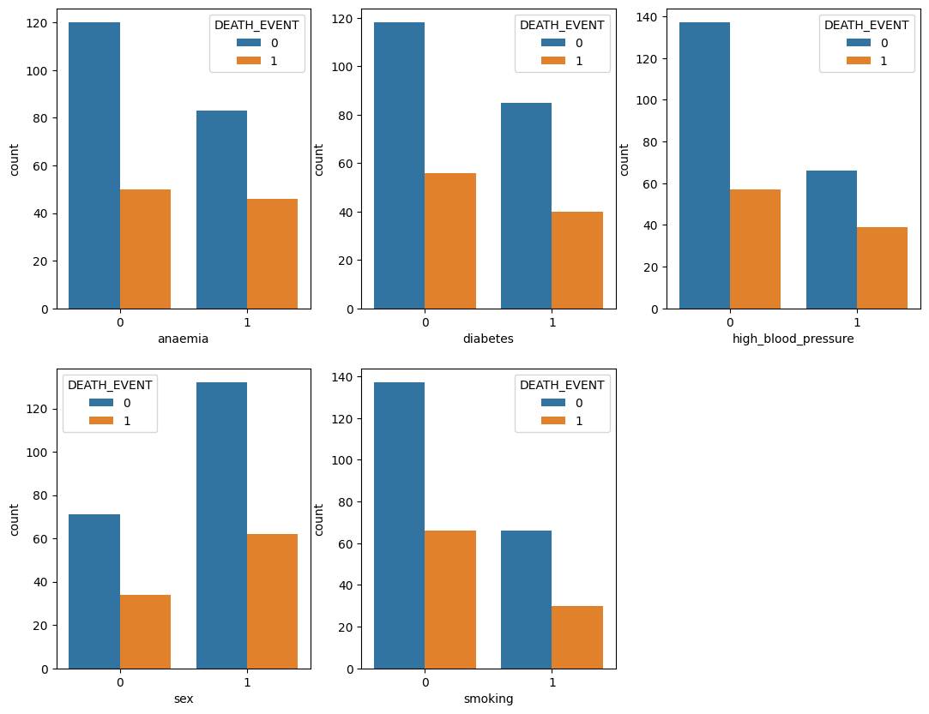
2. Data Visualization

Slide 8
Methods Used
Logistic Regression:
A commonly used statistical technique for binary classification tasks like predicting heart strokes.
Decision Trees:
Effective for capturing non-linear relationships and interactions between features.
3. Support Vector Machine:
It is a supervised machine learning algorithm that can be used for classification or regression tasks. The primary goal of an SVM is to find a hyperplane in a high-dimensional space that best separates data points of one class from another.

Slide 9
4. K-Nearest Neighbors (KNN):
is a supervised machine learning algorithm used for both classification and regression tasks. It's a type of instance-based learning or lazy learning, meaning it doesn't explicitly build a model but memorizes the training dataset.
5. Random Forest:
It is a powerful and versatile algorithm that is widely used in practice due to its good performance and ease of use. It is effective in handling high-dimensional data, capturing complex r relationships, and dealing with noisy datasets.
6. Naive Bayes:
It is a family of probabilistic classification algorithms based on Bayes' theorem, with the "naive" assumption of independence between features. These classifiers are particularly popular for text classification tasks, such as spam filtering and sentiment analysis.

Slide 10
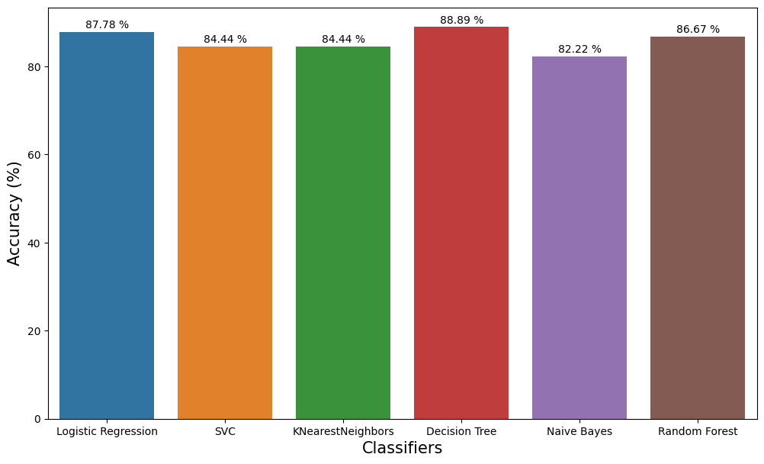
Result

Slide 11

Conclusions
It seemed like both BMI and Age were positively correlated, though the association was not strong.
Older patient was more likely to suffer a stroke than a younger patient.
Higher BMI does not increase the stroke risk.
Diabetes is one of the risk factors for stroke occurrence and prediabetes patients have an increased risk of stroke.
Higher proportion of patients who suffered from hypertension or heart disease experienced a stroke, all else being equal.
Regardless of patient’s gender, and where they stayed, they have the same likelihood to experience stroke
Work type variable was highly associated with age.
Marital status variable was highly associated with age.

Slide 12
References
[1] E. S. Donkor, Stroke in the 21st century: a snapshot of the burden, epidemiology, and quality of life (2018), Stroke research and treatment
[2] W. Johnson, O. Onuma, M. Owolabi and S. Sachdev, Stroke: a global response is needed (2016), Bulletin of the World Health Organization

Slide 13
THANK YOU

