Slide 1
What really sets the price of a mobile phone
Feature extraction and price prediction on 517 phone listings
Data science project | prices in Indian rupees (Rs)
Notes:
Project goal: understand which phone features drive price, and build a model that predicts price from specs.

Slide 2
The answer in three numbers
517
Rs 2,165
0.85
clean phone listings, from 541 raw rows
average error on phone models the model has never seen
R² for Gradient Boosting, the best model
Performance tier (chipset, RAM, storage) dominates, followed by brand and 5G. AI Lens and colour have no measurable effect.
Notes:
A naive median-price guess is off by about Rs 6,300 on the same phones; the model cuts that to about Rs 2,200.

Slide 3
Messy data, cleaned first
10
exact duplicate rows removed
14
feature phones and mis-scraped rows (price under Rs 3,000)
123 → 8
processor spellings mapped to chipset families
3
impossible screen heights fixed (one was 41.94 cm)
Notes:
Raw: 541 rows, 12 columns. Cleaned: 517 rows. Camera strings like 50MP were parsed to numbers and mojibake characters stripped.

Slide 4
From raw columns to useful features
Raw field | Extracted feature | Why it helps
Model name | Brand | Captures brand positioning
Processor (123 spellings) | Chipset family and tier 1–4 | Ordered measure of power
Model name | 5G flag | Connectivity generation
"50MP" text | Megapixels as numbers | Usable by models
Model, Colour | Not used as predictors | They only let a model memorise phones
Notes:
Feature extraction here means building new features from raw data; selection (next slides) ranks them. PCA was also tested as an extraction alternative.

Slide 5
Specs that move with price
Strongly positive: chipset, storage, front camera, 5G and RAM move together with price.
Negative: battery and AI Lens are more common on cheap phones. These are associations, not causes.
Notes:
Spearman rank correlation on the cleaned data. PCA shows the strong specs form one performance axis explaining 41.5% of variance.

Slide 6
Gradient Boosting predicts best
An honest test
A random split gives Gradient Boosting an error of Rs 1,763, but it leaks: the same phone in other colours lands in both sets.
We hold out whole models instead.
Notes:
Split holds out 35 whole phone models. Cross-validation shows Ridge and Gradient Boosting are statistically tied; PCA-based models are worse because there is little to compress.

Slide 7
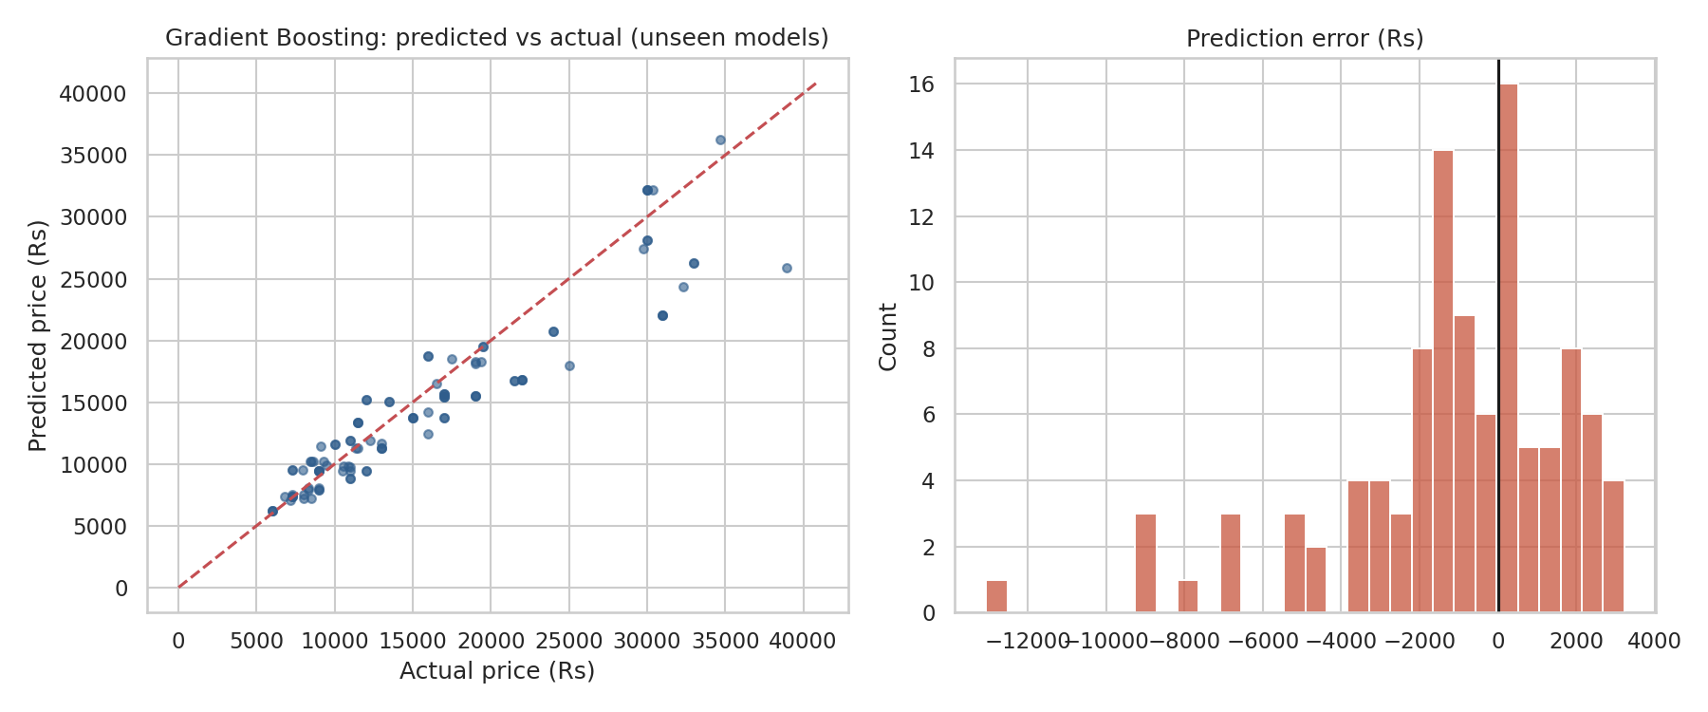
Predictions track actual prices
Test set: 35 phone models the model never saw. MAE Rs 2,165, RMSE Rs 3,120, MAPE 12.7%.
Notes:
Dashed line is perfect prediction. Premium phones above about Rs 50,000 are sparse in the data, so those predictions are least reliable.

Slide 8
Performance tier dominates
No measurable effect
AI Lens: importance near zero.
Colour: p = 0.29 after controlling for specs.
Rear-camera megapixels: almost nothing once other specs are known.
Notes:
Features are shuffled as correlated bundles, because shuffling RAM alone lets the model recover the information from chipset and storage.

Slide 9
What to do with this
Price on performance tier
Start from chipset, then RAM and storage.
Use a storage ladder
Medians step Rs 6,794 to Rs 29,999 from 32 to 256 GB.
Add 5G and brand premiums
Both add value beyond raw specs.
Treat front camera as a segment signal
Rear megapixels carry little pricing power.
Do not charge for AI Lens or colour
No predictive value after specs.
Benchmark new launches
Model gives a reference price within about Rs 2,200.
Notes:
Battery size is not a price lever: bigger batteries are associated with cheaper phones.

Slide 10
Limits and next steps
Small data: 517 listings, 174 models, so rankings between close models are uncertain.
Few premium phones, so predictions above about Rs 50,000 are least reliable.
Chipset tier and 5G flag come from hand-written rules and should be reviewed.
Results are associations from one price snapshot, not causal effects.
Next: add launch date, display, charging speed and sales volume; retrain as new models launch.
Notes:
Full details, code and data are in the project folder.

