Slide 1
Voice Activity Detection in Noise Using Deep Learning

Slide 2
INTRODUCTION
This model shows how to detect regions of speech in a low signal-to-noise environment using deep learning.
The example uses the Speech Commands Dataset to train a Bidirectional Long Short-Term Memory (BiLSTM) network to detect voice activity.
An LSTM network can learn long-term dependencies between time steps of a sequence.
An LSTM layer can look at the time sequence in the forward direction, while a bidirectional LSTM layer can look at the time sequence in both forward and backward directions. This example uses a bidirectional LSTM layer.
This example trains a voice activity detection bidirectional LSTM network with feature sequences of spectral characteristics and a harmonic ratio metric.

Slide 3
TRAINING
Create an audioDatastore that points to the audio speech files used to train the LSTM network.
Create a training signal consisting of speech segments separated by segments of silence of varying durations.
Create an audioDatastore that points to the noise files.
Corrupt the speech-plus-silence signal with noise signal at SNRs ranging from - 10 dB.
Extract feature sequences consisting of spectral characteristics and harmonic ratio from the noisy signal.
Train the LSTM network using the feature sequences to identify regions of voice activity.

Slide 4
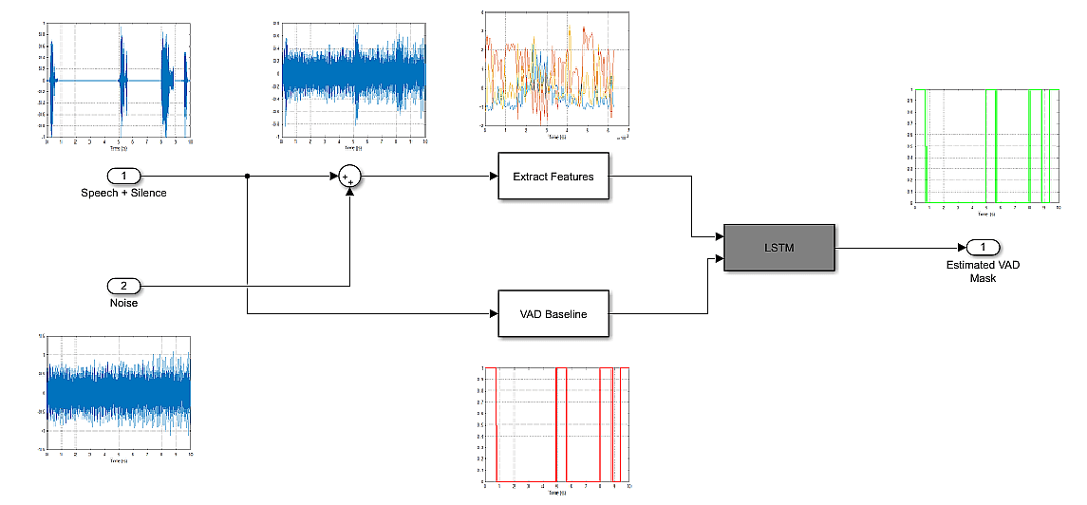

Slide 5
PREDICTION
Create an audioDatastore of speech files used to test the trained network, and create a test signal consisting of speech separated by segments of silence.
Corrupt the speech-plus-silence signal with noise signal at SNRs ranging from - 10 dB.
Extract feature sequences from the noisy test signal.
Identify regions of voice activity by passing the test features through the trained network.
Compare the network's accuracy to the voice activity baseline from the signal-plus-silence test signal.

Slide 6
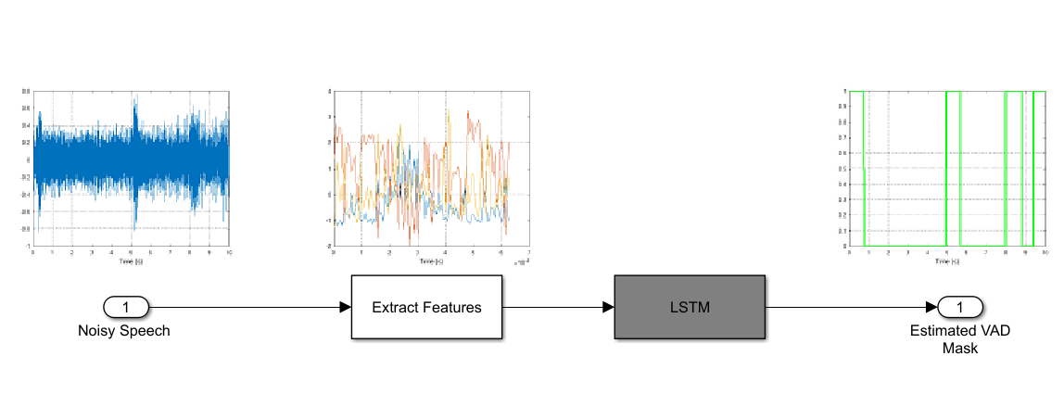

Slide 7
Load Speech Commands Data Set
%Create an audioDatastore that points to the training data set.
adsTrain = audioDatastore('google_speech \train', "Includesubfolders", true);
%Create an audioDatastore that points to the validation data set.
adsValidation = audioDatastore('google_speech \validation', "Includesubfolders", true);

Slide 8
Create Speech-Plus-Silence Training Signal
Read the contents of an audio file using read.
Get the sample rate from the adsInfo struct.
[data, adsInfo] = read(adsTrain);
Fs = adsInfo.SampleRate;
Reset the training datastore and shuffle the order of files in the datastores.
reset(adsTrain)
adsTrain = shuffle(adsTrain);
adsValidation = shuffle(adsValidation);

Slide 9
The detectSpeech function calculates statistics-based thresholds to determine the speech regions.
You can skip the threshold calculation and speed up the detectSpeech function by specifying the thresholds directly.
To determine thresholds for a data set, call detectSpeech on a sampling of files and get the thresholds it calculates.
Take the mean of the thresholds.
TM = [];
for index1 = 1:500
data = read(adsTrain);
[~,T] = detectSpeech(data, Fs, 'Window’, win);
TM = [TM;T];
end
T = mean(TM);
reset(adsTrain)

Slide 10
Create a 6000-second training signal by combining multiple speech files from the training data
set. Use detectSpeech to remove unwanted portions of each file. Insert a random period of
silence between speech segments. Preallocate the training signal.
duration = 6000*Fs;
audioTraining = zeros(duration,1);
Preallocate the voice activity training mask. Values of 1 in the mask correspond to samples
located in areas with voice activity. Values of 0 correspond to areas with no voice activity.
maskTraining = zeros(duration,1);
Specify a maximum silence segment duration of 2 seconds.
maxSilenceSegment = 2;

Slide 11
Construct the training signal by calling read on the datastore in a loop.
numSamples = 1;
while numSamples < duration
data = read(adsTrain);
data = data ./ max(abs(data)); % Normalize amplitude
% Determine regions of speech
idx = detectSpeech(data, Fs, 'Window’, win, 'Thresholds’, T);
% If a region of speech is detected
if ~isempty (idx)
% Extend the indices by five frames
idx(1,1) = max(1,idx(1,1) - 5*numel(win));
idx(1,2) = min(length(data),idx(1,2) + 5*numel(win));
% Isolate the speech
data = data(idx(1,1):idx(1,2));
% Write speech segment to training signal
audioTraining(numSamples : numSamples + numel(data)-1) = data;
% Set VAD baseline
maskTraining(numSamples : numSamples + numel(data)-1) = true;
% Random silence period
numSilenceSamples = randi(maxSilenceSegment*Fs,1,1);
numSamples = numSamples + numel(data) + numSilenceSamples;
end
end

Slide 12
Create Noise Signal
%Create an audioDatastore that points to the noise data set.
adsNoise = audioDatastore('noise_new', "Includesubfolders",true);
adsNoise=shuffle(adsNoise);
numSample=1;
duration=18000*Fs;
noiseData = zeros(duration,1);
while numSample < duration
data = read(adsNoise);
data = data ./ max(abs(data)); % Normalize amplitude
noiseData(numSample:numSample+numel(data)-1) = data;
numSample = numSample + numel(data);
end

Slide 13
Corrupt the speech-plus-silence signal with noise signal at SNRs ranging from -6 dB to 20 dB.
Add Noise to the Training Signal
noiseData = noiseData(1:numel(audioTraining));
numsam = 1;
frame = 9600000;
snrRange = -6:20;
idx=1;
while numsam<numel(noiseData)
i = mod(idx,27)+1;
SNR = snrRange( i );
noise = 10^(-SNR/20) * noiseData(numsam:numsam+frame-1) * norm(audioTraining) / norm(noiseData);
audioTrainingNoisy(numsam:numsam+frame-1) = audioTraining(numsam:numsam+frame-1) + noise;
numsam = numsam + frame;
idx = idx+1;
end

Slide 14
Create Speech-Plus-Silence Validation Signal
Create a 200-second noisy speech signal to validate the trained network.
Use the validation datastore. Note that the validation and training datastores
have different speakers. Preallocate the validation signal and the validation
mask. This mask will be used to assess the accuracy of the trained network.
duration = 200*Fs;
audioValidation = zeros(duration,1);
maskValidation = zeros(duration,1);

Slide 15
numSamples = 1;
while numSamples < duration
data = read(adsValidation);
data = data ./ max(abs(data)); % Normalize amplitude
% Determine regions of speech
idx = detectSpeech(data, Fs, 'Window’, win, 'Thresholds’ , T);
% If a region of speech is detected
if ~isempty(idx)
% Extend the indices by five frames
idx(1,1) = max(1,idx(1,1) - 5*numel(win));
idx(1,2) = min(length(data),idx(1,2) + 5*numel(win));
% Isolate the speech
data = data(idx(1,1):idx(1,2));
% Write speech segment to training signal
audioValidation(numSamples : numSamples+ numel(data)-1) = data;
% Set VAD Baseline
maskValidation (numSamples : numSamples + numel(data)-1) = true;
% Random silence period
numSilenceSamples = randi(maxSilenceSegment*Fs, 1, 1);
numSamples = numSamples + numel(data) + numSilenceSamples;
end
end

Slide 16
Add Noise to the Validation Signal
Corrupt the speech-plus-silence signal with noise signal at SNRs ranging from -6 dB to 20 dB. Use a different noise file for the validation signal than you did for the training signal.
noiseData2=noiseData2(1:numel(audioValidation));
numsam=1;
frame=9600000;
snrRange=-6:20;
idx=1;
while numsam<numel(noiseData2)
i=mod(idx,27)+1;
SNR=snrRange(i);
noise= 10^(-SNR/20) * noiseData2(numsam:numsam+frame-1) * norm(audioValidation) / norm(noiseData2);
audioValidationNoisy(numsam:numsam+frame-1) = audioValidation(numsam:numsam+frame-1) + noise;
numsam = numsam + frame;
idx=idx+1;
end

Slide 17
Extract Training Features
This example trains the LSTM network using the following features:
spectralCentroid
spectralCrest
spectralEntropy
spectralFlux
spectralKurtosis
spectralRolloffPoint
spectralSkewness
spectralSlope
harmonicRatio

Slide 18
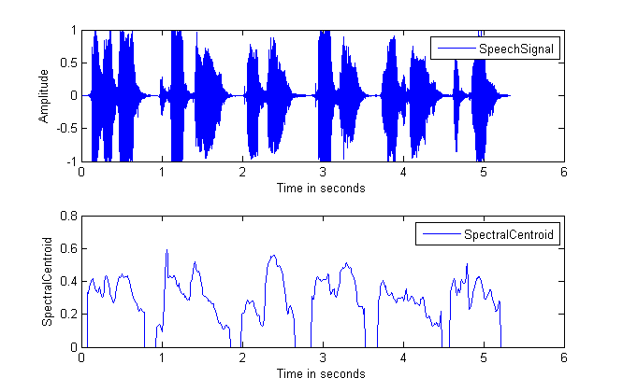
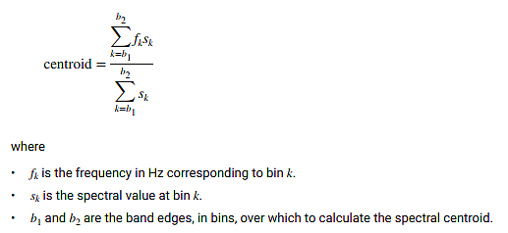
spectralCentroid
centroid = spectralCentroid ( x , f ) returns the spectral centroid of the signal, x, over time. How the function interprets x depends on the shape off.
Spectral centroid (SC) measures the shape of the spectrum of signals.
The spectral centroid indicates where the centre of mass of the spectrum is located.
A higher value of SC corresponds to more energy of the signal being concentrated within higher frequencies.

Slide 19
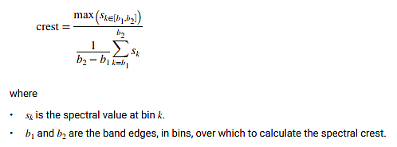
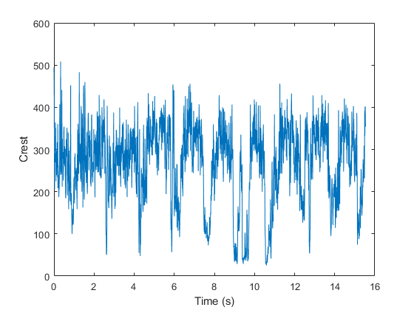
spectralCrest
crest = spectralCrest(x, f) returns the spectral crest of the signal, x, over time. How the function interprets x depends on the shape of f.

Slide 20
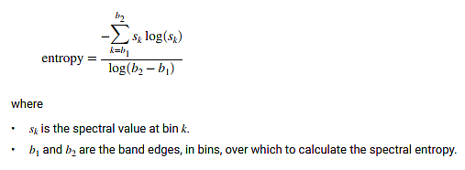
spectralEntropy
entropy = spectralEntropy(x, f) returns the spectral entropy of the signal, x, over time. How the function interprets x depends on the shape of f.
Spectral entropy indicates the amount of unpredictability and disorder in spectrum
Spectral entropy measures the uniformity of energy distribution in the frequency-domain.
Spectral entropy can discriminate random noise from signals whose energy is concentrated in the (t, f) domain
In speech recognition, noise energy generally is flat. And over each frequency it is relatively stable distribution. The average amount of information on the noise signal spectral entropy is small. But the amount of information of the speech signal is big. So we can use this distinction to detect both speech and nonspeech section.

Slide 21
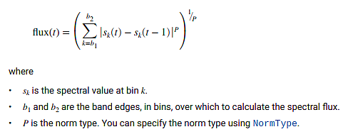
spectralFlux
flux = spectralFlux (x, f) returns the spectral flux of the signal, x, over time.
Spectral flux is a measure of the variability of the spectrum over time. How the function interprets x depends on the shape of f.
Spectral flux measures the cycle-to-cycle fluctuation in the power spectrum (PS). The spectral flux, was measured as the Euclidian distance between the PS of consecutive frames

Slide 22
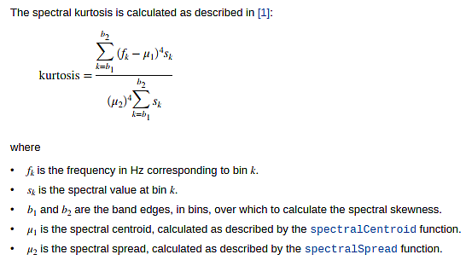
spectralKurtosis
kurtosis = spectralKurtosis (x, f) returns the spectral kurtosis of the signal, x, over time. How the function interprets x depends on the shape of f.
Spectrum kurtosis describes the degree of flatness versus peakedness of the frequency distribution of band energy.
A kurtosis value of zero indicates that spectral band energy surrounds the centroid in a normal-shaped distribution.
Negative kurtosis indicates that the distribution of energy around the centroid has a flatter shape, while positive kurtosis indicates that the distribution of energy has a more peaked shape.

Slide 23
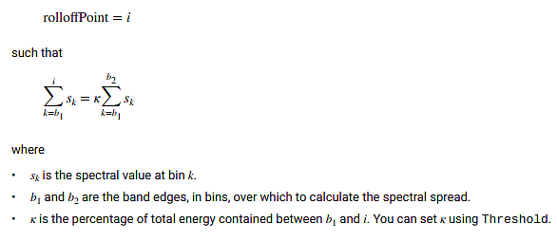
spectralRolloffPoint
rolloffPoint = spectralRolloffPoint (x, f) returns the spectral roll off point of the signal, x, over time. How the function interprets x depends on the shape of f.
The spectrum roll off is defined as the frequency below which some stated percentage of the overall spectrum magnitude distribution is concentrated
Energy in speech signals has a tendency to be lower at high frequencies

Slide 24
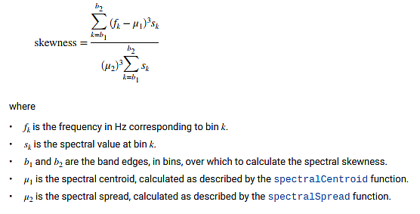
spectralSkewness
skewness = spectralSkewness (x, f) returns the spectral skewness of the signal, x, over time.
Spectrum skewness describes the degree of asymmetry of the frequency distribution of band energy.
A skewness value of zero indicates that spectrum band energy is evenly distributed above and below the spectrum centroid frequency.
Negative skewness indicates that more band energy is present above the centroid,
while positive skewness indicates that more band energy is present below the centroid

Slide 25
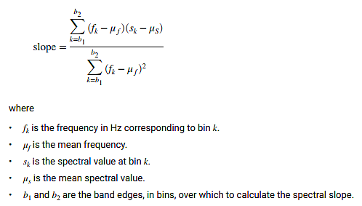
spectralSlope
slope = spectralSlope (x, f) returns the spectral slope of the signal, x, over time
The spectral slope is a basic approximation of the spectrum shape by a linear regression line.
It represents the decrease of the spectral amplitudes from low to high frequencies.
The slope, the y-intersection, the maximum and median regression error may be used as features.
Spectral slope/tilt may be employed for discrimination of voiced and unvoiced speech segments.

Slide 26
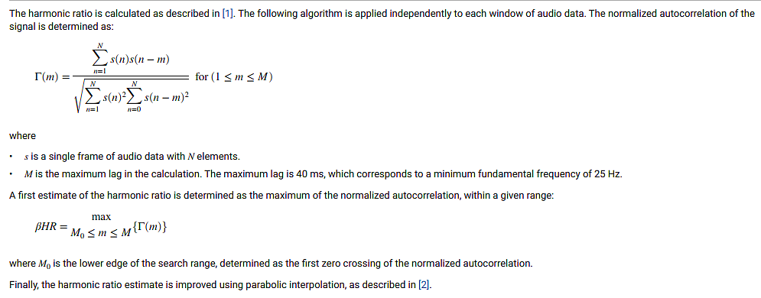
harmonicRatio
hr = harmonicRatio(audioIn, fs) returns the harmonic ratio of the signal, audioIn, over time.
The harmonic ratio is the ratio of the fundamental frequency's power to the total power in an audio frame
It is a measure for the degree of harmonicity contained in a signal.

Slide 27
This example uses audioFeatureExtractor to create an optimal feature extraction pipeline for the feature set. Create an audioFeatureExtractor object to extract the feature set. Use a 256-point Hann window with 50% overlap.
afe = audioFeatureExtractor('SampleRate',Fs, ...
'Window',hann(256,"Periodic"), ...
'OverlapLength',128, ...
...
'spectralCentroid',true, ...
'spectralCrest',true, ...
'spectralEntropy',true, ...
'spectralFlux',true, ...
'spectralKurtosis',true, ...
'spectralRolloffPoint',true, ...
'spectralSkewness',true, ...
'spectralSlope',true, ...
'harmonicRatio',true);
featuresTraining = extract(afe, audioTrainingNoisy);

Slide 28
Extract the feature set training signal
numsam=1;
FT=[];
frame1=frame*10;
while numsam<numel(audioTrainingNoisy)
featuresTraining = extract(afe, audioTrainingNoisy(numsam:numsam+frame1-1));
FT=[FT ; featuresTraining];
numsam=numsam+frame1;
end
% Normalize the data
M = mean(FT,1);
S = std(FT,[],1);
FT = (FT - M) ./ S;

Slide 29
Extract the feature set validation signal
numsam=1;
FV=[];
while numsam<numel(audioValidationNoisy)
featuresValidation = extract(afe, audioValidationNoisy(numsam:numsam+frame1-1));
FV = [ FV; featuresValidation];
numsam=numsam + frame1;
end
FV = (FV - mean(FV,1)) ./ std(FV,[],1); % Normalize the data

Slide 30
Each feature corresponds to 128 samples of data (the hop length).
For each hop, set the expected voice/no voice value to the mode of the baseline mask values corresponding to those 128 samples. Convert the voice/no voice mask to categorical.
windowLength = numel(afe . Window);
hopLength = windowLength – afe . OverlapLength;
% Training signal
range = (hopLength) * (1:size(FT,1)) + hopLength;
maskMode = zeros(size(range));
for index = 1:numel(range)
maskMode(index) = mode(maskTraining( (index-1)*hopLength+1:(index-1)*hopLength + windowLength ));
end
maskTraining = maskMode.';
maskTrainingCat = categorical(maskTraining);
% Validation signal
range = (hopLength) * (1:size(FV,1)) + hopLength;
maskMode = zeros(size(range));
for index = 1:numel(range)
maskMode(index) = mode(maskValidation( (index-1)*hopLength+1:(index-1)*hopLength + windowLength ));
end
maskValidation = maskMode.';
maskValidationCat = categorical(maskValidation);

Slide 31
Split the training features and the mask into sequences of length 800, with 75% overlap between consecutive sequences.
sequenceLength = 150;
sequenceOverlap = round(0.75*sequenceLength);
trainFeatureCell = helperFeatureVector2Sequence(FT’, sequenceLength, sequenceOverlap);
trainLabelCell = helperFeatureVector2Sequence(maskTrainingCat’, sequenceLength, sequenceOverlap);

Slide 32
Supporting Functions - Convert Feature Vectors to Sequences
function [sequences, sequencePerFile] = helperFeatureVector2Sequence(features, featureVectorsPerSequence, featureVectorOverlap)
if featureVectorsPerSequence <= featureVectorOverlap
error('The number of overlapping feature vectors must be less than the number of feature vectors per sequence.')
end
if ~iscell(features)
features = {features};
end
hopLength = featureVectorsPerSequence - featureVectorOverlap;
idx1 = 1;
sequences = {};
sequencePerFile = cell(numel(features),1);
for ii = 1:numel(features)
sequencePerFile{ii} = floor((size(features{ii},2) - featureVectorsPerSequence)/hopLength) + 1;
idx2 = 1;
for j = 1:sequencePerFile{ii}
sequences{idx1,1} = features{ii}(:,idx2:idx2 + featureVectorsPerSequence - 1); %#ok<AGROW>
idx1 = idx1 + 1;
idx2 = idx2 + hopLength;
end
end
end

Slide 33
Define the LSTM Network Architecture
layers = [ ...
sequenceInputLayer( size(featuresValidation,2) )
bilstmLayer(200,"OutputMode","sequence")
bilstmLayer(200,"OutputMode","sequence")
fullyConnectedLayer(2)
softmaxLayer
classificationLayer
];

Slide 34
Description of Layers
sequenceInputLayer – inputs Sequence data to a network
bilstmLayer – it learns bidirectional long-term dependencies between time steps of time series or Sequence data. These dependencies can be useful when you want the network to learn from the complete time series at each time step.
fullyConnectedLayer - A fully connected layer multiplies the input by a weight matrix and then adds a bias vector.
softmaxLayer - softmax layer applies a softmax function to the input. The softmax function is a function that turns a vector of K real values into a vector of K real values that sum to 1
classificationLayer- A classification layer computes the cross-entropy loss for classification and weighted classification tasks with mutually exclusive classes. The layer infers the number of classes from the output size of the previous layer. For example, to specify the number of classes K of the network, include a fully connected layer with output size K and a softmax layer before the classification layer.

Slide 35
Define the LSTM Network Architecture
Specify the input size to be sequences of length 9 (the number of features).
Specify a hidden bidirectional LSTM layer with an output size of 200 and output a sequence.
This command instructs the bidirectional LSTM layer to map the input time series into 200 features that are passed to the next layer.
Then, specify a bidirectional LSTM layer with an output size of 200 and output the last element of the sequence.
This command instructs the bidirectional LSTM layer to map its input into 200 features and then prepares the output for the fully connected layer.
Finally, specify two classes by including a fully connected layer of size 2, followed by a softmax layer and a classification layer.

Slide 36
Specify the training options for the classifier.
maxEpochs = 20;
miniBatchSize = 64;
options = trainingOptions("adam", ...
"MaxEpochs", maxEpochs, ...
"MiniBatchSize", miniBatchSize, ...
"Shuffle", "every-epoch", ...
"Verbose",0, ...
"SequenceLength", sequenceLength, ...
"ValidationFrequency", floor(numel(trainFeatureCell)/miniBatchSize), ...
"ValidationData", {featuresValidation.’, maskValidationCat.'}, ...
"Plots", "training-progress", ...
"LearnRateSchedule", "piecewise", ...
"LearnRateDropFactor",0.1, ...
"LearnRateDropPeriod",5);

Slide 37
Specify the training options for the classifier.
Set MaxEpochs to 20 so that the network makes 20 passes through the training data.
Set MiniBatchSize to 64 so that the network looks at 64 training signals at a time.
Set Plots to "training-progress" to generate plots that show the training progress as the number of iterations increases.
Set Verbose to false to disable printing the table output that corresponds to the data shown in the plot.
Set Shuffle to "every-epoch" to shuffle the training sequence at the beginning of each epoch.
Set LearnRateSchedule to "piecewise" to decrease the learning rate by a specified factor (0.1) every time a certain number of epochs (10) has passed.
Set ValidationData to the validation predictors and targets.
This example uses the adaptive moment estimation (ADAM) solver. ADAM performs better with recurrent neural networks (RNNs) like LSTMs than the default stochastic gradient descent with momentum (SGDM) solver.

Slide 38
Train the LSTM Network
Train the LSTM network with the specified training options and layer
architecture using trainNetwork.
doTraining = true;
if doTraining
[speechDetectNet, netInfo] = trainNetwork(trainFeatureCell, trainLabelCell, layers, options);
fprintf("Validation accuracy: %f percent.\n", netInfo.FinalValidationAccuracy);
else
load speechDetectNet
end
Validation accuracy: 84.962963 percent.

Slide 39
Use Trained Network to Detect Voice Activity
Estimate voice activity in the validation signal using the trained network.
Convert the estimated VAD mask from categorical to double.
EstimatedVADMask = classify(speechDetectNet, featuresValidation.');
EstimatedVADMask = double(EstimatedVADMask);
EstimatedVADMask = EstimatedVADMask.' - 1;

Slide 41
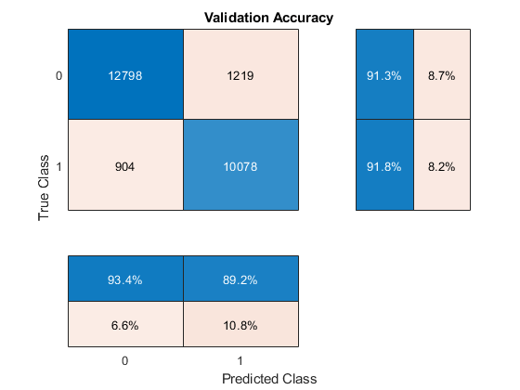
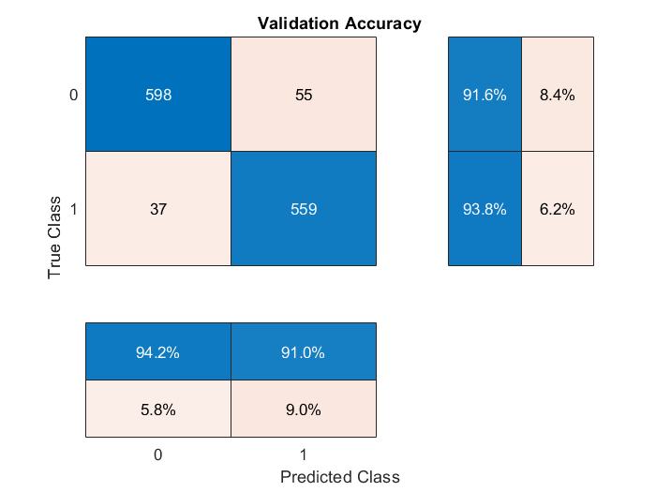
Calculate and plot the validation confusion matrix from the vectors of actual and estimated labels.
figure
cm = confusionchart (maskValidation, EstimatedVADMask, "title", "Validation Accuracy");
cm.ColumnSummary = "column-normalized";
cm.RowSummary = "row-normalized";

