Slide 1
TIME SERIES MODELLING
Presented By: Srishti Rathi

Slide 2
WHAT IS TIME SERIES FORECASTING?
Time series involves data collected sequentially in time.
Making predictions about the future is called extrapolation in the classical statistical handling of time series data also referred to as Time Series Forecasting.
Forecasting involves taking models fit on historical data and using them to predict future observations
PURPOSE?
The purpose of time series analysis is generally two fold:
to understand or model the stochastic mechanisms that gives rise to an observed series
and
to predict or forecast the future values of a series based on the history of that series

Slide 3
Components of Time Series
Time series analysis provides a body of techniques to better understand a dataset.
Perhaps the most useful of these is the decomposition of a time series into 4 constituent parts:
Level. The baseline value for the series if it were a straight line.
Trend. The optional and often linear increasing or decreasing behavior of the series over time.
Seasonality. The optional repeating patterns or cycles of behavior over time.It may be caused by various factors, such as weather, vacation, and holidays and consists of periodic, repetitive, and generally regular and predictable patterns in the levels of a time series
Noise. The optional variability in the observations that cannot be explained by the model.
All time series have a level, most have noise, and the trend and seasonality are optional.

Slide 4
Some More Statistical Terms
Stationarity: A time series is said to be stationary if its statistical properties do not change over time. In other words, it has constant mean and variance, and covariance is independent of time.
White Noise: A time series is said to be white noise if the mean of time series is zero, the standard deviation is constant with time and there is no correlation between lags. It is not predictable.
Why is White Noise Important?
Yt = Signal +Noise
So, if we are truly able to find all the components that make up the signal in given series, predict the time series for the signal and the residuals or errors left are only white noise, then it is a great model.

Slide 5







Lag/Backshift Operator: In time series analysis, the lag operator (L) or backshift operator (B) operates on an element of a time series to produce the previous element. For example, given some time series
then
  for all
or similarly in terms of the backshift operator B: for all .
Equivalently, this definition can be represented as
  for all
The lag operator (as well as backshift operator) can be raised to arbitrary integer powers so that
And

Slide 6
The Problem Statement:
International Airlines Passanger Problem
This is a problem where given a year and a month, the task is to predict the number of international airline passengers in units of 1,000. The data ranges from January 1949 to December 1960 or 12 years, with 144 observations.

Slide 7
Approach Used
SARIMA
Data should be stationary
no need of tuning of hyperparameter
Works better for small datasets
Assumes that the trend will continue forever
LSTM
Stationality is not an issue
Hyperparameter needs to be tuned
works better for big datasets
believes that trend changes over time and epocs

Slide 8
ARIMA
AutoRegressive Integrated Moving Average
WHAT IS ARIMA?
It is a prediction model used for time series(time series is a collection of observations of well-defined data items obtained through repeated measurements over time)analysis &forecasting.
ARIMA models are applied in some cases where data show evidence of
non-stationarity, where an initial differencing step (corresponding to the "integrated" part of the model) can be applied one or more times to eliminate the non-stationarity.
Here the terms are:
Auto Regressive : lags of variables itself
Integrated :Differencing steps required to make stationary
Moving Average :lags of previous information shocks

Slide 9

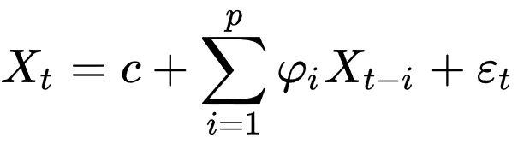


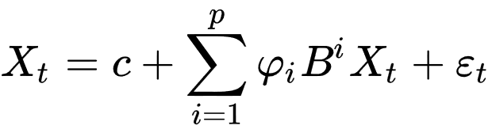

AUTO REGRESSION(AR)
The AR part of ARIMA indicates that the evolving variable of interest is regressed on its own lagged (i.e., prior) values.
The notation indicates an autoregressive model of order p. The AR(p) model is defined as
Where are the parameters of the model, c is a constant, and is white noise. This can be equivalently written using the backshift operator B as
so that, moving the summation term to the left side and using polynomial notation, we have
The simplest AR process is AR(0), which has no dependence between the terms. Only the error/innovation/noise term contributes to the output of the process, so AR(0) corresponds to white noise.

Slide 10
MOVING AVERAGE(MA)
In time series analysis, the moving-average model (MA model), also known as moving-average process, is a common approach for modeling univariate time series. The moving-average model specifies that the output variable depends linearly on the current and various past values of a stochastic (imperfectly predictable) term.
The notation MA(q) refers to the moving average model of order q:
where μ is the mean of the series, the θ₁, ..., θ_{q} are the parameters of the model and the ε_{t}, ε_{t−1},..., ε_{t−q} are white noise error terms. The value of q is called the order of the MA model. This can be equivalently written in terms of the backshift operator B as
Thus, a moving-average model is conceptually a linear regression of the current value of the series against current and previous (observed) white noise error terms or random shocks.

Slide 11

INTEGRATED(I)
In statistics, the order of integration, denoted I(d), of a time series is a summary statistic, which reports the minimum number of differences required to obtain a covariance-stationary series.
A time series is integrated of order d if
is a stationary process, where L is the lag operator and 1- L is the first difference, i.e.
In other words, a process is integrated to order d if taking repeated differences d times yields a stationary process.

Slide 12
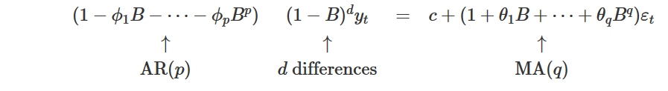
If we combine differencing with autoregression and a moving average model, we obtain a non-seasonal ARIMA model. The full model can be written as
where y′t is the differenced series (it may have been differenced more than once). The “predictors” on the right hand side include both lagged values of yt and lagged errors. We call this an ARIMA(p,d,q) model, where
p is the number of autoregressive terms,
d is the number of nonseasonal differences needed for stationarity, and
q is the number of lagged forecast errors in the prediction equation.
The same stationarity and invertibility conditions that are used for autoregressive and moving average models also apply to an ARIMA model.
Once we start combining components in this way to form more complicated models, it is much easier to work with the backshift notation. For example, the above equation can be written in backshift notation as

Slide 13


Maximum likelihood estimation
Once the model order has been identified (i.e., the values of p, d and q), we need to estimate the parameters c, ϕ1,…,ϕp, θ1,…,θq. When R estimates the ARIMA model, it uses maximum likelihood estimation (MLE). This technique finds the values of the parameters which maximise the probability of obtaining the data that we have observed. For ARIMA models, MLE is similar to the least squares estimates that would be obtained by minimizing
Akaike’s Information Criterion (AIC), which was useful in selecting predictors for regression, is also useful for determining the order of an ARIMA model. It can be written as
where L is the likelihood of the data, k=1 if c≠0 and k=0 if c=0. Note that the last term in parentheses is the number of parameters in the model (including σ2, the variance of the residuals).
The lower the AIC value better the model.

Slide 14
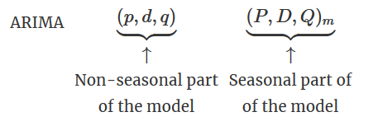
SEASONAL ARIMA(SARIMA)
A seasonal ARIMA model is formed by including additional seasonal terms in the ARIMA models we have seen so far. It is written as follows:
where m=number of observations per year. We use uppercase notation for the seasonal parts of the model, and lowercase notation for the non-seasonal parts of the model.
The seasonal part of the model consists of terms that are similar to the non-seasonal components of the model, but involve backshifts of the seasonal period. For example, an ARIMA(1,1,1)(1,1,1)4 model (without a constant) is for quarterly data (m=4), and can be written as
The additional seasonal terms are simply multiplied by the non-seasonal terms.

Slide 15

The models are compared based on the statistical measure - Root mean squared error (RMSE)
yî is the predicted quantity; 𝑦𝑖 is the predicted quantity with variables considered n times.

Slide 16
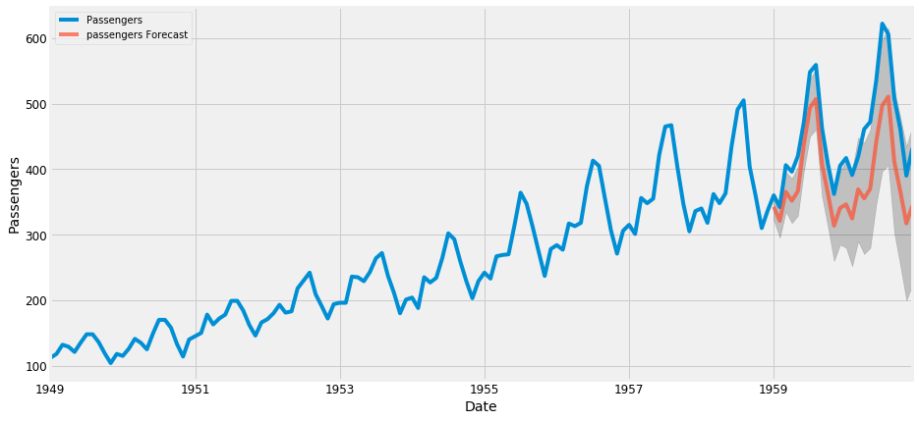
PLOT
SARIMA
RMSE:71.83

Slide 17
LSTM-Long Short-Term Memory
WHAT IS LSTM?
LSTM is an artificial recurrent neural network (RNN) architecture used in the field of deep learning. Unlike standard feedforward neural networks, LSTM has feedback connections. It can not only process single data points, but also entire sequences of data.
Instead of neurons, LSTM networks have memory blocks that are connected through layers.
A block has components that make it smarter than a classical neuron and a memory for recent sequences. A block contains gates that manage the block’s state and output. A block operates upon an input sequence and each gate within a block uses the sigmoid activation units to control whether they are triggered or not, making the change of state and addition of information flowing through the block conditional.

Slide 18
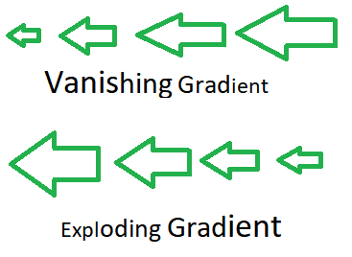
Why use LSTM over RNN?
Vanishing or Exploding Gradient Problem:
Neural network uses BackPropagation to update the weights of the network. So what BP does is It first calculates the gradients from the error using the chain rule in Calculus, then it updates the weights (Gradient descent).
Since the BP starts from the output layer to all the way back to input layer , In a simple neural network we may not face problems with updating weights but in a deep neural network we might face some issues.
As we go back with the gradients , It is possible that the values get either smaller exponentially which causes Vanishing Gradient problem or larger exponentially which causes Exploding Gradient problem.

Slide 19
Three types of gates within a unit:
Forget Gate: conditionally decides what information to throw away from the block.
Input Gate: conditionally decides which values from the input to update the memory state.
Output Gate: conditionally decides what to output based on input and the memory of the block.
The LSTM cell contains the following components
Forget Gate “f” ( a neural network with sigmoid)
Candidate layer “C`"(a NN with tanh)
Input Gate “I” ( a NN with sigmoid )
Output Gate “O”( a NN with sigmoid)
Hidden state “H” ( a vector )
Memory state “C” ( a vector)

Slide 20
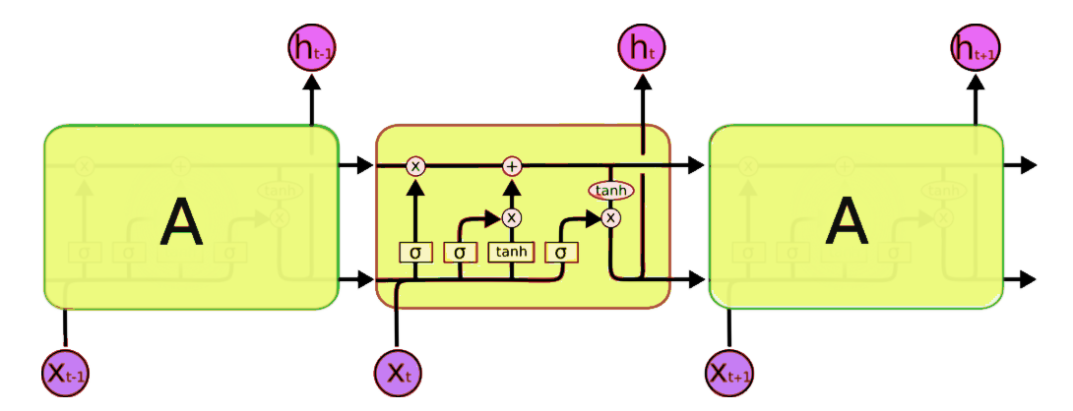
LSTM MODEL

Slide 21
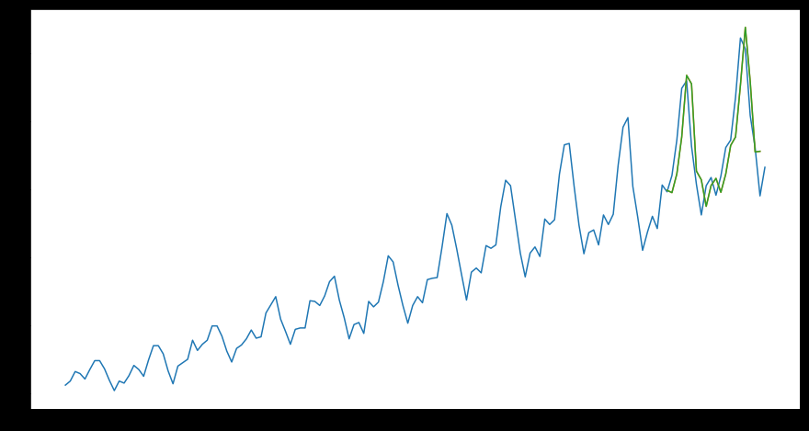
PLOT
LSTM
RMSE:44.44

Slide 22
RESULT
For the given problem statement ,LSTM gives better results than SARIMA.

Slide 23
Applications of LSTM and ARIMA
ARIMA yields better results in forecasting short term, whereas LSTM yields better results for long term modeling.
Traditional time series forecasting methods (ARIMA) focus on univariate data with linear relationships and fixed and manually-diagnosed temporal dependence.
Machine learning problems with substantial dataset, its found that the average reduction in error rates obtained by LSTM is between 84–87 percent when compared to ARIMA indicating the superiority of LSTM to ARIMA.
LSTMs when compared to simpler NNs like RNN and MLP appear to be more suited at fitting or overfitting the training dataset rather than forecasting it.
Classical methods like ETS and ARIMA out-perform machine learning and deep learning methods for one-step forecasting on univariate datasets.

Slide 24
Classical methods like Theta and ARIMA out-perform machine learning and deep learning methods for multi-step forecasting on univariate datasets.
Classical methods like ARIMA focus on fixed temporal dependence: the relationship between observations at different times, which necessitates analysis and specification of the number of lag observations provided as input.
Neural networks add the capability to learn possibly noisy and nonlinear relationships with arbitrarily defined but fixed numbers of inputs. In addition, NNs output multivariate and multi-step forecasting.
Recurrent neural networks (RNNs) add the explicit handling of ordered observations and is able to adapt itself to learn the temporal dependencies from context. With one observation at a time from a sequence, RNN can learn what relevant observations it has seen previously and determine its relevancy in forecasting.

Slide 25


