Slide 1

Microsoft Malware Attacks
Introduction
Data
EDA
Srishti Saha (ss1078)
Model
Conclusions
Possible Limitations

Slide 2




Introduction
Objective
Assumptions &
Selections
Background
Malware is any ‘malicious software’ intentionally designed to cause damage to a computer, server, client, or computer network.
Data Source: Microsoft's endpoint protection solution, Windows Defender (Kaggle)
What hardware and software characteristics make a machine susceptible to malware attacks?
Does the presence of an Anti Virus software on a machine protect it from malware attacks?
Only software and hardware characteristics data have been selected for this analysis
User characteristics and geographical locations, despite being present have not yet been taken into account.
Only a ~0.4% sample of the complete data (~9 million rows) has been used to create this model
Dataset sourced from: https://www.kaggle.com/c/microsoft-malware-prediction/data

Slide 3


Data-Dictionary and Overview
The data has been collected at a machine-level, and thus every record corresponds to a single Microsoft Machine. The original dataset has 8,921,483 rows and 83 columns.
Variable | Definition
MachineIdentifier | Unique Identifier for a Machine
IsProtected | Whether a machine is protected (TRUE (1) if Anti Virus is installed and updated)*
AVProductsInstalled | Number of Anti Virus Products installed
Wdft_IsGamer | If the device is a gamer device or not based on its hardware combination
Census_SystemVolumeTotalCapacity | Size of the partition that the System volume is installed on in MB
Census_InternalPrimaryDisplayResolutionHorizontal (&Vertical) | number of pixels in the horizontal (& vertical) direction of the internal display.
Census_TotalPhysicalRAM | physical RAM size in MB
Census_OSInstallTypeName | Friendly description of what OS install was used on the machine (categorical-levels 1-9)
HasDetections | If Malware was detected on the machine (response)
Current Issues detected in the Data:
High dimensionality
High amount of Missing Values in a lot of columns and no information of trend of ‘missing-ness’
Some columns are highly imbalanced i.e. large portion of data under one-value
(*)FALSE (2) if there is no active AV product on this machine, or if the AV is active, but is not receiving the latest updates. c. missing (3) if there are no Anti Virus Products in the report

Slide 4
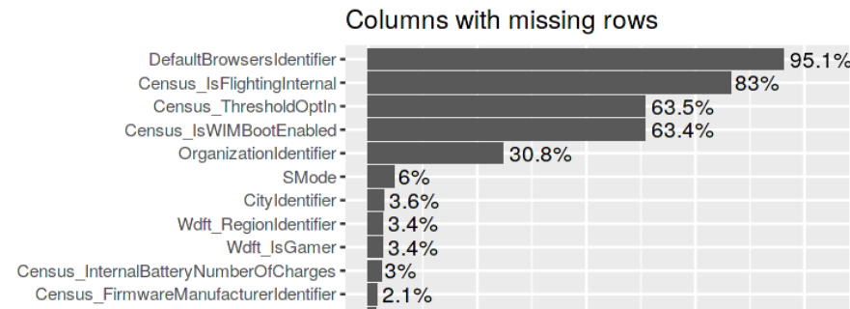
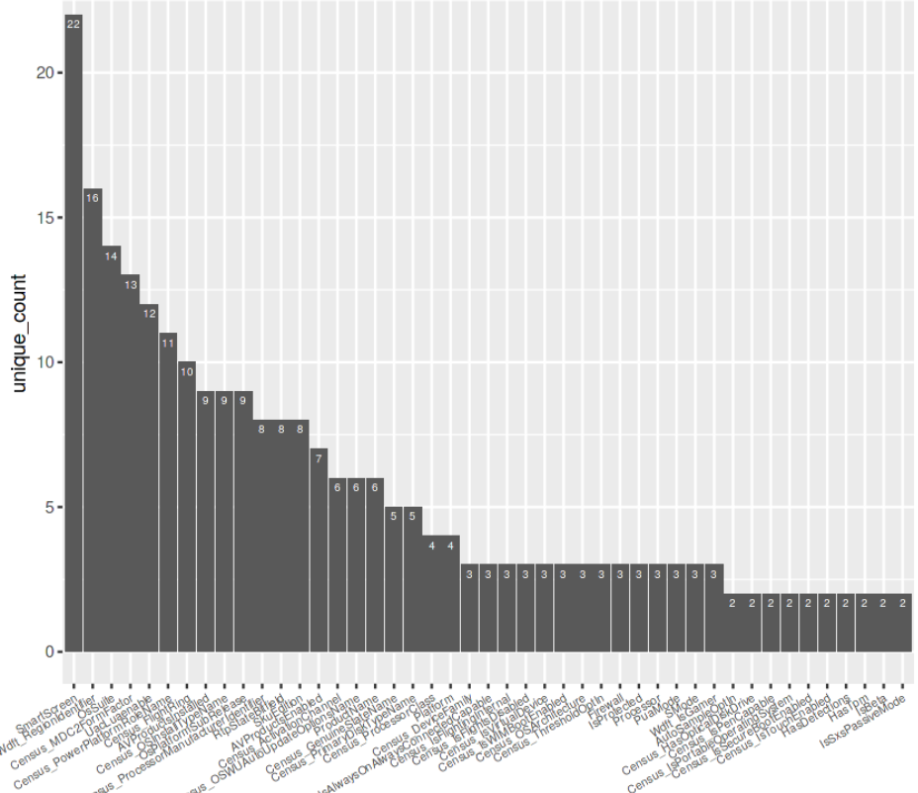
Data-Preprocessing
2 basic steps were followed to eliminate some features and select necessary predictors for the current model.
Missing Values:
Columns with missing data above 60% were simply eliminated. Thus, 4 columns were eliminated
Imbalanced Data:
There are no columns with 1 unique value that can be removed.
Check for the Ratio of the frequency of the most-common value to the frequency of the second-most-common value- If ratio was above 98- the columns were removed (8 removed)
Additionally, all geographical IDs and location data was removed to create this current model

Slide 5
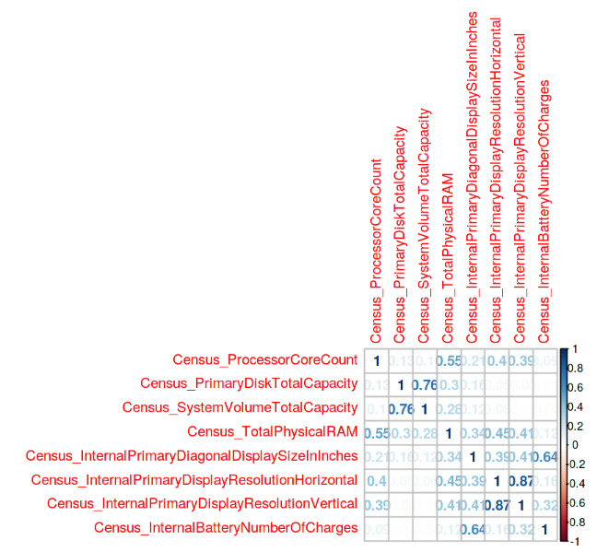
Data-Preprocessing
Correlation of the numerical variables were checked to eliminate highly correlated predictors.
Out of Capacity predictors, only system volume capacity was selected
For the display characteristics, only diagonal display size was considered
Out of Core Count and RAM, RAM specs were taken into account
Finally, a random sample of 30k rows were selected to build a simple logistic regression model in the best interest of computational time and space. Final dimension of input dataset of the model: 30,000 rows and 62 columns including the response variable (HasDetections)

Slide 6
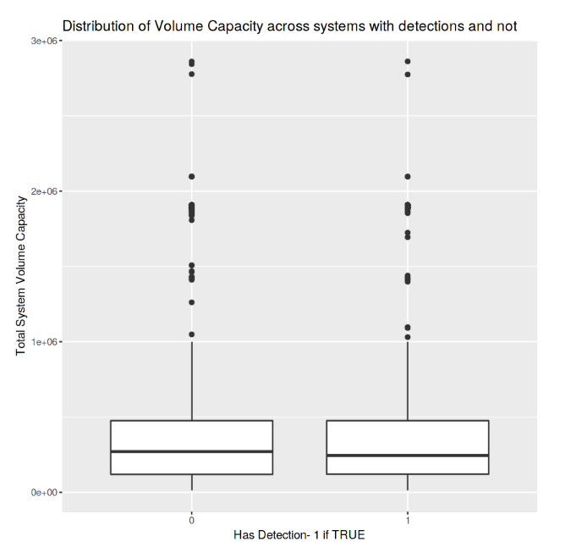
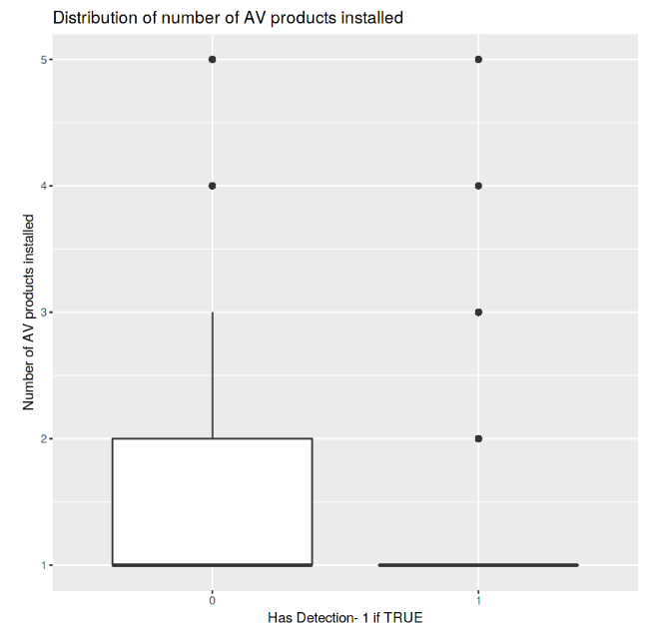
Exploratory Data Analysis- Capacity and Anti Virus
Key Insight 1
No significant difference of system volume capacity across machines with detections of malware attacks and those without.
Key Insight 2
Most machines that have had malware detections did not have a lot of AntiVirus products installed.
From the Chi-squared test between ‘IsProtected’ and ‘HasDetections’, similar results were observed.

Slide 7
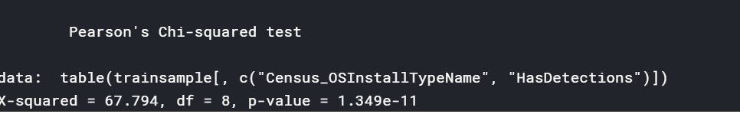
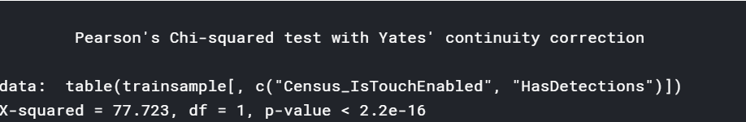
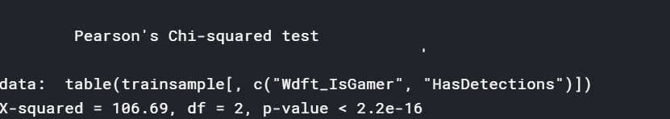
Exploratory Data Analysis- OS, Touch and Gaming Devices
Type of OS Installed:
Since the p-value is low (<0.05), we can reject the null hypothesis. There seems to be a relation between the type of the OS and malware attacks.
Touch Enabled on Device:
Since the p-value is low (<0.05), we can reject the null hypothesis. There seems to be a relation between touch enabled features and malware attacks.
Gaming Device:
Since the p-value is low (<0.05), we can reject the null hypothesis. There seems to be a relation between gaming devices and malware attacks.

Slide 8
Model- characteristics and inference
Model Type: Logistic Regression
Response: HasDetections
Number of Predictors: 61
Inference 1
Presence of Anti Virus reduces the odds of a malware attack on a device
With every unit increase in the number of Anti Virus Products installed, there is a ~49% decrease in the odds of a malware attack on a device
Most Significant Factors
Inference 2
A gamer device is more susceptible to malware attacks than non-gamer devices
Touch-enabled devices are more susceptible to malware attacks than the devices that are not touch-enabled
AVProductsInstalled
Wdft_IsGamer
System Volume Capacity
Touch enabled?
Inference 3
Higher the system volume capacity, lower are the odds of a malware attack

Slide 9
Top 4 hardware and software characteristics that determine susceptibility of a device to malware attacks:
Presence of anti virus
Touch enabled?
Gamer Device?
System Volume Capacity
Microsoft Malware Attacks
Conclusion
Presence of an Anti Virus protects a device from malware attacks
Model results and EDA both prove this point.

Slide 10
Possible limitations
01
02
03
Multiple Predictors (high dimension of data)
Due to the high dimension of data, a complete inference of the current model is difficult. There are several predictors that define the baseline, that have not been studied carefully yet.
Model created on a sample of data
As only 30k rows (0.4%) of the complete data was considered for the model, this might have led to loss of information and biased results in this model
No interaction terms or transformed variables
The current model does not account for any interaction effects or transformations of variables and thus might not be the most accurate representation of the model of the data.

