Slide 1


A product recommender system using graphs
Walmart company challenge
Bhaskar Botcha
September 28, 2020

Slide 2
Relevance

Slide 3
Tasks
Assemble data of 20,000 products
Index the crawled web pages
Comparison and clustering criteria
GUI

Slide 4
Data curation
Too tedious for four computers
We deployed 18 parallel ones!
Multi-threading and parallel crawling for different categories
Total datapoints collected over 9 categories – 12,681
Electronics |  | Toys
Automotive |  | Video Games
Books |  | Home
Clothing |  | Food
Personal Care

Slide 5
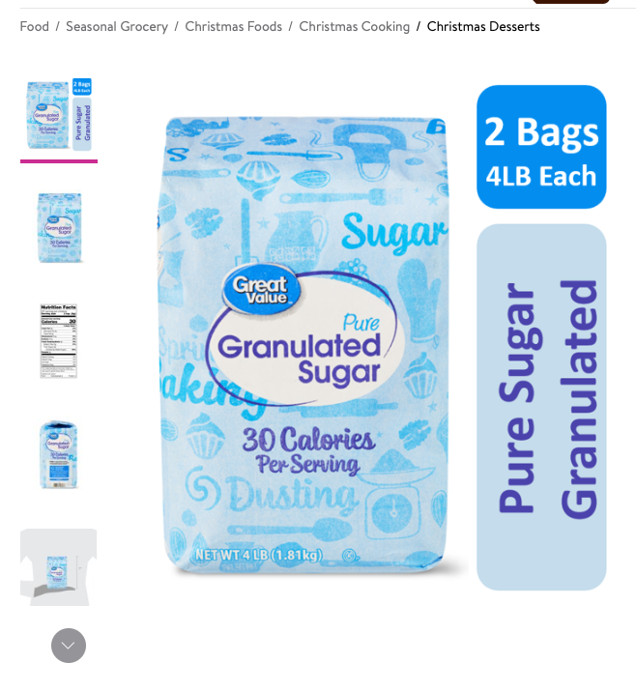
Data attributes
Product code – 12 alpha-numeric characters
Product name and description
Breadcrumbs
Current
Parent
Product price
Rating
Number of ratings
All other recommendations and their product codes on a product webpage

Slide 6
Why recommendations?
A lot of suggestions are connected when they are provided to the user
Example:
A page for pound of sugar contains recommendations on
Oil, cocoa powder, all-purpose flour (used for baking)
Creamer (coffee)
Coffee powder
Salt
Also viewed
Raw cane sugar
Splenda, …

Slide 7
What did we do?
We utilized the recommendation system already used by Walmart
Scraped web pages and found out the recommendations and other metadata
Clustered the samples to predict category
Built a weighted graph-based representation of the attributes

Slide 8
Weights
Assigning weights
Built and adjacency matrix
Nodes – the main product codes
Also nodes – the recommendations which are connected to these nodes
Edges – the strength with which the nodes are connected
How did we decide on the weights?

Slide 9
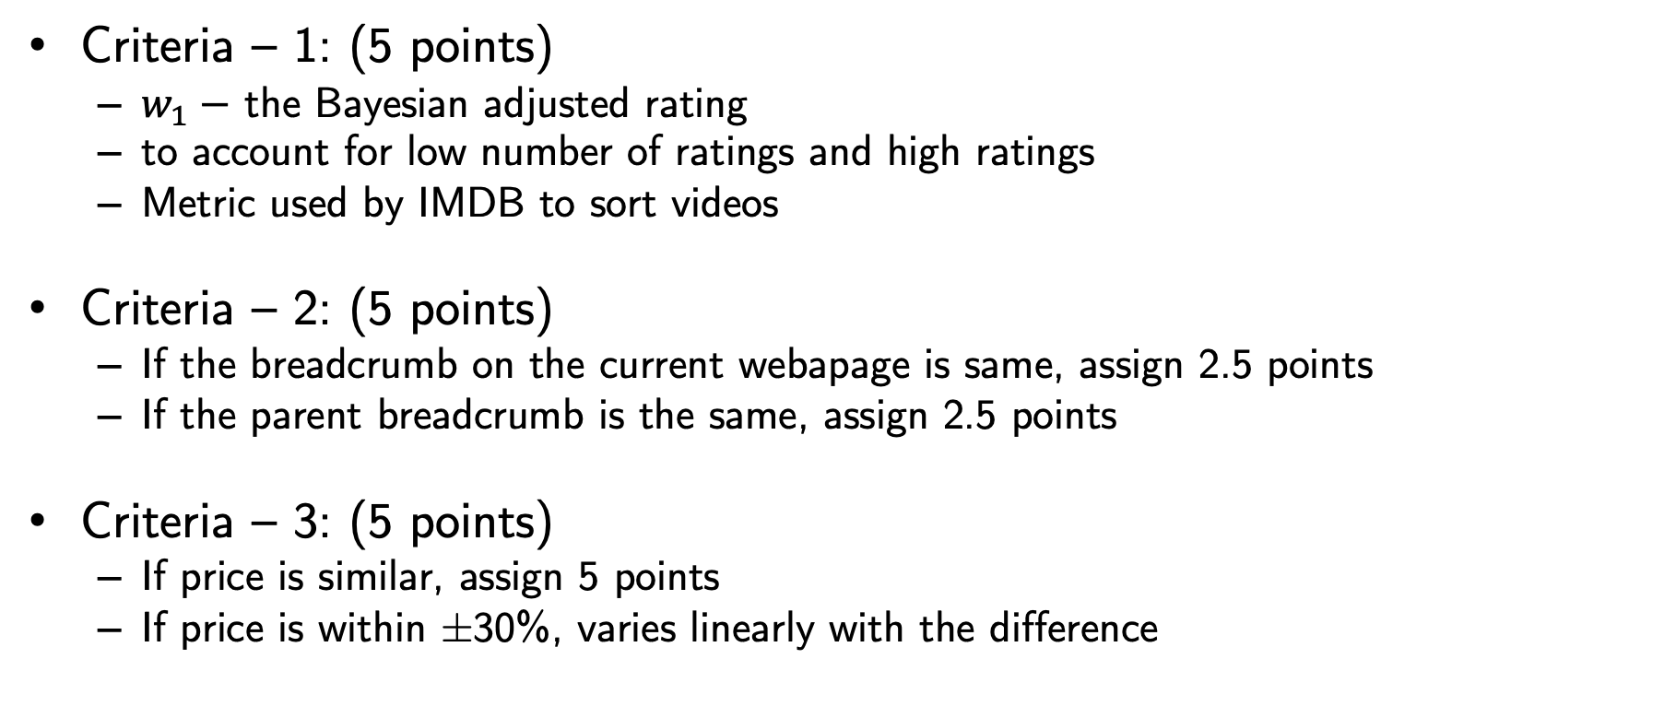
Weighted graph
Criteria – 1: (5 points)
$w_{1}−$ the Bayesian adjusted rating
to account for low number of ratings and high ratings
Metric used by IMDB to sort videos
Criteria – 2: (5 points)
If the breadcrumb on the current webapage is same, assign 2.5 points
If the parent breadcrumb is the same, assign 2.5 points
Criteria – 3: (5 points)
If price is similar, assign 5 points
If price is within ±30%, varies linearly with the difference
5
P
0.6P

Slide 10
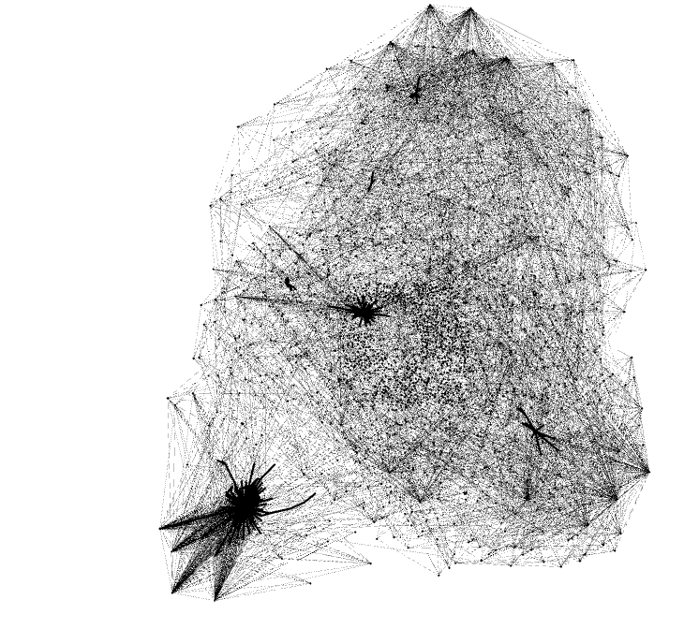
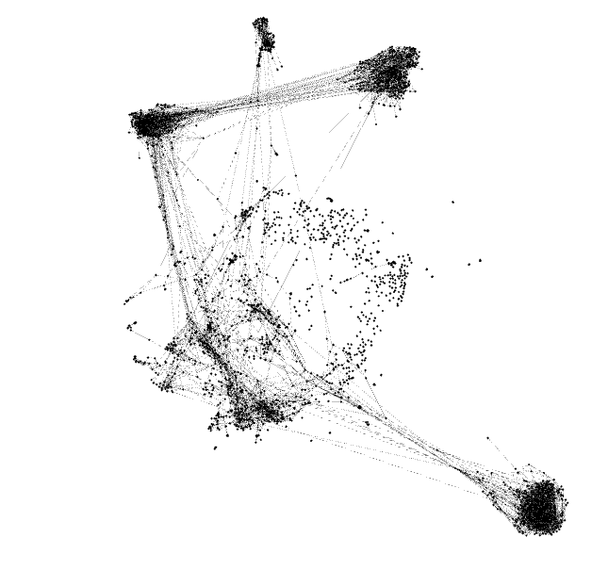
For Electronics
For 200 data points
For 2000 data points
Automatic formation of clusters

