Slide 1
End-Semester Project Presentation CSE523: Machine Learning
Sleep and Physical Performance Analysis:
A case study of collegiate women’s basketball players
(Data Imputations)
Name of Candidate Srishti Sharma (AU2049002), PhD in Engineering, School of Engineering and Applied Science Ahmedabad University

Slide 2
Outline
Introduction
Objectives
Literature Review
Methodology to be adopted
Dataset
Permutation based Feature Importance Technique
Data Imputation Techniques
Evaluation Metrics
Results
Conclusion
Future Work
References

Slide 3
Introduction
Over a decade, there has been a considerable amount of research done in analyzing strain and load that an athlete goes through and its impacting factors. An athlete undergoes both cognitive and physical strain in their life due to the training load imposed upon them, their emotional and physical states, academic routine or regular routine strain, sleep etc. [1]
This project aims at analyzing the impacts of sleep and exercise on performance and recovery rate from injuries of athletes.
Training and Exercise Load
Change in Diet
Change in Sleep Patterns
Academic Routine
Emotional state of mind
Figure 1: Factors influencing an athlete’s performance

Slide 4
Objectives
The short term objective in this term is to preprocess the real time data gathered from the athletes. This preprocessing involves performing necessary data imputations and dimensionality reduction over the dataset.
The long term objective of this research is to make use of the Machine Learning to create a predictive model that would help a coach determine whether a player is fit to play in the forthcoming match on the basis of the underlying patterns and correlations between sleep, training load, cognitive state information of the athlete and their performance.

Slide 5
Literature Review
Sleep has a profound effect on the athletic as well as cognitive performance of the athletes. It is believed that a good sleep helps the athletes recover fast from the cognitive load they undergo [1].
They analyzing the impacts of deprived sleep due to night soccer matches [2]. They stated that sleep plays an important role in helping the athletes recover from the routine strain thereby improving their response time [2].
A study of the soccer players [3] suggested how a degradation in the athletic performance and recovery was directly related to the consumption of substances such as caffeine, alcohol, deprivation of the right quality and the right quantity of sleep, travel fatigue etc.

Slide 6
Literature Review
It was reported that a deprivation of sleep for 36 long hours would lead to degradation of tolerance to a long duration of exercise or training load [4].
It was also concluded that sleep extension resulted in a better shooting rate and accuracy of basketball players [5].
A week-long sleep deprivation and irregular sleep habits would lead to degradation in attention and alertness of the players [6].

Slide 7
Methodology to be adopted
Phase 1: Data Collection
Sleep Monitoring using a WHOOP Strap - This is a wearable devices that helps track the sleep and recovery patterns of the player. It records the data in three categories: attributes dependent on the cardiovascular strain and exertion, other one depending on the resting heart rate and the sleep hours, sleep consistency, sleep score etc. and the last category is related to the physiological markers such as heart rate, respiratory rate, sleep etc.
Short Recovery Short Stress Questionnaire – A set of eight questions on emotional and physical state of the athletes.
Training Load – Time and the intensity of the metabolic activities of the athletes is computed in the form a score every week and is recorded in the dataset.
Dataset collected from 17 women’s basketball team players (Age: 20.5± 1.2yrs, Height: 172.4±4.4 cm, Body Mass: 74.4±0.6 kg) from Sacred Heart University
Phase 2: Data Preprocessing
This data is then to be preprocessed which include imputing the missing values that arise due to any fault with the device. Next step is the reduction of dimensionality of the data as the numbers of attributes taken into consideration are too many and hence extraction of the most relevant attributes from the attribute set is an important step.
Phase 3: Predictive Modeling
The final phase will be studying the impact of sleep and exercise on the athletic performance of the athletes as well as their recovery from injuries. This predictive analysis will thereby help the coach determine whether a player will be able to play well in a forthcoming match.
Figure 2: Methodology to be adopted

Slide 8
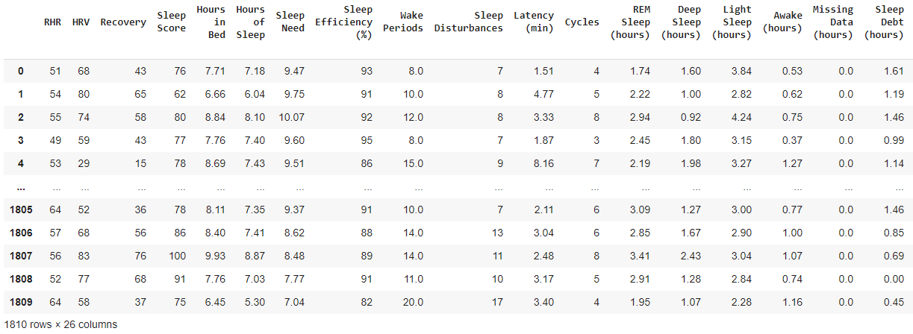
Dataset
A real time dataset collected for an experiment to be conducted over 17 women’s basketball team players from Sacred Heart University.
For imputations, Whoop Strap Data is considered:
There are 1810 records (14 weeks of data)
Attributes: 26 (RHR, HRV, Sleep Score, Hours of Sleep, Wake Periods, Sleep Consistency, Respiration Rate, etc.)
Figure 3: Dataset

Slide 9
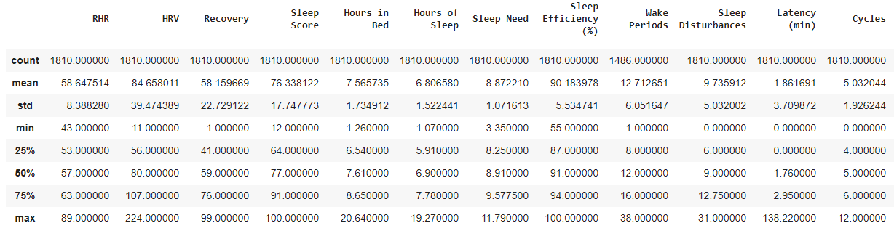
Dataset
Step 1: Identifying Attributes with Missing Values
Wake Periods, Sleep Consistency, Respiratory Rate, Total Cycle Sleep Time (hours), REM Percentage, Deep Sleep Percentage, Restorative Sleep (hours), Restorative Sleep (%)
Step 2: RHR is a complete column. I selected RHR and randomly deleted 82 records. This was my new dataset. This was done so as to test the correctness of imputation techniques with original data.
Figure 4: Dataset Description

Slide 10
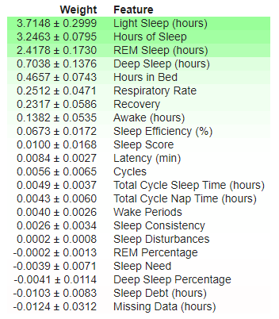
Permutation based Feature Importance
Fit a model for predicting target variable using independent variables and store the predictions.
For each independent attribute, considering one attribute at a time, shuffle values of only that attribute rows and predict target variable using the fitted model. Calculate the loss suffered from shuffling.
The independent variable for which there was maximum loss incurred due to shuffling is the most important attribute for particular target attribute considered.
Figure 5: For RHR attribute - Dominant features

Slide 11
Data Imputation
Data Imputation Techniques Experimented
1. Imputation using Global Mean
2. Imputation using Local Mean
a. k-Means Clustering based Imputations on entire dataset in general
b. RHR based k-Means Clustering
c. light-sleep (hours) based k-Means Clustering
3. Imputation using Linear Regression
a. Deterministic Linear Regression based Imputations
b. Stochastic Linear Regression based Imputations
c. Iterative Imputer based Imputations

Slide 12
Evaluation Metrics
Raw Bias: Expected Value – Predicted Value
This is the difference between the expected value and the predicted value. The permissible range of raw bias must be close to 0 [7]
Percentage Bias: Raw Bias/Predicted Value * 100
This is the percentage of difference between the expected and predicted value divided by the predicted value. The upper bound set of percentage bias is 5% [7].

Slide 13
Results
1 | 2 | 3 | 4 | 5 | 6 | 7 | 8 | Minimum Raw Bias | Respective Technique
Iterative Imputer | Stochastic Linear Regression | Deterministic Linear Regression | K Means Clustering (feature - 6) | K Means Clustering (Self - 6) | K Means Clustering (feature 6-3) | K Means (17 Clusters 3 features | K Means Clustering (17 clusters - 1 feature)
3.593045691 | 17 | 3.902736568 | 2.265356451 | 2.862507276 | 3.206194575 | 2.116771207 | 3.206194575 | 2.116771207 | 7
10.89612753 | 0 | 10.90537065 | 5.099078851 | 4.861038816 | 6.314262858 | 4.036664771 | 6.314262858 | 0 | 2
1.748755916 | 3 | 2.200090711 | 0.335316639 | 1.14043253 | 0.023600033 | 0.182096159 | 0.023600033 | 0.023600033 | 8
6.810549843 | 6 | 7.103507572 | 11.33522603 | 12.14190677 | 11.79494277 | 10.37230928 | 11.79494277 | 6 | 2
5.125462035 | 8 | 4.953098979 | 0.260962343 | 0.856616102 | 0.764157864 | 0.59505675 | 0.764157864 | 0.260962343 | 4
11.78661661 | 3 | 11.82600837 | 4.664864735 | 3.855136067 | 5.315742499 | 4.881938686 | 5.315742499 | 3 | 2
18.68405339 | 12 | 19.17155359 | 26.90187964 | 27.14634688 | 25.97535804 | 26.65872222 | 25.97535804 | 12 | 2
10.45399336 | 22 | 10.61774098 | 22.74344613 | 22.14783273 | 21.79754738 | 20.89864257 | 21.79754738 | 10.45399336 | 1
3.63112906 | 0 | 2.564436421 | 7.252130999 | 7.850678494 | 8.203916672 | 7.107137771 | 8.203916672 | 0 | 2
8.505743232 | 1 | 8.105326534 | 10.27754863 | 6.849186794 | 8.025686518 | 7.81930891 | 8.025686518 | 1 | 2
5.679623675 | 6 | 5.492458475 | 4.097160074 | 3.847692164 | 5.317225249 | 3.097442185 | 5.317225249 | 3.097442185 | 7
18.61919156 | 26 | 18.51290264 | 12.71349971 | 16.1538054 | 12.98544103 | 10.28250386 | 12.98544103 | 10.28250386 | 7
Table1: Raw Bias based Comparison

Slide 14
Results
Figure 6: Raw Bias based Results

Slide 15
Results
Iterative Imputer | Deterministic Linear Regression | Stochastic Linear Regression | Minimum Percentage Bias | Technique
6.132205024 | 6.625730476 | 23.6111111 | 6.132205 | 1
17.05287621 | 17.06487348 | 0 | 0 | 3
2.878669513 | 3.594914133 | 5.35714286 | 2.87867 | 1
10.77798561 | 11.29396457 | 7.89473684 | 7.894737 | 3
9.880496745 | 9.516606909 | 16.3265306 | 9.516607 | 2
17.91643532 | 17.96555596 | 5.2631579 | 5.263158 | 3
28.17429947 | 29.12350912 | 16.4383562 | 16.43836 | 3
15.03176655 | 15.30325061 | 37.9310345 | 15.03177 | 1
7.830962855 | 5.406147261 | 0 | 0 | 3
14.29398705 | 13.71336055 | 1.92307692 | 1.923077 | 3
9.516855713 | 9.232192812 | 10 | 9.232193 | 2
33.62029571 | 33.36433786 | 54.1666667 | 33.36434 | 2
Table 7: Percentage Bias based results
Table 2: Percentage Bias based Comparison

Slide 16
Conclusion
Permutation based feature importance is an effective technique for finding the most dominant attribute for a given target attribute whose values are to be imputed.
Data Imputation using Multivariate Regression using combination of important attributes selected worked well. Linear Regression, Stochastic Linear Regression as well as Iterative Imputer (MICE imputer) performed well on the dataset.
In comparison based on Raw Bias as well as that on basis of Percentage Bias, Iterative Imputation technique works better compared to all the other data imputation technique tried.

Slide 17
Future Work
Dimensionality Reduction on basis of feature importance
Analyzing underlying patterns and correlations between sleep, training load, cognitive state information of the athlete and their performance and predictive analysis

Slide 18
References
Vyazovskiy, V.V., 2015. Sleep, recovery, and metaregulation: explaining the benefits of sleep. Nature and science of sleep, 7, p.171.
Fullagar, H.H., Skorski, S., Duffield, R., Hammes, D., Coutts, A.J. and Meyer, T., 2015. Sleep and
athletic performance: the effects of sleep loss on exercise performance, and physiological and
cognitive responses to exercise. Sports medicine, 45(2), pp.161-186.
Nédélec, M., Halson, S., Abaidia, A.E., Ahmaidi, S. and Dupont, G., 2015. Stress, sleep and recovery in elite soccer: a critical review of the literature. Sports Medicine, 45(10), pp.1387- 1400.
4. Martin, B.J., 1981. Effect of sleep deprivation on tolerance of prolonged exercise. European journal of applied physiology and occupational physiology, 47(4), pp.345-354.
5. Mah, C.D., Mah, K.E., Kezirian, E.J. and Dement, W.C., 2011. The effects of sleep extension on
the athletic performance of collegiate basketball players. Sleep, 34(7), pp.943-950.
6. Al-Kandari, S., Alsalem, A., Al-Mutairi, S., Al-Lumai, D., Dawoud, A. and Moussa, M., 2017. Association between sleep hygiene awareness and practice with sleep quality among Kuwait
University students. Sleep health, 3(5), pp.342-347
7. Demirtas, H., Freels, S.A. and Yucel, R.M., 2008. Plausibility of multivariate normality assumption when multiply imputing non-Gaussian continuous outcomes: a simulation assessment. Journal of Statistical Computation and Simulation, 78(1), pp.69-84.

Slide 19
Thank You

