Slide 1
Hack to hire
Srishti Sahni

Slide 2
Libraries Used
Library | Use
pandas | Data manipulation and analysis
transformers | State-of-the-art NLP models
torch | Deep learning
nltk.translate.bleu_score | BLEU score calculation
rouge_score | ROUGE score calculation
sklearn.metrics | Evaluating machine learning models
numpy | Numerical computations
matplotlib.pyplot | Creating visualizations
wordcloud | Creating word clouds
nltk | Natural language processing tools
nltk.corpus.stopwords | Excluding common words from text analysis
nltk.stem.PorterStemmer | Stemming words to their root form
string | Common string operations

Slide 3
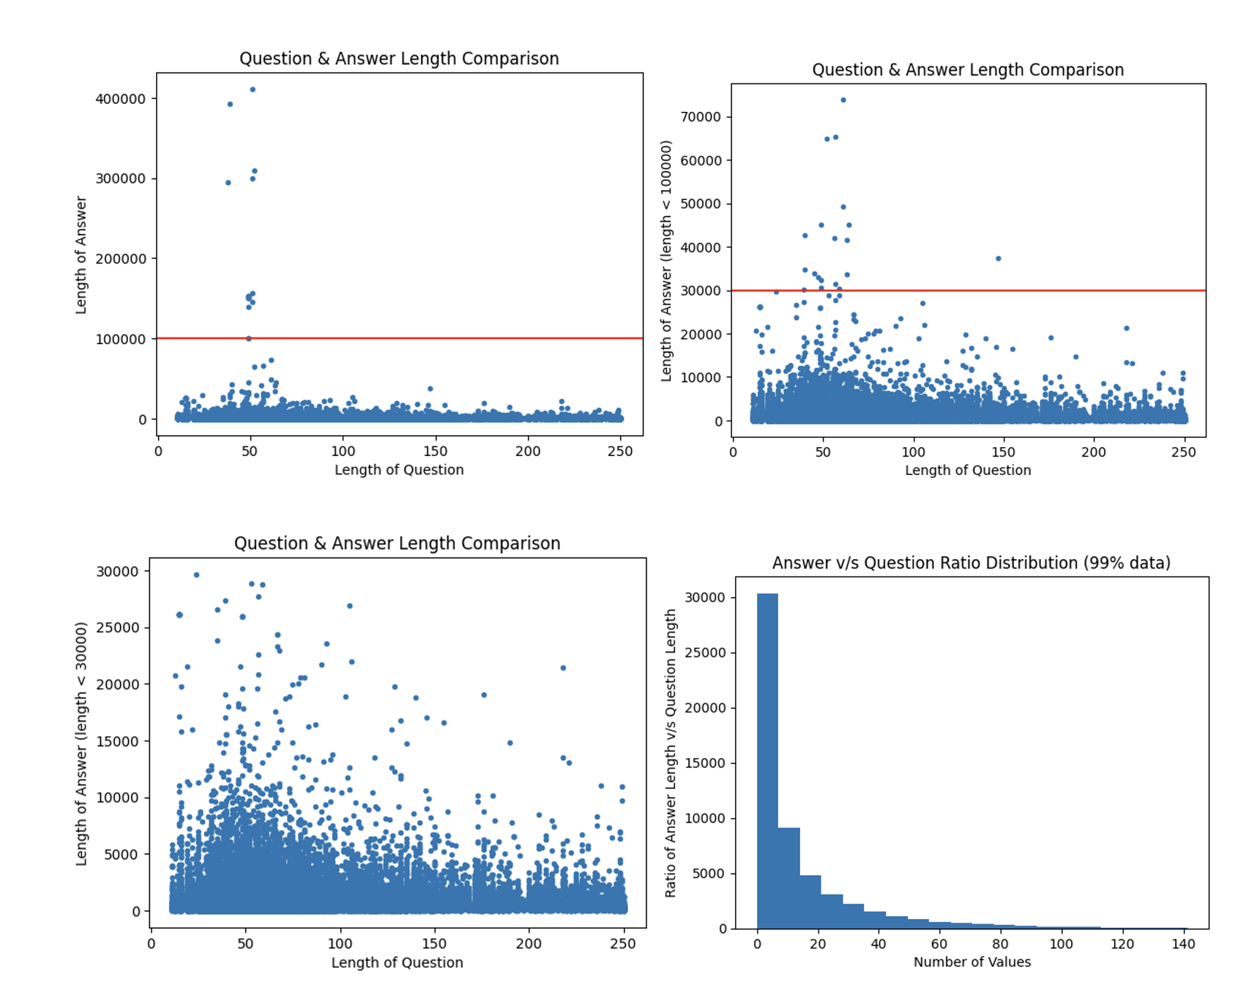
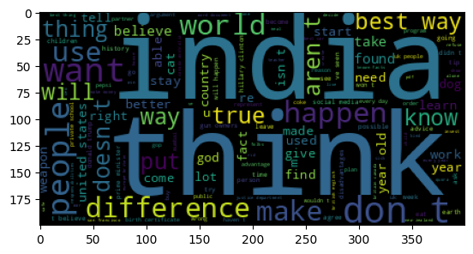
Exploratory Data Analysis
Word Frequency Using Word Clouds
Length Analysis

Slide 4
Model Architecture
BERT | GPT-2 | T5
Pre-trained on a large corpus and fine-tuned on the Quora dataset. Used for extracting contextual embeddings of questions and answers. Architecture involves feeding the [CLS] token representation to a classifier for predicting the start and end positions of the answer. | Pre-trained on a large text corpus and fine-tuned on the Quora dataset. Utilizes a decoder-only architecture that generates answers based on the given question. Fine-tuning involves adjusting the model to minimize the loss on the Quora question-answer pairs. | Converts all NLP tasks into a text-to-text format. Fine-tuned by framing the question-answering task as text generation. Input format: "question: <question> Output format: "<answer>"

Slide 5
Training Process
Hyperparameter tuning was performed for each model to find the optimal learning rate, batch size, and number of epochs.
The Adam optimizer was used for training with a learning rate scheduler to adjust the learning rate during training

Slide 6
Evaluation Metrics
F1 Score: Measures the overlap between the predicted and ground truth answers, considering both precision and recall.
ROUGE (Recall-Oriented Understudy for Gisting Evaluation): Measures the overlap of n-grams between the predicted and ground truth answers, focusing on recall.
BLEU (Bilingual Evaluation Understudy): Measures the precision of n-grams in the predicted answer compared to the ground truth, focusing on precision.

Slide 7
Results
Model Name | BLEU | ROUGE-L | F1-Score
BERT | 0.0002 | 0.02517 | 0.02546
GPT-2 | 0.002 | 0.088 | 0.093
T5 | - | - | -

Slide 8
Conclusion
GPT-2 demonstrated superior performance over BERT.
Expected outcome as BERT was trained without any context.
BERT needs context to develop Question/Answer models.
GPT-2 is more suited to text-generation problems.
T5 offers flexibility and can be trained for various problem-sets.
Not compared in this context.
Expected to perform similarly or better than GPT-2.

Slide 9
Future Work (Novel Suggestions)
Experimenting with ensemble methods to combine the strengths of these models and further improving the pre-processing and fine-tuning processes​.
Using information retrieval techniques to extract context for the questions being asked.
The goal was to create human like answers, to achieve that, training a custom RNN with a larger data-set and custom embeddings can help achieving that task.

