Slide 1

Detecting Eavesdroppers with BB84 Quantum Key Distribution
A Qiskit simulation of quantum-secure key exchange: can we tell Eve from noise?
[Team name] | [Member names]
Qiskit Fall Fest 2026 @ MPSTME | Hybrid Quantum Hackathon
Notes:
Introduce the team and the track: Quantum Secure Communication. One line: we simulate a quantum key exchange and show that an eavesdropper can be detected.

Slide 2


The problem: sharing secrets safely
Maths-based key exchange
Eavesdropping is invisible
Today's key exchange relies on problems that are hard for classical computers. A large quantum computer could solve them using Shor's algorithm.
On a classical channel, someone can copy the traffic without leaving a trace. Data recorded today could be decrypted later.
Can two parties share a secret key and be able to tell if someone listened?
Notes:
Set up the problem. Key exchange today depends on hard maths, and a classical eavesdropper leaves no trace. The question on the bottom bar is what BB84 answers.

Slide 3

Why quantum: measuring changes the state
Superposition and bases
Bob's measurement outcome
A qubit prepared in the X basis has no definite Z value. Measuring in the wrong basis gives a random result.
100%
Measurement disturbs the state
Same basis: the correct bit
Measuring collapses the qubit. After a wrong-basis measurement the original information is lost.
50%
No-cloning theorem
Different basis: a random result
An unknown quantum state cannot be copied perfectly, so Eve cannot keep a copy and forward the original.
Notes:
Three physical facts make this work: wrong-basis measurements are random, measuring disturbs the state, and states cannot be cloned. Eve cannot know the basis in advance, so she disturbs some qubits.

Slide 4
How BB84 works
1
2
3
4
5
Prepare
Transmit
Measure
Sift
Check
Alice picks random bits and random bases (Z or X) and encodes each bit in a qubit.
The qubits travel to Bob. Eve may intercept and resend them.
Bob measures every qubit in his own random basis.
Alice and Bob publicly compare bases and keep the positions where they matched.
They compare a sample of the key. A high error rate means interception.
Z basis: |0>, |1> X basis: |+>, |-> Wrong basis gives a random result
Notes:
Walk through the five steps left to right. Only the bases are announced publicly, never the bits. Z and X are two different ways of measuring the same qubit.

Slide 5
Example: sifting the key
Qubit | 1 | 2 | 3 | 4 | 5 | 6 | 7 | 8
Alice's bit | 1 | 0 | 1 | 1 | 0 | 0 | 1 | 0
Alice's basis | Z | X | X | Z | Z | X | Z | X
Bob's basis | Z | Z | X | X | Z | X | X | X
Bases match? | Yes | No | Yes | No | Yes | Yes | No | Yes
Key bit kept | 1 | - | 1 | - | 0 | 0 | - | 0
8-qubit illustration, no Eve: sifted key = 1 1 0 0 0. On average, half the qubits are kept.
Notes:
Highlighted columns are the positions where Alice's and Bob's bases matched. Only those bits go into the key. Without Eve, Bob's bit equals Alice's bit in every matched column.

Slide 6
Our Qiskit implementation
Start in |0>
X gate if bit = 1
H gate if basis = X
Eve measures and resends
H gate if Bob's basis = X
Measure
Alice prepares
Eve (optional)
Bob measures
What the code does
200
qubits sent per run
Each qubit is a 1-qubit circuit run on Qiskit Aer
A NumPy twin of the circuits runs thousands of repeats
Eve intercepts a chosen fraction of the qubits
QBER is measured on a random sample of the sifted key
Optional readout-noise model to test for false alarms
11%
QBER abort threshold
50%
of sifted key sampled
Notes:
One qubit is one tiny circuit: prepare, optionally pass through Eve, then Bob measures. The pipeline across the top is that circuit. Mention the GitHub repo contains the full code.

Slide 7

What Eve's attack does to the error rate
50%
50%
25%
x
=
Eve picks the wrong basis
Bob then reads a wrong bit
errors in the sifted key
When Eve guesses the right basis she learns the bit and leaves no trace. Over many qubits the errors add up, so comparing a sample exposes her.
Notes:
This is the key calculation. Half the time Eve guesses the wrong basis. When she does, her resent qubit gives Bob a random bit, which is wrong half the time. 0.5 x 0.5 = 25%.

Slide 8
Results: interception shows up as errors
~0%
No Eve: keys match and the key is kept
~25%
Eve on every qubit: above the 11% threshold, so she is detected
~3%
No Eve, 3% noise: below the threshold, so no false alarm
Notes:
The chart shows the expected relationship from theory. Replace or overlay it with your own qber_vs_eve.png from the Qiskit run, and update the three values on the right with the numbers you actually measured. Small samples make the simulated points wobble around the line; say so.

Slide 9
Can we tell Eve apart from noise?
4%
Noise up to 4%: honest users see only about 1% false alarms
8%
At 8% noise, 20% of honest runs are wrongly flagged as attacks
10%
At 10% noise, 41% false alarms: the exchange becomes unreliable
Notes:
Noise and an attacker both raise the error rate. A full attacker keeps the QBER far above the threshold at every noise level, so she is always caught. The real problem is the other direction: once noise passes about 8%, honest users start aborting because their own errors look like an attack. Numbers come from 500 repeated runs per point.

Slide 10
How many qubits are enough?
98%
Full attack caught with 160 qubits (100% with 320)
67%
A 50% attacker is caught only this often, even with 320 qubits
1%
A 20% attacker is almost never caught: her QBER (about 5%) stays under 11%
Notes:
More qubits make the error estimate more accurate, so a full attacker is caught reliably by about 160 qubits. Partial attackers are a different story: with a fixed 11 percent threshold, an attacker who intercepts only 20 percent produces about 5 percent errors and slips through. This motivates privacy amplification and adaptive thresholds in future work.

Slide 11
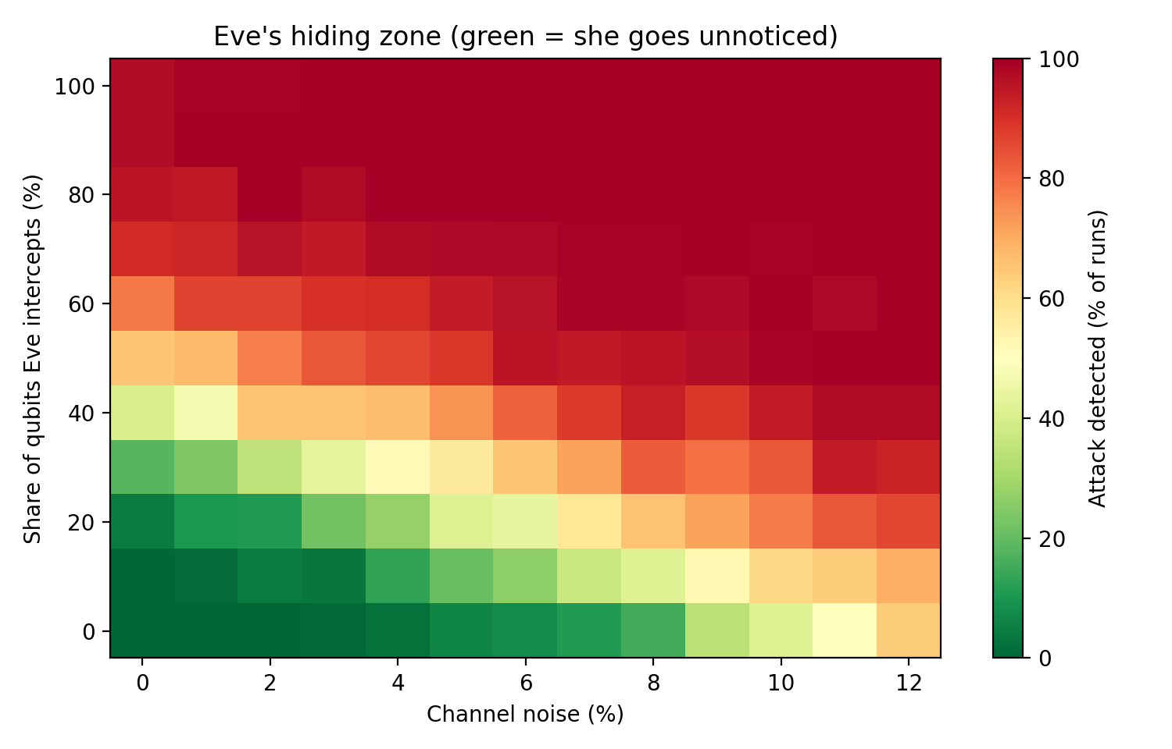
Eve's hiding zone
40%
Clean channel: Eve can intercept this share and still be caught in under half the runs
20%
At 4-6% noise her unnoticed share shrinks, since noise already uses up the error budget
10%
At 7-8% noise she can hide only a little, but honest users are already flagged up to 20% of the time
Notes:
Each cell is 200 simulated runs. Green means the attack usually goes unnoticed, red means it is detected. The boundary moves down as noise rises: noise eats into the error budget. The zone is bounded on both sides: on a noisy channel honest users get false alarms, on a clean one a small attacker can still stay below the threshold. Hiding here means detected in under half the runs.

Slide 12

Limitations and future scope
Limitations
Future scope
Simulation only: noise is a simple bit-flip model, not hardware
Only the intercept-resend attack is tested
No error correction or privacy amplification yet
QBER from small samples varies from run to run
Run the protocol on real IBM quantum hardware
Add error correction and privacy amplification
Try other protocols such as E91 and decoy-state BB84
Combine with post-quantum cryptography in a hybrid scheme
Notes:
Be honest about limits: this is a simulation of one attack. Then show where it goes next: hardware, error correction, other protocols, and hybrid post-quantum security.

Slide 13

Conclusion
BB84 turns eavesdropping into a measurable error rate
A full attacker is caught in 98% of runs with 160 qubits; weaker attackers can slip under a fixed 11% threshold
Noise above about 8% causes frequent false alarms, so the exchange needs a quiet channel
Next: real hardware, error correction, adaptive thresholds
github.com/[your-username]/bb84-qkd
Thank you
Notes:
Three takeaways, then the GitHub link. Replace the placeholder with your real repository URL before presenting.

