Slide 1


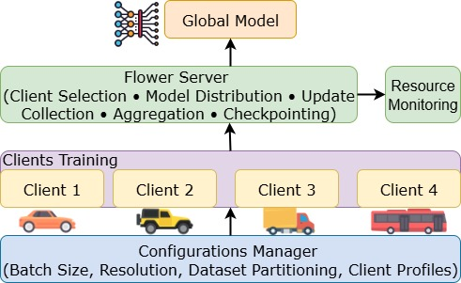
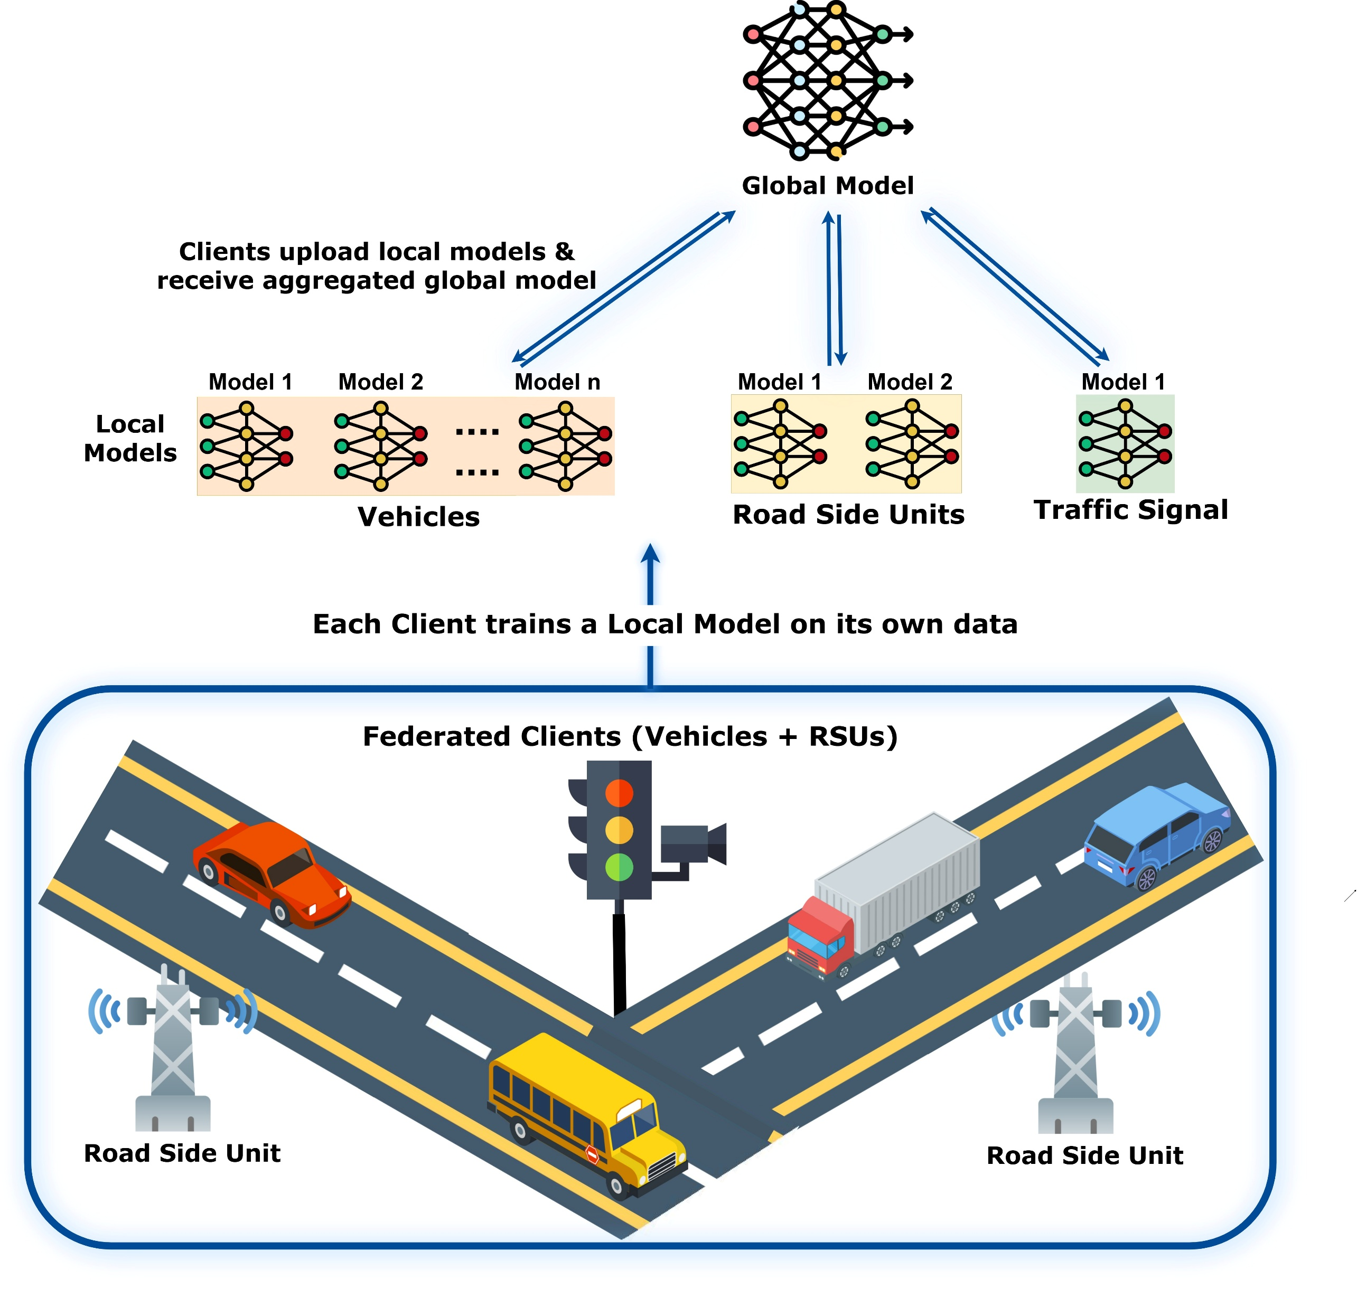
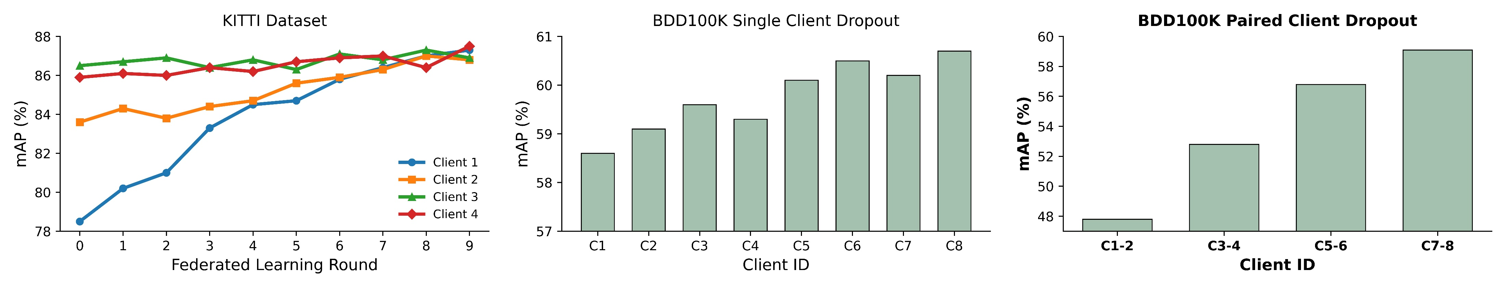
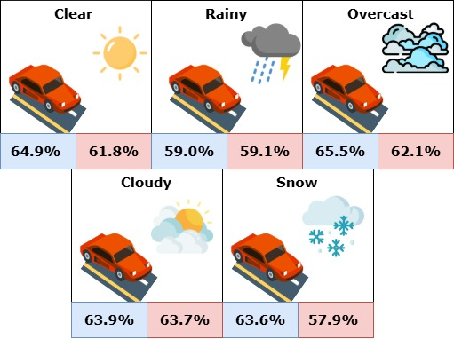
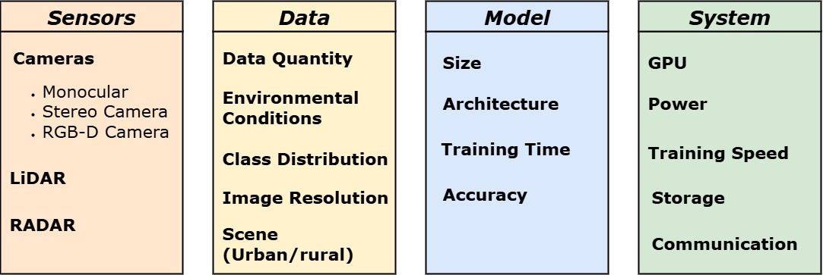
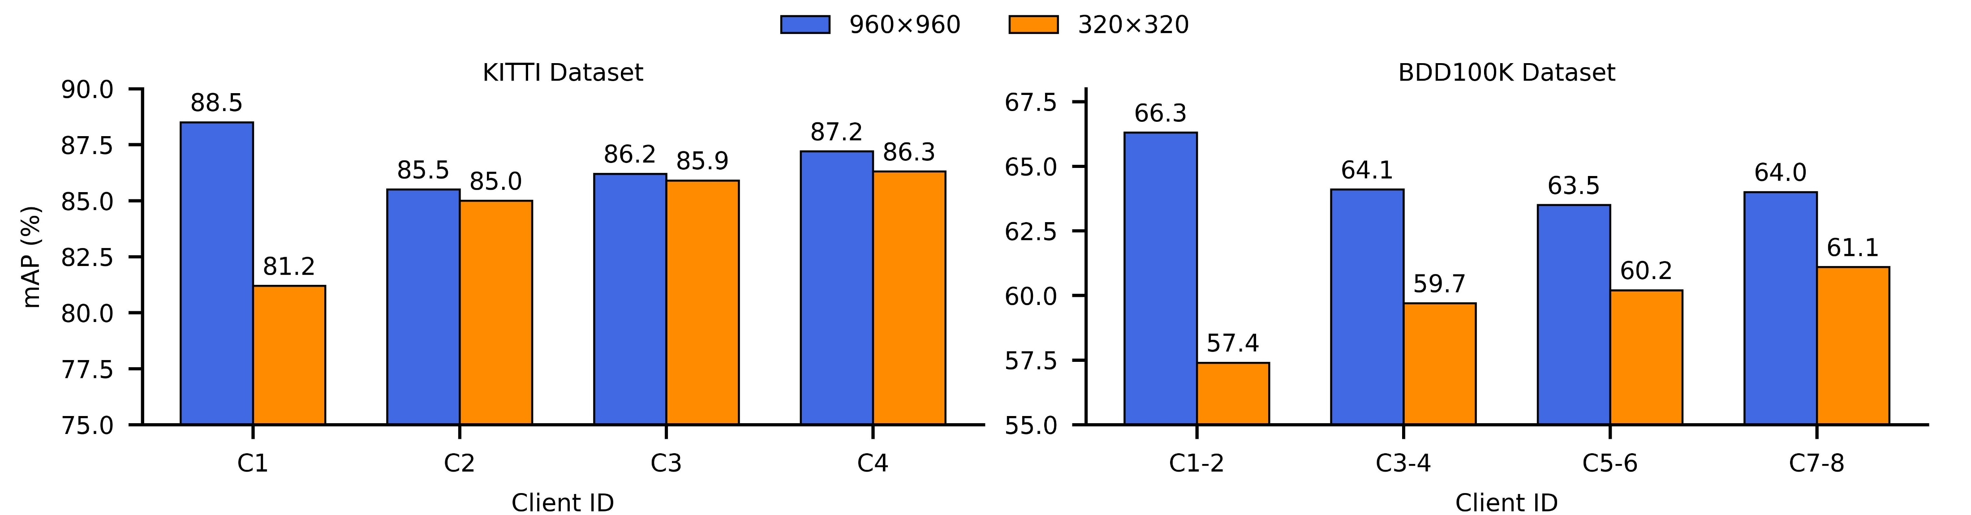

Evaluating Federated Object Detection for Connected Autonomous Vehicles
Komala Subramanyam Cherukuri, Research Assistant at Secure, Reliable, Intelligent Systems Lab, University of North Texas
Advisors: Dr. Kewei Sha, The Anuradha and Vikas Sinha Department of Data Science, University of North Texas
Introduction
FL Evaluation Framework
Open Research Problems
Object detection is crucial for Connected Autonomous Vehicles (CAVs) to perceive their surroundings. Centralized training of models often achieves promising accuracy, fast convergence, and simplified training process, falls short in scalability, adaptability, and privacy preserving. Federated learning (FL), by contrast, enables collaborative, privacy-preserving, and continuous training across naturally distributed CAVs shown in Fig 1.
Datasets: Limited diversity, static snapshots, and lack of standardized multimodal benchmarks hinder reproducibility and deployment.
Models: Detection struggles with small objects, long-tail classes, and robustness; federated-ready, secure, and efficient designs are needed.
Aggregation: Adaptive strategies must address fairness, resource variability, bandwidth, and fault tolerance under dynamic conditions.
Security & Privacy: Defenses against poisoning, backdoors, and inference leakage remain unresolved; lightweight privacy-preserving and unlearning methods are essential.
Environment: Weather and lighting shifts degrade generalization; robust multimodal adaptation and standardized evaluation protocols are lacking.
Figure 3. FL Setup with Flower for Object Detection Evaluation
Experiment Results
Object Detection Models: YOLOv5, v8, v11 Aggregation Methods: FedAvg, FedProx, FedAsync Datasets: KITTI, BDD100K, NuScenes
Evaluation Goals: We analyze trade-offs between detection accuracy, resource utilization under varying resolutions, batch sizes, weather, and lighting conditions, as well as dynamic client participation, to guide robust and scalable FL deployment in CAVs.
Model | Centralised |  |  | FedAvg |  |  | FedProx |  |  | FedAsync
Dataset | V5 | V8 | V11 | V5 | V8 | V11 | V5 | V8 | V11 | V5 | V8 | V11
KITTI | 78.4 | 81.6 | 77.6 | 82.9 | 87.5 | 84.0 | 83.4 | 87.9 | 84.1 | 78.3 | 82.0 | 80.1
BDD | 58.9 | 61.4 | 60.2 | 59.3 | 61.5 | 60.5 | 59.6 | 61.5 | 60.7 | 42.3 | 45.7 | 44.1
Nuscenes | 53.2 | 56.6 | 55.9 | 57.3 | 60.6 | 59.4 | 57.7 | 60.8 | 59.9 | 38.6 | 41.8 | 41.7
Model | Inference (ms)
Dataset | V5 | V8 | V11
KITTI | 0.9 | 1.1 | 1.2
BDD | 1.3 | 1.6 | 3.1
Figure 1. Federated Learning for CAVs
Tab 1. mAP Comparison of Centralized and Federated Learning across YOLO versions
Tab 2. Inference across models
Motivation
Current FL studies focus on accuracy but overlook feasibility. We evaluate models under diverse conditions and resource limits to assess the real-world readiness of FL for CAV deployment. Practical deployment must address three critical factors:
Heterogeneity from non-IID data distributions,
Constrained onboard computing hardware
Environmental variability such as lighting and weather
Figure 4. Effect of client dropout on mAP for KITTI and BDD100K YOLOv8
Figure 6. Weather performance. In‑Domain (Blue), Cross‑Domain (Red)
FULL
PAPER
Figure 2. Heterogeneity in Connected Autonomous Vehicles
Figure 5. Client resolution heterogeneity and its effect on accuracy YOLOv8

