Slide 1
CAR ACCIDENT SEVERITY
By Sri Soumya Gudla

Slide 2
INTRODUCTION
Considering the traffic conditions in the Seattle city let's consider a business model like installing accident prone areas signboard at the areas where more severe accidents occur.
To predict the top 10 vulnerable locations it is required to collect the accident data.
In order to predict the most vulnerable places where the accident occur the following factors are considered i.e. time of occurrence, weather, fatalities, traffic delay, property damage etc

Slide 3
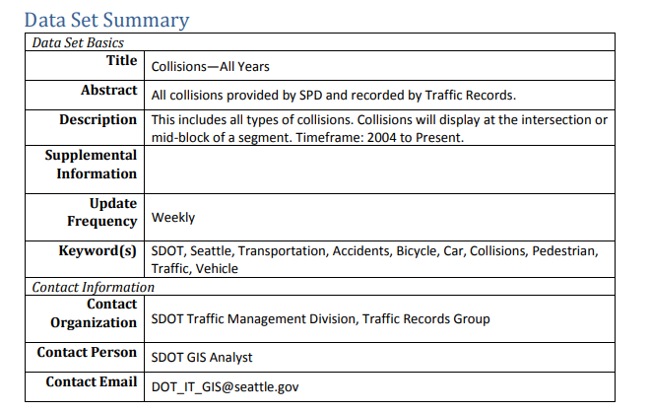
Dataset
This dataset is about past accident data. The Data-Collisions.csv data set includes details of 194673 accidents from 2004 to 2020. It has a total of 38 fields.

Slide 4
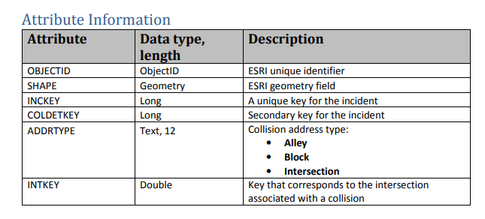
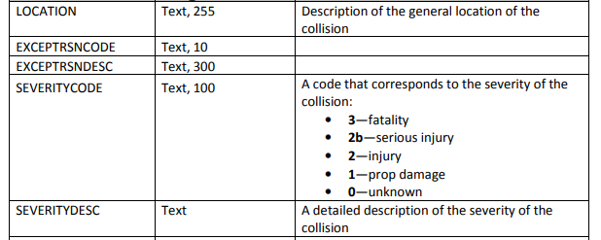

Slide 5
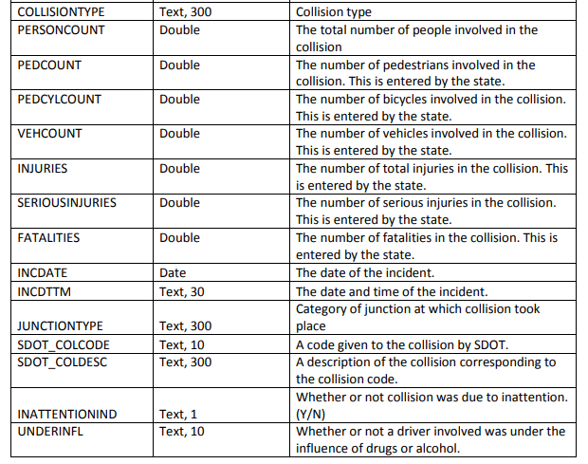

Slide 6
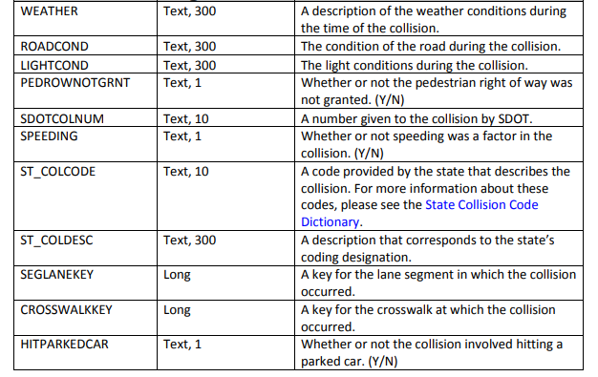

Slide 7
DATA WRANGLING
Data Wrangling is the process of converting data from the initial format to a format that may be better for analysis. The steps followed are as shown below.
* Identifying and handling missing values
* Data Evaluation
* Data Standardization
Once data is cleaned it can be used to visualize and built the model for the business problem stated above.

Slide 8
Identifying and handling missing values
Steps Involved are
Import Libraries
Download and load the data set
Evaluate the missing data:-
To deal with missing data we either drop the data or replace with mean values or the frequency of its occurrence.
Columns dropped
OBJECTID,INCKEY,COLDETKEY,REPORTNO,STATUS,INTKEY,EXCEPTRSNCODE,EXCEPTRSNDESC,SEVERITYCODE.1, SEVERITYDESC,SDOT_COLDESC,INATTENTIONIND,SDOTCOLNUM,SPEEDING,ST_COLDESC,SEGLANEKEY,CROSSWALKKEY,PEDROWNOTGRNT,ST_COLCODE,INCDATE
Columns Modified
ADDRTYPE, LOCATION, COLLISIONTYPE, WEATHER, ROADCOND, LIGHTCOND, INCDTTM
Columns Added
DayOfWeek, Hours

Slide 9
DATA VISUALISATION
To identify top 10 accident prone locations i am considering location field as a dependent variable for rest of the fields. So in order to observe the pattern of these occurrences am considering Histogram plot to observe the frequency of accidents occurred for each day of the week, most frequent type of collisions and ADDRType category based on severity code. While pie chart is used for the visualizing the weather, road condition and light conditions at the time of accident based on severity code.

Slide 10
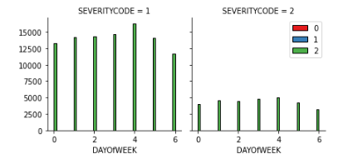
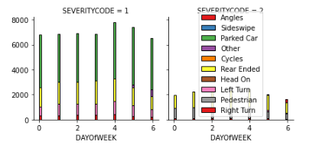
Plot to identify the max. no of accidents occurred at which day of the week for ADDRTPE and CollisionType

Slide 11
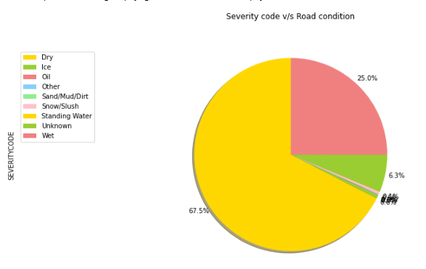
Pie Charts to observe the weather , road and licgt conditions at the time of accidents based on severity code

Slide 12
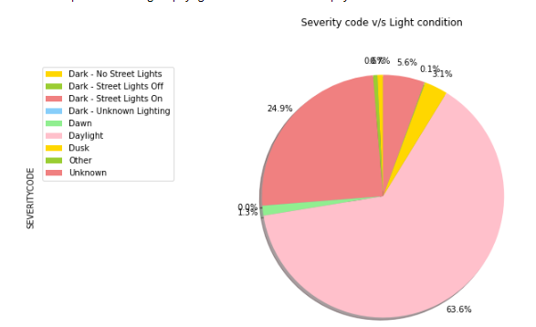

Slide 13
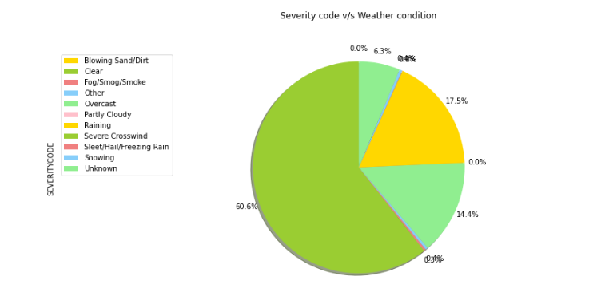

Slide 14
METHODOLOGY
So to determine the top 10 accident prone areas, the major factors influencing the accidents are Day of the week, weather, light condition, road condition and address type. Based on these conditions the top most accident prone locations can be identified. Hence I used KNN and Decision tree methods to test and train data and evaluate the model. Since the accuracy of the data model is high when we use these methods
In order to prepare the data for the above mentioned data we need to convert the categorical data into numerical data
Then divide the data to train and test data, then execute the methods
We will then evaluate the model by calculating f1 score, jacquard index

Slide 15
Results
Methods | F1 score | Jacquard Index
KNN | 0.0060 | 0.0091
DT | 0.00072 | 0.0157

Slide 16
THANK-YOU

