Slide 1
E-LEARNING RESOURCE LOCATER
By
Srisruthi.S
Sowmiya.P
Siva parvathy.S

Slide 2
ABSTRACT
In e-learning user will be able to locate the needed material in efficient manner
Uploading can be done in easier manner
Allows the user to download their needed material in free of cost
While uploading it checks for file size and get uploaded if the file follows the constraint

Slide 3
INTRODUCTION
E-learning resource locater will allows the documents, file to get uploaded
Materails get stored in the database
There occurs the different database tables for different domain,like an separate database for storing the c file,php files etc
When the user choose their domain then they allowed to download materials corresponding to that domain

Slide 4
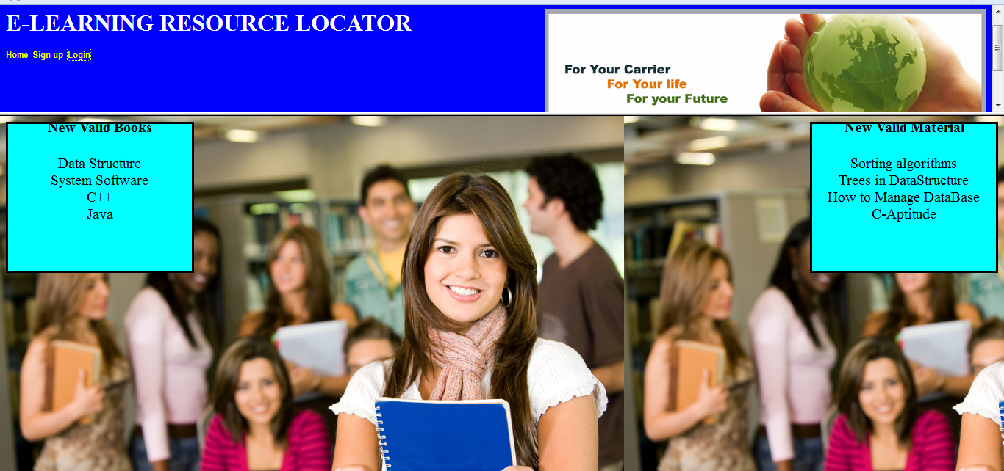
Home page

Slide 5
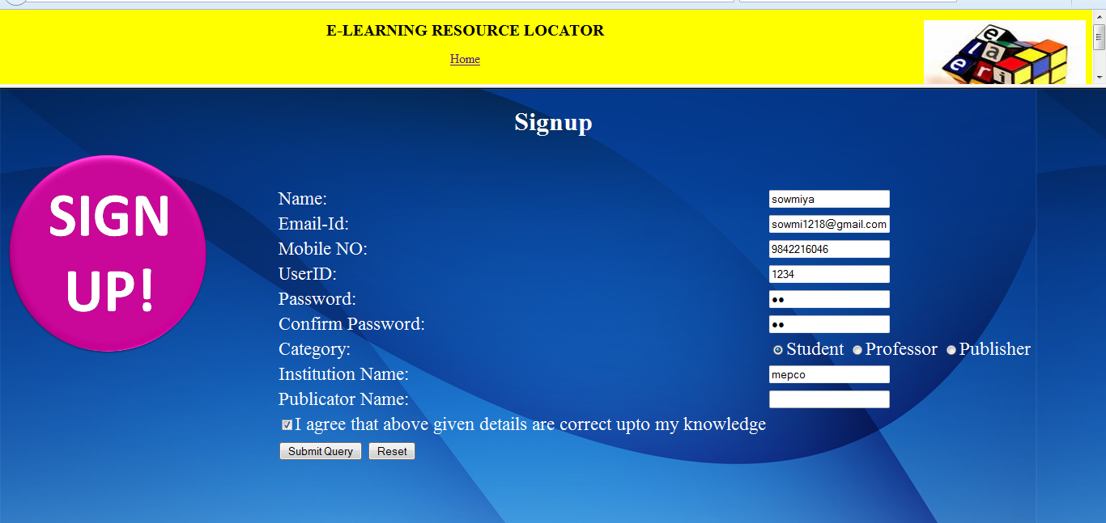
Sign up page

Slide 6
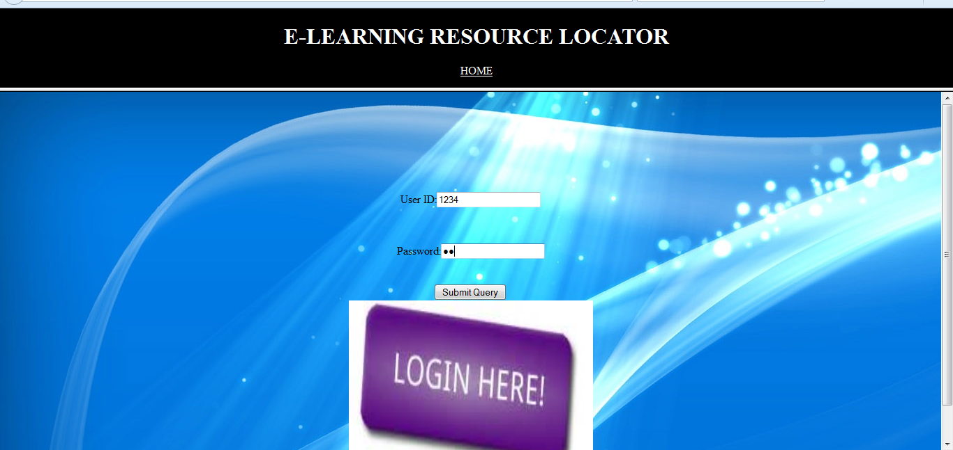
Login page

Slide 7
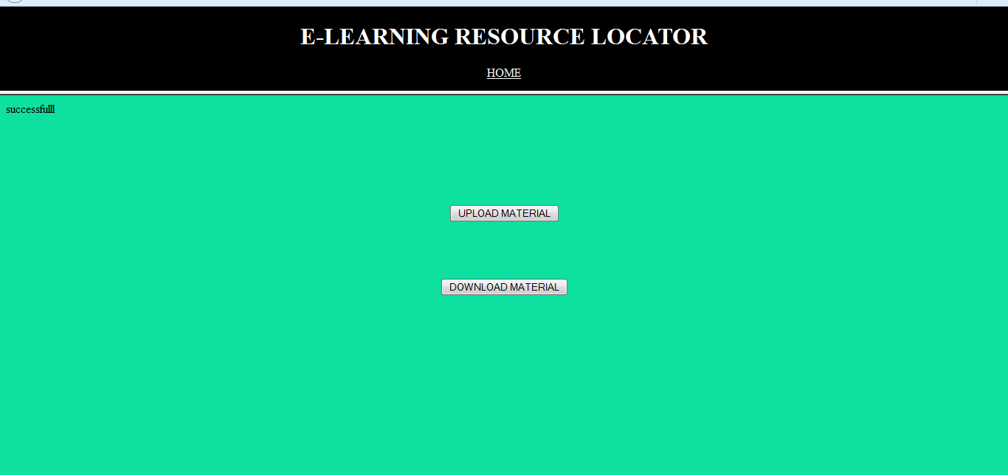
Select the category(upload or download)

Slide 8
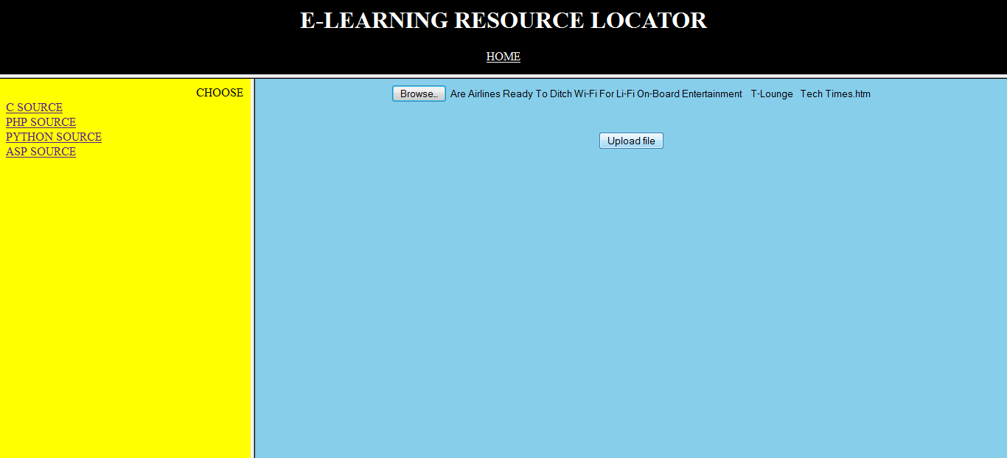
Upload page

Slide 9
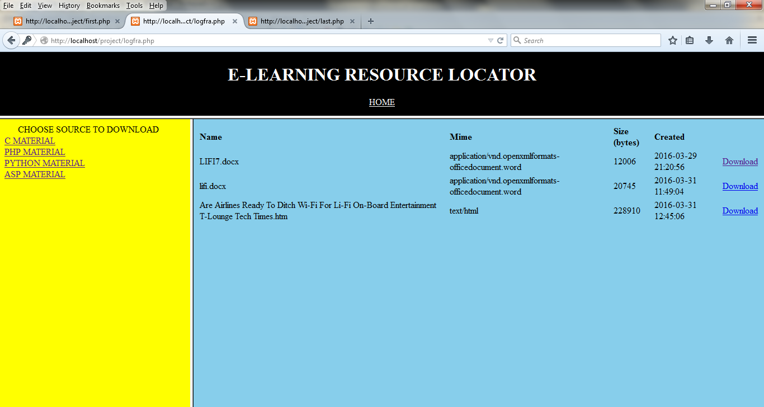
Download page

Slide 10
LIMITATION
Database stores only the files which is within the limited file size.
Not able to upload pdf,videos,images.

