Slide 1
DevOps
Jenkins
By
B Manikyala Rao M.Tech(Ph.d)
Assistant Professor
Dept of Computer Science & Engineering
Aditya College of Engineering & Technology
Surampalem

Slide 2
Jenkins
Jenkins is a powerful application that allows continuous integration and continuous delivery of projects, regardless of the platform you are working on. It is a free source that can handle any kind of build or continuous integration. You can integrate Jenkins with a number of testing and deployment technologies.
Jenkins is a software that allows continuous integration. Jenkins will be installed on a server where the central build will take place. The following flowchart demonstrates a very simple workflow of how Jenkins works.

Slide 3
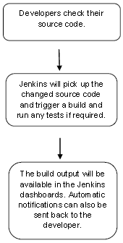
Jenkins

Slide 4
Continuous Integration
Continuous Integration is a development practice that requires developers to integrate code into a shared repository at regular intervals. This concept was meant to remove the problem of finding later occurrence of issues in the build lifecycle. Continuous integration requires the developers to have frequent builds. The common practice is that whenever a code commit occurs, a build should be triggered.
Download Jenkins
The official website for Jenkins is https://www.jenkins.io/
Click the Long-Term Support Release tab in the download section.

Slide 5
Starting Jenkins
Open the command prompt. From the command prompt, browse to the directory where the jenkins.war file is present. Run the following command
D:\>Java –jar Jenkins.war
After the command is run, various tasks will run, one of which is the extraction of the war file which is done by an embedded webserver called winstone.
Once the processing is complete without major errors, the following line will come in the output of the command prompt.
INFO: Jenkins is fully up and running

Slide 6
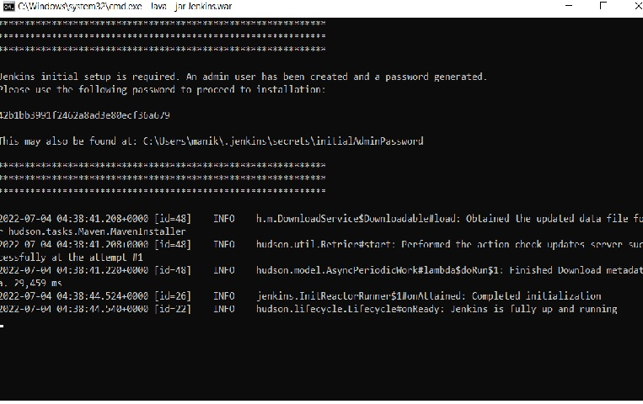

Slide 7
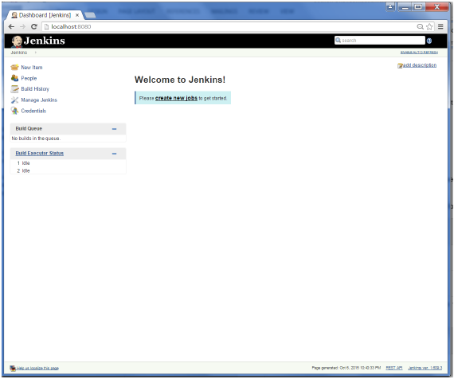
Accessing Jenkins
Once Jenkins is up and running, one can access Jenkins from the link − http://localhost:8080
This link will bring up the Jenkins dashboard.

Slide 8
Tomcat
The official website for tomcat is https://tomcat.apache.org/
Link: https://tomcat.apache.org/download-90.cgi
https://tomcat.apache.org/download-90.cgi
Download the 64-bit Windows zip file
Then unzip the contents of the downloaded zip file

Slide 9
Jenkins and Tomcat Setup
Copy the Jenkis.war file which was downloaded from the previous section and copy it to the webapps folder in the tomcat folder.
Now open the command prompt. From the command prompt, browse to the directory where the tomcat7 folder is location. Browse to the bin directory in this folder and run the start.bat file
E:\Apps\tomcat7\bin>startup.bat
Once the processing is complete without major errors, the following line will come in the output of the command prompt.
INFO: Server startup in 1302 ms
Open the browser and go to the link − http://localhost:8080/jenkins. Jenkins will be up and running on tomcat.
Notes:
9

Slide 10
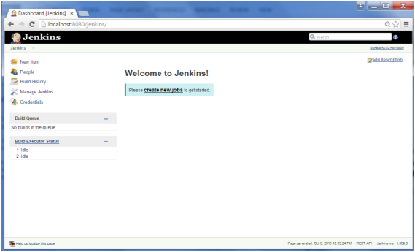
Jenkins

Slide 11
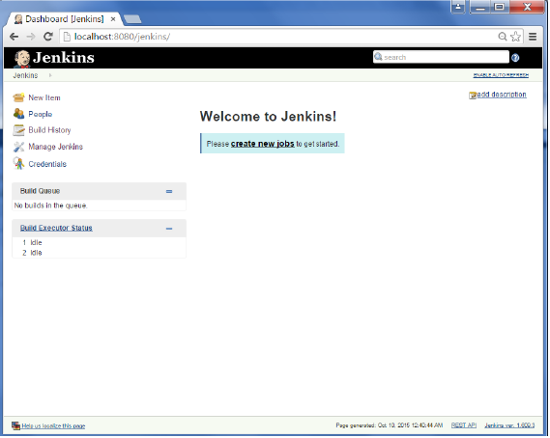
Jenkins
we will create a job in Jenkins which picks up a simple HelloWorld application, builds and runs the java program.
Go to the Jenkins dashboard and Click on New Item

Slide 12
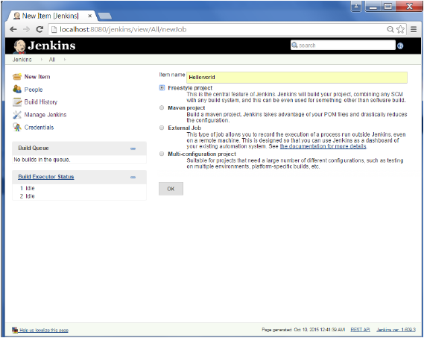
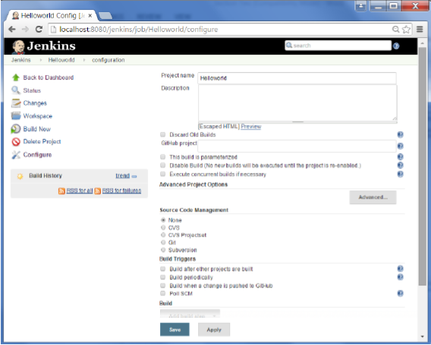
Jenkins
Step 2:In the next screen, enter the Item name, in this case we have named it Helloworld. Choose the ‘Freestyle project option’
Step 3 − The following screen will come up in which you can specify the details of the job.
12

Slide 13
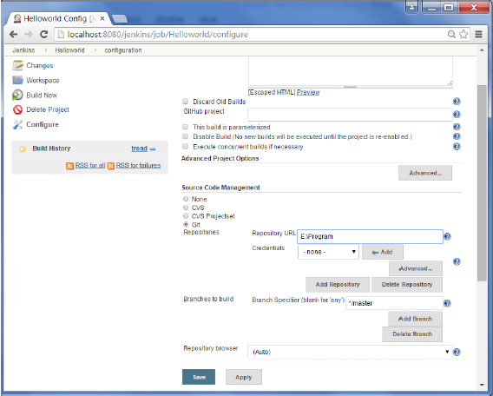
Jenkins
Step 4 − We need to specify the location of files which need to be built. In this example, we will assume that a local git repository(E:\Program) has been setup which contains a ‘HelloWorld.java’ file. Hence scroll down and click on the Git option and enter the URL of the local git repository.
Note − If you repository if hosted on Github, you can also enter the url of that repository here. In addition to this, you would need to click on the Add button for the credentials to add a user name and password to the github repository so that the code can be picked up from the remote repository.

Slide 14
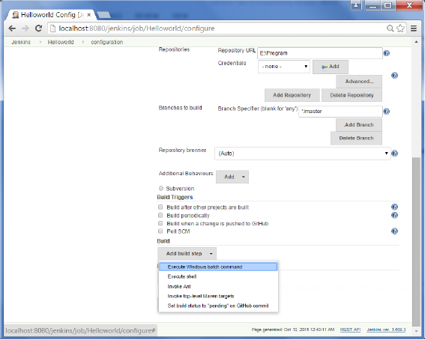
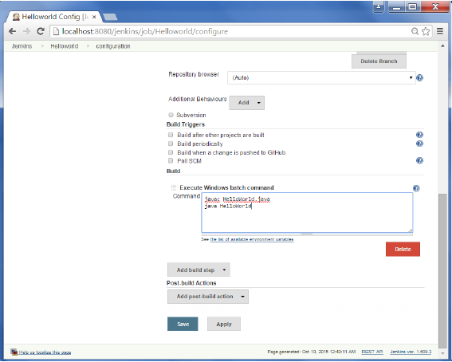
Jenkins
Step 5 − Now go to the Build section and click on Add build step → Execute Windows batch command
Step 6 − In the command window, enter the following commands
and then click on the Save button. button.
Javac HelloWorld.java
Java HelloWorld

Slide 15


