Slide 1
CI/CD Using DevOps
Jenkins
By
B Manikyala Rao M.Tech(Ph.d)
Assistant Professor
Dept of Computer Science & Engineering
Aditya College of Engineering & Technology
Surampalem

Slide 2
Continuous Integration
Continuous Integration (CI) is a development practice in which the developers are needs to commit changes to the source code in a shared repository at regular intervals. Every commit made in the repository is then built. This allows the development teams to detect the problems early.
Jenkins is the most mature Continuous Integration tool available so let us see how Continuous Integration with Jenkins.

Slide 3
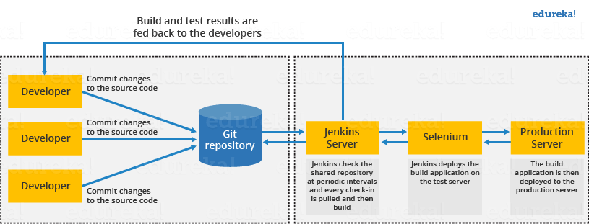

Slide 4
Let's see how Jenkins works. The above diagram is representing the following functions:
First of all, a developer commits the code to the source code repository. Meanwhile, the Jenkins checks the repository at regular intervals for changes.
Soon after a commit occurs, the Jenkins server finds the changes that have occurred in the source code repository. Jenkins will draw those changes and will start preparing a new build.
If the build fails, then the concerned team will be notified.
If built is successful, then Jenkins server deploys the built in the test server.
After testing, Jenkins server generates a feedback and then notifies the developers about the build and test results.
It will continue to verify the source code repository for changes made in the source code and the whole process keeps on repeating.

Slide 5
Advantages of Jenkins
It is an open source tool.
It is free of cost.
It does not require additional installations or components. Means it is easy to install.
Easily configurable.
It supports 1000 or more plugins to ease your work. If a plugin does not exist, you can write the script for it and share with community.
It is built in java and hence it is portable.
It is platform independent. It is available for all platforms and different operating systems. Like OS X, Windows or Linux.
Easy support, since it open source and widely used.
Jenkins also supports cloud based architecture so that we can deploy Jenkins in cloud based platforms.

Slide 6
Disadvantages of Jenkins:
Its interface is out dated and not user friendly compared to current user interface trends.
Not easy to maintain it because it runs on a server and requires some skills as server administrator to monitor its activity.
CI regularly breaks due to some small setting changes. CI will be paused and therefore requires some developer's team attention.

Slide 7


